Slide 1
Marcom 84
January 2020

Slide 2
Press Releases
A press release on the details of Release 4 was issued.
A joint press release regarding oneM2M’s and the IIC’s latest white paper was issued in December.
A news story on oneM2M’s and the ICA’s partnership is also due to be issued in the next few weeks.
A potential press release on oneM2M’s and ETSI’s joint AI project is in the pipeline.
A news release on oneM2M’s involvement in the Indigo project is also on the cards.
oneM2M also plans to host a Hackathon event in Belgium, which has the potential for a press release.

Slide 3
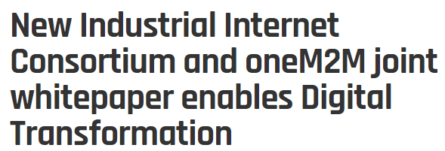
Press Release Coverage Highlights

Slide 4
Contributed Content Highlights
A feature on connected and intelligent transport was published in ETSI Enjoy Magazine.

Slide 5
Contributed Content Highlights
A feature on the benefits of IoT standards was published in IoT Evolution.

Slide 6
Features which are currently being drafted and approved for:
A piece on smart cities has been drafted for EE World and is awaiting approval.
A feature on Release 4 is currently being drafted for ETSI Enjoy Magazine.
A feature with C-DOT has been drafted for IoT Agenda and is awaiting approval
IoT Agenda has agreed to host a piece on the content of oneM2M’s latest webinar, market maturity.

Slide 7
Upcoming editorial coverage
A feature on A piece on breaking down silos in IoT has been submitted to IoT Tech News.
A comment piece on securing smart cities in IT Pro Portal.
A feature on semantic interoperability is due to be published in Networking +.

Slide 8
Media Invitations
A media invitation promoting the ‘How oneM2M Standards Improve IoT Protection of Mobile Networks’ webinar was issued
A media invitation will be drafted on Ken Figueredo’s speaking slot at IoT Tech Expo in April.
Proactive PR has reached out to oneM2M’s membership to find out if they plan to host any oneM2M demos at the show. PPR to draft media invitation based on this.

Slide 9
Webinars
A webinar on ‘How oneM2M Standards Improve IoT Protection of Mobile Networks’ was held in December.
A webinar on Release 4 is also in the pipeline for late February/early March.
A webinar on ‘Data marketplace work in Korea’ is also currently being arranged.

Slide 10
White Papers
An industry liaison white paper with the IIC was published.
oneM2M will be included in a white paper on MEC by ETSI, which is set to be published in the coming months.
A joint white paper with 3GPP is also in the pipeline

Slide 11
Upcoming speaking slots
Event name | Date | Location | Topic | Audience | Reach | Level | Speaker?
IoT Tech Expo | 17-18 March 2020 | Olympia, London | Data Analytics for IIoT Manufacturing 5.0, what’s new? | High-level executives across a range of industry sectors. | Global | 1 | Ken Figueredo
Smart Home for assisted Living | 26-27 March 2020 | Birmingham, UK | Smart Cities, IoT, data | Event for government and technology decision-makers mapping America’s smart cities. | UK | 1 | Still requires speaker.
IoT World 2020 | 6-9 April 2020 | Santa Jose, US | Topic TBC | IoT professionals from a range of industry verticals. | Global | 1 | Vanja Subotic has put herself forward.

