Slide 1
Marcom 86
March 2020

Slide 2
Press Releases and Media Invitations
A news release on oneM2M’s involvement in the InDiCo project is in the pipeline but on hold for the moment.
oneM2M also plans to host a Hackathon event in Belgium, which has the potential for a press release. This has been postponed due to CO-VID19.
A media invitation was drafted for ‘India's First Living Lab at IIITH: use case for oneM2M’ webinar on March 11th.
A media invitation has been issued on Ken Figueredo’s speaking slot at IoT Tech Expo. Ken has completed telephone briefings with Satellite Evolution, Computer Weekly and Active Cyber.

Slide 3
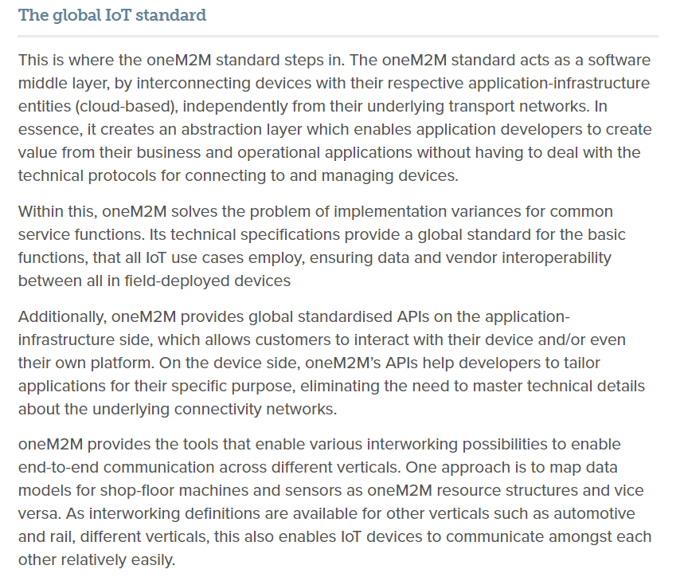
Feature Coverage Highlights
A feature on breaking down silos in IoT has been published on IoT Tech News.

Slide 4
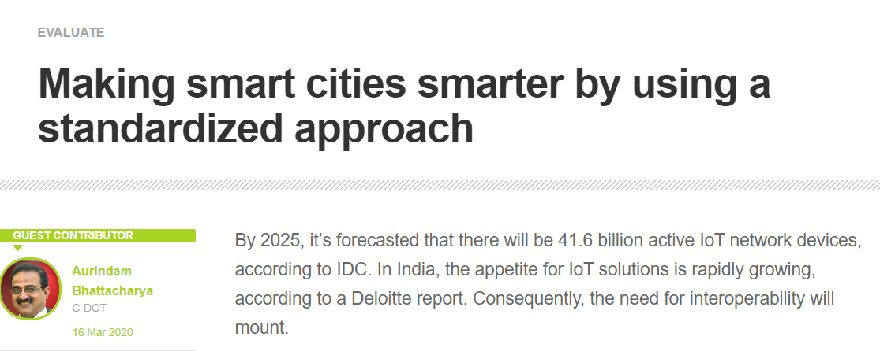
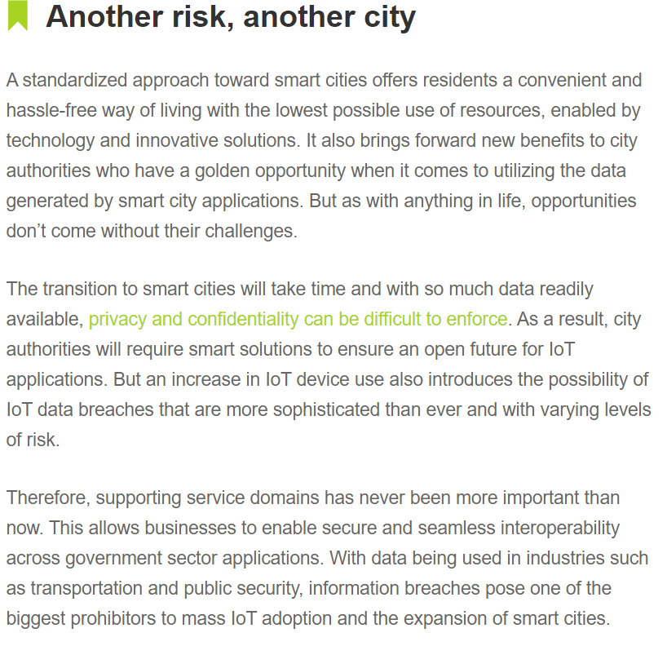
Feature Coverage Highlights
A feature with C-DOT has been published on IoT Agenda.

Slide 5
Features on the oneM2M and ETSI AI project and oneM2M IIC whitepaper are being pitched to publications.
Features which are currently being drafted and approved::
A feature on oneM2M’s mobile networks webinar is in approvals.
An article discussing how the oneM2M standard has matured over the years is due to be published in IoT Agenda.

Slide 6
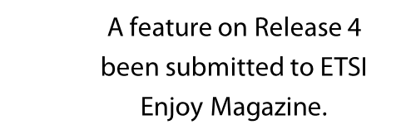
Upcoming editorial coverage
A piece on smart cities is due to be published in EE World.
A feature on semantic interoperability is due to be published in Networking +.

Slide 7
Upcoming editorial coverage
A comment piece on IoT standardisation is due to be published in April.
A comment piece on the oneM2M standard will be published following a briefing with Ken and Peter.
A Q&A with Ken is due to be published in the July issue.

Slide 8
Feature pitching
IIoT focus for May issue
Telco innovation for July issue
IoT focus for May issue

Slide 9
Webinars and White Papers
The webinar ‘India's First Living Lab at IIITH: use case for oneM2M’ was held on March 11th. A post-webinar blog is currently in the pipeline.
A Release 4 webinar is in the pipeline.
A webinar on ‘Data marketplace work in Korea’ is also due to be arranged.
oneM2M will be included in a white paper on MEC by ETSI, which is set to be published in the coming months.
A joint white paper with 3GPP is also in the pipeline.

Slide 10
Executive Interviews
Two executive interviews have been created and are currently being pitched for Roland and JaeSeung Song.
An executive interview with 3GPP is in the pipeline.
The interviews are also being promoted on social media.

Slide 11
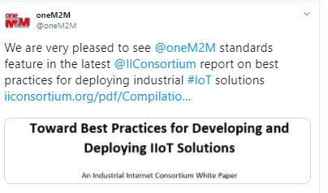
Social media
Alongside the daily Twitter schedule, Proactive PR has also drafted a ‘Did you Know’ series of posts regarding oneM2M and the IIC’s white paper.
An additional schedule promoting the executive interviews has also been drafted.

