Slide 1
Marcom 87
April 2020

Slide 2
Press releases and media alerts
A news item on India’s First Living Lab webinar was posted on the oneM2M website.
A news release highlighting the number of new members is currently being drafted.
A press release will be drafted on the Indian Government smart cities once it has been confirmed.
A news release on new deployments is currently being discussed.
oneM2M also plans to host a Hackathon event in Belgium, which has the potential for a press release. This has been postponed due to CO-VID19.
A news release on the Interop event in September is currently being discussed.
A news release on oneM2M’s involvement in the InDiCo project is in the pipeline but on hold for the moment.
A media invite for an IoT Tech Expo has been drafted and will be issued as soon as the registration link is available.

Slide 3
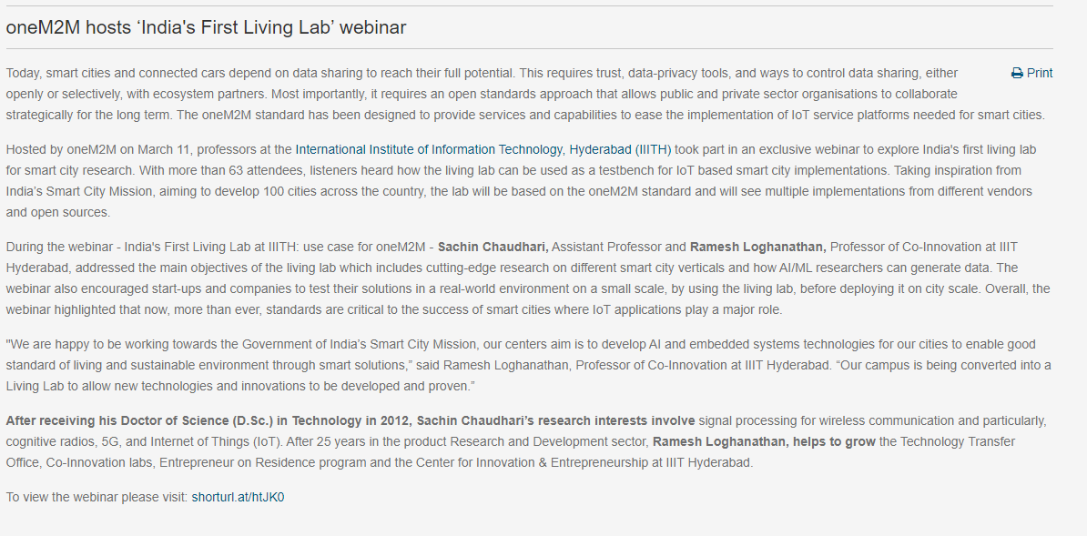
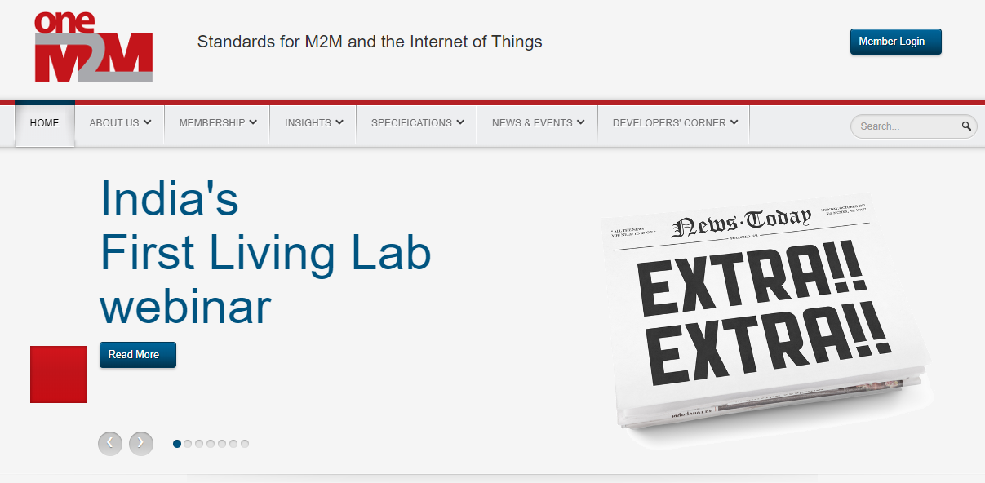
News Item Highlights
A news item on India’s First Living Lab webinar was posted on the oneM2M website.

Slide 4
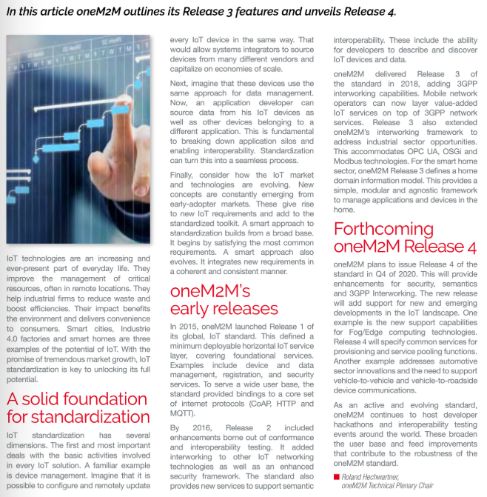
Feature Coverage Highlights
A feature focusing on oneM2M’s early releases and the forthcoming Release 4 has been published in the April edition.

Slide 5
Feature Coverage Highlights
A feature on the topic of Smart Cities has been published on the EE World website in April.

Slide 6
Features which are currently being drafted and approved:
A feature for IEEE Newsletter is currently being drafted with content used from the IIIC Whitepaper.
A feature on oneM2M’s mobile networks webinar is in approvals.
An article discussing how the oneM2M standard has matured over the years is due to be published in IoT Agenda.

Slide 7
Features which are currently being drafted and approved:
A feature has been secured for the IEEE Standards in IoT issue.
A feature based on the oneM2M mature standard is in approvals.
An opportunity has been secured on the topic of smart cities for IoT News.

Slide 8
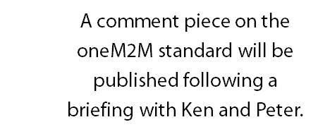
Upcoming editorial coverage
A Q&A with Ken is due to be published in the July issue.
A feature based on the IIC whitepaper has been drafted and submitted.
A feature on semantic interoperability is due to be published in Networking +.

Slide 9
Webinars and White Papers
The webinar ‘India's First Living Lab at IIITH: use case for oneM2M’ was held on March 11th. A post-webinar blog has been drafted and posted on the website.
A Release 4 webinar will take place on June 17th. Once more detail has been shared, this will be uploaded to BrightTALK and promoted..
A webinar on ‘Data marketplace work in Korea’ is also due to be arranged.
An IoT Tech Expo webinar is due to take place this month, featuring Ken Figueredo.
oneM2M will be included in a white paper on MEC by ETSI, which is set to be published in the coming months.
A joint white paper / Executive Interview with 3GPP is also in the pipeline.

Slide 10
Executive Interviews
Two oneM2M executive interviews have been created and are currently being pitched for Roland and JaeSeung Song. Networking + has expressed interest in hosting Roland’s.
An executive interview with 3GPP is in the pipeline.
An executive interview with the GCF is currently being pitched to publications.
The interviews are also being promoted on social media.

Slide 11
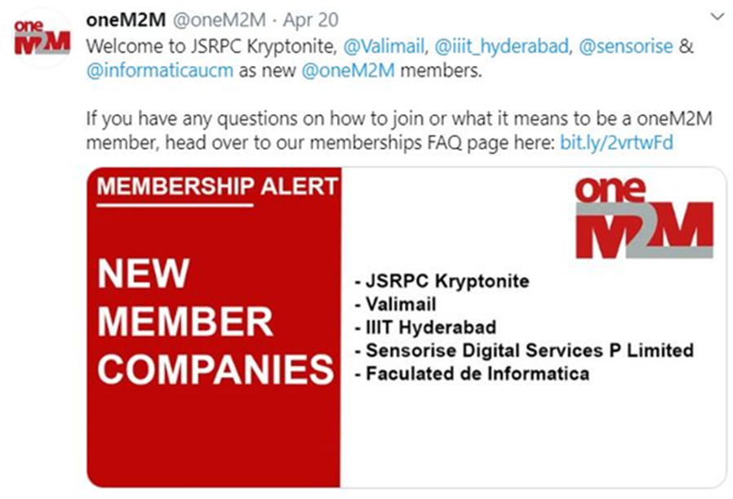
Social media
The latest social media schedule has been shared.
PPR has also created some additional new graphics to accommodate the posts.
Alongside the daily Twitter schedule, Proactive PR has also drafted a ‘Did you Know’ series of posts regarding oneM2M and the IIC’s white paper.
An additional schedule promoting the executive interviews has also been drafted.

