Slide 1
Marcom 88
May 2020

Slide 2
Press releases
A news release highlighting the number of new members is currently in Marcom review.
A press release will be drafted on the Indian Government smart cities and a briefing call will take place on Thursday.
A news release on oneM2M’s involvement in the InDiCo project is in the pipeline and a briefing call will take place on Thursday.
A briefing call is being held on June 5 to discuss a possible press release on Release 4.
A joint ETSI press release is coming up and we are awaiting further information.
A news release on new deployments is in the pipeline.
A briefing call is planned for August to discuss a possible press release on the interworking with ITU-T.
A news release on the Interop event in September is currently being discussed.
A joint PR is with ATIS / OFC is on hold for now.
oneM2M also plans to host a Hackathon event in Belgium, which has the potential for a press release. This has been postponed due to CO-VID19.

Slide 3
Media alerts
A media invite has been issued for the IoT Tech Expo webinar which invited journalists to listen to the webinar, as well as arrange a one-to-one briefing with Ken.
A media invite has been drafted for the Release 4 webinar and is currently with oneM2M for review.

Slide 4
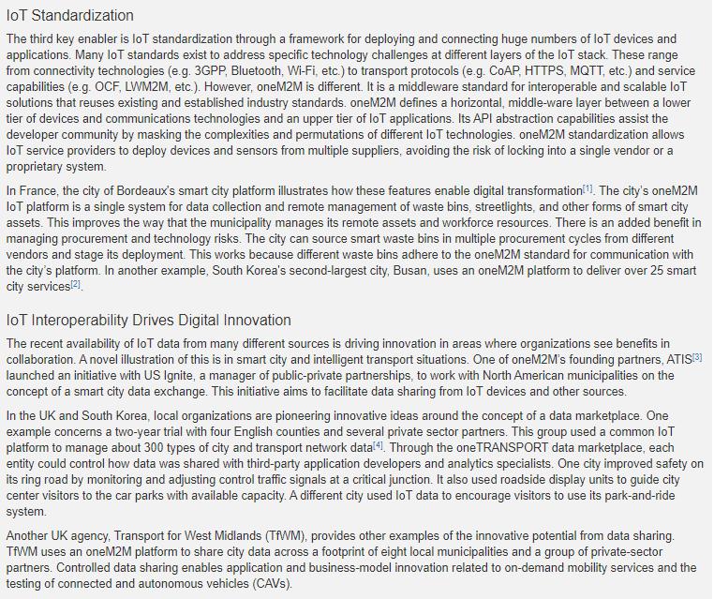
Feature Coverage Highlights
A feature on how oneM2M is unlocking the potential of IoT has been published in the IEEE newsletter.

Slide 5
Features secured:
Opportunities have been secured for CIE Online, IoT Evolution World, Geo Connexion on the ETSI AI project.
Proactive PR has secured the opportunity to provide a series of articles for IEEE Communications Standards Magazine.
A feature has also been secured for the IEEE Standards in IoT issue for 2021.

Slide 6
Features being drafted and in approvals :
A feature is currently being drafted for RCR Wireless on the GCF / oneM2M initiative.
A feature on oneM2M’s mobile networks webinar is in approvals.
A feature is currently being drafted on the topic of smart cities for IoT News.

Slide 7
Monitoring for coverage:
A feature based on the oneM2M mature standard has been submitted to IoT Agenda.
A comment piece on IoT standardisation is due to be published in IoT Now Transport and the coverage is expected in Autumn.
A feature for IoT now has been submitted based on the IIC white paper. Proactive PR is currently monitoring for coverage.

Slide 8
Monitoring for coverage:
Following the briefing with Ken, a Q&A piece is due to be published in the July issue of Satellite Evolution.
A comment piece on the oneM2M standard will be published in Active Cyber following a briefing with Ken and Peter.
An article on semantic interoperability was submitted to Networking+.

Slide 9
Webinars and White Papers
A webinar on Release 4 will take place on June 17th and is currently being promoted, with PPR drafting a media invite. A briefing call is being held on June 5 to discuss a possible press release.
A webinar on ‘Data marketplace work in Korea’ is also due to be arranged.
An IoT Tech Expo webinar, featuring Ken Figueredo, has taken place this month.
oneM2M will be included in a white paper on MEC by ETSI, which is set to be published in the coming months.

Slide 10
Executive Interviews
Proactive PR is currently pitching to publications based on Dr. Sachin Chaundhari’s Executive Interview.
Proactive PR is currently proofing an Executive Interview for Parthiv Parikh (SGS).
A potential ESTI Enjoy article on joint oneM2M / 3GPP Executive Interview has been pushed back to next issue.

Slide 11
Social Media
Alongside the daily Twitter schedule, PPR shared and updated the 'Did you Know' oneM2M specification for Japanese translation. PPR will also create new (DYK) graphic, following Ken’s feedback.
An additional schedule promoting oneM2M’s Executive Interviews has also been drafted.

Slide 12
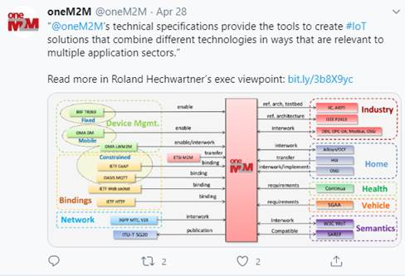
Social Media summary
May 2020:
Tweet impressions: 14.3K
Profile visits: 77
Mentions: 27
New followers: 13+
Total Followers: 1,256

