Slide 1
Marcom 89
June 2020

Slide 2
Press releases and media alerts
A news release highlighting the number of new members has been distributed on June 1 and a full coverage report has been shared.
A press release is in the pipeline on Release 4 following the webinar on June 17.
A press release is currently being drafted on the Indian Government smart cities.
A joint ETSI press release is currently being drafted by PPR.
A briefing call is planned for August to discuss a possible press release on the interworking with ITU-T.
A news release on oneM2M’s involvement in the InDiCo project will be drafted later in the year.
A news release on the Interop event in September is currently being discussed.
A joint PR is with ATIS / OFC is on hold for now.
oneM2M also plans to host a Hackathon event in Belgium, which has the potential for a press release. This has been postponed due to CO-VID19.
A media invite has been issued on June 8 prior to the Release 4 webinar.

Slide 3
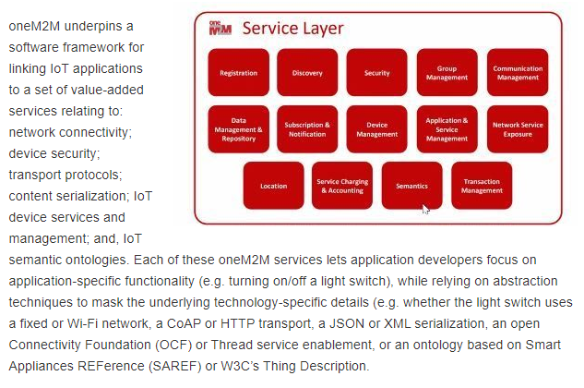
Feature Coverage Highlights
A feature on the oneM2M standard has been published on Active Cyber following a briefing with Ken and Peter.

Slide 4
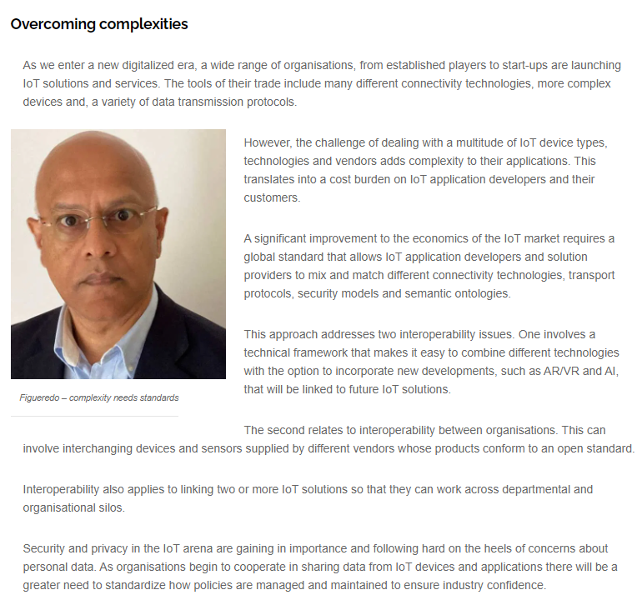
Feature Coverage Highlights
A feature on the oneM2M / GCF initiative has been published on Enterprise IoT Insights and is being pitched to RCR Wireless.

Slide 5
Features being drafted:
Proactive PR has secured the opportunity to provide a series of articles for IEEE Communications Standards Magazine and is planning the next submission for August.
PPR is currently drafting features for CIE Online, IoT Evolution World, Geo Connexion on the ETSI AI project.

Slide 6
Features being drafted and in approvals :
A feature is currently being drafted on the topic of smart cities for IoT News.
A feature on the oneM2M mature standard is currently being reworked following feedback from the publication.
A feature on oneM2M’s mobile networks webinar has been approved and is currently being pitched.

Slide 7
Features secured:
A feature has been secured for the November issue of Instrumentation Monthly on the topic of India’s First Living Lab.
A feature has also been secured for the IEEE Standards in IoT issue for 2021.

Slide 8
Monitoring for coverage:
A feature for IoT now has been submitted based on the IIC white paper. Proactive PR is currently monitoring for coverage.
PPR has submitted two articles to IEEE as part of its series and is currently monitoring for coverage.
A comment piece on IoT standardisation is due to be published in IoT Now Transport and the coverage is expected in Autumn.

Slide 9
Monitoring for coverage:
Following the briefing with Ken, a Q&A piece is due to be published in the July issue of Satellite Evolution.
An article on semantic interoperability has been submitted to Networking+.

Slide 10
Webinars and White Papers
The Release 4 webinar has taken place on June 17 and PPR has circulated a PR plan following this.
A webinar on ‘Data marketplace work in Korea’ is also due to be arranged.
oneM2M will be included in a white paper on MEC by ETSI, which is set to be published in the coming months.

Slide 11
Executive Interviews
Proactive PR has pitched Dr. Sachin Chaundhari’s Executive Interview to publications and secured an opportunity with Instrumentation Monthly.
Proactive PR is currently pitching an Executive Interview for Parthiv Parikh (SGS).
Potential ESTI Enjoy article on joint oneM2M / 3GPP interview has been pushed back to next issue.

Slide 12
Social Media
PPR has shared two fortnightly social media schedules for June.
PPR shared and updated the 'Did You Know' oneM2M specification for Japanese translation. PPR will also create new (DYK) graphic, following Ken’s feedback.
An additional schedule promoting oneM2M’s Executive Interviews has also been drafted.

Slide 13
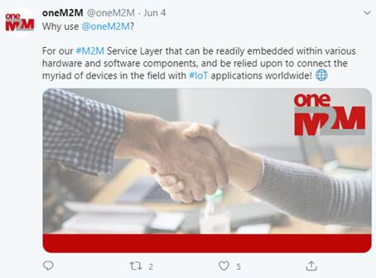
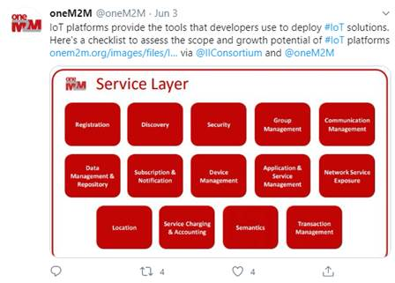
Social Media summary
June 2020:
Tweet impressions: 17.5K
Profile visits: 144
Mentions: 35
Total Followers: 1,263

