Slide 1
Marcom 90
July 2020

Slide 2
Press releases and media alerts
A press release providing updates on progress with Release 4 was distributed on the 15 July and a full coverage report has been shared.
A comment was drafted and submitted to ITPro magazine on the topic of European AI leadership.
A press release has been drafted in preparation for the approval of oneM2M as an official standard in India and awaits approval
A briefing call is planned for August to discuss a possible press release on the interworking with ITU-T.
A news release on oneM2M’s involvement in the InDiCo project will be drafted later in the year.
A news release on the Interop event in September is currently being discussed.
A joint PR is with ATIS / OFC is on hold for now.
oneM2M also plans to host a Hackathon event in Belgium, which has the potential for a press release. This has been postponed due to CO-VID19.

Slide 3
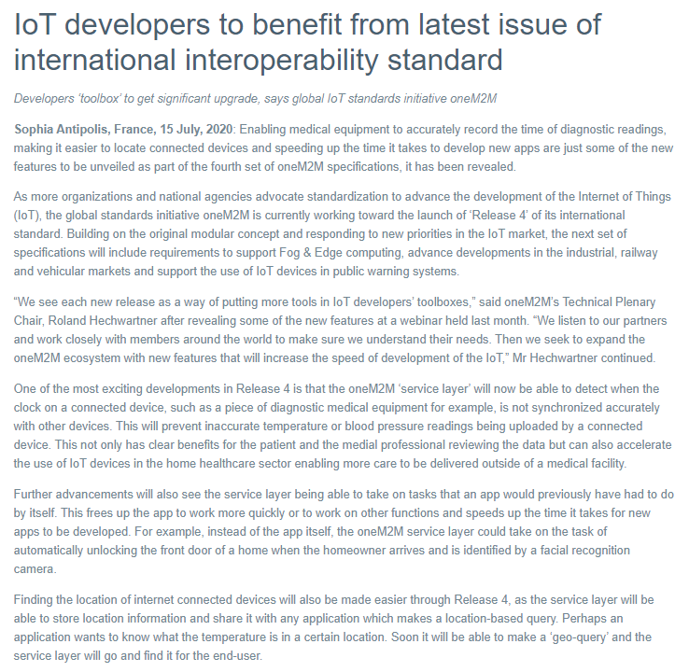
Press Release Highlights
A news release on Release 4 has been issued on July 15.

Slide 4
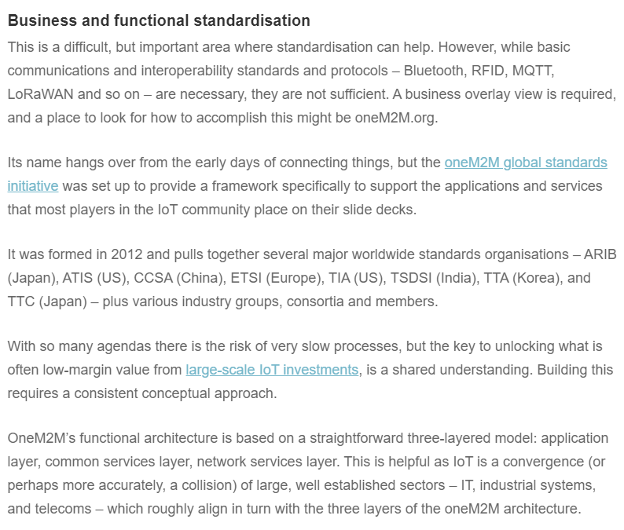
Feature coverage Highlights
An article has been published on Computer Weekly following a briefing with Ken.

Slide 5
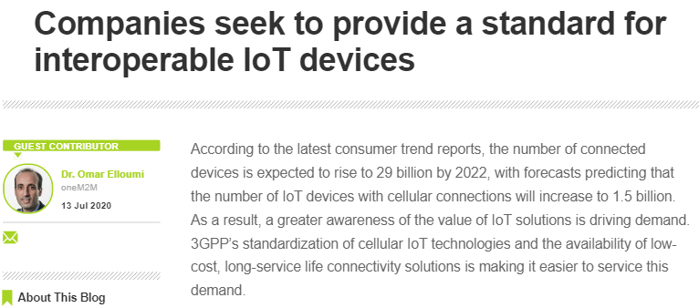
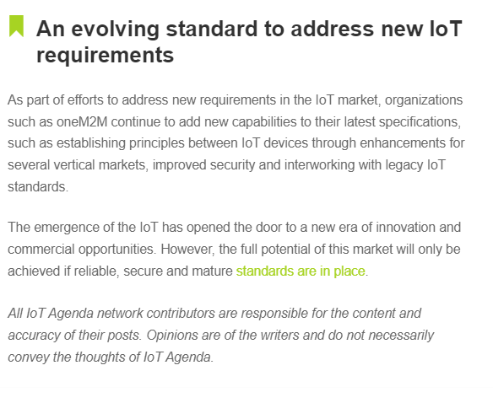
Feature coverage Highlights
A feature on the oneM2M standard has been published on IoT Agenda.

Slide 6
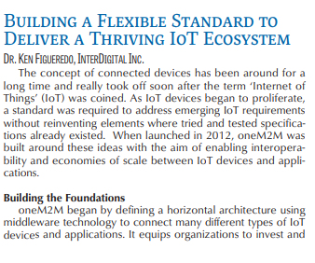
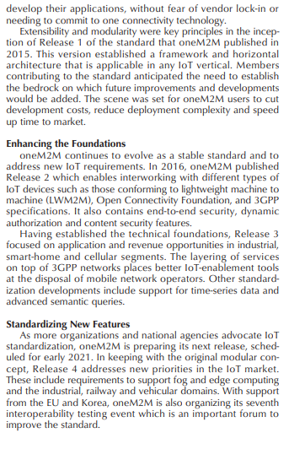
Feature coverage Highlights
Two articles have been published on IEEE as part of its ongoing series, with contributions from Ken and Roland.

Slide 7
Monitoring for coverage:
A feature for IoT now has been submitted based on the IIC white paper. Proactive PR is currently monitoring for coverage.
A comment piece on IoT standardisation is due to be published in IoT Now Transport and the coverage is expected in Autumn.
A comment was drafted and submitted to ITPro magazine on the topic of European AI leadership.

Slide 8
Monitoring for coverage:
Following the briefing with Ken, a Q&A piece is due to be published in the July issue of Satellite Evolution.
An article on semantic interoperability has been submitted to Networking+.

Slide 9
Features being drafted:
Proactive PR has secured the opportunity to provide a series of articles for IEEE Communications Standards Magazine and is planning the next submission for August.
PPR is currently drafting features for CIE Online, IoT Evolution World, Geo Connexion on the ETSI AI project.

Slide 10
Features being drafted and in approvals :
A feature on oneM2M’s mobile networks webinar has been approved and is currently being pitched.
A feature is currently being drafted on the topic of smart cities for IoT News.

Slide 11
Features secured:
A feature has been secured for the November issue of Instrumentation Monthly on the topic of India’s First Living Lab.
A feature has also been secured for the IEEE Standards in IoT issue for 2021.

Slide 12
Webinars and White Papers
A webinar on ‘Data marketplace work in Korea’ is also due to be arranged.
oneM2M will be included in a white paper on MEC by ETSI, which is set to be published in the coming months.

Slide 13
Executive Interviews
Interviews with Roland Hechwartner and Shane He to be used as basis of media pitches
PPR is also currently proofing an interview for Min-Byeong Lee

Slide 14
Social media
PPR has shared two fortnightly social media schedules for July.
PPR shared and updated the 'Did You Know' oneM2M specification for Japanese translation. PPR will also create new (DYK) graphic, following Ken’s feedback.
An additional schedule promoting oneM2M’s Executive Interviews has also been drafted and shared.

Slide 15
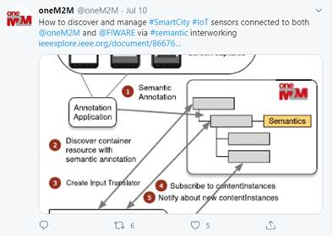
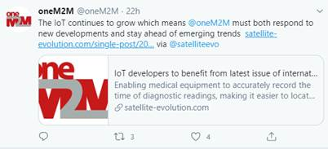
Social media summary
July 2020:
Tweet impressions: 17.1K
Profile visits: 171
Mentions: 31
Total followers: 1,270

