Slide 1
Marcom 91
September
2020

Slide 2
Press releases and media alerts
A press release will be issued to announce the results of the upcoming oneM2M elections.
A press release has been drafted in preparation for the approval of oneM2M as an official standard in India and awaits approval.
A call is to take place to discuss partnership working with GCF. A press release may follow.
A decision is expected this month on the formalisation of cooperation between the study group and oneM2M. A press release may follow.
A press release on the Interop event in September is currently being discussed. It could also incorporate mention of the ETSI InDico project.
An announcement will be made to mark the introduction of the new oneM2M website
A joint PR is with ATIS / OFC is on hold for now.
A media alert will be issued to mark Ken Figueredo’s involvement in the IoT Tech Expo
A media alert will be issued to mark Ken Figueredo’s involvement in the Managed Services Summit

Slide 3
Feature coverage Highlights
An article has been published on Satellite Evolution following a Q&A briefing call with Ken.

Slide 4
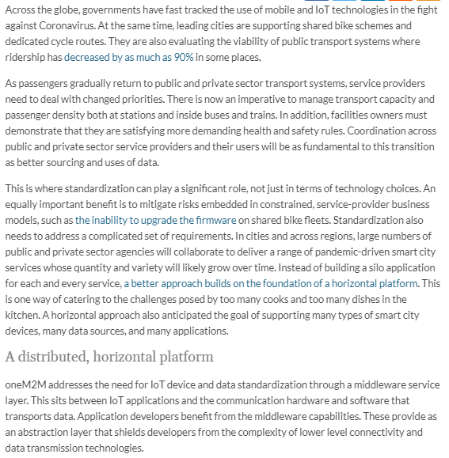
Feature coverage Highlights
A feature on smart cities amid the pandemic has been published on IoT News.

Slide 5
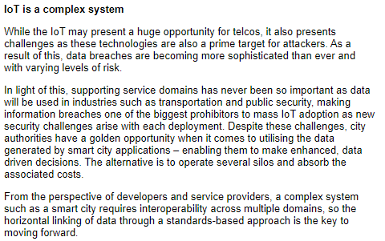
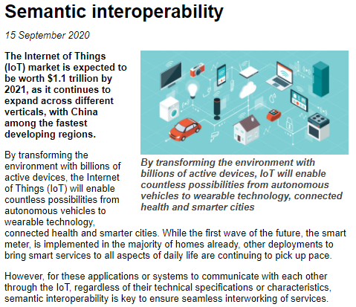
Feature coverage Highlights
A feature on the topic of semantic interoperability has been published on Networking+.

Slide 6
Feature coverage Highlights
An article on the topic of AI and IoT has been featured on IoT Evolution.

Slide 7
Monitoring for coverage:
A feature for IoT now has been submitted based on the IIC white paper. Proactive PR is currently monitoring for coverage.
A comment piece on IoT standardisation is due to be published in IoT Now Transport.

Slide 8
Monitoring for coverage:
A feature has been submitted on the topic of AI and IoT. PPR is currently monitoring for coverage in the September issue of ETSI Enjoy.
As part of its ongoing series, PPR is currently monitoring for coverage in the Autumn edition.

Slide 9
Features being drafted:
Proactive PR has secured the opportunity to provide a series of articles for IEEE Communications Standards Magazine and is planning the next submission for November.
PPR is currently drafting features for CIE Online and Geo Connexion on the ETSI AI project.

Slide 10
Features being drafted:
A feature is being drafted for the November issue of Instrumentation Monthly on the topic of India’s First Living Lab.
A feature has also been secured and will be drafted for the IEEE Standards in IoT issue for 2021.

Slide 11
Webinars and White Papers
Joint webinars with GCF are being explored.
Webinars to replace the ETSI IoT Week event are being looked into.
A webinar on ‘Data marketplace work in Korea’ is also due to be arranged
oneM2M will be included in a white paper on MEC by ETSI, which is set to be published in the coming months.

Slide 12
Executive Interviews and Briefings
An interview with Min-Byeoung Lee of Hyundai was published
An interview with Kenichi Yamamoto of KDDI, was published
A briefing call was held with IIoT World and thought-leadership content will be shared with them.
A briefing with analyst firm Omdia will be held on the 25th September.

Slide 13
Social media
PPR has shared two fortnightly social media schedules for August.
PPR will also provide online event support through social media promotion for:
-IoT Tech Expo
-Industrial IoT USA Summit
-Managed Services Summit Live
PPR will suggest theming content to align with the four key verticals. Opportunity for OneM2M to make sure each section has an equal voice across socials.

Slide 14
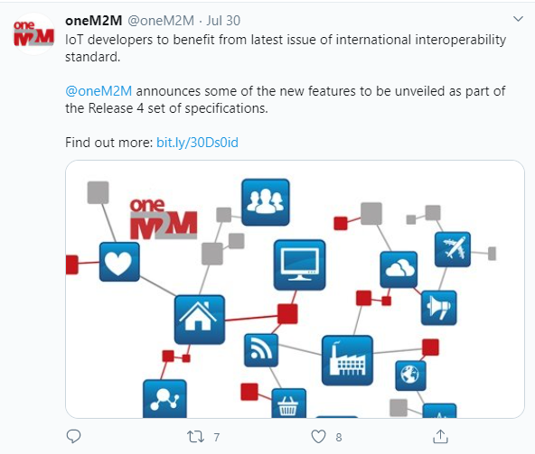
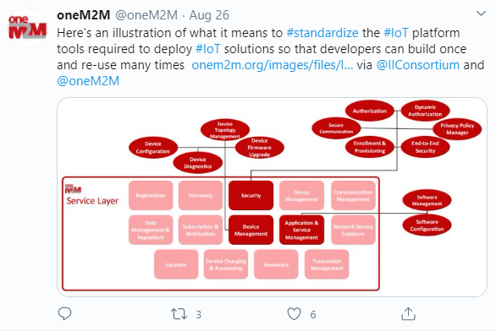
Social media summary
August 2020:
Tweet impressions: 17K
Profile visits: 105
Mentions: 37
Total followers: 1,285
Top Tweet earned 722 impressions
Top mention earned 23 engagements

