Slide 1
Marcom 92
October
2020

Slide 2
Press releases and media alerts
A press release has been distributed on the topic of oneM2M as an official standard in India.
A press release on the Interop event and ETSI InDico project is currently being drafted following a briefing call this month.
A news release on the ITU-T relationship formalisation is due to be drafted.
A press release on the Technical Excellence Awards has been drafted and is in approvals.
A press release will be issued to announce the results of the upcoming oneM2M elections.
A call is to take place to discuss partnership working with GCF. A press release may follow.
An announcement will be made to mark the introduction of the new oneM2M website.
A joint PR is with ATIS / OFC is on hold for now.
A media alert has been issued to mark Ken Figueredo’s involvement in the Managed Services Summit.

Slide 3
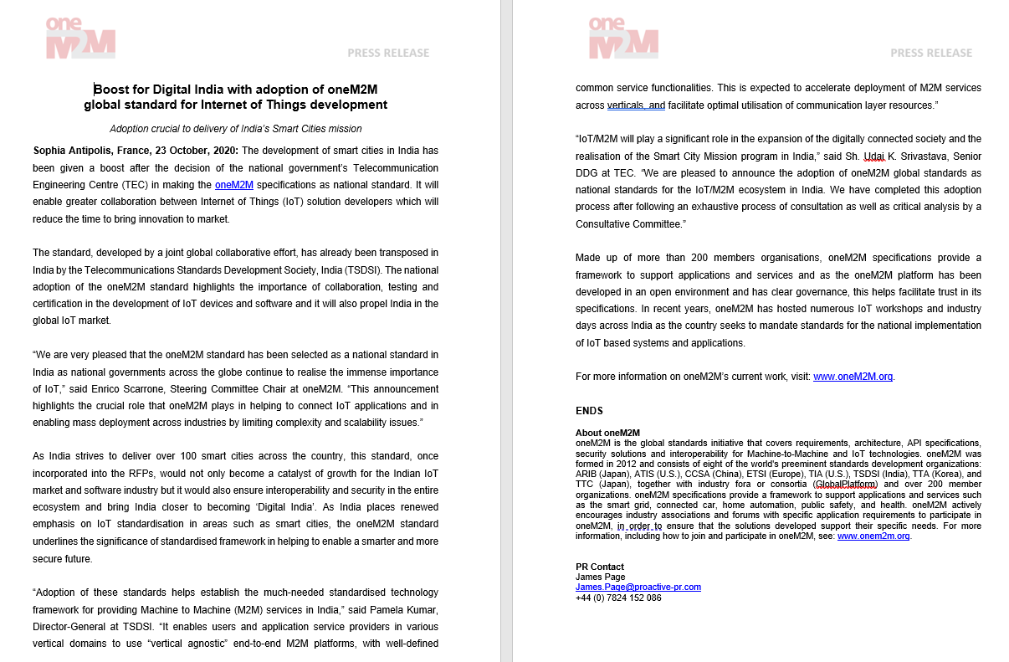
Press release highlights
A press release has been distributed on the topic of oneM2M as the national standard for India.

Slide 4
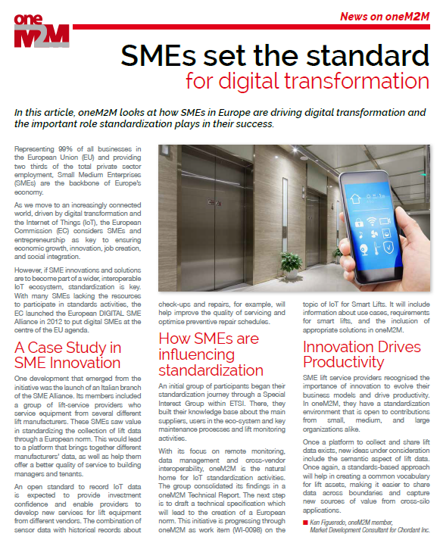
Feature coverage highlights
An article has been published in the ETSI Enjoy October issue on the topic of digital transformation.

Slide 5
Feature coverage highlights
An article has been published in CIE Online October issue on the topic of AI and IoT.

Slide 6
Monitoring for coverage:
A feature for IoT now has been submitted based on the IIC white paper. Proactive PR is currently monitoring for coverage.
A comment piece on IoT standardisation is due to be published in IoT Now Transport.

Slide 7
Monitoring for coverage:
As part of its ongoing series, PPR is currently monitoring for coverage in the Autumn edition.
A feature has been submitted for the November issue of Instrumentation Monthly on the topic of India’s First Living Lab.

Slide 8
Features being drafted:
Proactive PR has secured the opportunity to provide a series of articles for IEEE Communications Standards Magazine and is drafting the next submission for November.
PPR is currently drafting a feature for Geo Connexion on the ETSI AI project.

Slide 9
Webinars and White Papers
Joint webinars with GCF are being explored.
Webinars to replace the ETSI IoT Week event are being looked into.
A webinar on ‘Data marketplace work in Korea’ is also due to be arranged
oneM2M will be included in a white paper on MEC by ETSI, which is set to be published in the coming months.

Slide 10
Executive Interviews and Briefings
An interview with Colin Blanchard of BT has been published.
A briefing call was held with IIoT World and thought-leadership content will be shared with them.
A briefing with analyst firm Omdia was held on the 25th September.

Slide 11
Social media
PPR has shared two fortnightly social media schedules for October.
PPR has also provided online event support through social media promotion for:
-IoT Tech Expo
-Managed Services Summit Live
PPR will suggest theming content to align with the four key verticals. Opportunity for OneM2M to make sure each section has an equal voice across socials.

Slide 12
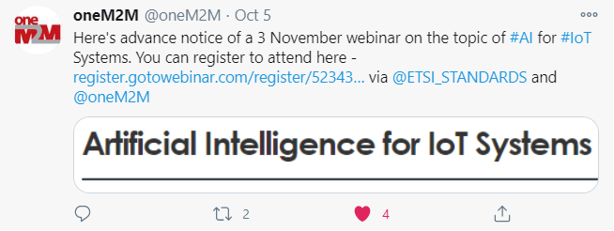
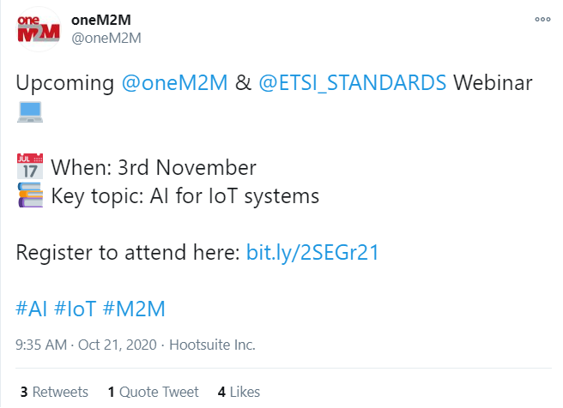
Social media summary
October 2020:
Tweet impressions: 14.6K
Profile visits: 85
Mentions: 32
New followers: 12+
1,299 Total Followers

