Slide 1
Marcom 92
October / November 2020

Slide 2
Press releases and media alerts
A press release has been distributed on the topic of oneM2M as an official standard in India.
A press release on the Technical Excellence Awards has been distributed.
A press release on the ETSI InDico project has been distributed.
A press release on the Interop event is in the pipeline.
A news release on the ITU-T relationship formalisation is due to be drafted.
A press release will be drafted to announce the results of the upcoming oneM2M elections.
A call is to take place to discuss partnership working with GCF. A press release may follow.
An announcement will be made to mark the introduction of the new oneM2M website.
A joint PR is with ATIS / OFC is on hold for now.

Slide 3
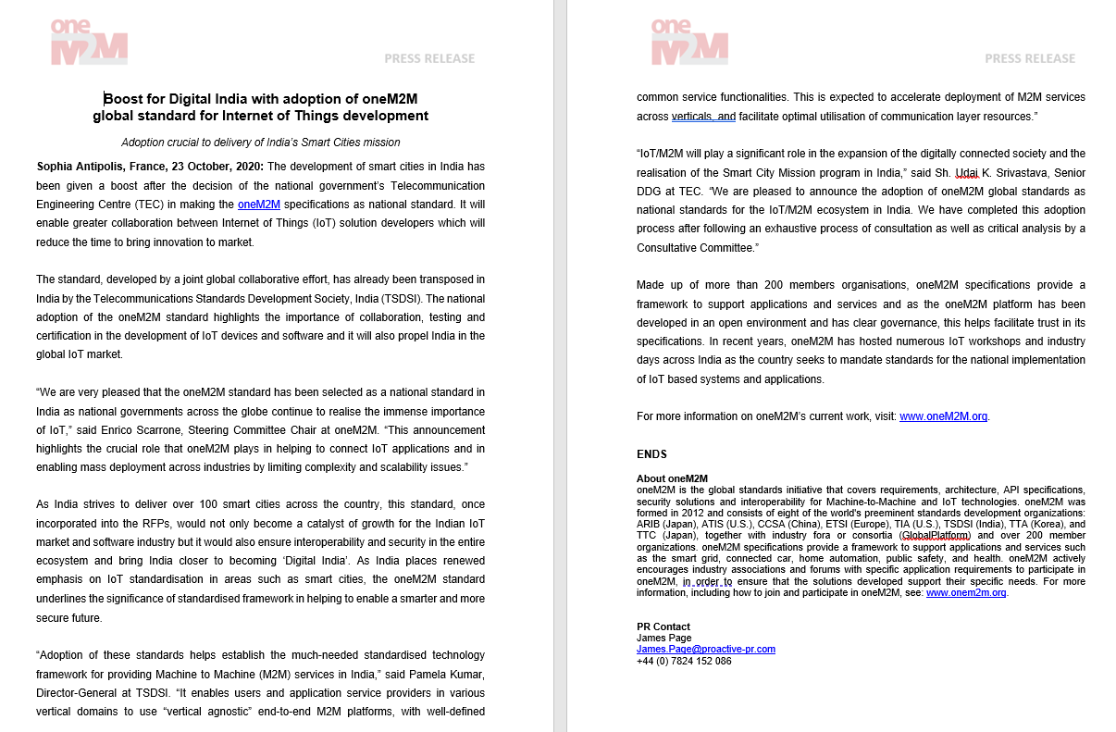
Press release highlights
A press release has been distributed on the topic of oneM2M as the national standard for India.

Slide 4
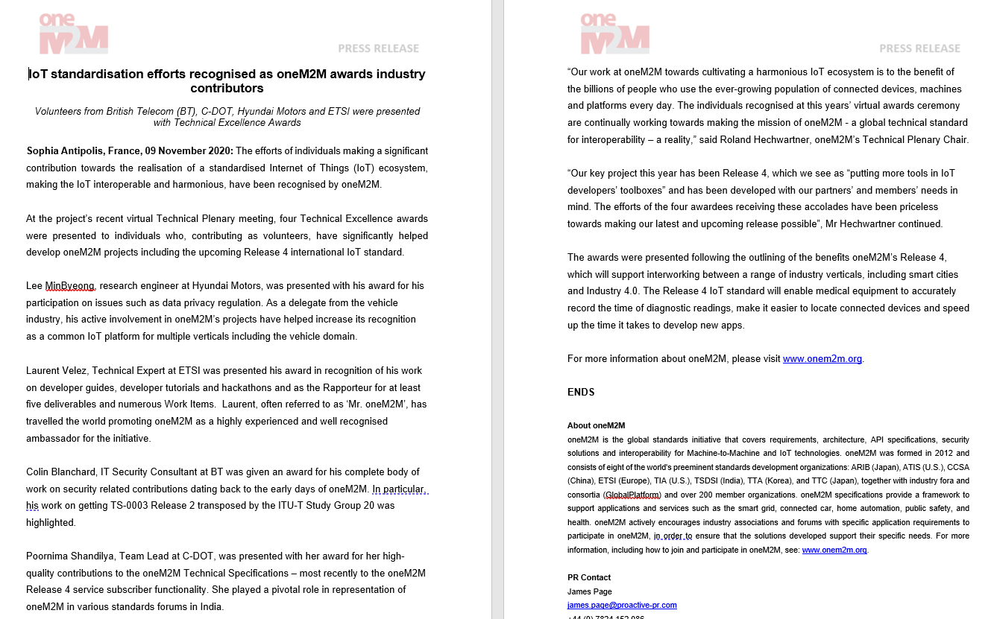
Press release highlights
A press release has been distributed on the topic of the Technical Excellence Awards.

Slide 5
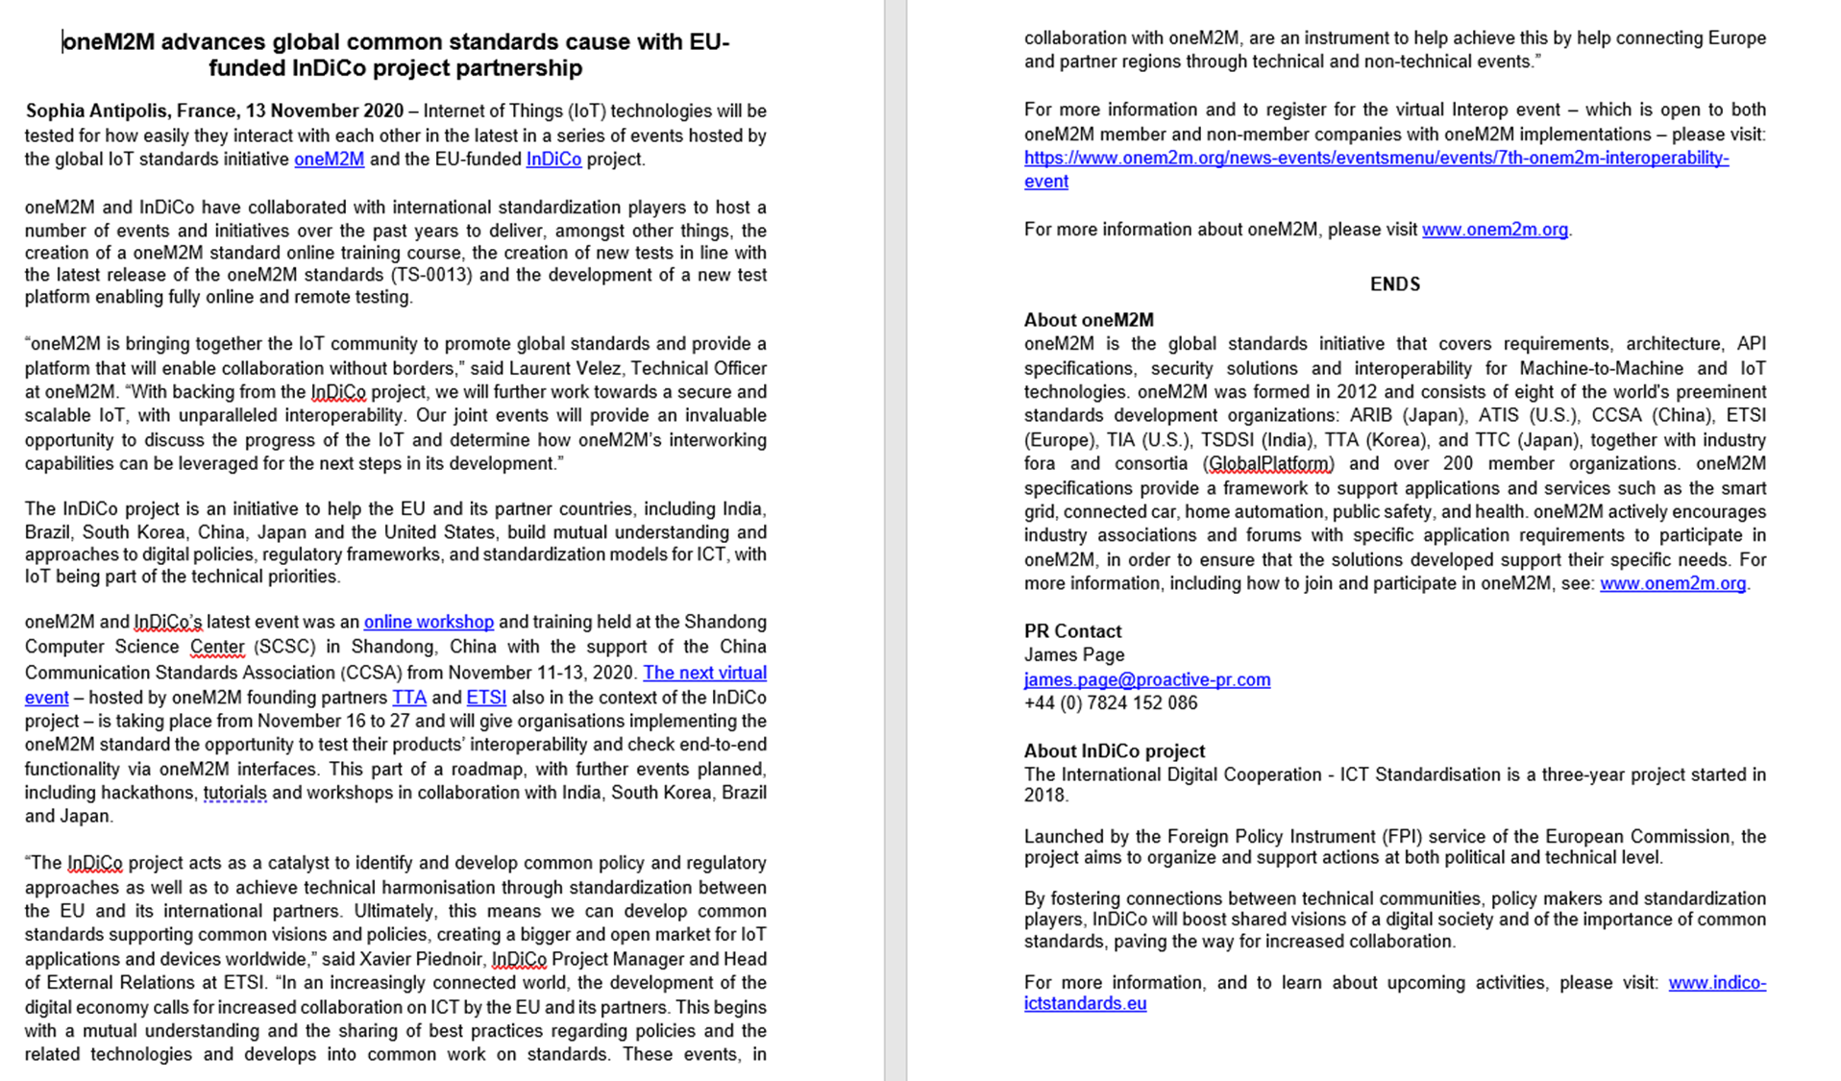
Press release highlights
A press release has been distributed on the ETSI InDico Project.

Slide 6
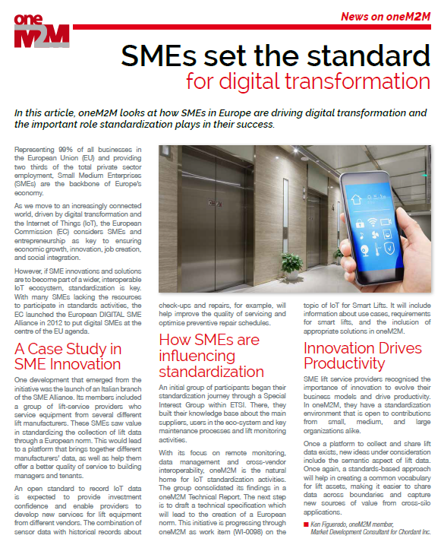
Feature coverage highlights
An article has been published in the ETSI Enjoy October issue on the topic of digital transformation.

Slide 7
Feature coverage highlights
An article has been published in CIE Online October issue on the topic of AI and IoT.

Slide 8
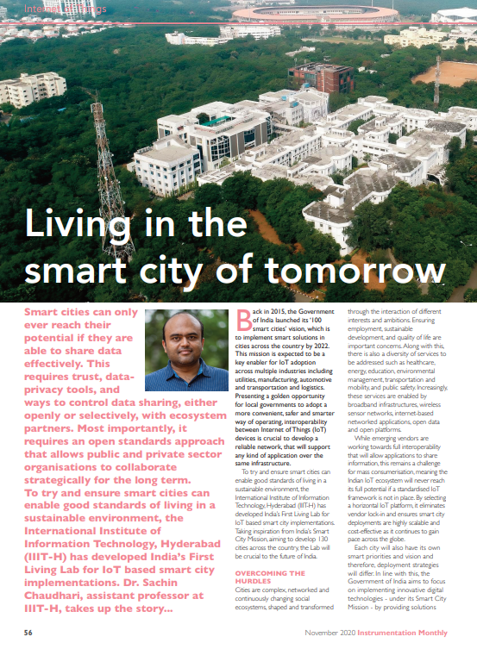
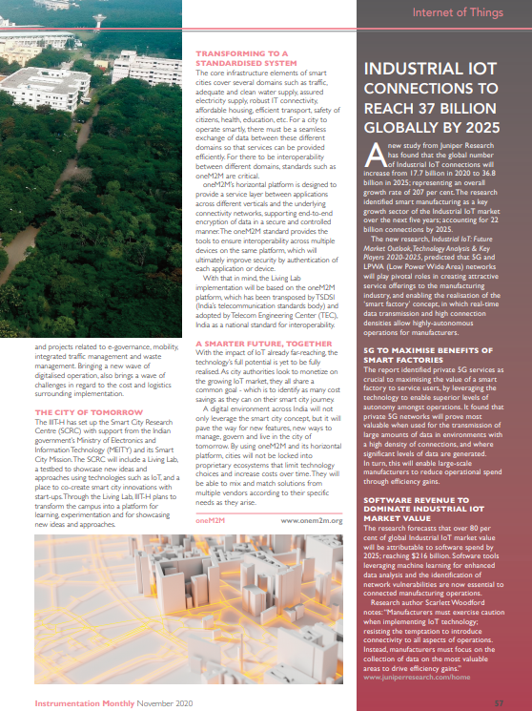
Feature coverage highlights
A feature has been published in the November issue of Instrumentation Monthly on the topic of India’s First Living Lab.

Slide 9
Monitoring for coverage:
Proactive PR has secured the opportunity to provide a series of articles for IEEE Communications Standards Magazine and is monitoring for coverage in November.

Slide 10
Webinars and White Papers
Joint webinars with GCF are being explored.
Webinars to replace the ETSI IoT Week event are being looked into.
A webinar on ‘Data marketplace work in Korea’ is also due to be arranged
oneM2M will be included in a white paper on MEC by ETSI, which is set to be published in the coming months.

Slide 11
Executive Interviews and Briefings
An interview with Colin Blanchard of BT has been published.
A briefing call was held with IIoT World and thought-leadership content will be shared with them.
A briefing with analyst firm Omdia was held on the 25th September.

Slide 12
Social media
PPR has shared two fortnightly social media schedules for November.
PPR has also provided online event support through social media promotion for:
-IoT Tech Expo
-Managed Services Summit Live
-oneM2M interoperability, 2020
-oneM2M hackathon in china.

Slide 13
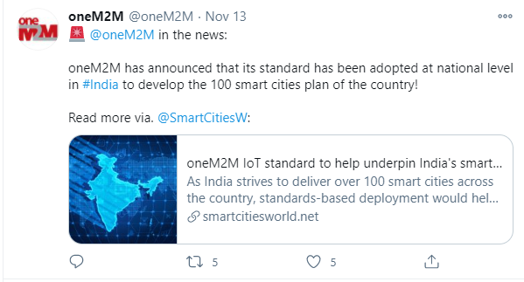
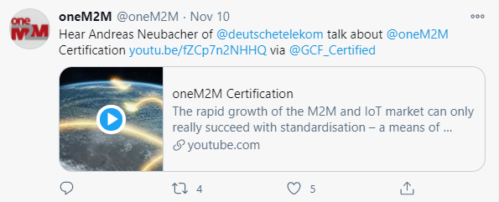
Social media summary
November 2020:
Tweet impressions: 20.2k
Profile visits: 248
Mentions: 53
New followers: 9
Total followers: 1,309

