Slide 1
New Branding Material
MARCOM92 – Estelle Mancini
3 Dec 2020

Slide 2
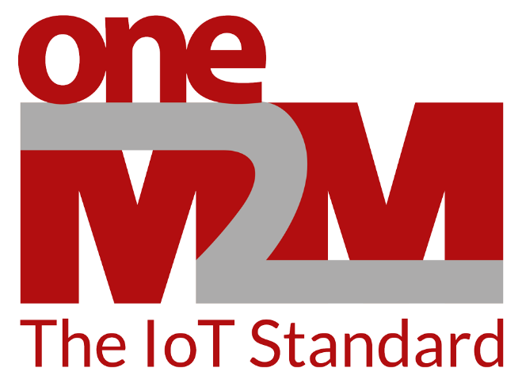
3 major updates
New logo with tagline
Updated branding guide
Updated powerpoint template
This template now uses 2 fonts to allow compatibility with developer code:
Primary font: Myriad Pro
Monospace font: Roboto Mono (Google Font)

Slide 3
Monospace font: Roboto Mono (Google Font)
Text/Code example
<xs:element name="CSEBase" substitutionGroup="m2m:sg_resource">
<xs:complexType>
<xs:complexContent>
<!-- Inherit just the universal resource attributes -->
<xs:extension base="m2m:resource">
<xs:sequence>
<!-- Resource Specific Attributes -->
<xs:element name="accessControlPolicyIDs" type="m2m:acpType" minOccurs="0" />
<xs:element name="cseType" type="m2m:cseTypeID" minOccurs="0" />
<xs:element name="CSE-ID" type="m2m:ID" />
<xs:element name="supportedResourceType">
<xs:simpleType>
<xs:list itemType="m2m:resourceType" />
</xs:simpleType>
</xs:element>
<xs:element name="pointOfAccess" type="m2m:poaList" />
<xs:element name="nodeLink" type="xs:anyURI" minOccurs="0" />
<xs:element name="dynamicAuthorizationConsultationIDs" type="m2m:listOfURIs" minOccurs="0" />
<xs:element name="contentSerialization" type="m2m:serializations" minOccurs="0" />
<xs:element name="e2eSecInfo" type="m2m:e2eSecInfo" minOccurs="0" />
<xs:element name="supportedReleaseVersions" type="m2m:supportedReleaseVersions" />

