Slide 1
Marcom 94
March 2021

Slide 2
Press releases and media alerts
A media invite was drafted and distributed in relation to Ken’s presentation at the IoT Tech Expo Global event.
A press release is planned to announce progress toward/ the announcement of Release 4

Slide 3
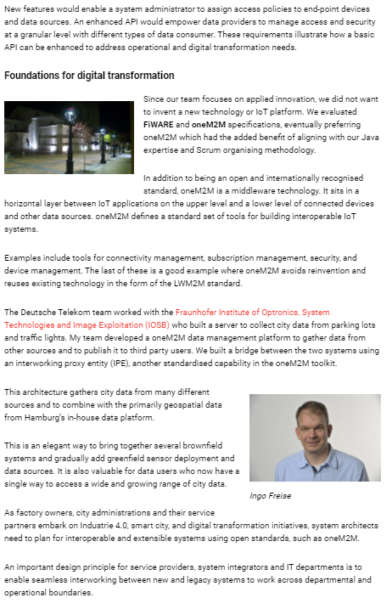
Feature coverage highlights
An article on Smart Cities has been published on IoT Now.

Slide 4
Monitoring for coverage
A comment has been provided to The Economist on Industrial IoT. Coverage expected in April.
A comment has been provided to ITPro on the importance of data. Coverage expected in March/April.
Three articles have been provided to Architecture & Governance Magazine on IoT infrastructure and oneM2M standards. First piece of coverage expected in March/April.

Slide 5
Monitoring for coverage
An article has been provided to IoT News on oneM2M welcoming new Indian members. Coverage expected in March/April.
An article has been provided to CIE magazine on how to share IoT data sustainably. Coverage expected in March.
An article has been provided to IEEE Communications Standards magazine on standards for smart cities. Coverage expected in March.

Slide 6
Features secured
An article has been secured for IoT Now on the topic of successful IoT connectivity and deployment.
An article has been secured for Mission Critical Magazine on the topic of oneM2M standards in the context of public safety and other critical industries.

Slide 7
Speaking opportunities and media alerts
Ken Figueredo presented at the virtual IoT Tech Expo Global on the 18th March on a session entitled “Enterprise IoT Connectivity”
Proactive PR has shared a media agreement from Embedded Technology Convention which includes speaking opportunities for oneM2M at the 2022 events in Singapore and Las Vegas
Proactive PR has also created opportunities for oneM2M to present at the following events:
Future of Communications Conference
IoT Virtual Summit
Virtual Sensors and IIOT: Manufacturing, Robotics, Automation, North America & EMEA summits
Proactive PR has created and shared an events calendar which outlines relevant speaking opportunities for oneM2M throughout 2021

Slide 8
Executive Interviews and Briefings
An Executive Viewpoint with Marianne Mohali of Orange has been published

