Slide 1
Marcom 95
April 2021

Slide 2
Press releases and media alerts
A press release promoting the launch of oneM2M’s sustainability initiative was distributed
A press release is planned to announce progress toward/ the announcement of Release 4

Slide 3
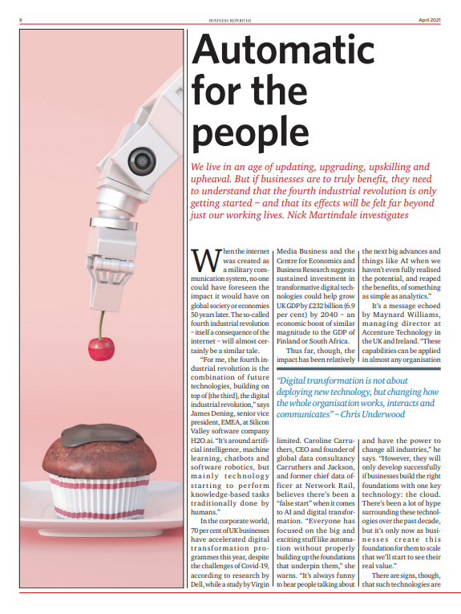
Feature coverage highlights
A comment from oneM2M has been published in an article on automation in The Economist and Business Reporter.

Slide 4
Feature coverage highlights
An article on the public safety benefits of IoT standards has been published in Mission Critical Communications.

Slide 5
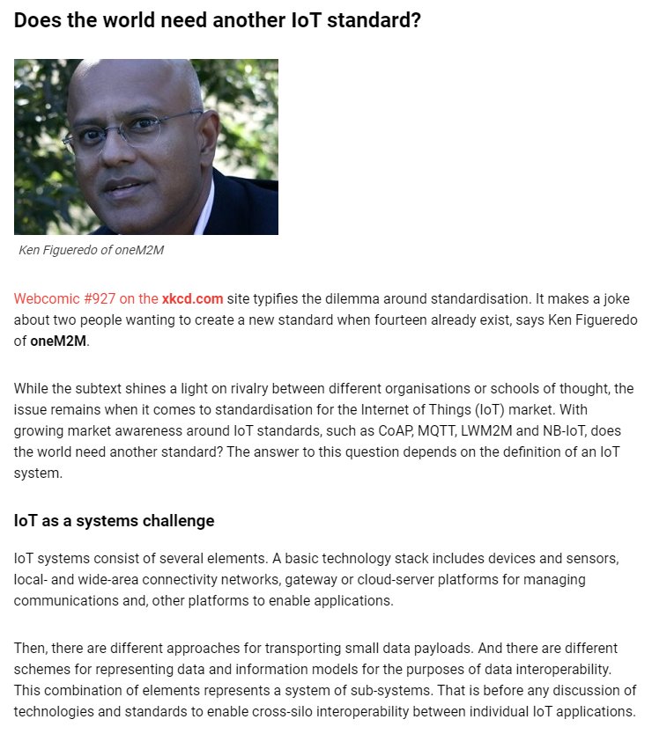
Feature coverage highlights
An article on IoT standards been published in IoT Now.

Slide 6
Feature coverage highlights
An article on how to share IoT data sustainably has been published in CIE Magazine.

Slide 7
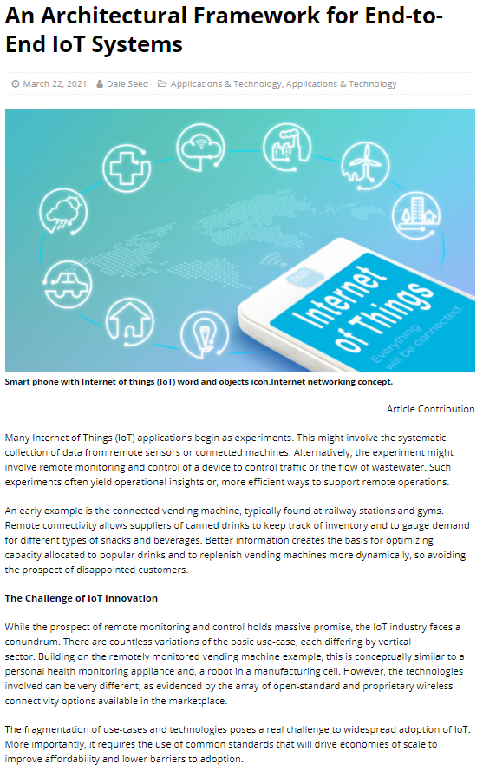
Feature coverage highlights
An article on the architectural framework for end-to-end IoT systems has been published in Architecture & Governance Magazine.

Slide 8
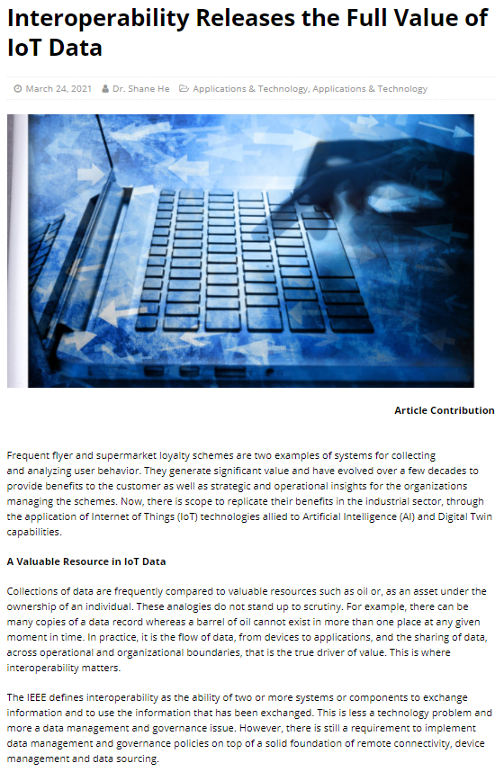
Feature coverage highlights
An article on the interoperability and IoT data has been published in Architecture & Governance Magazine.

Slide 9
Feature coverage highlights
A third article has been published in Architecture & Governance Magazine about providing a roadmap for IoT security.

Slide 10
Monitoring for coverage
An article has been provided to IEEE Communications Standards magazine on standards for smart cities.
A comment has been provided to ITPro on the importance of data. Coverage expected in March/April.

Slide 11
Features secured
An article has been secured for Pipeline on the topic of the role of IoT in public safety communications.

Slide 12
Interviews secured
An interview opportunity has been secured on The Peggy Smedley Show on the topic of oneM2M’s sustainability initiative.

Slide 13
Speaking opportunities and media alerts
Proactive PR has shared a media agreement from Embedded Technology Convention which includes speaking opportunities for oneM2M at the 2022 events in Singapore and Las Vegas
Proactive PR has also created opportunities for oneM2M to present at the following events:
Future of Communications Conference
IoT Virtual Summit
IoT Tech Expo series
Proactive PR has created and shared an events calendar which outlines relevant speaking opportunities for oneM2M throughout 2021

