Slide 1
Marcom 96
May 2021

Slide 2
Press releases and media alerts
A press release is planned to announce progress toward/ the announcement of Release 4

Slide 3
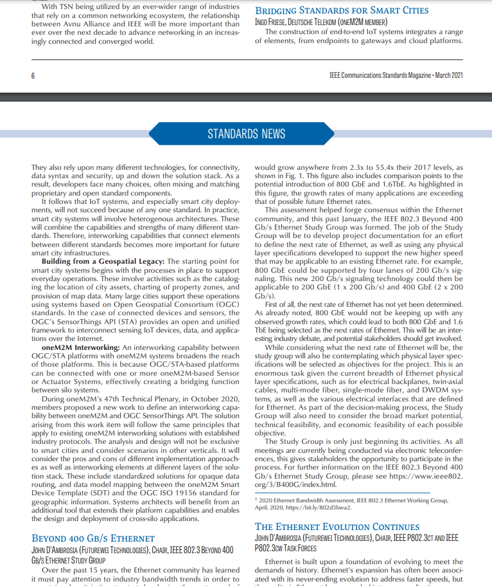
Feature coverage highlights
An article from oneM2M on smart cities has been published in IEEE Communications Standards Magazine
https://ieeexplore.ieee.org/stamp/stamp.jsp?tp=&arnumber=9392783

Slide 4
Monitoring for coverage
Comments from oneM2M have been submitted to Digital Bulletin on the topic of smart city transport. Coverage expected in June.
An article has been submitted to Pipeline on the topic of the role of IoT in public safety communications. Coverage expected in July.

Slide 5
Monitoring for coverage
An article has been submitted to Architecture & Governance Magazine on the topic of IoT and sustainability. Coverage expected in June.
An article has been submitted to IoT for All on the topic of IoT systems. Coverage expected in June.

Slide 6
Monitoring for coverage
A comment has been provided to ITPro on the importance of data. Coverage expected in June.
Dale Seed was interviewed on The Peggy Smedley Show on the topic of oneM2M’s sustainability initiative. Coverage expected in June.

Slide 7
Features secured
An article has been secured in Architecture & Governance Magazine on the topic of how IoT enables sustainability and what it means to deploy sustainable systems.

Slide 8
Speaker opportunities and media alerts
Speaking opportunity has been secured for Ken Figueredo at the IoT Global Innovation Forum on the topic of IoT standards.
Proactive PR has shared available panel opportunities at IoT Tech Expo Global for oneM2M to review.
Proactive PR has also created opportunities for oneM2M to present at the following events:
IoT Virtual Summit
Future of Communications Conference
IoT Tech Expo North America and Europe
Call and Contact Center Expo
Embedded Technology Convention 2022
A tab has been created by Proactive PR in the Promotions Tracker that outlines relevant speaking opportunities.

Slide 9
An Executive Viewpoint with Girish Ramachandran of TATA Consultancy Services has been published

