Slide 1
Marcom 97
June 2021

Slide 2
Press releases and media alerts
A press release is planned to announce progress toward/ the announcement of Release 4

Slide 3
Feature coverage highlights
An article from oneM2M on IoT and sustainability has been published in Architecture & Governance Magazine
https://www.architectureandgovernance.com/uncategorized/sustainability-done-sustainably/

Slide 4
Feature coverage highlights
An article from oneM2M on IoT systems has been published on IoT For All
https://www.iotforall.com/building-iot-systems-with-reusable-tools

Slide 5
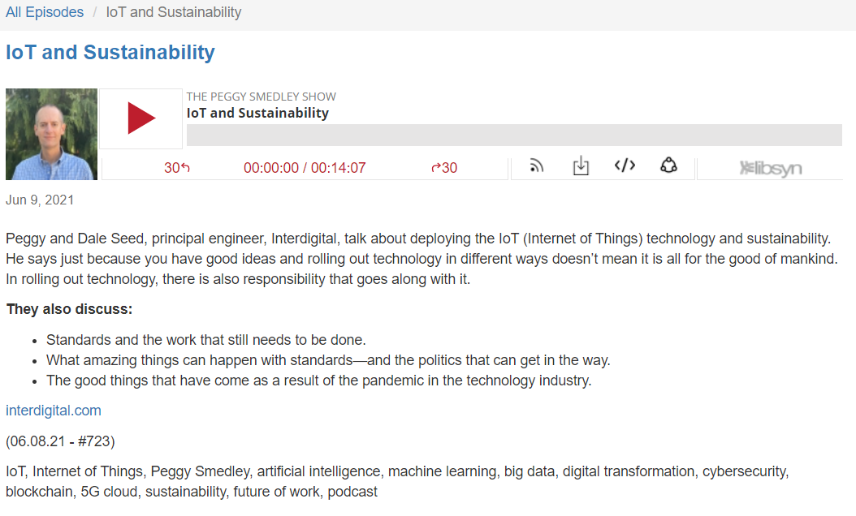
Interview coverage highlights
An interview with Dale Seed on IoT and sustainability on The Peggy Smedley Show has been published.
https://peggysmedleyshow.com/iot-and-sustainability

Slide 6
Features planned
An article is planned on the topic of smart city transport for IoT For All

Slide 7
Monitoring for coverage
Comments from oneM2M have been submitted to Digital Bulletin on the topic of smart city transport. Coverage expected in June/July.
An article has been submitted to Pipeline on the topic of the role of IoT in public safety communications. Coverage expected in July.

Slide 8
Speaker opportunities and media alerts
Shane He has been accepted as a speaker at the Future of Communications Conference with a presentation on the topic of interoperability importance.
Shane has also been accepted as a speaker at the IoT Virtual Summit with a presentation on the topic of oneM2M architecture and IoT security.
Bob Flynn has been accepted as a speaker at IoT Tech Expo North America, joining a panel on the topic of integrating IoT connectivity.
Andreas Neubacher will join the Integrating IoT Connectivity panel at IoT Tech Expo Global on behalf of oneM2M.
Proactive PR has also created opportunities for oneM2M to present at the following events:
Call and Contact Center Expo
IoT Tech Expo Europe
Embedded Technology Convention 2022
A tab has been created by Proactive PR in the Promotions Tracker that outlines relevant speaking opportunities.

Slide 9
An Executive Viewpoint with Roland Hechwartner of Deutsche Telekom has been published
An Executive Viewpoint with Klaus Grobe of ADVA has been published

