Slide 1
Marcom 98
July 2021

Slide 2
Press releases and media alerts
A press release announcing progress towards the announcement of Release 4 and Release 5 has been distributed

Slide 3
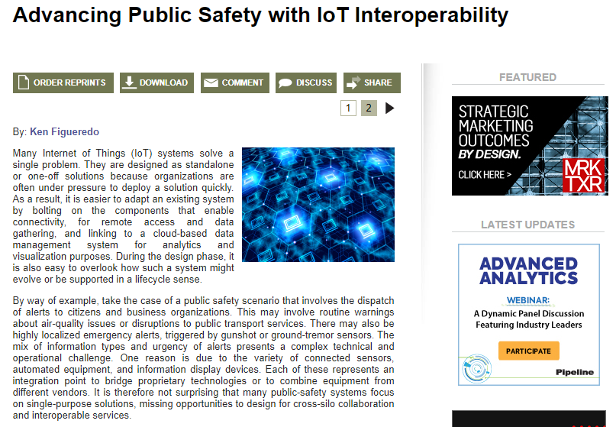
Feature coverage highlights
An article from oneM2M has been published in Pipeline on the topic of the role of IoT in public safety communications
https://www.pipelinepub.com/IoT/IoT-for-public-safety

Slide 4
Features secured
An article has been secured on the topic of IoT and sustainability for IoT Evolution World.

Slide 5
Monitoring for coverage
An article has been submitted on the topic of IoT communications to IoT For All. Coverage expected in August.
Comments from oneM2M have been submitted to Digital Bulletin on the topic of smart city transport. Coverage expected in July/August.

Slide 6
Speaker opportunities
A number of speaking opportunities have already been secured and speakers have been confirmed.
Event | Date | Physical or virtual | Panel or topic information
5th IoT Global Innovation Forum | 28 July 2021 | Virtual | Ken Figueredo will be presenting on the topic of ‘Does the world need another IoT standard?’
IoT Tech Expo Global | 15 September 2021 | Virtual | Andreas Neubacher will be joining the ‘Integrating IoT Connectivity’ panel.
Future of Communications Conference | 27 September 2021 | Virtual | Shane He will be joining the event as a speaker with a presentation on the topic of interoperability importance.
IoT Tech Expo North America | 29 September 2021 | Virtual | Bob Flynn will be joining the ‘Integrating IoT Connectivity’ panel.
IoT Virtual Summit | TBC (organisers in the process of confirming) | Virtual | Shane He will be presenting on the topic of oneM2M architecture and IoT security.

Slide 7
Speaker opportunities
Proactive PR is conducting event outreach to secure new speaking opportunities, including Telecoms World Asia, Digital Twin World and IoT World.
There are speaking opportunities still available for the following events:
Event | Date | Physical or virtual | Panel or topic information
Call and Contact Center Expo | 16-17 November 2021 | Physical, London | The organisers are open to topics related to customer experience technology.
IoT Tech Expo Europe | 23-24 November 2021 | Physical, Amsterdam | Please click here for available panels.
Embedded Technology Convention ASIA | 19-20 January 2022 | Physical, Singapore | The organisers are open to topics.
Embedded Technology Convention USA | 8-9 June 2022 | Physical, Las Vegas | The organisers are open to topics.

Slide 8
An Executive Viewpoint with Poornima Shandilya of the Centre for Development of Telematics (C-DOT) has been published

