Slide 1
Marcom 99
September 2021

Slide 2
Press releases and media alerts
A press release announcing the sustainability white paper has been distributed. Proactive PR is monitoring for coverage.
A media invite has been drafted and distributed to support Andreas Neubacher’s speaking opportunity at IoT Tech Expo Global on behalf of oneM2M.

Slide 3
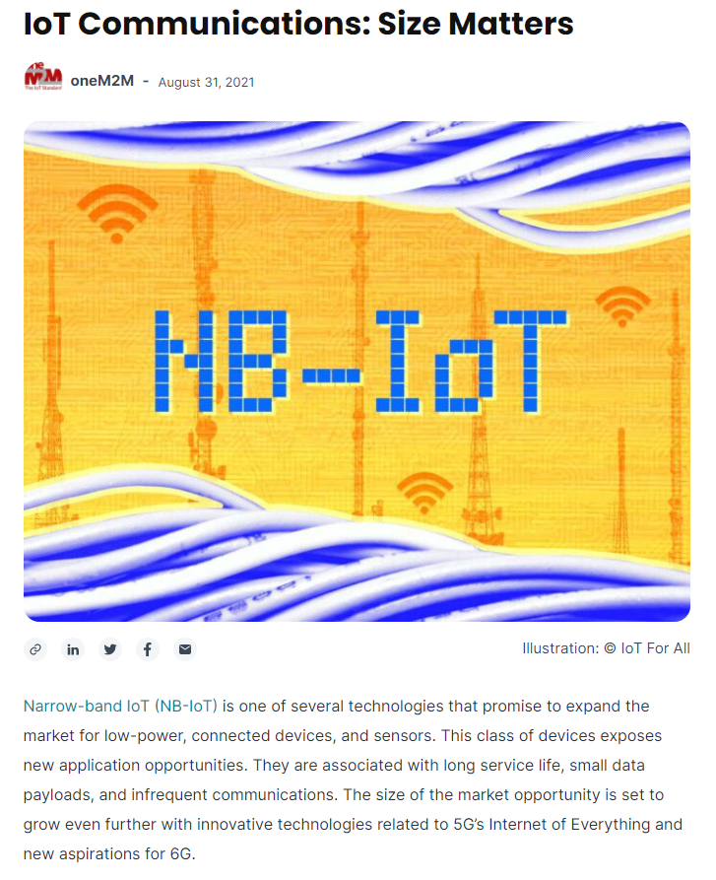
Feature coverage highlights
An article from oneM2M has been published on IoT for All on the topic of IoT communications.
https://www.iotforall.com/iot-communications-size-matters

Slide 4
Features secured
An article has been secured on the topic of waste procurement for the November issue of Waste Advantage Magazine.

Slide 5
Comments submitted
Comments on IoT sensors have been submitted to Information Age as part of a wider feature on the topic.

Slide 6
Monitoring for coverage
An article has been submitted to CIE Magazine on the importance of IoT standards. Coverage expected in the October issue.
An article has been submitted to Critical Comms on the topic of IoT in public safety communications. Coverage expected in October.

Slide 7
Monitoring for coverage
An article on the topic of IoT and sustainability has been submitted to Digitalisation World. Coverage expected in the October issue.
An article has been submitted to IoT for All on the topic of IoT sustainability. Coverage expected in October.

Slide 8
Features in the pipeline
oneM2M is currently reviewing an opportunity to submit a feature on the topic of 2021 IoT trends to Pipeline.

Slide 9
Speaker opportunities
A number of speaking opportunities have recently taken place.
Ken Figueredo spoke at the 5th IoT Global Innovation Forum on the topic of IoT standards.
Andreas Neubacher joined the Integrating IoT Connectivity panel at IoT Tech Expo Global.
Shane He represented oneM2M at the Future of Communication Conference with a presentation on interoperability.
Bob Flynn joined the Integrating IoT Connectivity panel at IoT Tech Expo North America. This was pre-recorded and will go live as part of the event on 29th September 2021.

Slide 10
Speaker opportunities
Event | Date | Physical or virtual | Panel or topic information
IoT Tech Expo North America | 29 September 2021 | Virtual | Bob Flynn will be joining the ‘Integrating IoT Connectivity’ panel.
IoT Tech Expo Europe | 23-24 November 2021 | Physical, Amsterdam | Speaker volunteer received, panel opportunities to be confirmed by the event.
Embedded Technology Convention ASIA | 19-20 January 2022 | Physical, Singapore | Speaker volunteer received, awaiting information from the event.
Embedded Technology Convention USA | 8-9 June 2022 | Physical, Las Vegas | Speaker volunteer received, awaiting information from the event.
IoT Virtual Summit | TBC (organisers in the process of confirming) | Virtual | Shane He will be presenting on the topic of oneM2M architecture and IoT security.

Slide 11
Speaker opportunities
Speaking opportunities have been secured as part of media partnerships with the following events:
Event | Date | Physical or virtual | Panel or topic information
Digital Twin World | 9 November 2021 | Virtual | Ken Figueredo will be moderating the panel ‘Digital Twin Development and Deployment – Breaking down the barriers’.
Digital Transformation Week North America | 9-10 November 2021 | Virtual | The organisers are open to topics.
IoT World | 3-4 November | Silicon Valley, Santa Clara | The organisers are open to topics.

Slide 12
An Executive Viewpoint with Professor Désirée M. van Gorp of Nyenrode Business University has been published
An Executive Viewpoint with Joachim Koss of JK Consulting and Projects has been published

