Slide 1
oneM2M analytics
Estelle Mancini, MARCOM Secretary 30 September 2021

Slide 2
WEBSITE - Overview
1,818 users stable (at least one session)
1,632 news users - 4% (first time users)
7,877 page views +11% (total number of pages)

Slide 3
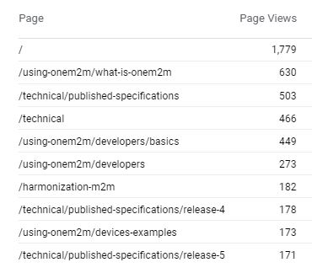
WEBSITE - Top 10 pages

Slide 4
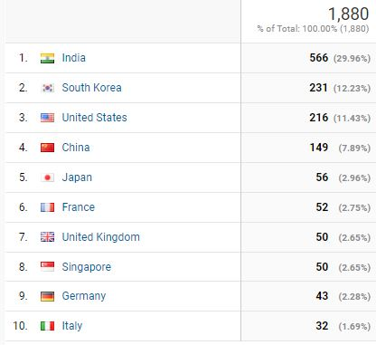
WEBSITE - Top 10 countries

Slide 5
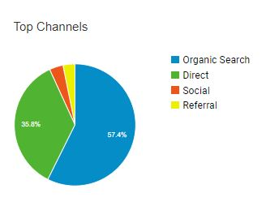
WEBSITE - Channels
Organic: +446% same period last year
Direct: landing pages
Social : Twitter and LinkedIn
Referral: via other website

Slide 6
WEBSITE - 2021 vs. 2020

Slide 7
Social Media
LinkedIn:
1,122 followers, + 15
108 pages views
8 updates Most successful update: Joachim Koss’ interview

