Slide 1
oneM2M analytics
Estelle Mancini, MARCOM Secretary 28 October 2021

Slide 2
WEBSITE – Overview Vs. Previous period
2,203 users + 20,90% (at least one session)
2,004 news users + 22,27% (first time users)
8,495 page views +7,27% (total number of pages)

Slide 3
WEBSITE - 2021 vs. 2020

Slide 4
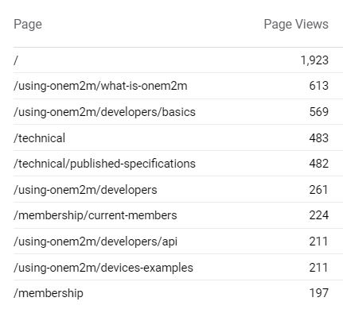
WEBSITE - Top 10 pages

Slide 5
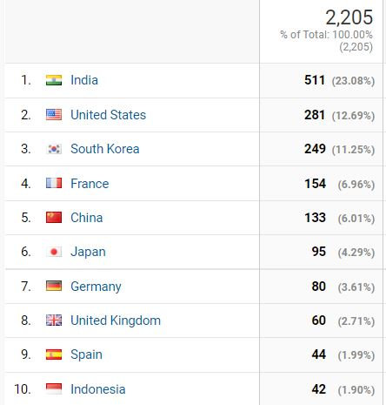
WEBSITE - Top 10 countries

Slide 6
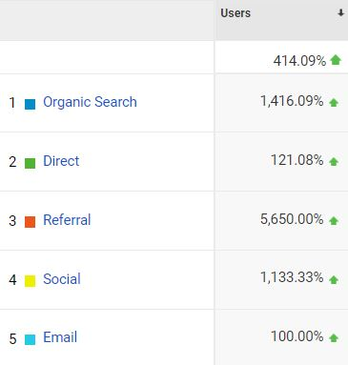
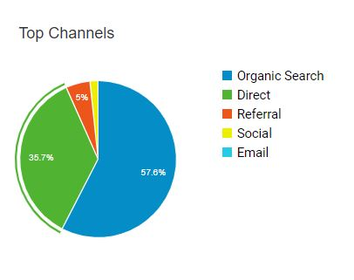
WEBSITE - Channels
2021
2020

Slide 7
Social Media
LinkedIn:
1,138 followers, +16
193 visits
14 posts
Twitter:
1,380 followers, +5 612 visits 40 Tweets

