Slide 1
oneM2M analytics
Estelle Mancini, MARCOM Secretary 5 November 2021

Slide 2
WEBSITE – Overview Oct 2021 vs. Sept 2021
2,197 users + 16,49% (at least one session)
1,996 news users + 17,48% (first time users)
8,701 page views +5,43% (total number of pages)

Slide 3
WEBSITE – Oct 2021 vs. Oct 2020

Slide 4
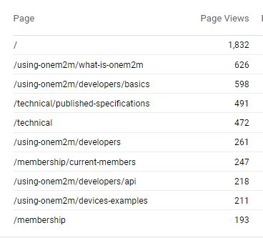
WEBSITE - Top 10 pages

Slide 5
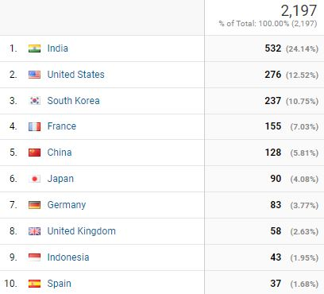
WEBSITE - Top 10 countries

Slide 6
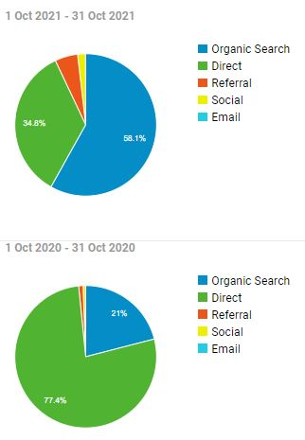
WEBSITE - Channels
CHANNELS | 2,197 visits
Organic search Search Engine Results | 1,319 (58,13%)
Direct Landing pages visited by direct typing into browser, bookmarks or if no refererral data is provided | 790 (34,82%)
Referral Sites that “referred” website (hyperlink) | 118 (5,20%)
Social Twitter, LinkedIn etc | 41 (1,81%)
Email Newsletter | 1 (0,04%)

Slide 7
Social Media
LinkedIn:
1,140 followers, +18
193 visits
16 posts
Twitter:
1,381 followers, +4 940 visits 39 Tweets

