Slide 1
Marcom 100
October 2021

Slide 2
Press releases
The press release announcing the sustainability white paper received some great pieces of coverage, including Digitalisation World, Electronic Specifier, IoT Now and IoT Global Network.

Slide 3
Upcoming PR opportunities
Rana Kamill’s upcoming speaking opportunity at the virtual IoT Tech Expo Europe event provides a great PR opportunity for oneM2M. Rana will be joining the IoT Security – Acting Ahead of the Threat panel on 30th November 2021.
Upcoming PR activities may involve deployments, the 10th anniversary of oneM2M, 2022 predictions and promotion of the University College London project.

Slide 4
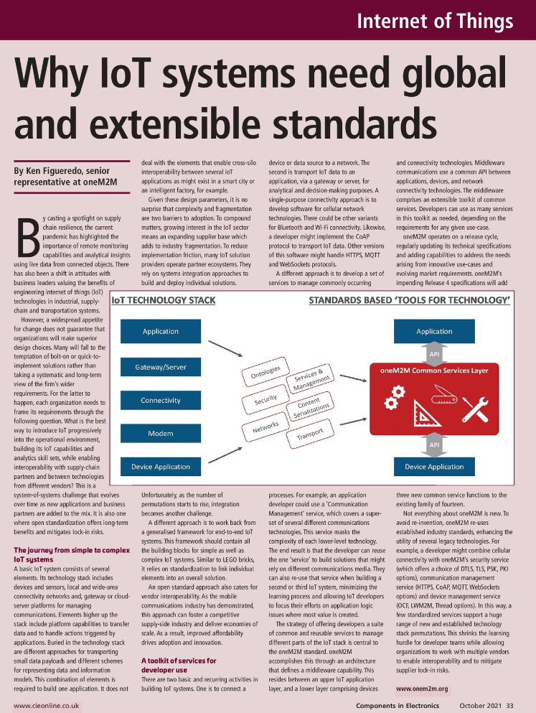
Feature coverage highlights
An article has been published on CIE Magazine on the importance of IoT standards.
https://content.yudu.com/web/69r/0A18qm2/CIEOct21/html/index.html?page=34&oriign=reader

Slide 5
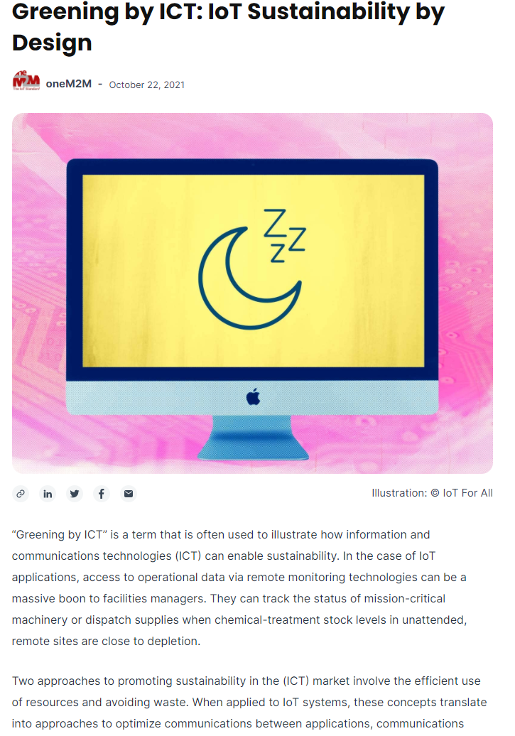
Feature coverage highlights
An article from oneM2M has been published on IoT for All on the topic of IoT sustainability by Design.
https://www.iotforall.com/greening-by-ict-iot-sustainability-by-design

Slide 6
Feature coverage highlights
An article has been published on Architecture and Governance on the topic of IoT sensors.
https://www.architectureandgovernance.com/app-tech/iot-sensors-for-iot-systems-what-you-need-to-know/

Slide 7
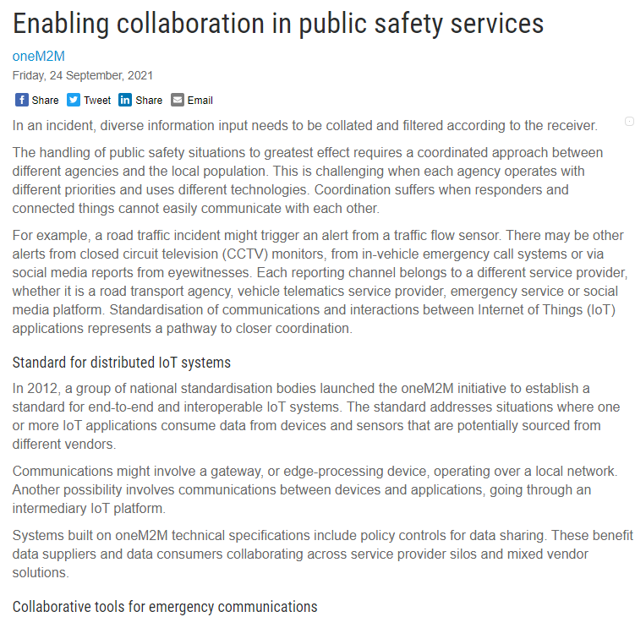
Feature coverage highlights
An article was published on Critical Comms on the topic of IoT in public safety communications.
https://www.criticalcomms.com.au/content/public-safety/article/enabling-collaboration-in-public-safety-services-1514249039

Slide 8
Monitoring for coverage
An article has been submitted on the topic of waste procurement for the December issue of Waste Advantage Magazine.
An article on the topic of IoT and sustainability has been submitted to Digitalisation World. PPR is monitoring for coverage in an upcoming issue.

Slide 9
Monitoring for coverage
An article has been submitted on the topic of semantic interoperability to Pipeline. Coverage expected in their December issue ‘2021 IoT trends’.

Slide 10
Speaker opportunities
Ken Figueredo will be moderating the Digital Twin Development and Deployment – Breaking down the Barriers? panel at Digital Twin World on 9th November 2021.

Slide 11
Speaker opportunities
Event | Date | Physical or virtual | Panel or topic information
IoT Tech Expo Europe | 23-24 November 2021 | Physical, Amsterdam | Rana Kamill will be representing oneM2M on the IoT Security – Acting Ahead of the Threat panel
Embedded Technology Convention ASIA | 19-20 January 2022 | Physical, Singapore | Speaker volunteer received, awaiting information from the event.
Embedded Technology Convention USA | 8-9 June 2022 | Physical, Las Vegas | Speaker volunteer received, awaiting information from the event.
IoT Virtual Summit | TBC (organisers in the process of confirming) | Virtual | Shane He will be presenting on the topic of oneM2M architecture and IoT security.

Slide 12
Speaker opportunities
We are currently conducting event outreach to secure new speaking opportunities in industries such as IoT, automation, smart cities etc.

