Slide 1
oneM2M website analytics
Estelle Mancini, MARCOM Secretary 16 December 2021

Slide 2
Monthly overview & 2021 vs. 2020
2,030 Users + 383,33 % (at least one session)
1,807 news users + 419,25 % (first time users)
8,143 page views + 510,88 % (total number of pages)
Figures have been stable for the past 3 months

Slide 3
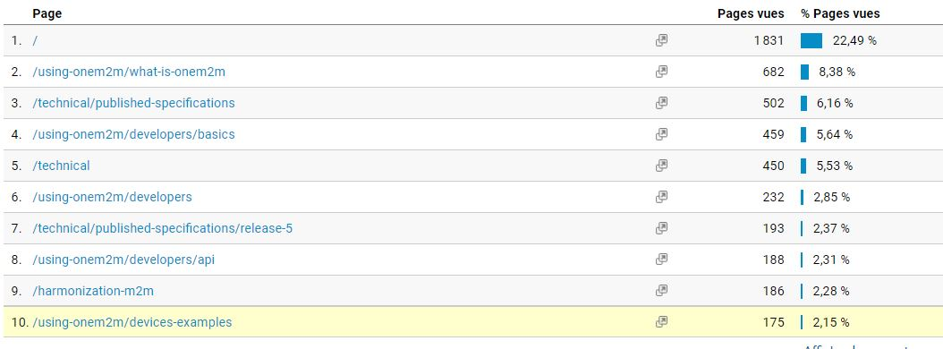
Top 10 pages

Slide 4
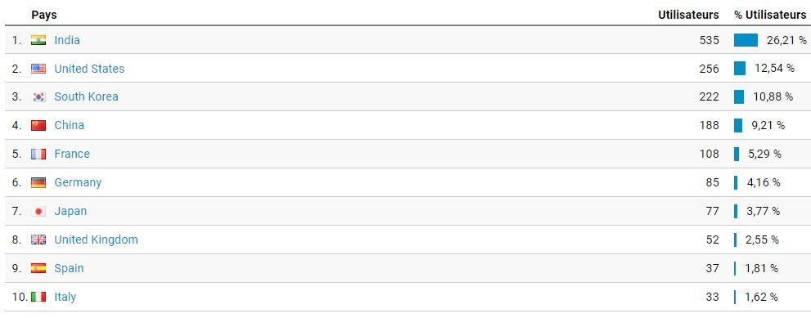
Top 10 countries

Slide 5
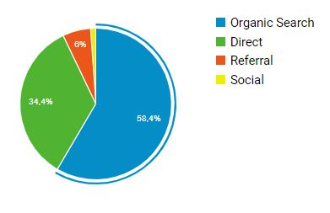
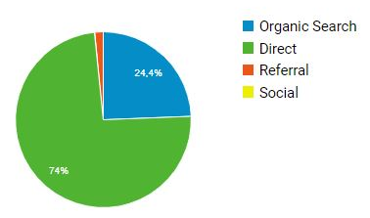
CHANNELS
2021
CHANNELS | 2,030 visits
Organic Search (Search Engine results) | 1,225 (58,4%) +419,25 compared to 2020
Direct Landing pages visit by direct typing into browser, bookmarks… | 722 (34,4%)
Referral Sites that refer oneM2M website (hyperlink) | 126 (6%)
Social Networks Twitter, LinkedIn | 23 (1,1%)
2020

Slide 6
Social Media
LinkedIn:
1,158 followers, +18
173 visits
9 posts
Twitter:
1,392 followers, +11 121 visits 39 Tweets

