Slide 1
Marcom 102
December 2021

Slide 2
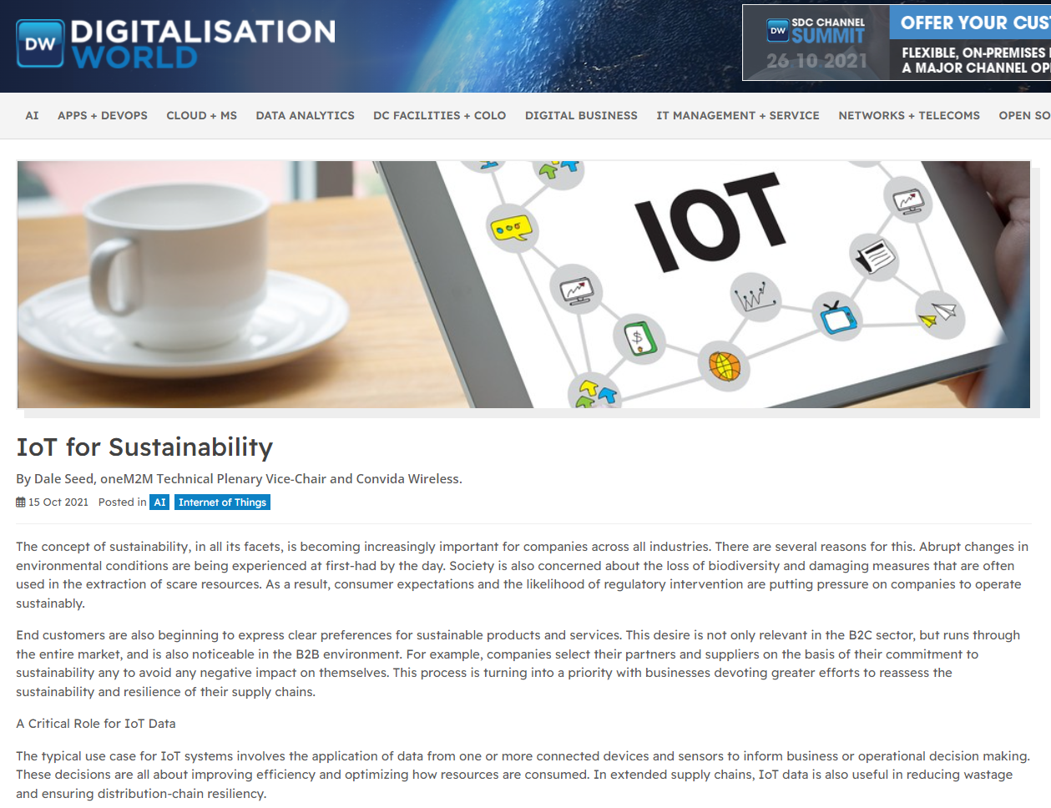
Feature coverage highlights
An article on the topic of IoT and sustainability has been published in Digitalisation World.

Slide 3
Upcoming editorial opportunities
The Manufacturer is interested in comments from oneM2M on how manufacturers can adopt older devices for Industrial IoT.
The next contribution for IoT for All is planned for early 2022.

Slide 4
Monitoring for coverage
Comments on Industrial IoT have been submitted to AI Magazine. Coverage expected in January 2022

Slide 5
Speaker opportunities
Event | Date | Physical or virtual | Panel or topic information
Embedded Technology Convention ASIA | 19-20 January 2022 | Physical, Singapore | Speaker volunteer received from oneM2M. Proactive PR is awaiting information from the event.
Embedded Technology Convention USA | 8-9 June 2022 | Physical, Las Vegas | Speaker volunteer received from oneM2M. Proactive PR is awaiting information from the event.
IoT Virtual Summit | TBC (organisers in the process of confirming) | Virtual | Shane He will be presenting on the topic of oneM2M architecture and IoT security.

Slide 6
Speaker opportunities
We are currently conducting event outreach to secure new speaking opportunities in industries such as IoT, automation, smart cities etc.

