Slide 1
oneM2M website analytics
Estelle Mancini, MARCOM Secretary 23 February 2022

Slide 2
Monthly overview
1,671 Users + 285 % since 2021 (at least one session)
1,497 news users +298% since 2021 (first time users)
6,508 page views +283% since 2021 (total number of pages)
Figures have been stable for the past 3 months
Per month Average of 1,500/1,600 visits Average of 1,500 new users Average of 6,000/6,500 pages views

Slide 3
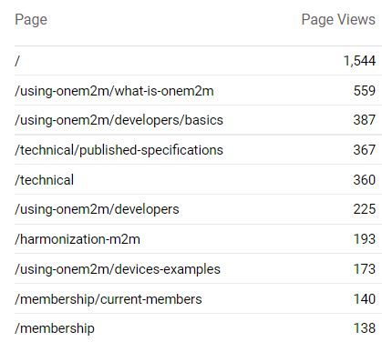
Top 10 pages

Slide 4
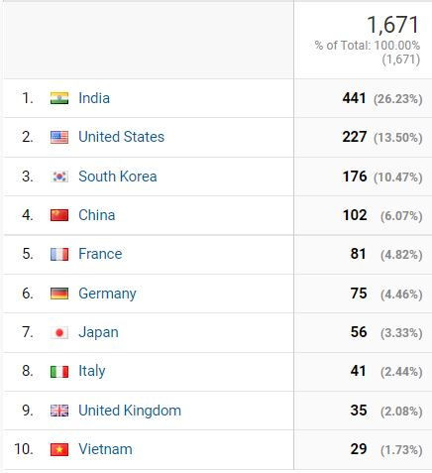
Top 10 countries

Slide 5
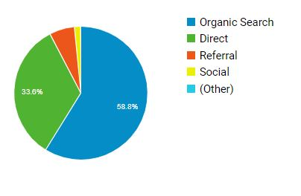
CHANNELS
2022
CHANNELS | visits
Organic Search (Search Engine results) | 1,018 +11,25% compared to 2021
Direct Landing pages visit by direct typing into browser, bookmarks… | 581
Referral Sites that refer oneM2M website (hyperlink) | 105
Social Networks Twitter, LinkedIn | 26

Slide 6
Social Media
LinkedIn:
1,181 followers, +23
170 visits
7 posts
Twitter:
1,400 followers, +8 927 visits 41 Tweets

