Slide 1
Updates for Marcom 104
Bindoo Srivastava/Aurindam Bhattacharya
24 March 2022

Slide 2
Overview
Key Highlights – YTD CY22
Website and SM Engagement –Analytics
10 years Anniversary Celebration
Where are we after 10 years?
What is expected from MARCOM Committee?
Proposed Strategy and Action Plan for CY22

Slide 3
Key Highlights – CY’22
Publications –
2 articles (ETSI Enjoy Jan’22, Voice & Data Feb’22), 4 in pipeline
1 interview published, 4 in pipeline
ABI Research conducted an interview with oneM2M for their Smart Cities research program and it is likely that oneM2M will be referenced in their March publication
PR by Govt. of India on the TEC Webinar – where oneM2M was showcased
Media Coverage (TEC Webinar – several leading news agencies)
Activities Tracker link
VISIBILITY | oneM2M | Partner driven | Regional
Events | - | 3 Webinars conducted under India-EU PP (ETSI-TSDSI)
Speaking Oppprtunities | 2 in pipeline | 3 in pipeline | 2 trainings at NTIPRIT, DoT, GoI TEC (India) webinar on Stds based Smart City Solutions
Notes:
Speaking Opps in Pipeline:
9 March Shane HE – IoT Virtual Summit
7 April and 29/30 Apil: DoT (Govt of India)-TSDSI Webinar on IoT/M2M for Select Verticals (part of a series)
28 March NTIPRIT (Govt of India)-TSDSI webinar on IoT/M2M Technologies
Rana (BT) speaking at IoT World Forum 2022

Slide 4
Website and SM Engagement
WEBSITE
Spurt in Organic Search
Website visits in Jan-Feb has reduced as compared to H2’21 (after Jun’21 when the new website was launched). (See the Feb analytic). Spain dropped off in Jan-Feb.
Visit by country: In Dec had visits from Turkey and Taiwan; and from Vietnam in Jan -Feb
Top 10 page views- being analysed (Question – Where does Executive insights/news page views show in stats?)
LinkedIN
followers 1195 (as of 17/03/2022); followers from students and product management community gaining traction
posts till 1March : 3 posts YTD
Twitter
Followers - 1398 (as of 17/03/2022) – 12+31 posts till 1Mar’22

Slide 5
Celebrate 10 Years of oneM2M
Strategy?
TP #56 In September 2022 in ETSI?

Slide 6
10 years of oneM2M – Where are we?
Adoption:
Deployment (pilots & commercial) trends
Engagement:
Project level – Regionwise/Verticals;
User Community/System Integrators/Solution and Service providers
Availability and growth in Devices/Products/Solutions,
Compliance and Certification ecosystem
How can we make oneM2M easy to adopt by Developers/System Integrators et al
perceived to be difficult by developers (niche skill set)
oneM2M Quick Start self learning videos? on linkedIN/Youtube
Notes:
Is focus on Market Development required?

Slide 7
Expectations from MARCOM?
Seek SC- TP inputs on any specific expectations from MARCOM?
Examples:
Market Development ?
Demystify the framework for developers
Engage Decision makers to adopt oneM2M
Our ASK: Need more oneM2M Experts from the project to contribute towards messaging/content (1 person hour in CY’22?)

Slide 8
Tentative Proposed Goals CY’22
GOALS?
provide sustained market visibility for oneM2M;
to increase the understanding of oneM2M both as a technical standard and as an organization for developing and maintaining a standardization roadmap; and,
to illustrate applications of oneM2M that will educate potential users develop the market for oneM2M solutions.
MARCOM + Market Development?
Key themes/campaigns
How to enhance engagement of the developer and technology community with oneM2M across partners and regions.

Slide 9
Proposed Action Plan CY’22
Milestones:
Celebrate 10th Anniversary of oneM2M
Mark World IoT Day (9th April)
Around Rel 4/5?
Thought Leadership:
Executive Viewpoints, White Papers, Strategic/oneM2M Level events
Tactical-
Collaterals (Corporate Brochure, Presentations etc.)
Visibility – Events, Speaking Opportunities
Events/Activities Calendar for common visibility at link here

Slide 10
Reference Slides

Slide 11
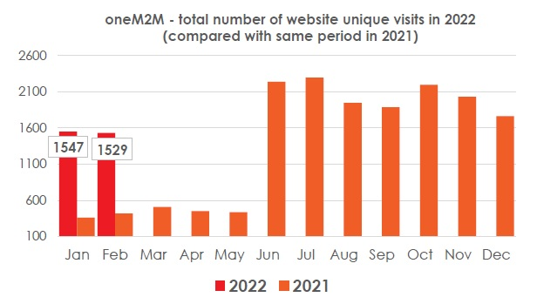
Monthly overview & 2021 vs. 2020
Website visits in Jan-Feb has reduced as compared to H2’21 (after Jun’21 when the new website was launched). (See the Feb analytic).

Slide 12
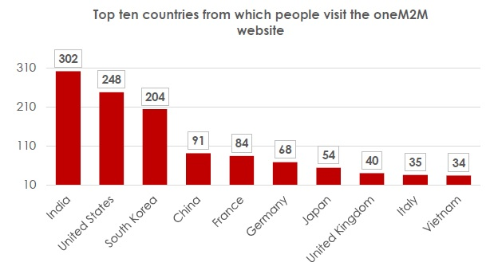
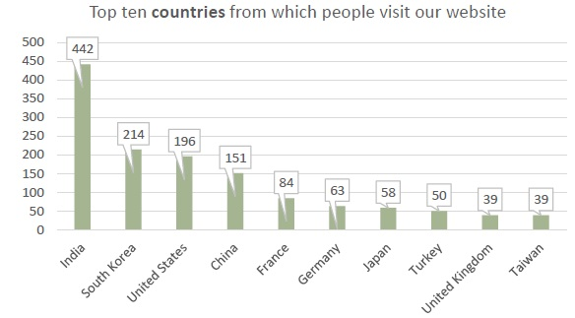
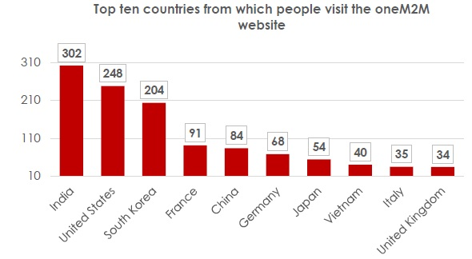
Monthly overview & 2021 vs. 2020
Visit by country: In Dec had visits from Turkey and Taiwan; and from Vietnam in Jan –Feb
Spain dropped off in Jan-Feb.
Jan 2022
Dec 2021
Feb 2022

Slide 13
Top 10 pages
Top 10 page views- being analysed. Executive insights/news page where does this show in stats?

Slide 14
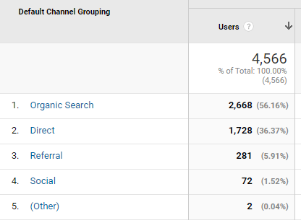
CHANNELS
This is the engagement by channel for the last 3 months (1 December 21 to 28 February 22):

Slide 15
Social Media
No. of Followers on LinkedIN: 1195 (as of 17/03/2022)
LinkedIN Posts on till 17 March : 3 posts YTD ill 1 March
No. of followers on Twitter: 1398 (as of 17/03/2022) – 12+31 posts till 1Mar’22

Slide 16
Thank You

