Slide 1
Updates for Marcom 105
Bindoo Srivastava/Aurindam Bhattacharya
21 April 2022

Slide 2
oneM2M Overview Video
oneM2M Video is now ready to be launched - https://www.youtube.com/watch?v=5-gXAyYakJE&ab_channel=oneM2M
Next Steps
Approval
Upload on Website
Promote

Slide 3
Status of Open Action Items
ACTION MARCOM104 #01: TSDSI to send the information on India EU PP Webinars to Karen for uploading on oneM2M website.
ACTION MARCOM104 #02: Clarify meaning of organic search
This means traffic from search engine
ACTION MARCOM104 #03: Ken will create a calendarized postings schedule tracker sheet for Linkedin from where the admin can pick content and post on the scheduled date.
ACTION MARCOM104 #04: Explore feasibility of tracking number of specification downloads from oneM2M website, profile of visitors. Explore if cookies can be used to enable this.
Downloads information is available. Cookies – being explored.
ACTION MARCOM104 #05: Check for budget for a celebratory social event be organised to mark the 10th anniversary of oneM2M at the Sep’22 TP?
There is no budget earmarked.

Slide 4
Status of Open Action Items (cont’d)
ACTION MARCOM104 #06: Karen to help with contact details of all oneM2M chairs, VCs and other experts who could be contacted.
ACTION MARCOM104 #07: Complete the video before Sep’22 TP - 10th anniversary celebration.
Final Video tabled MARCOM #105 for approval
ACTION MARCOM104 #08: Identify ways to promote the WIKI pages - signature line of oneM2M folks? Etc...
ACTION MARCOM104 #09: Make short duration videos for audiences on self-learning videos for getting started with oneM2M
ACTION MARCOM104 #10: Share contracts of MARCOM consultants with partners for comments and suggestions.
ACTION MARCOM104 #10: The secretary to conduct a doodle poll for deciding on the new timings for the future meetings.

Slide 5
Website and SM Engagement
WEBSITE
Website visits in March improved slightly : oneM2M related events including in India
Visit by country: India max. ; Vietnam figured in Jan-Feb; Singapore new addition in March – how to leverage?
Top 10 page views- being analysed
Executive Insights – 106 max. to 14 in Dec. visits despite no new content
Feasibility of using cookies is being explored
oneM2M News : 1199 subscribers to oneM2M NEWS
LinkedIN
1204 (on 1st Apr’22, gained 20 in the previous month
10 Posts till YTD till 1st April (7 new posts in previous month)
Twitter
Followers - 1400 (as of 01/04/2022) – gained 2 followers in Mar’22
84 tweets YTD ‘CY’22 (41 in previous month)

Slide 6
Key Highlights – CY’22: Thought Leadership - @AKASH
Publications: 4 articles
Global Journals
Paper in IEEE Internet of Things Journal;
Trade Journals
oneM2M and sustainability - IoT Business News;
ABI Research conducted an interview with oneM2M for their Smart Cities research program and it is likely that oneM2M will be referenced in their March publication
Regional
Feature in National Post, Canada)
Partner Communiques
ETSI Enjoy - Addressing Societal Challenges with IoT
Interviews:
(UCL standardization study),
Pipeline: May -1; June -2
Executive Insights
Interview about UCL standardization study published on 7th April 2022
oneM2M in the News
Press Releases – NIL
Media Coverage – information not available
Dedicated Email address to which media queries are routed - oneM2M_PressMedia@list.onem2m.org being forwarded to Bindoo/Aurindam/Ken/Akash
Activities Tracker link
Notes:
- 21 Apr: Webinar on CCSP and CoSMiC - indigenous software platforms for M2M/IoT Communication
- 7 April and 4May : DoT (Govt of India)-TSDSI Webinar on IoT/M2M for Select Verticals (part of a series)
- 28 March NTIPRIT (Govt of India)-TSDSI webinar on IoT/M2M Technologies
Speaking Opportunities -
- Rana (BT) speaking at IoT World Forum 2022
PR Proactive- 8-9 Jun: Embedded Technology Convention, Las Vegas (Speaker volunteer from oneM2M recvd, awaiting revert from organisers)
28-29 Sep: Embedded Technology Convention, Singapore??
- Interviews in pipeline - Interview with TCS (DigiFleet), SMARTM2M study on IoT data for AI and Mauro Dragoni STF602 interview

Slide 7
Article Suggestion from Joachim Koss
An article in ETSI Magazine ENJOY!, which tells the success story of ETSI TC SmartM2M supporting oneM2M specifying a new important feature for its Release 5.
The next edition of Enjoy! magazine is focused on AI so this information may not be appropriate at the moment.
How do we publicise this work ?
Suggestions
Easy (and within oneM2M control): post 3 summaries on LinkedIn, one from ETSI, another from oneM2M and a third from Joachim (slightly different text to highlight different aspects of the project).
Medium: Would ETSI publicize it via a Press Release? Given ETSI’s wide distribution network – could generate greater coverage.
Joachim draft a 1-page summary of the project with links to the published material? oneM2M could post that as an item in the News section.
More time Consuming (and outside of oneM2M control):
- Article (would require us to find a magazine/web site willing to cover the topic) and Joachim would need to draft the article.
- Webinar - this depends on Joachim agreeing to develop and deliver a webinar

Slide 8
Key Highlights – CY’22: Events and Speaking Opportunities - @AKASH
VISIBILITY | oneM2M | Partner driven | Regional
Events | - | TSDSI- A webinar conducted by DoT-TSDSI on M2M for transport vertical on 7 Apr’22 ETSI: EU-Brazil Bilateral | 1 Webinar on Indigenously developed oneM2M platofrms in India -21 Apr’22;
Speaking Opportunities | 2 in pipeline | 3 in pipeline | NTIPRIT, DoT, GoI Conference on M2M held on 28 Mar’22
World IoT Day (9th April) – message from Roland And Enrico was put out on LinkedIn and Twitter :
Wishing you a very happy “World IoT Day 2022"
The open and agile IoT standards from the oneM2M Global Standard is the key to a secure, sustainable and interoperable IoT World
Enrico Scarrone (Telecom Italia), Chair – Steering Committee and Roland Hechwartner (Deutsche Telekom), Chair - Technical Plenary
Activities Tracker link
Notes:
- 21 Apr: Webinar on CCSP and CoSMiC - indigenous software platforms for M2M/IoT Communication
- 7 April and 4May : DoT (Govt of India)-TSDSI Webinar on IoT/M2M for Select Verticals (part of a series)
- 28 March NTIPRIT (Govt of India)-TSDSI webinar on IoT/M2M Technologies
Speaking Opportunities -
- Rana (BT) speaking at IoT World Forum 2022
PR Proactive- 8-9 Jun: Embedded Technology Convention, Las Vegas (Speaker volunteer from oneM2M recvd, awaiting revert from organisers)
28-29 Sep: Embedded Technology Convention, Singapore??
- Interviews in pipeline - Interview with TCS (DigiFleet), SMARTM2M study on IoT data for AI and Mauro Dragoni STF602 interview

Slide 9
Potential Key Events /Speaking Opps
Proactive PR 9 Mar’22 IoT Virtual Summit:: Shane HE could not be availed
Rana (BT) speaking slot at IoT World Forum 2022 - TBC
Potential Global and Regional Events
IEEE 8th IoT World Forum (26 Oct-11 Nov’22 // Yokohama, Japan (in person and hybrid)
ASIA CCS '22: ACM Asia Conference on Computer and Communications Security Nagasaki, Japan 30 May- 3 Jun’22
Futurecom 2022 : 18-20 Oct’22, Sao Paulo, Brazil
Australia’s Internet of Things conference 9 Jun’22,Melbourne
ETSI IoT Week
Korea IoT event
TSDSI Tech Deep Dive 2022
India Mobile Congress IMC 2022
Request partners to share information about their events and speaking opportunities
Notes:
- 21 Apr: Webinar on CCSP and CoSMiC - indigenous software platforms for M2M/IoT Communication
- 7 April and 4May : DoT (Govt of India)-TSDSI Webinar on IoT/M2M for Select Verticals (part of a series)
- 28 March NTIPRIT (Govt of India)-TSDSI webinar on IoT/M2M Technologies
Speaking Opportunities -
- Rana (BT) speaking at IoT World Forum 2022
PR Proactive- 8-9 Jun: Embedded Technology Convention, Las Vegas (Speaker volunteer from oneM2M recvd, awaiting revert from organisers)
28-29 Sep: Embedded Technology Convention, Singapore??
- Interviews in pipeline - Interview with TCS (DigiFleet), SMARTM2M study on IoT data for AI and Mauro Dragoni STF602 interview

Slide 10
Celebrate 10 Years of oneM2M @ TP56 (Sep’22) in ETSI
Conduct dedicated Executive Interviews of oneM2M Stakeholders,
Post short congratulatory videos -
from oneM2M SC/TP veterans
Explore obtaining a (video) anniversary greeting from ITU-T expert contact- Cristina Bueti
Secure congratulatory messages from Partner organizations
Articles on oneM2M milestones and key accomplishments over last 10 years
Mark Interops/Liaisons with ITU and 3GPP
Animated slides about timeline of releases with capability/features
oneM2M Showcases - at Events + deployments /pilots/trials (ETSI IoT Week. Korea IoT events
Article from experts who have attended all oneM2M meetings from the beginning, especially JaeSeung Song and Roland Hechwartner.
10 years anniversary + oneM2M Excellence Award for 2022
Felicitate oneM2M Veterans?
Form a sub-team to Action and assign responsibilities

Slide 11
Initial Impressions from interactions with a few Stakeholders (WIP)
External Visibility not good
oneM2M has very advanced Specifications. In step with latest technology trends: AI-Digital Twins- Metaverse etc.
Basic scope of IoT platform already covered in Rel 2.
Further enhancements – fierce competition/not perceived to be required from oneM2M.
Many folks don’t need the advanced features of oneM2M Yet.
Users do not seem to mind services based on “proprietary” solutions. Full End to End solutions available from big players
Big challenge is not competing standards but proprietary cloud based end to end solutions. CSPs are rapidly already moving to the edge also.
Participation has always been limited – niche scope?
Resource availability constraints due to parallel initiatives
Membership drop- lack of quick Wins so far
Information on oneM2M compliant devices/implementations is lacking.
The Vast Educational material not easily discoverable.
Industry Days used to be good vehicles for education/awareness.
oneM2M allows outsourcing of the middle layer
Initial wish was to consolidate the market- but rather it has fragemented more. However, since the big players also have a very small chunk o the market hare, window to consolidate is still open.

Slide 12
Suggestions based on Initial interactions with few Stakeholders (WIP)
External World selling required (Let other people know what we are doing)
Target – Developers, Decision makers
User Community/System Integrators/Solution and Service providers
Leverage Global/established conferences to speak/promote (Example -IEEE-ACM, IEEE Globecom/ICC, IoT/Smart City Events
Explore Regions - LATAM, Africa, Australia, SEA (Vietnam, Singapore….)
Reuse content to optimise efforts for enhancing external visibility
Enhance Wiki
oneM2M Quick Start self learning videos? on linkedIN/Youtube
Showcase Devices/Products/Solutions, Deployments
Compliance and Certification ecosystem
Do we want to relook at the name oneM2M ?

Slide 13
Reference Slides

Slide 14
Monthly overview
Website visits in March has slightly increased as compared to Jan-Feb’22. However, overall trend is decreasing.
Add a line graph on no. of downloads

Slide 15
Country wise overview Monthly 2022
Vietnam dropped off in March. Singapore introduced in Mar’22

Slide 16
Specifications downloads

Slide 17
Top 10 pages – homepage is nearly double of other pages: do the others go to portal?

Slide 18
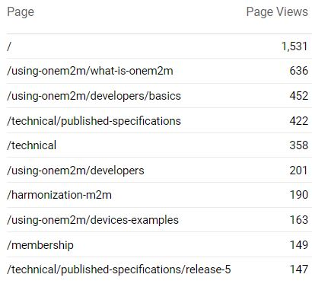
Top 10 pages

Slide 19
Executive Viewpoints

Slide 20
Executive (line chart for interviews published, bar graph for views)
 | Total | /membership/executive-viewpoints | Insights published
Page | Page Views | Page Views
/membership/executive-viewpoints | 405 | 405
 | 405 | 405
Month Index | Page Views
June 2021 | 74 |  | 2
July 2021 | 27 |  | 1
August 2021 | 25 |  | 1
Sept 2021 | 42 |  | 1
October 2021 | 45 |  | 1
November 2021 | 106 |  | 1
December 2021 | 14 |  | 0
Janvier 2022 | 17 |  | 1
February 2002 | 28 |  | 0
March 2022 | 27 |  | 2
April 2022 |  |  | 1
 | 405

Slide 21
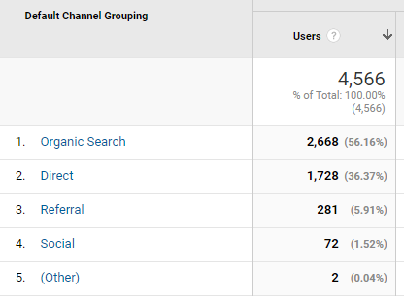
CHANNELS – data not updated in Apr’22
This is the engagement by channel for the last 3 months (1 December 21 to 28 February 22): (data for March could not be obtained)
organic search” Traffic from search engine results
Direct: (does this mean someone types in oneM2M and/or onem2m.org?): No this is organic search. “Direct” is any traffic where the referrer or source is unknown
Referral: (does this mean - someone is referred to oneM2M website/page from another webpage where oneM2M related link is embedded?): YES
Social: (does this mean -someone clicks on oneM2M link embedded in a Tweet/linkedIn post).: YES

Slide 22
Twitter Metrics
TWITTER | Jan 22 | Feb 22 | Mar 2022
Tweets | 12 | 31 | 41
Tweet Impressions | 4035 | 4209 | 5998
Profile visits | 875 | 690 | 1128
Mentions | 14 | 23 | 34
New Followers | 4 | 5 | 2
LinkedIn | Jan 22 | Feb 22 | Mar 22
Posts | 3 | 0 | 7
Followers | 1176 | 1184 | 1204

Slide 23
MARCOM 104 updates

Slide 24
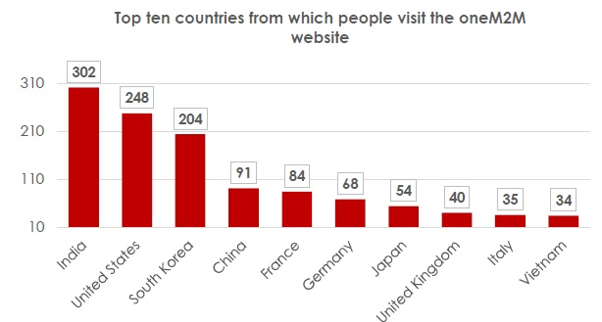
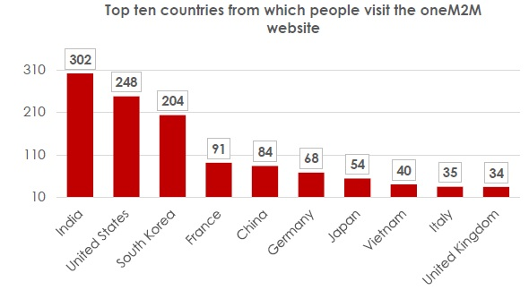
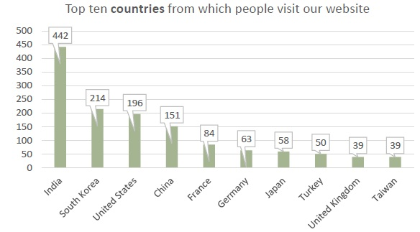
Monthly overview & 2022
Jan 2022
Feb 2022
Dec 2021
Visit by country: Vietnam dropped off in March. Got Singapore
Analyse Singapore (mail to Sabine, Ken and Aurindam cc. to Nadja and Karen) – Analyse origin of traffic – to retain interest.

Slide 25
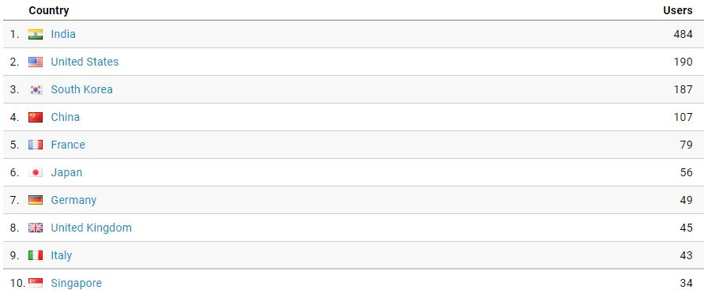
Country wise overview Monthly 2022
Visit by country: Vietnam dropped off in March. Got Singapore

Slide 26
Top 10 pages (TBU – bar graph)
Top 10 page views- being analysed. Executive insights/news page where does this show in stats?

Slide 27
Executive (line chart for interviews published, bar graph for views)
 | Total | /membership/executive-viewpoints | Insights published
Page | Page Views | Page Views
/membership/executive-viewpoints | 405 | 405
 | 405 | 405
Month Index | Page Views
June 2021 | 74
July 2021 | 27
August 2021 | 25
Sept 2021 | 42
October 2021 | 45
November 2021 | 106
December 2021 | 14
Janvier 2022 | 17
February 2002 | 28
March 2022 | 27
 | 405

Slide 28
Thank You

