Slide 1
Marcom Report to TP# 54
Bindoo Srivastava
9 May 2022

Slide 2
Overview
Key Highlights – CY22
MARCOM action Plan for CY22
Where are we after 10 years?
Expectations of TP from MARCOM

Slide 3
Key Highlights
NEW:
oneM2M Overview Video – click here
4 Executive Insights published – visit link here
Publications in Global Journals, Trade periodicals, Regional press and Partner Communiques
Activities Tracker link

Slide 4
Key Events & Speaking Opps
VISIBILITY | oneM2M | Partner driven | Regional
Events | 10th Anniversary Related –being planned | TSDSI –DoT webinar series on IoT/M2M for select verticals ETSI: EU-Brazil Bilateral (InDiCo) ETSI IoT Week TTA - Korea IoT Week TSDSI Tech Deep Dive 2022 | India: A Webinar on Indigenously developed oneM2M platforms in India in Apr’22 India Mobile Congress 2022
Speaking Opportunities | 2 in pipeline | 3 in pipeline | India: NTIPRIT (DoT, GoI) Conference on M2M – held on 28 Mar’22 IEEE 8th IoT World Forum (26 Oct-11 Nov’22 || Yokohama, Japan Futurecom 2022||18-20 Oct’22|| Sao Paulo, Brazil AfricaTech 2022

Slide 5
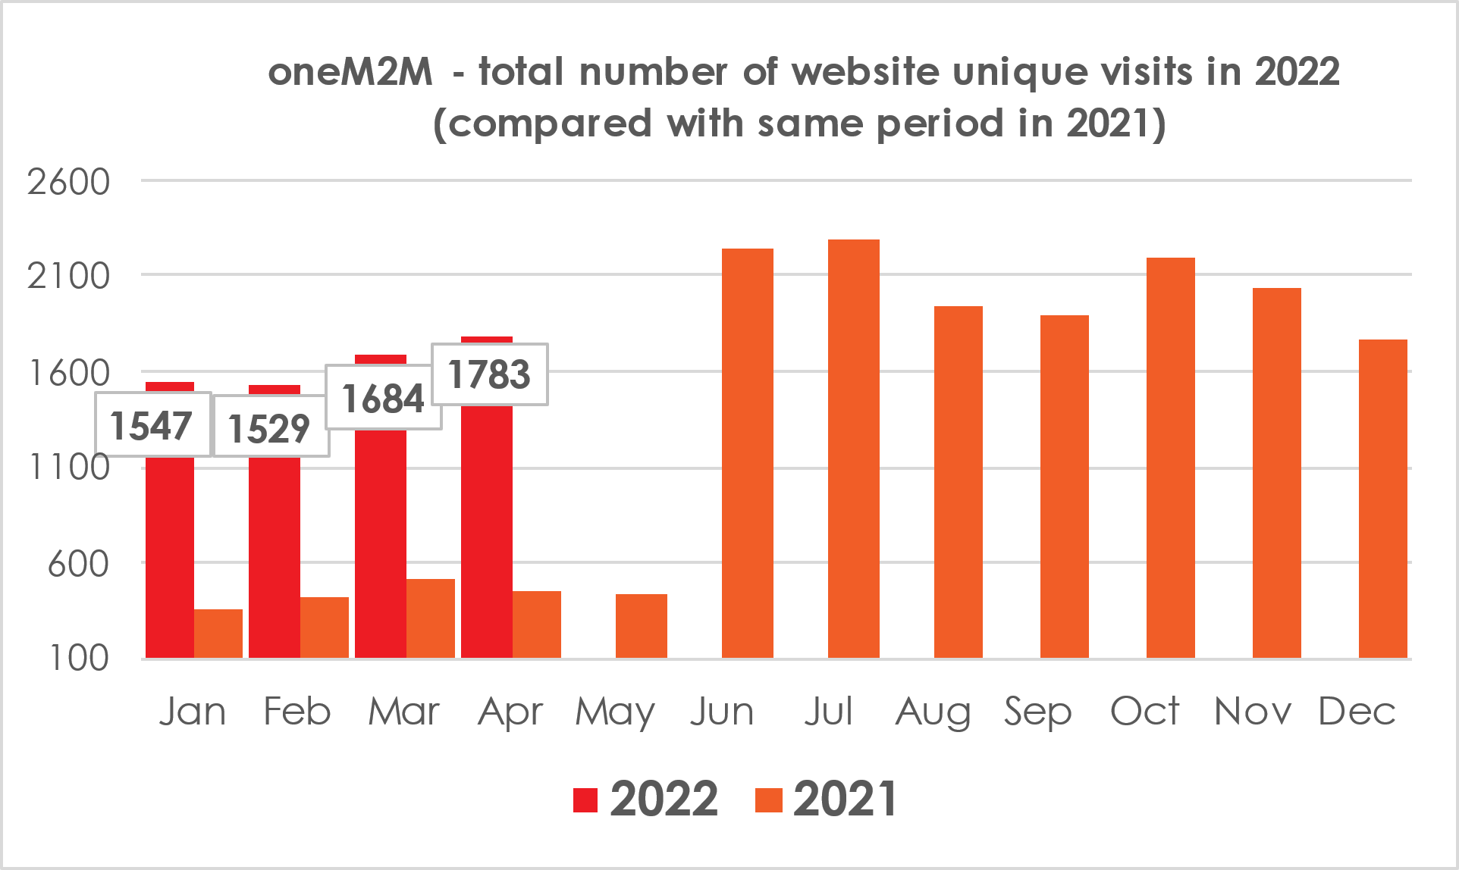
Website Engagement
Monitoring Website visits , # downloads of specs, Top 10 page views, Executive Insights and WiKi
Visits by country
Jan-22 | Feb-22 | Mar-22 | Apr-22
India | India | India | India
United States | United States | United States | South Korea
South Korea | South Korea | South Korea | United States
France | China | China | China
China | France | France | France
Germany | Germany | Japan | Germany
Japan | Japan | Germany | Japan
Vietnam | UK | UK | UK
Italy | Italy | Italy | Canada
United Kingdom | Vietnam | Singapore | Vietnam

Slide 6
Social Media Engagement
1199 subscribers to oneM2M NEWS (as on 1st Apr’22)
LinkedIN
1221 (on 1st May22 –58 new YTD CY’22)
17 Posts YTD CY’22
Twitter
Followers - 1407 (on 1st May’22–15 new YTD CY’22)
135 tweets YTD ‘CY’22

Slide 7
MARCOM Action Plan CY’22
Celebrate 10th Anniversary of oneM2M
Actively seeking speaking Opportunities in Global /Regional Events
Promote the oneM2M WiKi
Short video tutorials on oneM2M
Strategic/oneM2M Level events

Slide 8
10th Anniversary Celebrations
oneM2M was launched on 24th July 2012
First TP meeting held in ETSI in Sep 2012
Dedicated Executive Interviews of oneM2M Stakeholders
Short congratulatory videos -
from oneM2M SC/TP veterans
Explore obtaining a (video) anniversary greeting from ITU-T expert contact- Cristina Bueti
Secure congratulatory messages from Partner organizations
Articles related to oneM2M journey
oneM2M Veterans views

Slide 9
10 years of oneM2M –Introspection
Adoption:
Deployment (pilots & commercial) trends
Engagement:
Project level – Region wise/Verticals;
User Community/System Integrators/Solution and Service providers
Availability and growth in Devices/Products/Solutions,
Compliance and Certification ecosystem
How can we make oneM2M easy to adopt by Developers/System Integrators et al
perceived to be difficult by developers (niche skill set)
oneM2M Quick Start self learning videos? on linkedIN/YouTube

Slide 10
Expectations from MARCOM?
What are TP expectations from MARCOM?
Examples:
Market Development ?
Demystify the framework for developers
Engage Decision makers to adopt oneM2M
Need more oneM2M Experts from the project to contribute towards messaging/content (1 person hour in CY’22?)

Slide 11
Thank You

