Slide 1
Marcom Report
Bindoo Srivastava
TSDSI
26 May 2022

Slide 2
Outline
Summary from MARCOM-TP Adhoc sessions held in TP54
Preparations for celebrating 10th Anniversary of oneM2M
Updates
Thought Leadership – Articles
Engagement – Interviews, Exec Insights
Visibility - Events, Speaking Opps,
Website, WiKi, Social Media
Communiques
PRs and Media

Slide 3
Summary from TP#54-MARCOM Adhoc Session

Slide 4
TP54-MARCOM Ad-hoc discussion
Ad-hoc sessions held on 10th , 12th and 13th (with online participation) to discuss status of oneM2M adoption (e.g. devices and appliances, software stacks for new and existing embedded environments…) and plans for future development.
Non decision making sessions
Reference documents:
MARCOM Presentation made to TP opening plenary, from Bindoo Srivastava, oneM2M MARCOMS Chair
oneM2M Development and Directions from Prof JaeSeung Song. KETI

Slide 5
Summary of Discussions - SWOT
Strengths Interworking Data sharing across diverse applications Highly mature CORE and Rich feature set that is growing | Opportunities SMART CITIES Smart cities want to monetise their data Scalability support
Weaknesses Poor Visibility oneM2M may have been implemented but not being declared | Threats Offerings from Big players – end to end even if walled garden Competition- other forums, Service Providers owned platforms
Experiences gained from engagements in LATAM, Japan, Korea, India were shared

Slide 6
Suggested Recommendations -WIP (1 of 2)
Engage with Policy makers/Govts. to mandate Standards (that support interworking) for applications : MRO/Associate Member options?
Speaking slots in ITU-T SG20?
Engage with ISO/IEC JTC1
Leverage Industry Days – recast to engage users
Consider organising a oneM2M Flagship/branded Event
IoT 2.0 – concept
Consumer IoT is a focus topic of interest among stakeholders
Data privacy and security
Focus only on select items to best utilise limited resources
Pro-active marketing: Go directly to Smart Cities

Slide 7
Suggested Recommendations – WIP (2 of 2)
Develop oneM2M Talent Pool:
Engage with interested entities discovered in the earlier IoT/oneM2M events
Learning materials
short tutorials being developed by Andreas Kraft –Ken;
oneM2M “handbook” by TTA
Documentation –
Make it easy for Developers to read the specs – like referencing to specific sections in docs.
Consider using tools that support editing and version management – with integrity checks et al to prevent errors introduced in manual
Input from JaeSeung could not be discussed due to paucity of time
Propose to organize further joint TP-MARCOM adhoc sessions to refine the recommendations and come out with an action plan
Feedback from SC61 Chair (Enrico): We should analyse data on members who have left and contributing experts who have now disengaged. How do we get them back?
Specifically Engage with Adopters of Standards - Solution and Service Providers as a Target Segment.

Slide 8
10th Anniversary Celebrations - Plan

Slide 9
Plan for Celebrating 10 Years of oneM2M
Event | Activities
Launch Celebrations: 24-26th Jul 2022 | Website and SM announcements – banner + key messages + article on flashback oneM2M
Felicitate SC Stalwarts: 27th Jul 2022 | SC62 – Felicitate Past SC Leaders
Revisit TP#1 in ETSI HQ: 26-30 Sep’22 | TP 56 – Felicitate long serving experts and Past TP leaders Launch oneM2M Short Videos Series for Developers Sponsored Social Event?
oneM2M Conference: Week of 2-9 Dec’ 22 | Exploring a 2*0.5 days Hybrid Conference with support from TTA in Seoul colocated with Interop Event (thank you Keebum!) Launch the oneM2M Handbook (translated into English from Korean)?
MARCOM will reach out to SC members to solicit “messages”, inputs for the flashback article etc.
Thank you Andreas Kraft and Ken for already working on the Short Videos Series for Developers
Volunteer Sponsors for the Social Event?

Slide 10
Detailed Plan
Refer document MARCOM-2022-0014-oneM2M_10_yrs_anniversary_plan

Slide 11
Website & Social Media Engagements

Slide 12
Highlights (since Marcom 105)
Thought Leadership: Articles 1 Published (Total 10 YTD CY’22), 5 in Pipeline
Engagement:
1 new Executive Insight published (Total 05 YTD CY’22), 5 in Pipeline
Visibility:
Events Total organised ( NIL @oneM2M, 05@Partner, 07@ Regional level)
Speaking Opportunities – 08 availed
Social Media:
1407 Twitter followers (+4 in April), 37 posts
1221 LinkedIn followers (-3 in April), 7 posts
Communiques & PRs:
oneM2M in the News – 1197 followers
PRs issued – 2
Activities Tracker link

Slide 13
Press Coverage
Apr'22 | Apr'22
1 | https://iotbusinessnews.com/2022/04/06/71164-iot-and-sustainability/ | 6 Apr'22
May'22 | May'22
1 | https://english.newstracklive.com/news/iiit-hyderabad-hosts-an-iot-and-onem2m-workshop-sc75-nu318-ta318-1228945-1.html | 16 May'22
2 | https://www.indianweb2.com/2022/05/iiit-hyderabad-organised-workshop-on.html | 16 May'22
3 | https://www.thehansindia.com/hans/young-hans/iiit-h-organises-workshop-on-iot-onem2m-743104 | 17 May'22
4 | https://www.telecompaper.com/news/c-dot-vodafone-idea-strike-iotm2m-partnership-deal-in-india--1424837 | 19 May'22

Slide 14
VISIBILITY – Events & Speaking Opportunities
VISIBILITY | oneM2M | Partner driven | Regional
Events | - | 28th April 2022: EU - Republic of Korea cooperation workshop on IoT and Smart Cities | 4 May: DoT-TSDSI Webinar #2 on M2M applied to Utilities
Speaking Opportunities | 2 in pipeline | - 20~22 Oct TTA - IoT Week Korea - 20 Oct TTA seminar for oneM2M 10 years anniversary - ETSI IoT Week 2022 | 1 in pipeline (12-15 Oct: The 2nd International Conference on AI-ML-Systems (AIMLSystems'22), Bangalore, India)
Bob Flynn to speak in the Embedded Technology Convention, Las Vegas , 8-9 June
Speaking Opportunity Open - 28-29 Sep: Embedded Technology Convention, Singapore
Social Media Significant posts: World Telecommunication and Information Society Day (17th May)
We are pleased to commemorate the founding of the International Telecommunication Union on 17 May 1865 and to celebrate World Telecommunication and Information Society Day 2022 with its emphasis on digital technologies for older persons and healthy ageing.
oneM2M, the global initiative for developing standards that enable interoperable, secure, and simple-to-deploy services for the IoT ecosystem, has addressed use cases related to Secure Remote Patient Care and Monitoring using IoT/M2M technologies in our Technical Report on Use Cases Collection (TR-0001-Use_Cases_Collection-V4_3_0) .
Activities Tracker link
Notes:
2 speaking opp. In pipeline -
Rana (BT) speaking at IoT World Forum 2022
PR Proactive- 8-9 Jun: Embedded Technology Convention, Las Vegas (Speaker volunteer from oneM2M recvd, awaiting revert from organisers)

Slide 15
Website - Visits
Vietnam, Canada, Singapore to be noted

Slide 16
Website - Top Pages

Slide 17
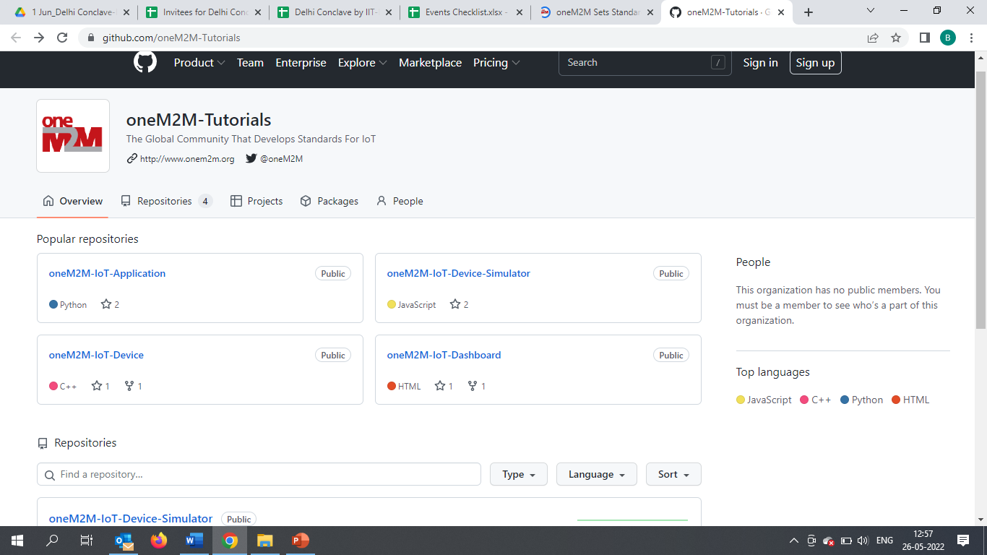
oneM2M WiKi
Teaching Material -
oneM2M Advanced Tutorial Full 2-day training to allow to build a complete IoT solution based on oneM2M
oneM2M Semantic Tutorial: An overview of semantics, applied to IoT and how using ontology can considerably enrich IoT applications and use cases.
oneM2M Hackster List of Hackster.io projects based on oneM2M. Some projects have been produced at the oneM2M International hackathon in Fall 2021.
IIIT Hyderabad MOOC:

Slide 18
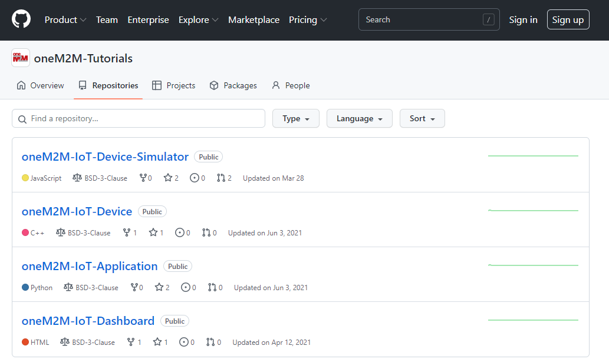
WiKi- Repositories

Slide 19
Specification Downloads & Exec Viewpoints
2 | 1 | 1 | 1 | 1 | 1 | 0 | 1 | 0 | 2 | 1
#Viewpoints published every month

Slide 20
Engagement by Channels – Mar - Apr’22
This is the engagement by channel for last 2 months :
Default Channel Grouping | Visits (Mar’22) | Apr’22
Organic Search | 1036 | 996
Direct | 573 | 682
Referral | 99 | 115
Social | 28 | 48
Organic: visitors that arrive from search engines by typing a keyword.
Direct: visitors arriving at website by typing the URL
into the address bar
Referral: someone referred to oneM2M website/page from another webpage where oneM2M related link is embedded
Social: someone clicks on oneM2M link embedded in a Tweet/LinkedIn post

Slide 21
Reference Slides

Slide 22
MARCOM Approach

Slide 23
MARCOM Approach
MARCOM Goals
Provide sustained Market Visibility for oneM2M;
to increase the understanding of oneM2M both as a technical standard and as an organization for developing and maintaining a standardization roadmap; and,
develop the market for oneM2M solutions.
Approach
Global (oneM2M level), Partner level and Regional activities
Articles & Speaking Opportunities in targeted journals/periodicals and Events
Support development of collateral for Developers
Interactions being held with Partner and oneM2M experts

Slide 24
Highlights YTD’CY22
oneM2M Overview Video launched (thank you Nadja and team for your efforts)
Thought Leadership: Articles 10 Published, 5 in Pipeline
Engagement:
1 Interview inputs published
5 Executive Insights published, 5 in Pipeline
Visibility:
Events 13 Total organised ( NIL @oneM2M, 05@Partner, 07@ Regional level)
Speaking Opportunities – 08 availed
Social Media:
1407 Twitter followers (+14 in CY’22), 165 posts
1221 LinkedIn followers (+66 in CY22), 18 posts
Communiques & PRs:
oneM2M in the News – 1197 followers
PRs issued – 1
Activities Tracker link

Slide 25
Thought Leadership – Articles
Global Journals
Paper in IEEE Internet of Things Journal
Trade Journals
oneM2M and sustainability - IoT Business News;
Open Standards article for Interoperability News EU
ABI Research interview with oneM2M for their Smart Cities research program
Comments on Industrial IoT submitted to AI Magazine
Regional
Feature in National Post, Canada)
Voice & Data, India Smart Cities Edition
oneM2M in context of smart cities for tele.net, India
Partner Communiques
ETSI Enjoy - Addressing Societal Challenges with IoT
ETSI Enjoy - IoT data for industrial verticals
Activities Tracker link

Slide 26
Potential Article Opportunities
Global Journals
IEEE Network Special Edition on Smart Communities (being explored)
Trade Journals
Article submitted to IoTforAll - "efficient IoT messages“
Second article for Interoperability News (with Enrico)
Magazine - Making IoT Intelligent
Regional
Partner Communiques
ETSI Enjoy (edition on AI)

Slide 27
Engagement – Interviews & Executive Insights
oneM2M in the News – 1199 Subscribers
Press Releases – NIL
Media queries to oneM2M_PressMedia@list.onem2m.org being forwarded to Bindoo, Aurindam, Ken, Akash
Interviews
Briefing discussion with ABI on Smart Cities (Roland, Bob, Dale, Ken)
Pipeline: June -2
Executive Insights
Roland on TP#52 - 5 Jan’22
Roland on TP#53 - 9 Mar’22
IoT and 6G interview with Onel Alcaraz López (Finland) 16 Mar’22
Interview about UCL standardization study 7 Apr’22
SMARTM2M study on IoT data for AI - Michelle W 25 May’22
Activities Tracker link
Notes:
- Interviews in pipeline - Interview with TCS (DigiFleet), SMARTM2M study on IoT data for AI and Mauro Dragoni STF602 interview

Slide 28
VISIBILITY – Events & Speaking Opportunities
VISIBILITY | oneM2M | Partner driven | Regional
Events | - | 18 Jan: ETSI-TSDSI Webinar on oneM2M “Risk/Benefit analyses” 25 Jan: ETSI-TSDSI Webinar on oneM2M ” Smart Lift private sector use case ” ETSI: EU-Brazil Bilateral 4 Feb: ETSI-TSDSI Webinar on oneM2M “Smart Home/Smart Building private sector use case” ETSI-Argentina talk on oneM2M 6 Apr: ETSI- EU-Brasil cooperation workshop : on IoT Policy, Regulation & Standards 28 Apr: ETSI-TTA Smart Cities in Korea TSDSI- A webinar conducted by DoT-TSDSI on M2M for transport vertical on 7 Apr’22 | 24 Feb: INDIA- TEC Organised webinar on oneM2M- Smart cities 28 Mar: NTIPRIT Conference on M2M 7-8 Apr: New Delhi India - InTranSe conference 21 Apr: Webinar on CCSP and CoSMiC - indigenous software platforms for M2M/IoT Communication 7 Apr: DoT-TSDSI Webinar #1 on M2M applied to verticals- transportation 4 May: DoT-TSDSI Webinar #2 on M2M applied to Utilities
Speaking Opportunities | 2 in pipeline | 5 in pipeline | 1
Social Media Significant posts:
Twitter posts to mark World IoT Day (9th April) and World Telecommunication and Information Society Day (17th May)
Activities Tracker link

Slide 29
Potential Key Events /Speaking Opps
Potential Global and Regional Events
Embedded Technologies Convention
IEEE 8th IoT World Forum (26 Oct-11 Nov’22 // Yokohama, Japan (in person and hybrid)
Futurecom 2022: 18-20 Oct’22, Sao Paulo, Brazil
ETSI IoT Week
Korea IoT event
TSDSI Tech Deep Dive 2022
India Mobile Congress IMC 2022

Slide 30
Initial Impressions from interactions with a Partner and oneM2M Stakeholders
External Visibility not good
oneM2M has very advanced Specifications. In step with latest technology trends: AI-Digital Twins- Metaverse etc.
Basic scope of IoT platform already covered in Rel 2.
Further enhancements – fierce competition/not perceived to be required from oneM2M.
Many folks don’t need the advanced features of oneM2M Yet.
Users do not seem to mind services based on “proprietary” solutions. Full End to End solutions available from big players
Big challenge is not competing standards but proprietary cloud based end to end solutions. CSPs are rapidly already moving to the edge also.
Participation has always been limited – niche scope?
Resource availability constraints due to parallel initiatives
Membership drop- lack of quick Wins so far
Information on oneM2M compliant devices/implementations is lacking.
The Vast Educational material not easily discoverable.
Industry Days used to be good vehicles for education/awareness.
oneM2M allows outsourcing of the middle layer
Initial wish was to consolidate the market- but rather it has fragemented more. However, since the big players also have a very small chunk o the market hare, window to consolidate is still open.

Slide 31
Suggestions based on Initial interactions with few Stakeholders (WIP)
External World selling required (Let other people know what we are doing)
Target – Developers, Decision makers
User Community/System Integrators/Solution and Service providers
Leverage Global/established conferences to speak/promote (Example -IEEE-ACM, IEEE Globecom/ICC, IoT/Smart City Events
Explore Regions - LATAM, Africa, Australia, SEA (Vietnam, Singapore….)
Reuse content to optimise efforts for enhancing external visibility
Enhance Wiki
oneM2M Quick Start self learning videos? on linkedIN/Youtube
Showcase Devices/Products/Solutions, Deployments
Compliance and Certification ecosystem
Do we want to relook at the name oneM2M ?

Slide 32
Thank You

