Slide 1
Marcom Report
Bindoo Srivastava
TSDSI
30 Jun 2022

Slide 2
Highlights (since Marcom 106)
Thought Leadership:
0 new Articles Published (Total 10 YTD CY’22), 5 in Pipeline
Engagement:
2 new Executive Insights published (Total 07 YTD CY’22), 4 in Pipeline, 2 planned
Visibility:
Events Total organized (NIL @oneM2M, NIL@Partner, NIL@ Regional level)
Speaking Opportunities – 3 availed since Marcom 106
Social Media:
1420 Twitter followers (+13 in May), 32 posts
1231 LinkedIn followers (+10 in May), 8 posts
Communiques & PRs:
oneM2M in the News – 1199 followers
PRs issued – 1 (Resources for developers working with oneM2M)
Activities Tracker link

Slide 3
VISIBILITY – Events & Speaking Opportunities (Upcoming/Potential)
VISIBILITY | oneM2M | Partner driven | Regional
Events | Tentative Interop hosted by TTA in Dec’22 oneM2M Webinar/s oneM2M Conference | multi-month hackathon (ETSI-TTA) 20-22 Oct: TTA - IoT Week Korea 20 Oct: TTA seminar for oneM2M 10 years anniversary 10-14 Oct: ETSI IoT Week 2022 3-5 Oct: ETSI Security Conference 2022* 15-18 Nov: TSDSI- Tech Deep Dive* | 18-20 Oct: Future Com Brazil/Hybrid/Sau Paolo 18-20 Oct: IMC 2022*
Speaking Opportunities | 26 Oct-11 Nov’22: IEEE IoT WF /Tokyo/Hybrid 13-14 Oct’22: Rana (BT) speaking at IoT World Forum 2022 london (RESCHEDULED to 13-14 Oct ‘22) Potential speaking opportunities for CY’22 are listed in notes
Activities Tracker link
Notes:
Industry Event
20-21 Sep'22: "IoT Tech Expo : POWERING THE CONNECTED WORLD WITH IOT|| AMSTERDAM/Hybrid|| free to attend|| Rana Kamill speaking"
12-15 Oct’22: The 2nd International Conference on AI-ML-Systems (AIMLSystems'22), Bangalore, India
Total Speaking Opportunities for CY’22
WORLD SMART CITY EXPO 2022 – Korea - 31 Aug-2 Sep’22
Embedded Technology Convention ASIA - 28-29 Sep’22
India Mobile Congress- 18-20 Oct’22
TSDSI Tech Deep Dive - 15-18 Nov’22
5th INTERNATIONAL CONFERENCE ON FUTURE SMART CITIES (FSC) - 18-20 Nov’22
IET Future Tech Congress 2022 (phygital event) - 22-23 Nov’22

Slide 4
Website & Social Media Engagements

Slide 5
Website – Visits
Vietnam, Canada, Singapore to be noted

Slide 6
Media Mentions
Apr'22
1 | https://iotbusinessnews.com/2022/04/06/71164-iot-and-sustainability/ | 6 Apr'22
May'22
1 | https://english.newstracklive.com/news/iiit-hyderabad-hosts-an-iot-and-onem2m-workshop-sc75-nu318-ta318-1228945-1.html | 16 May'22
2 | https://www.indianweb2.com/2022/05/iiit-hyderabad-organised-workshop-on.html | 16 May'22
3 | https://www.thehansindia.com/hans/young-hans/iiit-h-organises-workshop-on-iot-onem2m-743104 | 17 May'22
4 | https://www.telecompaper.com/news/c-dot-vodafone-idea-strike-iotm2m-partnership-deal-in-india--1424837 | 19 May'22
5 | https://www.dqindia.com/c-dot-and-vodafone-idea-limited-signed-mou-for-cooperation-in-iot/ | 19 May'22

Slide 7
Website - Top Pages

Slide 8
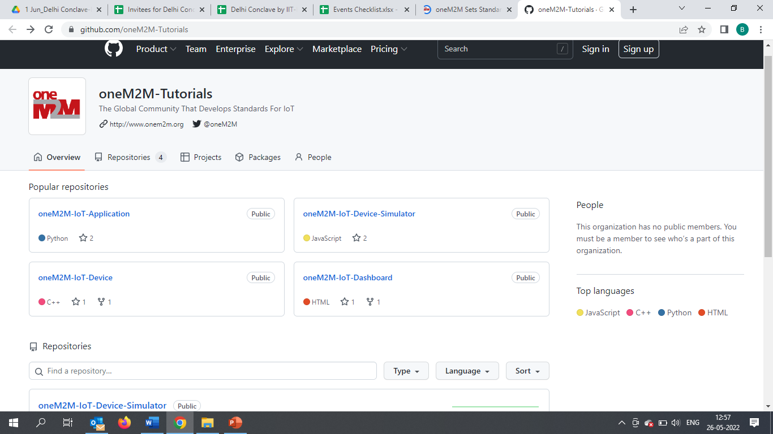
oneM2M WiKi
Teaching Material -
oneM2M Advanced Tutorial Full 2-day training to allow to build a complete IoT solution based on oneM2M
oneM2M Semantic Tutorial: An overview of semantics, applied to IoT and how using ontology can considerably enrich IoT applications and use cases.
oneM2M Hackster List of Hackster.io projects based on oneM2M. Some projects have been produced at the oneM2M International hackathon in Fall 2021.
IIIT Hyderabad MOOC:

Slide 9
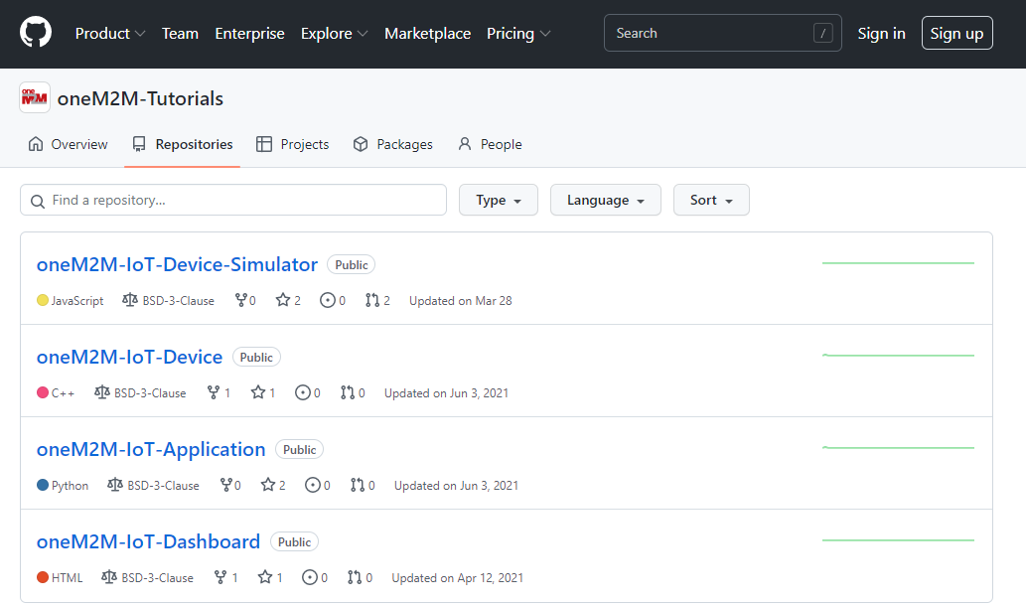
WiKi- Repositories

Slide 10
Specification Downloads & Exec Viewpoints
2 | 1 | 1 | 1 | 1 | 1 | 0 | 1 | 0 | 2 | 1 | 1
#Viewpoints published every month

Slide 11
Engagement by Channels
This is the engagement by channel for last 2 months :
Default Channel Grouping | Visit Apr’22 | Visit May’22
Organic Search | 996 | 1158
Direct | 682 | 927
Referral | 115 | 143
Social | 48 | 24
Organic: visitors that arrive from search engines by typing a keyword.
Direct: visitors arriving at website by typing the URL
into the address bar
Referral: someone referred to oneM2M website/page from another webpage where oneM2M related link is embedded
Social: someone clicks on oneM2M link embedded in a Tweet/LinkedIn post

Slide 12
Detailed Information

Slide 13
Thought Leadership – Published Articles (Q2 CY’22)
Global Journals
Paper in IEEE Internet of Things Journal
Trade Journals
oneM2M and sustainability - IoT Business News;
Open Standards article for Interoperability News EU
Regional (none)
Partner Communiques
ETSI Enjoy - Report on international hackathon organised by Korea & EU entities
Activities Tracker link

Slide 14
Upcoming/Potential Article Opportunities
Global Journals
IEEE Network Special Edition on Smart Communities*
Trade Journals
Article submitted to IoTforAll - "efficient IoT messages“
Second article for Interoperability News (with Enrico)
Regional
Invitation from Quality Council of India to write an article on "oneM2M in context of OPCUA and RAMI 4.0 " c/o Indrajit Bhattacharya- QCI- TSDSI:: Josef Blanz- Shane HE et al have written on this topic earlier*
Partner Communiques
ETSI Enjoy (edition on AI)
* being explored

Slide 15
Engagement – Interviews & Executive Insights
Executive Insights
Interview about UCL standardization study 7 Apr’22
SMARTM2M study on IoT data for AI - Michelle W 25 May’22
TP #54 (Roland) - 3 June 2022
Interview with TCS (DigiFleet) - 23 June 2022
oneM2M in the News – 1199 Subscribers
Press Releases – 4
Media queries to oneM2M_PressMedia@list.onem2m.org being forwarded to Bindoo, Aurindam, Ken, Akash
Activities Tracker link

Slide 16
VISIBILITY – Events & Speaking Opportunities (availed)
VISIBILITY | oneM2M | Partner driven | Regional
Events Q2 CY’22 | - | 28 Apr: EU - Republic of Korea cooperation workshop on IoT and Smart Cities 6 Apr: ETSI- EU-Brasil cooperation workshop : on IoT Policy, Regulation & Standards 7 Apr: DoT-TSDSI Webinar #1 on M2M applied to verticals- transportation 28 Apr: ETSI-TTA Smart Cities in Korea 4 May: DoT-TSDSI Webinar #2 on M2M applied to Utilities | 7-8 Apr: New Delhi India - InTranSe conference 21 Apr: Webinar on CCSP and CoSMiC - indigenous software platforms for M2M/IoT Communication
Speaking Opportunities Q2 CY’22 |  | 6-7 Jun’22: Bob Flynn spoke in Embedded Technology Convention, Las Vegas | 29 Jun'22: Aurindam and Rana Kamill spoke in the NTIPRIT event on IoT security
Social Media Significant posts: NIL
Activities Tracker link

Slide 17
Reference Slides

Slide 18
MARCOM Approach
MARCOM Goals
Provide sustained Market Visibility for oneM2M;
to increase the understanding of oneM2M both as a technical standard and as an organization for developing and maintaining a standardization roadmap; and,
develop the market for oneM2M solutions.
Approach
Global (oneM2M level), Partner level and Regional activities
Articles & Speaking Opportunities in targeted journals/periodicals and Events
Support development of collateral for Developers
Interactions being held with Partner and oneM2M experts

Slide 19
Initial Impressions from interactions with a Partner and oneM2M Stakeholders
External Visibility not good
oneM2M has very advanced Specifications. In step with latest technology trends: AI-Digital Twins- Metaverse etc.
Basic scope of IoT platform already covered in Rel 2.
Further enhancements – fierce competition/not perceived to be required from oneM2M.
Many folks don’t need the advanced features of oneM2M Yet.
Users do not seem to mind services based on “proprietary” solutions. Full End to End solutions available from big players
Big challenge is not competing standards but proprietary cloud based end to end solutions. CSPs are rapidly already moving to the edge also.
Participation has always been limited – niche scope?
Resource availability constraints due to parallel initiatives
Membership drop- lack of quick Wins so far
Information on oneM2M compliant devices/implementations is lacking.
The Vast Educational material not easily discoverable.
Industry Days used to be good vehicles for education/awareness.
oneM2M allows outsourcing of the middle layer
Initial wish was to consolidate the market- but rather it has fragemented more. However, since the big players also have a very small chunk o the market hare, window to consolidate is still open.

Slide 20
Suggestions based on Initial interactions with few Stakeholders (WIP)
External World selling required (Let other people know what we are doing)
Target – Developers, Decision makers
User Community/System Integrators/Solution and Service providers
Leverage Global/established conferences to speak/promote (Example -IEEE-ACM, IEEE Globecom/ICC, IoT/Smart City Events
Explore Regions - LATAM, Africa, Australia, SEA (Vietnam, Singapore….)
Reuse content to optimise efforts for enhancing external visibility
Enhance Wiki
oneM2M Quick Start self learning videos? on linkedIN/Youtube
Showcase Devices/Products/Solutions, Deployments
Compliance and Certification ecosystem
Do we want to relook at the name oneM2M ?

Slide 21
Thank You

