Slide 1
Marcom Report
Bindoo Srivastava
TSDSI
28 July 2022

Slide 2
Outline
Marcom updates from SC 62
Updates from oneM2M TP 55 - Marcom Ad-hoc
10th Anniversary Celebrations Updates
Website Engagement

Slide 3
oneM2M Rel 2 approved at ITU-T SG20 Plenary!

Slide 4
Updates from SC 62
Felicitation of Past SC Leaders
ETSI has opened Bank account and transfer of funds will be effected soon.
Payment to Ken to be initiated.
Contract with PR Agency to be initiated.
CY’23 Budget discussed based on MARCOM submission of priority options
Rel 4 expected to be ratified in Q3-Q4 (MARCOM to gear up wrt TP56)
SSC White paper likely in end CY’22
Next SC meeting – proposed to be collocated with TP56 – 29 Sep 2022? (TSDSI to confirm if this date works)

Slide 5
Summary from TP#55-MARCOM Adhoc Session
CONTEXT: Where are we after 10 years?
What are adoption trends? Deployment (pilots & commercial)
What is the Engagement?
Project level – Region wise/Verticals;
User Community/ System Integrators/ Solution and Service providers
Availability and growth in Devices/Products/Solutions,
Compliance and Certification ecosystem
How can we make oneM2M easy to adopt by Developers/ System Integrators et al
An introspection in the form of Joint non-decision making TP-MARCOM discussions conducted in TP#54 & #55
Recommendations from JaeSeung Song’s presentation on
oneM2M Development & Directions in TP55 – extract below:
Consider to support and interwork with new technologies (some key words)
6G
Metaverse
Blockchain
AI/ML
Quantum computing
Web 3.0
Still many features uncovered
Outreach to various industries (ITS, Smart City, Factory, etc)
Engage with other standards
3GPP
ETSI MEC, ETSI CIM, ETSI ITS, etc.

Slide 6
10th Anniversary Celebrations

Slide 7
10th Anniversary Celebrations
Event | Activities
Launch Celebrations: 24-26th Jul 2022 | Website and SM announcements – banner + key messages + article on flashback oneM2M
Felicitate SC Stalwarts: 27th Jul 2022 | SC62 – Felicitate Past SC Leaders
Revisit TP#1 in ETSI HQ: 26-30 Sep’22 | TP 56 – Felicitate long serving experts and Past TP leaders Launch oneM2M Short Videos Series for Developers *Sponsored Social Event?
oneM2M Conference: 1-2 Dec’ 22 | Hybrid Conference with support from TTA in Seoul co-located with PT57
Volunteer Sponsors for the Social Event?

Slide 8
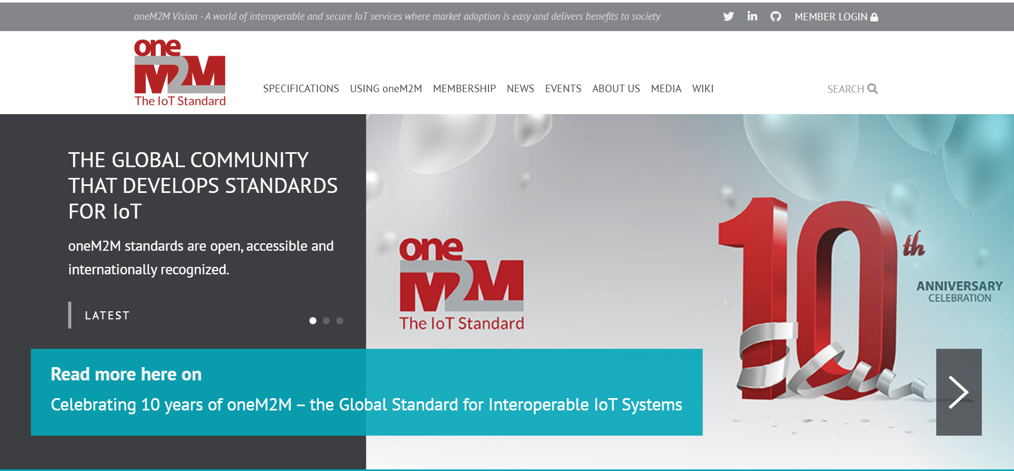
oneM2M@10

Slide 9
Key Highlights
oneM2M 10th anniversary celebrations launched !!!
Thought Leadership: 0 Articles Published, 5 in Pipeline
Engagement:
0 Executive Insights published, 5 in Pipeline
Visibility:
Events Total organised ( NIL@oneM2M, NIL@Partner, NIL@Regional level)
Speaking Opportunities – 0 availed since Marcom 107
Social Media:
1416 Twitter followers (-4 in CY’22), 26 posts
1247 LinkedIn followers (+16 in CY22), 7 posts
Communiques & PRs:
oneM2M in the News – 1200 followers
PR issued – 1 (oneM2M 10-year Press Release)
Activities Tracker link

Slide 10
VISIBILITY – Events & Speaking Opportunities (Upcoming/Potential)
VISIBILITY | oneM2M | Partner driven | Regional
Events | Tentative Interop hosted by TTA in Dec’22 oneM2M Webinar/s oneM2M Conference | 20-22 Oct: TTA - IoT Week Korea 20 Oct: TTA seminar for oneM2M 10 years anniversary 10-14 Oct: ETSI IoT Week 2022 3-5 Oct: ETSI Security Conference 2022* 15-18 Nov: TSDSI- Tech Deep Dive* TTA-ETSI-KETI.. Online Hackathon (30Oct-28 Nov) | 29 Sep-1 Oct: IMC 2022* 18-20 Oct: Future Com Brazil/Hybrid/Sau Paolo IET Future Tech Congress - 22-23 Nov (Phygital)/BLR 12-15 Oct: 2nd International Conference on AI-ML-Systems (AIMLSystems'22), F2F Bangalore, India
Speaking Opportunities | 20-21 Sep'22: "IoT Tech Expo : POWERING THE CONNECTED WORLD WITH IOT|| AMSTERDAM/Hybrid|| free to attend|| Rana Kamill speaking" 26 Oct-11 Nov’22: IEEE IoT WF /Tokyo/Hybrid 13-14 Oct’22: Rana (BT) speaking at IoT World Forum 2022 london (RESCHEDULED to 13-14 Oct ‘22) Potential speaking opportunities for CY’22 are listed in notes

Slide 11
Website & Social Media Engagements

Slide 12
Website - Visits
Australia added in June
Vietnam continued in June
Canada, Singapore dropped

Slide 13
Website - Visits
New Entrants in June: Rest-resources, api

Slide 14
Website - Visits
2 | 1 | 1 | 1 | 1 | 1 | 0 | 1 | 0 | 2 | 1 | 1 | 2
#Viewpoints published every month

Slide 15
Reference Slides

Slide 16
Thought Leadership – Articles
Global Journals
Paper in IEEE Internet of Things Journal
Trade Journals
oneM2M and sustainability - IoT Business News;
Open Standards article for Interoperability News EU
ABI Research interview with oneM2M for their Smart Cities research program
Comments on Industrial IoT submitted to AI Magazine
Regional
Feature in National Post, Canada)
Voice & Data, India Smart Cities Edition
oneM2M in context of smart cities for tele.net, India
Partner Communiques
ETSI Enjoy - Addressing Societal Challenges with IoT
ETSI Enjoy - IoT data for industrial verticals
Activities Tracker link

Slide 17
Potential Article Opportunities
Global Journals
IEEE Network Special Edition on Smart Communities (dropped)
Trade Journals
Article submitted to IoTforAll - "efficient IoT messages“
Second article for Interoperability News (with Enrico)
Magazine - Making IoT Intelligent
Regional
Partner Communiques
ETSI Enjoy (edition on AI)

Slide 18
Engagement – Interviews & Executive Insights
oneM2M in the News – 1200 Subscribers
oneM2M News – 1 (Since Marcom 107)
Press Releases – 1
Media queries to oneM2M_PressMedia@list.onem2m.org being forwarded to Bindoo, Aurindam, Ken, Akash
Interviews
None
Executive Insights
Roland on TP#52 - 5 Jan’22
Roland on TP#53 - 9 Mar’22
IoT and 6G interview with Onel Alcaraz López (Finland) 16 Mar’22
Interview about UCL standardization study 7 Apr’22
SMARTM2M study on IoT data for AI - Michelle W 25 May’22
Roland on TP#54 – 3 Jun’22
Interview with TCS (DigiFleet) – 23 Jun’22
Activities Tracker link
Notes:
- Interviews in pipeline - Interview with TCS (DigiFleet), SMARTM2M study on IoT data for AI and Mauro Dragoni STF602 interview

Slide 19
VISIBILITY – Events & Speaking Opportunities
VISIBILITY | oneM2M | Partner driven | Regional
Events | - Interop to be hosted by TTA in Dec’22 | 18 Jan: ETSI-TSDSI Webinar on oneM2M “Risk/Benefit analyses” 25 Jan: ETSI-TSDSI Webinar on oneM2M ” Smart Lift private sector use case ” ETSI: EU-Brazil Bilateral 4 Feb: ETSI-TSDSI Webinar on oneM2M “Smart Home/Smart Building private sector use case” ETSI-Argentina talk on oneM2M 6 Apr: ETSI- EU-Brasil cooperation workshop : on IoT Policy, Regulation & Standards 28 Apr: ETSI-TTA Smart Cities in Korea TSDSI- A webinar conducted by DoT-TSDSI on M2M for transport vertical on 7 Apr’22 | 24 Feb: INDIA- TEC Organised webinar on oneM2M- Smart cities 28 Mar: NTIPRIT Conference on M2M 7-8 Apr: New Delhi India - InTranSe conference 21 Apr: Webinar on CCSP and CoSMiC - indigenous software platforms for M2M/IoT Communication 7 Apr: DoT-TSDSI Webinar #1 on M2M applied to verticals- transportation 4 May: DoT-TSDSI Webinar #2 on M2M applied to Utilities
Speaking Opportunities | 20-21 Sep'22: "IoT Tech Expo : POWERING THE CONNECTED WORLD WITH IOT|| AMSTERDAM/Hybrid|| free to attend|| Rana Kamill speaking" 26 Oct-11 Nov’22: IEEE IoT WF /Tokyo/Hybrid 13-14 Oct’22: Rana (BT) speaking at IoT World Forum 2022 london (RESCHEDULED to 13-14 Oct ‘22) Potential speaking opportunities for CY’22 are listed in notes | 5 in pipeline | 1
Activities Tracker link
Notes:
Regional Events Upcoming -
18-20 Oct: IMC 2022*
18-20 Oct: Future Com Brazil/Hybrid/Sau Paolo
IET Future Tech Congress - 22-23 Nov (Phygital)/BLR
12-15 Oct: The 2nd International Conference on AI-ML-Systems (AIMLSystems'22), F2F Bangalore, India

Slide 20
Potential Key Events /Speaking Opps
Potential Global and Regional Events
Embedded Technologies Convention
IEEE 8th IoT World Forum (26 Oct-11 Nov’22 // Yokohama, Japan (in person and hybrid)
Futurecom 2022: 18-20 Oct’22, Sao Paulo, Brazil
ETSI IoT Week
Korea IoT event
TSDSI Tech Deep Dive 2022
India Mobile Congress IMC 2022
WORLD SMART CITY EXPO 2022 – Korea - 31 Aug-2 Sep’22
Embedded Technology Convention ASIA - 28-29 Sep’22
India Mobile Congress- 29 Sep - 01 Oct’22
TSDSI Tech Deep Dive - 15-18 Nov’22
5th INTERNATIONAL CONFERENCE ON FUTURE SMART CITIES (FSC) - 18-20 Nov’22
IET Future Tech Congress 2022 (phygital event) - 22-23 Nov’22

Slide 21
MARCOM Approach
MARCOM Goals
Provide sustained Market Visibility for oneM2M;
to increase the understanding of oneM2M both as a technical standard and as an organization for developing and maintaining a standardization roadmap; and,
develop the market for oneM2M solutions.
Approach
Global (oneM2M level), Partner level and Regional activities
Articles & Speaking Opportunities in targeted journals/periodicals and Events
Support development of collateral for Developers
Interactions being held with Partner and oneM2M experts

Slide 22
Thank You

