Slide 1
Marcom Report
Bindoo Srivastava
TSDSI
25 August 2022

Slide 2
Outline
10th Anniversary Celebrations Updates
Website Engagement

Slide 3
10th Anniversary Celebrations

Slide 4
10th Anniversary Celebrations
Event | Activities
Revisit TP#1 in ETSI HQ: 26-30 Sep’22 | TP 56 – Felicitate long serving experts and Past TP leaders Launch oneM2M Short Videos Series for Developers Sponsored Social Event Launch of SSC white paper Announcement related to Rel. 4, ITU-T SG20 approvals etc.
oneM2M Conference: 1-2 Dec’ 22 | Hybrid Conference with support from TTA in Seoul co-located with PT57

Slide 5
Key Highlights
oneM2M 10th anniversary celebrations launched !!!
Thought Leadership: 2 Articles Published, 2 in Pipeline
Engagement:
1 Executive Insights published, 4 in Pipeline
Visibility:
Events Total organised ( NIL@oneM2M, NIL@Partner, NIL@Regional level)
Speaking Opportunities – 0 availed since Marcom 108
Social Media:
1419 Twitter followers (+3 in CY’22), 40 posts
1255 LinkedIn followers (+8 in CY22), 5 posts
Communiques & PRs:
oneM2M in the News – 1202 followers
PR issued – 0
Activities Tracker link
Notes:
Articles –
Pipeline Magazine - Making IoT Intelligent (https://pipelinepub.com/IoT-2022/intelligent-IoT-systems)
ETSI Enjoy: Standards to Support AI/ML Services (By JaeSeung Song) (https://www.etsi.org/e-brochure/Magazine/July-2022/mobile/index.html#p=22)
Executive Insights –
Mauro Dragoni – activities in IoT industry and his project related to SAREF – 27th Jul’22

Slide 6
VISIBILITY – Events & Speaking Opportunities (Upcoming/Potential)
VISIBILITY | oneM2M | Partner driven | Regional
Events | Tentative Interop hosted by TTA in Dec’22 oneM2M Webinar/s oneM2M Conference | 20-22 Oct: TTA - IoT Week Korea 20 Oct: TTA seminar for oneM2M 10 years anniversary 10-14 Oct: ETSI IoT Week 2022 3-5 Oct: ETSI Security Conference 2022* 15-18 Nov: TSDSI- Tech Deep Dive* TTA-ETSI-KETI.. Online Hackathon (30Oct-28 Nov) | 1– 3 Oct: IMC 2022 18-20 Oct: Future Com Brazil/Hybrid/Sau Paolo IET Future Tech Congress - 22-23 Nov (Phygital)/BLR 12-15 Oct: 2nd International Conference on AI-ML-Systems (AIMLSystems'22), F2F Bangalore, India
Speaking Opportunities | 20-21 Sep'22: "IoT Tech Expo : POWERING THE CONNECTED WORLD WITH IOT|| AMSTERDAM/Hybrid|| free to attend|| Rana Kamill speaking“ 3-5 Oct: ETSI Security Conference 2022 (ETSI Security Week 2022) 26 Oct-11 Nov’22: IEEE IoT WF /Tokyo/Hybrid 13-14 Oct’22: Rana (BT) speaking at IoT World Forum 2022 london (RESCHEDULED to 13-14 Oct ‘22) Potential speaking opportunities for CY’22 are listed in notes

Slide 7
Website & Social Media Engagements

Slide 8
Website - Visits
No data for July 2022. Reason - Problem due to GA4 integration.

Slide 9
Website - Visits
Pages figured in list for 1st time - oneM2M@10, ontologies and device-developers
Pages from developers section – rise in visits noted in July 2022

Slide 10
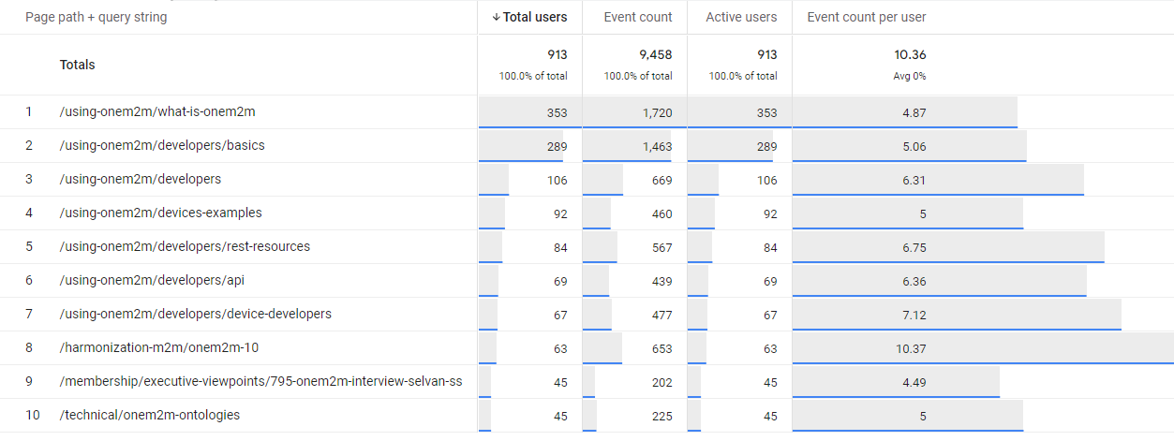
Website – Visits (Detail !!)
Unique visitor

Slide 11
PR – oneM2M@10 - analytics
PR – oneM2M@10 - 339 page views (39 unique visitors):

Slide 12
Website - Visits
2 | 1 | 1 | 1 | 1 | 1 | 0 | 1 | 0 | 2 | 1 | 1 | 2 | 1
#Viewpoints published every month

Slide 13
Reference Slides

Slide 14
Thought Leadership – Articles
Global Journals
Paper in IEEE Internet of Things Journal
Trade Journals
oneM2M and sustainability - IoT Business News;
Open Standards article for Interoperability News EU
ABI Research interview with oneM2M for their Smart Cities research program
Comments on Industrial IoT submitted to AI Magazine
Pipeline Magazine - Making IoT Intelligent
Regional
Feature in National Post, Canada)
Voice & Data, India Smart Cities Edition
oneM2M in context of smart cities for tele.net, India
Partner Communiques
ETSI Enjoy - Addressing Societal Challenges with IoT
ETSI Enjoy - IoT data for industrial verticals
ETSI Enjoy: Standards to Support AI/ML Services
Activities Tracker link

Slide 15
Potential Article Opportunities
Global Journals
IEEE Network Special Edition on Smart Communities (dropped)
Trade Journals
Article submitted to IoTforAll - "efficient IoT messages“
Second article for Interoperability News (with Enrico)
Regional
Partner Communiques

Slide 16
Engagement – Interviews & Executive Insights
oneM2M in the News – 1202 Subscribers
oneM2M News – 0 (Since Marcom 108)
Press Releases – 0
Media queries to oneM2M_PressMedia@list.onem2m.org being forwarded to Bindoo, Aurindam, Ken, Akash
Interviews
None
Executive Insights
Roland on TP#52 - 5 Jan’22
Roland on TP#53 - 9 Mar’22
IoT and 6G interview with Onel Alcaraz López (Finland) 16 Mar’22
Interview about UCL standardization study 7 Apr’22
SMARTM2M study on IoT data for AI - Michelle W 25 May’22
Roland on TP#54 – 3 Jun’22
Interview with TCS (DigiFleet) – 23 Jun’22
Mauro Dragoni – his activities in IoT industry and his project related to SAREF – 27th Jul’22
Activities Tracker link
Notes:
Executive Insights in pipeline –
TP #55 (Roland)
Dr Indergopal IISC Bangalore - IUDX-oneM2M interface for smart cities
Sateesh (CDAC - CoSMiC) satheeshg@cdac.in
TP #56 (Roland)

Slide 17
VISIBILITY – Events & Speaking Opportunities
VISIBILITY | oneM2M | Partner driven | Regional
Events | - Interop to be hosted by TTA in Dec’22 | 18 Jan: ETSI-TSDSI Webinar on oneM2M “Risk/Benefit analyses” 25 Jan: ETSI-TSDSI Webinar on oneM2M ” Smart Lift private sector use case ” ETSI: EU-Brazil Bilateral 4 Feb: ETSI-TSDSI Webinar on oneM2M “Smart Home/Smart Building private sector use case” ETSI-Argentina talk on oneM2M 6 Apr: ETSI- EU-Brasil cooperation workshop : on IoT Policy, Regulation & Standards 28 Apr: ETSI-TTA Smart Cities in Korea TSDSI- A webinar conducted by DoT-TSDSI on M2M for transport vertical on 7 Apr’22 | 24 Feb: INDIA- TEC Organised webinar on oneM2M- Smart cities 28 Mar: NTIPRIT Conference on M2M 7-8 Apr: New Delhi India - InTranSe conference 21 Apr: Webinar on CCSP and CoSMiC - indigenous software platforms for M2M/IoT Communication 7 Apr: DoT-TSDSI Webinar #1 on M2M applied to verticals- transportation 4 May: DoT-TSDSI Webinar #2 on M2M applied to Utilities
Speaking Opportunities | 20-21 Sep'22: "IoT Tech Expo : POWERING THE CONNECTED WORLD WITH IOT|| AMSTERDAM/Hybrid|| free to attend|| Rana Kamill speaking" 26 Oct-11 Nov’22: IEEE IoT WF /Tokyo/Hybrid 13-14 Oct’22: Rana (BT) speaking at IoT World Forum 2022 london (RESCHEDULED to 13-14 Oct ‘22) Potential speaking opportunities for CY’22 are listed in notes | 5 in pipeline | 1
Activities Tracker link
Notes:
Regional Events Upcoming -
1-3 Oct: IMC 2022*
18-20 Oct: Future Com Brazil/Hybrid/Sau Paolo
IET Future Tech Congress - 22-23 Nov (Phygital)/BLR
12-15 Oct: The 2nd International Conference on AI-ML-Systems (AIMLSystems'22), F2F Bangalore, India

Slide 18
Potential Key Events /Speaking Opps
Potential Global and Regional Events
Embedded Technologies Convention
IEEE 8th IoT World Forum (26 Oct-11 Nov’22 // Yokohama, Japan (in person and hybrid)
Futurecom 2022: 18-20 Oct’22, Sao Paulo, Brazil
ETSI IoT Week
Korea IoT event
TSDSI Tech Deep Dive 2022
India Mobile Congress IMC 2022
WORLD SMART CITY EXPO 2022 – Korea - 31 Aug-2 Sep’22
Embedded Technology Convention ASIA - 28-29 Sep’22
India Mobile Congress- 1 - 4 Oct’22
TSDSI Tech Deep Dive - 07-10 Nov’22
5th INTERNATIONAL CONFERENCE ON FUTURE SMART CITIES (FSC) - 18-20 Nov’22
IET Future Tech Congress 2022 (phygital event) - 22-23 Nov’22

Slide 19
MARCOM Approach
MARCOM Goals
Provide sustained Market Visibility for oneM2M;
to increase the understanding of oneM2M both as a technical standard and as an organization for developing and maintaining a standardization roadmap; and,
develop the market for oneM2M solutions.
Approach
Global (oneM2M level), Partner level and Regional activities
Articles & Speaking Opportunities in targeted journals/periodicals and Events
Support development of collateral for Developers
Interactions being held with Partner and oneM2M experts

Slide 20
Thank You

