Slide 1
Marcom Report
Bindoo Srivastava
TSDSI
22 September 2022

Slide 2
Post event activity – oneM2M webinar@10
8th Sept’22

Slide 3
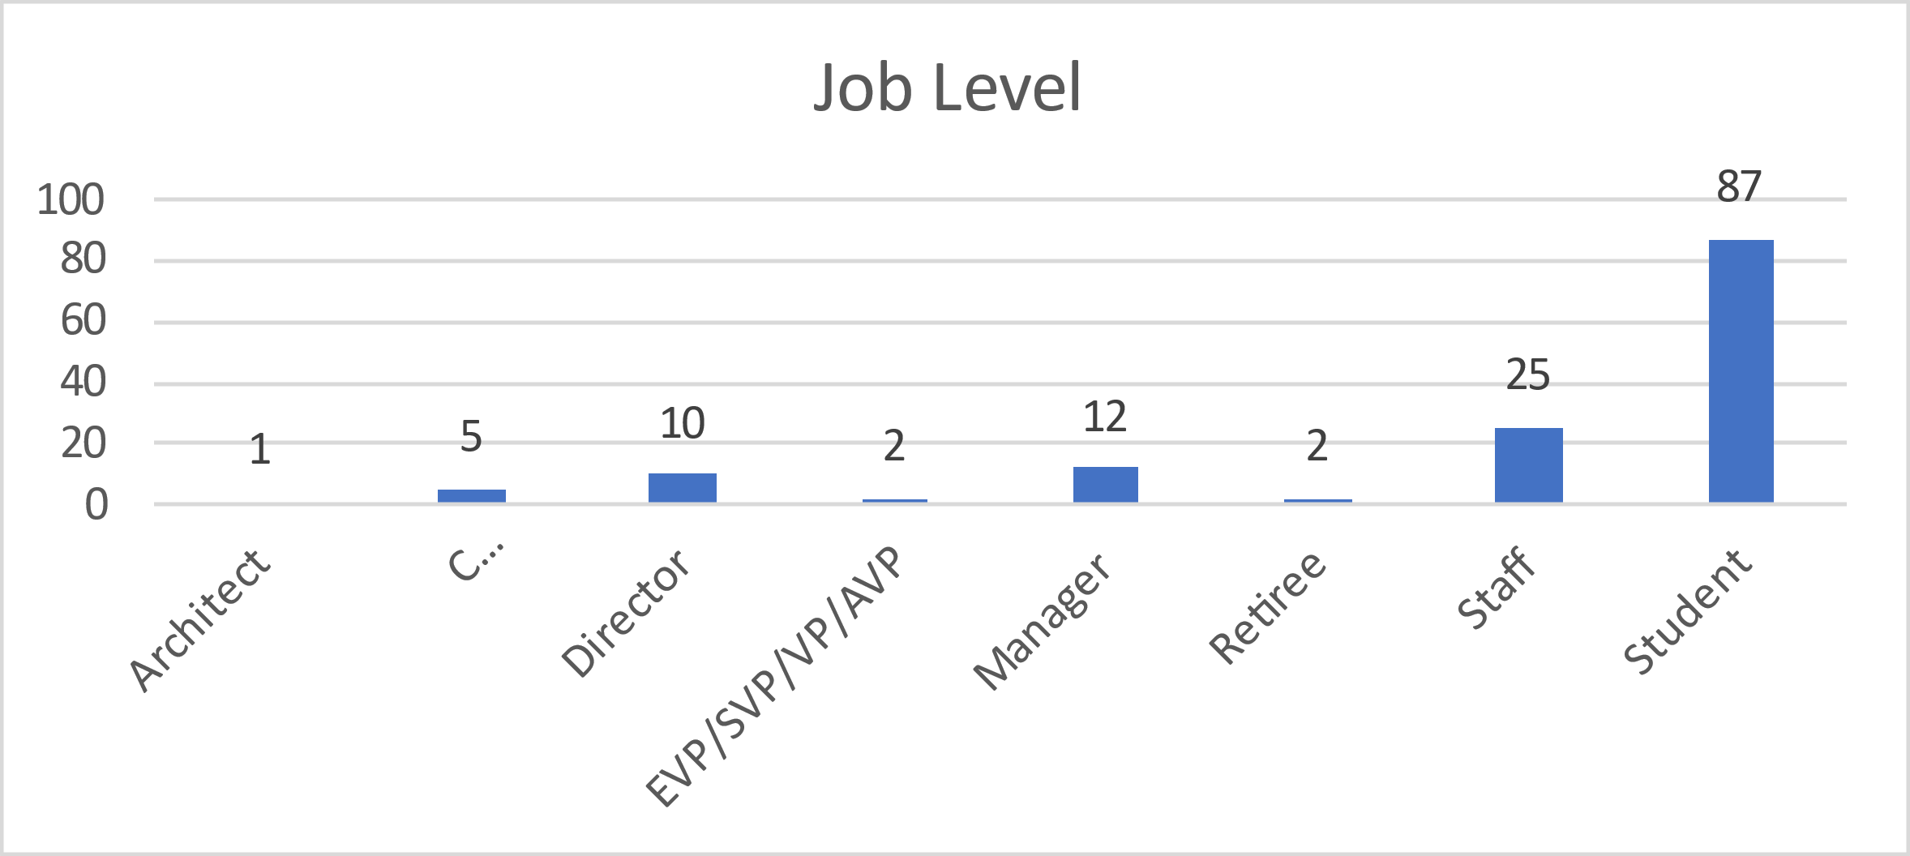
Analytics
Unique Attendees
Pre-registered | 147
Live view | 144
On demand | 8
Pre-Registered: These are the users who registered in advance before the event.
Live Viewers: These are the viewers who joined at the time of event.
On Demand Viewers: These are the viewers who watched on-demand the recorded version of the event.
Job Level
Architect | 1
C Level/ Executive Team | 5
Director | 10
EVP/ SVP/ VP/ AVP | 2
Manager | 12
Retired | 2
Staff | 25
Student | 87
Don’t start from scratch for your IoT implementations. If you want to combine variety of things, look at oneM2M

Slide 4

Webinar: oneM2M @10
“Don’t start from scratch for your IoT implementations. If you want to combine variety of things, look at oneM2M”
Key Takeaways:
On 8 September 2022, oneM2M hosted an international discussion to celebrate oneM2M's 10th anniversary with a review of past achievements and future standardization plans. Click here to Rewatch the Webinar
Panelists discussed how oneM2M's standardization framework began around device management as a key service-enabler capability, followed by the need for a standardized API.
From the outset, oneM2M anticipated the need for distributed systems thereby ensuring a solid foundation for cross-silo interoperability and how oneM2M agent software can be included in many types of connected devices and co-exist with other IoT-stack technologies.
Panelists went on to discuss the distinction between standards and solutions. To put this in perspective, oneM2M is a standard whereas the IoT service-enabler capabilities offered by hyperscaler platforms, for example, are solutions.
The closing advice from panelists was to think about IoT systems as a collection of technologies with oneM2M providing an open-standard to integrate different elements. Users should also think about future technical requirements and the value of an open standard when making platform procurement decisions.
To help with decision-making, the oneM2M web site contains a lot of information about the benefits of standardization. The web site also contains analyses of future requirements and their planned inclusion in oneM2M's standardization roadmap. Finally, to gain a quick understanding and hands-on experience of oneM2M standardized capabilities, oneM2M has recently launched a series of short, video tutorials
(https://wiki.onem2m.org/index.php?title=OneM2M_Tutorials_using_Jupyter_Notebooks)

Slide 5
oneM2M Conference (hybrid)
The Journey to Massive IoT Through Interoperable and Open Standards
Date: 1-2 Dec ‘22
Venue: TTA premises (TBC), Seoul, S. Korea

Slide 6
About the Conference
Conference on “The Journey to Massive IoT Through Interoperable and Open Standards”
To achieve quick results, many IoT deployments deploy single-purpose solutions or rely on proprietary platforms. However, as new requirements and operational goals arise these can be difficult to evolve. Users may find themselves locked into single technology or single-vendor environments. This can affect the scope for innovation and the ability to deploy cross-silo systems.
This conference aims to illustrate the technical and innovation potential of open-standard, scalable and interoperable IoT systems. Presenters will describe IoT systems based on the oneM2M standard. They will share developer and deployment experiences while illustrating the benefits of global standardization.
In addition to technical specifications, multi-year standardization roadmaps are a proven way to address new requirements. Interoperability testing and certification are also important for building trust in IoT systems. These issues will be discussed in terms of oneM2M’s standardization framework as well as the formal roles of regional standardization bodies and the ITU.
AGENDA PROGRAM: to be announced shortly

Slide 7
Logistics Information
SCHEDULE: 1-2 December 2022, 1600-1800 KST
VENUE: 1-2 December 2022, Hybrid/<TTA office location>
PARTICIPATION: Open to all by prior registration at <link here>.
Participants from outside S. Korea who plan to attend the conference in person are requested to go through the visiting guidelines at link here.
It maybe noted that the conference is being held as part of the oneM2M TP 57 and Interop #8 activities, being hosted by TTA in its <Pangyo> premises. Conference participants who wish to join this visit, may reach out to the conference conveners <XXXX>.

Slide 8
Developer’s Tutorial Series

Slide 9
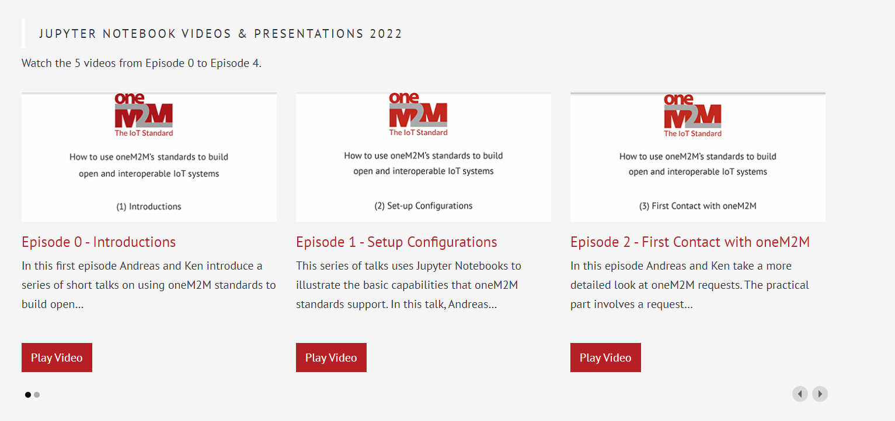
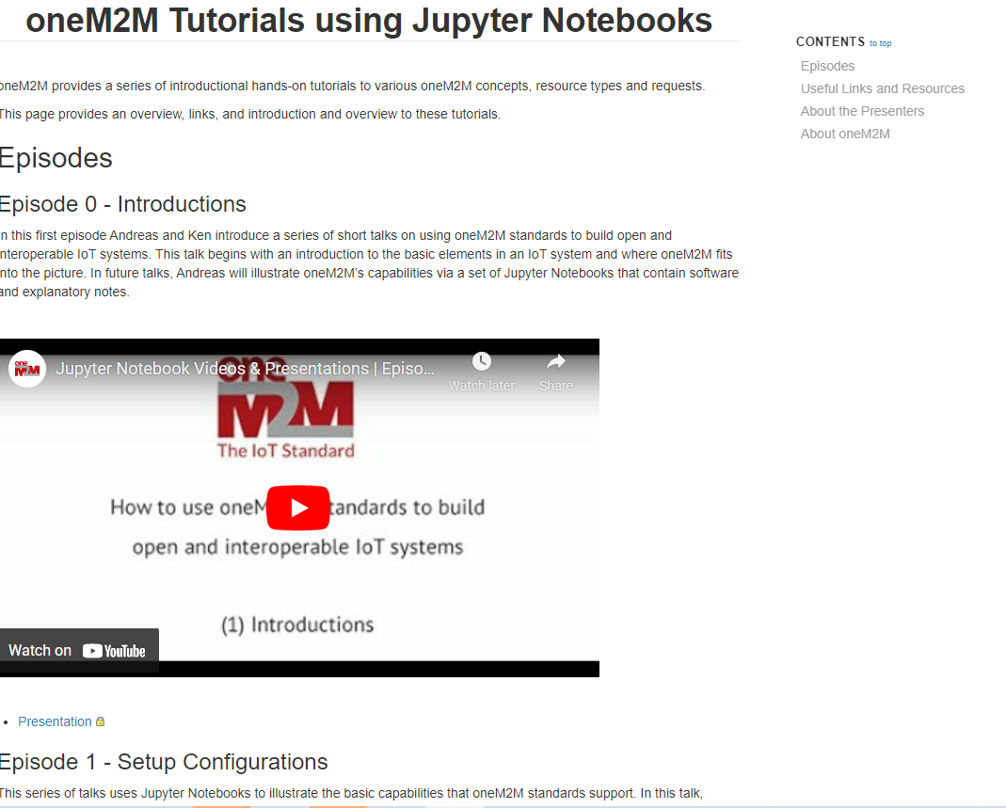
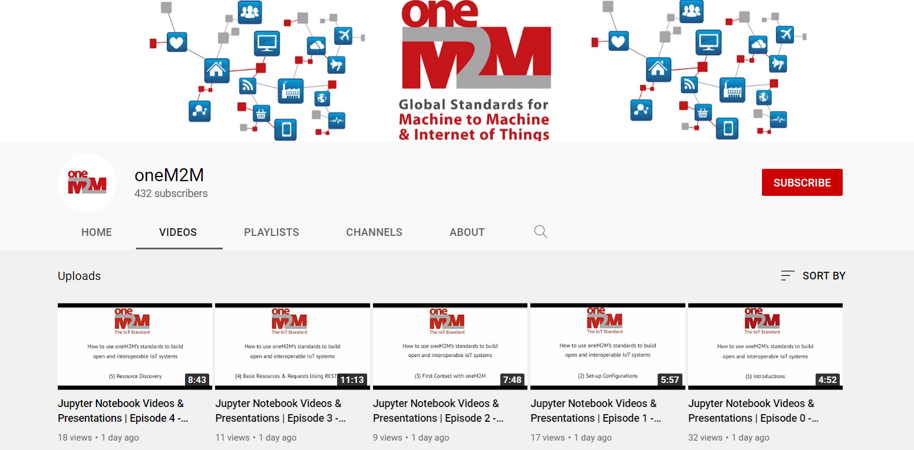
Developers’ Tutorial Series
oneM2M released a series of introductory hands-on tutorials to various oneM2M concepts, resource types and requests.
Tutorials available@
  oneM2M
  YouTube
  WiKi

Slide 10
10th Anniversary Celebrations

Slide 11
10th Anniversary Celebrations
Event | Activities
Revisit TP#1 in ETSI HQ: 26-30 Sep’22 | TP 56 – Felicitate long serving experts and Past leaders Launch oneM2M Short Videos Series for Developers Sponsored Social Event Souvenirs distribution Launch of SSC white paper
oneM2M Conference: 1-2 Dec’ 22 | Hybrid Conference with support from TTA in Seoul co-located with PT57

Slide 12
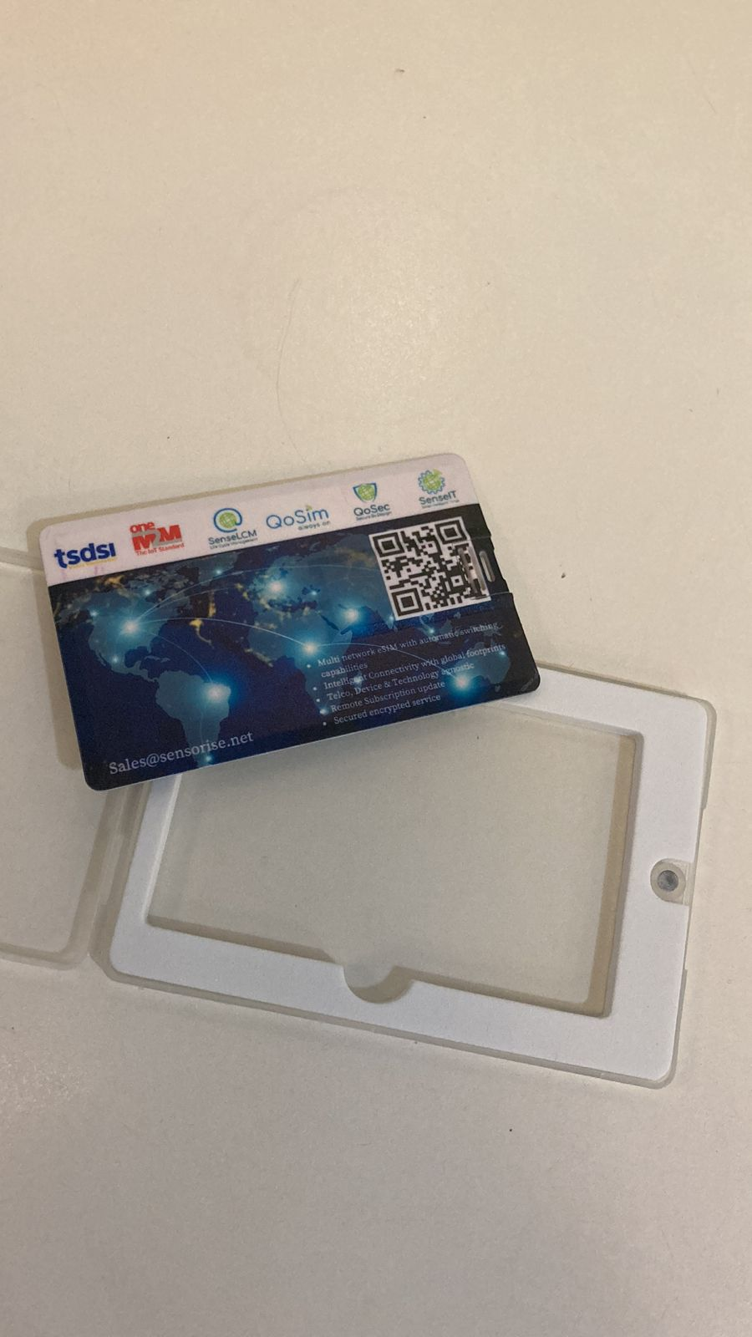
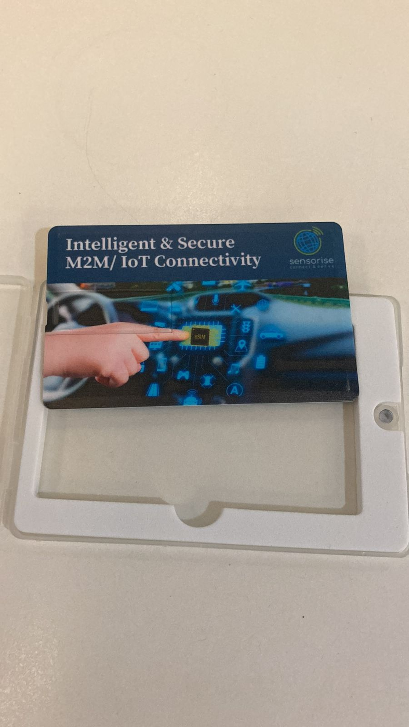
Thank you Sensorise for sponsoring the souvenirs!!

Slide 13
Events, Speaking Opps & Marcom Updates

Slide 14
VISIBILITY – Events & Speaking Opportunities (Upcoming/Potential)
VISIBILITY | oneM2M | Partner driven | Regional
Events | oneM2M Conference (1-2 Dec’22) in Korea Interop #8 hosted by TTA in Dec’22 (5 – 7 Dec’22) | 19 Oct: TTA seminar for oneM2M 10 years anniversary 07-10 Nov: TSDSI- Tech Deep Dive* TTA-ETSI-KETI.. Online Hackathon (4 Oct-28 Nov) | 1– 4 Oct: IMC 2022 18-20 Oct: Future Com Brazil/Hybrid/Sau Paolo IET Future Tech Congress - 22-23 Nov (Phygital)/BLR
Speaking Opportunities | 20-21 Sep'22: "IoT Tech Expo : POWERING THE CONNECTED WORLD WITH IOT|| AMSTERDAM/Hybrid|| free to attend|| Rana Kamill speaking“ 3-5 Oct: ETSI Security Conference 2022 (ETSI Security Week 2022) 10-14 Oct: ETSI IoT Week 2022 13-14 Oct’22: Rana (BT) speaking at IoT World Forum 2022 London 19-21 Oct: TTA - IoT Week Korea 26 Oct-11 Nov’22: IEEE IoT WF /Tokyo/Hybrid

Slide 15
Key Highlights
oneM2M 10th anniversary celebrations launched !!!
Thought Leadership: 0 Articles Published (since Marcom 109), 2 in Pipeline, (SSC whitepaper in final stages)
Engagement:
2 Executive Insights published (since Marcom 109), 2 in Pipeline
Visibility:
Events Total organised ( 1@oneM2M, NIL@Partner, NIL@Regional level)
Webinar – oneM2M@10 – Progress and prospects for global IoT Standardization
Speaking Opportunities – 0 availed since Marcom 108
Social Media:
1428 Twitter followers (+9 in CY’22), 33 posts
1263 LinkedIn followers (+8 in CY22), 4 posts
Communiques & PRs:
oneM2M in the News – 1203 followers
PR issued – 1 in pipeline for SSC whitepaper
Activities Tracker link
Notes:
Articles in pipeline –
Placeholder - ETSI Enjoy (10-year celebration) - Ken/Bindoo
Second article for Enjoy - deployments - Ken
Executive Insights –
For TP 55 by Roland Hechwartner - 7th Sep’22 (https://www.onem2m.org/membership/executive-viewpoints/812-onem2m-tp55-interview-Hechwartner)
IUDX-oneM2M pilot by Vasanth Rajaraman & Anuradha Vattem – 12th Sep’22 (https://www.onem2m.org/membership/executive-viewpoints/813-onem2m-interview-rajaraman-vattem)

Slide 16
Website – Visits analysis
Top 10 countries from where people visited website in Aug’22

Slide 17
Website - Visits
oneM2M – Top ten viewed pages in Aug’22
Total page views in Aug’22 = 5700

Slide 18
Website - Visits
Where do visits come from (monthly):
Aug-22
Organic search | 723
Direct | 480
Referral | 78
Social | 20
2 | 1 | 1 | 1 | 1 | 1 | 0 | 1 | 0 | 2 | 1 | 1 | 2 | 1 | 0
#Viewpoints published every month

Slide 19
Reference Slides

Slide 20
Thought Leadership – Articles
  Global Journals
  Paper in IEEE Internet of Things Journal
  Trade Journals
  oneM2M and sustainability - IoT Business News;
  Open Standards article for Interoperability News EU
  ABI Research interview with oneM2M for their Smart Cities research program
  Comments on Industrial IoT submitted to AI Magazine
  Pipeline Magazine - Making IoT Intelligent
  Regional
  Feature in National Post, Canada)
  Voice & Data, India Smart Cities Edition
  oneM2M in context of smart cities for tele.net, India
  Partner Communiques
  ETSI Enjoy - Addressing Societal Challenges with IoT
  ETSI Enjoy - IoT data for industrial verticals
  ETSI Enjoy: Standards to Support AI/ML Services
Activities Tracker link

Slide 21
Potential Article Opportunities
  Global Journals
  IEEE Network Special Edition on Smart Communities (dropped)
  Trade Journals
  Article submitted to IoTforAll - "efficient IoT messages“
  Second article for Interoperability News (with Enrico)
  Regional
  Partner Communiques

Slide 22
Engagement – Interviews & Executive Insights
oneM2M in the News – 1203 Subscribers
oneM2M News – 0 (Since Marcom 108)
Press Releases – 0
Media queries to oneM2M_PressMedia@list.onem2m.org being forwarded to Bindoo, Aurindam, Ken, Akash
  Interviews
  None
  Executive Insights
  Roland on TP#52 – 5th Jan’22
  Roland on TP#53 - 9th Mar’22
  IoT and 6G interview with Onel Alcaraz López (Finland) 16th Mar’22
  Interview about UCL standardization study 7th Apr’22
  SMARTM2M study on IoT data for AI - Michelle W 25th May’22
  Roland on TP#54 – 3rd Jun’22
  Interview with TCS (DigiFleet) – 23rd Jun’22
  Mauro Dragoni – his activities in IoT industry and his project related to SAREF – 27th Jul’22
  Roland on TP#54 – 7th Sep’22
  IUDX-oneM2M pilot – 12th Sep’22
Activities Tracker link
Notes:
Executive Insights in pipeline –
TP #55 (Roland)
Dr Indergopal IISC Bangalore - IUDX-oneM2M interface for smart cities
Sateesh (CDAC - CoSMiC) satheeshg@cdac.in
TP #56 (Roland)

Slide 23
VISIBILITY – Events & Speaking Opportunities
VISIBILITY | oneM2M | Partner driven | Regional
Events | - Interop to be hosted by TTA in Dec’22 | 18 Jan: ETSI-TSDSI Webinar on oneM2M “Risk/Benefit analyses” 25 Jan: ETSI-TSDSI Webinar on oneM2M ” Smart Lift private sector use case ” ETSI: EU-Brazil Bilateral 4 Feb: ETSI-TSDSI Webinar on oneM2M “Smart Home/Smart Building private sector use case” ETSI-Argentina talk on oneM2M 6 Apr: ETSI- EU-Brasil cooperation workshop : on IoT Policy, Regulation & Standards 28 Apr: ETSI-TTA Smart Cities in Korea TSDSI- A webinar conducted by DoT-TSDSI on M2M for transport vertical on 7 Apr’22 | 24 Feb: INDIA- TEC Organised webinar on oneM2M- Smart cities 28 Mar: NTIPRIT Conference on M2M 7-8 Apr: New Delhi India - InTranSe conference 21 Apr: Webinar on CCSP and CoSMiC - indigenous software platforms for M2M/IoT Communication 7 Apr: DoT-TSDSI Webinar #1 on M2M applied to verticals- transportation 4 May: DoT-TSDSI Webinar #2 on M2M applied to Utilities
Speaking Opportunities | 20-21 Sep'22: "IoT Tech Expo : POWERING THE CONNECTED WORLD WITH IOT|| AMSTERDAM/Hybrid|| free to attend|| Rana Kamill speaking" 26 Oct-11 Nov’22: IEEE IoT WF /Tokyo/Hybrid 13-14 Oct’22: Rana (BT) speaking at IoT World Forum 2022 london (RESCHEDULED to 13-14 Oct ‘22) Potential speaking opportunities for CY’22 are listed in notes | 5 in pipeline | 1
Activities Tracker link
Notes:
Regional Events Upcoming -
1-3 Oct: IMC 2022*
18-20 Oct: Future Com Brazil/Hybrid/Sau Paolo
IET Future Tech Congress - 22-23 Nov (Phygital)/BLR
12-15 Oct: The 2nd International Conference on AI-ML-Systems (AIMLSystems'22), F2F Bangalore, India

Slide 24
Potential Key Events /Speaking Opps
Potential Global and Regional Events
Embedded Technologies Convention
IEEE 8th IoT World Forum (26 Oct-11 Nov’22 // Yokohama, Japan (in person and hybrid)
Futurecom 2022: 18-20 Oct’22, Sao Paulo, Brazil
ETSI IoT Week
Korea IoT event
TSDSI Tech Deep Dive 2022
India Mobile Congress IMC 2022
WORLD SMART CITY EXPO 2022 – Korea - 31 Aug-2 Sep’22
Embedded Technology Convention ASIA - 28-29 Sep’22
India Mobile Congress- 1 - 4 Oct’22
TSDSI Tech Deep Dive - 07-10 Nov’22
5th INTERNATIONAL CONFERENCE ON FUTURE SMART CITIES (FSC) - 18-20 Nov’22
IET Future Tech Congress 2022 (Phygital event) - 22-23 Nov’22

Slide 25
MARCOM Approach
MARCOM Goals
Provide sustained Market Visibility for oneM2M;
to increase the understanding of oneM2M both as a technical standard and as an organization for developing and maintaining a standardization roadmap; and,
develop the market for oneM2M solutions.
Approach
Global (oneM2M level), Partner level and Regional activities
Articles & Speaking Opportunities in targeted journals/periodicals and Events
Support development of collateral for Developers
Interactions being held with Partner and oneM2M experts

Slide 26






Thank You

