Slide 1
Marcom Report
Bindoo Srivastava
TSDSI
27 October 2022

Slide 2
oneM2M Conference (hybrid) The Journey to Massive IoT Through Interoperable and Open Standards
Date: 1-2 Dec ‘22
Venue: TTA premises (TBC), Seoul, S. Korea

Slide 3
About the Conference
Conference on “The Journey to Massive IoT Through Interoperable and Open Standards”
To achieve quick results, many IoT deployments deploy single-purpose solutions or rely on proprietary platforms. However, as new requirements and operational goals arise these can be difficult to evolve. Users may find themselves locked into single technology or single-vendor environments. This can affect the scope for innovation and the ability to deploy cross-silo systems.
This conference aims to illustrate the technical and innovation potential of open-standard, scalable and interoperable IoT systems. Presenters will describe IoT systems based on the oneM2M standard. They will share developer and deployment experiences while illustrating the benefits of global standardization.
In addition to technical specifications, multi-year standardization roadmaps are a proven way to address new requirements. Interoperability testing and certification are also important for building trust in IoT systems. These issues will be discussed in terms of oneM2M’s standardization framework as well as the formal roles of regional standardization bodies and the ITU.
AGENDA PROGRAM: to be announced shortly

Slide 4
Logistics Information
SCHEDULE: 1-2 December 2022, 1600-1800 KST
VENUE: 1-2 December 2022, Hybrid/<TTA office location>
PARTICIPATION: Open to all by prior registration at <link here>.
Participants from outside S. Korea who plan to attend the conference in person are requested to go through the visiting guidelines at link here.
It maybe noted that the conference is being held as part of the oneM2M TP 57 and Interop #8 activities, being hosted by TTA in its <Pangyo> premises. Conference participants who wish to join this visit, may reach out to the conference conveners <XXXX>.

Slide 5
10th Anniversary Celebrations

Slide 6
10th Anniversary Celebrations
Event | Activities
Revisit TP#1 in ETSI HQ: 26-30 Sep’22 | TP 56 – Felicitated long serving experts and Past leaders oneM2M Short Videos Series for Developers Launched Sponsored Social Event Souvenirs distribution SSC white paper Launched
oneM2M Conference: 1-2 Dec’ 22 | Hybrid Conference with support from TTA in Seoul co-located with PT57

Slide 7
Events, Speaking Opps & Marcom Updates

Slide 8
VISIBILITY – Events & Speaking Opportunities (Upcoming/Potential)
VISIBILITY | oneM2M | Partner driven | Regional
Events | oneM2M Conference (1-2 Dec’22) in Korea Interop #8 hosted by TTA in Dec’22 (5 – 7 Dec’22) | 07-10 Nov: TSDSI- Tech Deep Dive* TTA-ETSI-KETI.. Online Hackathon (4 Oct-28 Nov) | 18-20 Oct: Future Com Brazil/Hybrid/Sau Paolo IET Future Tech Congress - 22-23 Nov (Phygital)/BLR IoT day seminar organised by Kerala Start-up Mission on 28th of October 2022 at Technopark, Thiruvananthapuram. Kerala.
Speaking Opportunities | 26 Oct-11 Nov’22: IEEE IoT WF /Tokyo/Hybrid 07-10 Nov: TSDSI- Tech Deep Dive oneM2M Conference in Korea (1-2 Dec’22) IoT day seminar organised by Kerala Start-up Mission on 28th of October 2022 at Technopark, Thiruvananthapuram. Kerala.
Notes:
Oct –
20-21 Sep'22: "IoT Tech Expo : POWERING THE CONNECTED WORLD WITH IOT|| AMSTERDAM/Hybrid|| free to attend|| Rana Kamill speaking“
3-5 Oct: ETSI Security Conference 2022 (ETSI Security Week 2022)
10-14 Oct: ETSI IoT Week 2022
13-14 Oct’22: Rana (BT) speaking at IoT World Forum 2022 London
19-21 Oct: TTA - IoT Week Korea

Slide 9
Key Highlights
Thought Leadership: 1 SSC whitepaper published, 1 article – IoTforAll – “efficient IoT messages”
Engagement:
2 Executive Insights published in September, 2 in Pipeline
Visibility:
Events Total organised ( 0@oneM2M, NIL@Partner, NIL@Regional level)
Speaking Opportunities – 3 availed in Oct
Social Media:
1439 Twitter followers (+11 in CY’22), 40 posts
1271 LinkedIn followers (+8 in CY22), 5 posts
Communiques & PRs:
oneM2M in the News – 1204 followers
PR issued – 1 issued for SSC whitepaper
Activities Tracker link
Notes:
Articles in pipeline –
Placeholder - ETSI Enjoy (10-year celebration) - Ken/Bindoo
Second article for Enjoy - deployments – Ken
SDO interviews about oneM2M for ETSI Enjoy
Executive Insights –
For TP 55 by Roland Hechwartner - 7th Sep’22 (https://www.onem2m.org/membership/executive-viewpoints/812-onem2m-tp55-interview-Hechwartner)
IUDX-oneM2M pilot by Vasanth Rajaraman & Anuradha Vattem – 12th Sep’22 (https://www.onem2m.org/membership/executive-viewpoints/813-onem2m-interview-rajaraman-vattem)

Slide 10
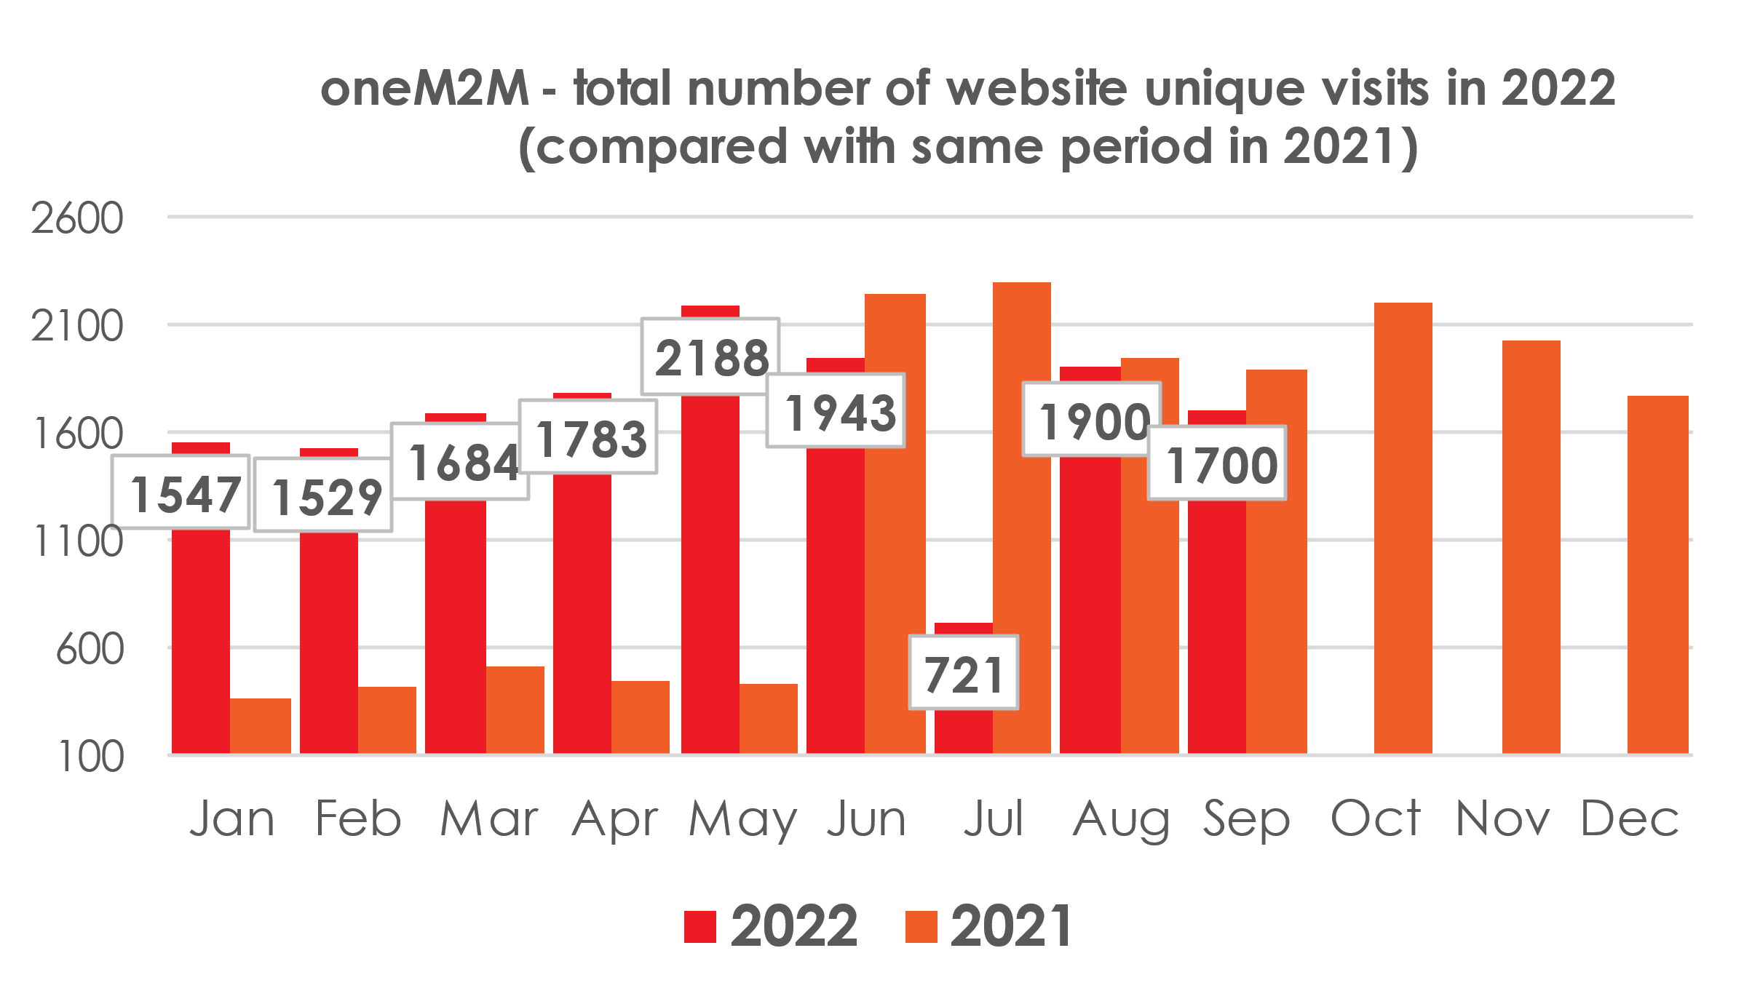
Website – Visits analysis
Top 10 countries from where people visited website in Sep’22
First time visit of Netherlands!!!

Slide 11
Website - Visits
oneM2M – Top ten viewed pages in Sep’22
Total page views in Sep’22 = 6863

Slide 12
Website - Visits
Where do visits come from (monthly):
Sep-22
Organic search | 891
Direct | 728
Referral | 78
Social | 27
2 | 1 | 1 | 1 | 1 | 1 | 0 | 1 | 0 | 2 | 1 | 1 | 2 | 1 | 0 | 2
#Viewpoints published every month

Slide 13
Reference Slides

Slide 14
Thought Leadership – Articles
Global Journals
Paper in IEEE Internet of Things Journal
Trade Journals
oneM2M and sustainability - IoT Business News;
Open Standards article for Interoperability News EU
ABI Research interview with oneM2M for their Smart Cities research program
Comments on Industrial IoT submitted to AI Magazine
Pipeline Magazine - Making IoT Intelligent
IoTforAll - "efficient IoT messages"
Regional
Feature in National Post, Canada)
Voice & Data, India Smart Cities Edition
oneM2M in context of smart cities for tele.net, India
Partner Communiques
ETSI Enjoy - Addressing Societal Challenges with IoT
ETSI Enjoy - IoT data for industrial verticals
ETSI Enjoy: Standards to Support AI/ML Services
Activities Tracker link

Slide 15
Potential Article Opportunities
Global Journals
IEEE Network Special Edition on Smart Communities (dropped)
Trade Journals
Second article for Interoperability News (with Enrico)
Regional
Partner Communiques
SDO Interviews about oneM2M for ETSI Enjoy!
ETSI Enjoy (10-year celebration)
oneM2M deployments for ETSI Enjoy!

Slide 16
Engagement – Interviews & Executive Insights
oneM2M in the News – 1204 Subscribers
Press Releases – 1
Media queries to oneM2M_PressMedia@list.onem2m.org being forwarded to Bindoo, Aurindam, Ken, Akash
Interviews
None
Executive Insights
Roland on TP#52 – 5th Jan’22
Roland on TP#53 - 9th Mar’22
IoT and 6G interview with Onel Alcaraz López (Finland) 16th Mar’22
Interview about UCL standardization study 7th Apr’22
SMARTM2M study on IoT data for AI - Michelle W 25th May’22
Roland on TP#54 – 3rd Jun’22
Interview with TCS (DigiFleet) – 23rd Jun’22
Mauro Dragoni – his activities in IoT industry and his project related to SAREF – 27th Jul’22
Roland on TP#54 – 7th Sep’22
IUDX-oneM2M pilot – 12th Sep’22
Activities Tracker link
Notes:
Executive Insights in pipeline –
TP #55 (Roland)
Dr Indergopal IISC Bangalore - IUDX-oneM2M interface for smart cities
Sateesh (CDAC - CoSMiC) satheeshg@cdac.in
TP #56 (Roland)

Slide 17
VISIBILITY – Events & Speaking Opportunities
VISIBILITY | oneM2M | Partner driven | Regional
Events | - Interop to be hosted by TTA in Dec’22 | 18 Jan: ETSI-TSDSI Webinar on oneM2M “Risk/Benefit analyses” 25 Jan: ETSI-TSDSI Webinar on oneM2M ” Smart Lift private sector use case ” ETSI: EU-Brazil Bilateral 4 Feb: ETSI-TSDSI Webinar on oneM2M “Smart Home/Smart Building private sector use case” ETSI-Argentina talk on oneM2M 6 Apr: ETSI- EU-Brasil cooperation workshop : on IoT Policy, Regulation & Standards 28 Apr: ETSI-TTA Smart Cities in Korea TSDSI- A webinar conducted by DoT-TSDSI on M2M for transport vertical on 7 Apr’22 | 24 Feb: INDIA- TEC Organised webinar on oneM2M- Smart cities 28 Mar: NTIPRIT Conference on M2M 7-8 Apr: New Delhi India - InTranSe conference 21 Apr: Webinar on CCSP and CoSMiC - indigenous software platforms for M2M/IoT Communication 7 Apr: DoT-TSDSI Webinar #1 on M2M applied to verticals- transportation 4 May: DoT-TSDSI Webinar #2 on M2M applied to Utilities
Speaking Opportunities | 20-21 Sep'22: "IoT Tech Expo : POWERING THE CONNECTED WORLD WITH IOT|| AMSTERDAM/Hybrid|| free to attend|| Rana Kamill speaking" 26 Oct-11 Nov’22: IEEE IoT WF /Tokyo/Hybrid 13-14 Oct’22: Rana (BT) speaking at IoT World Forum 2022 london (RESCHEDULED to 13-14 Oct ‘22) Potential speaking opportunities for CY’22 are listed in notes | 5 in pipeline | 1
Activities Tracker link
Notes:
Regional Events Upcoming -
1-3 Oct: IMC 2022*
18-20 Oct: Future Com Brazil/Hybrid/Sau Paolo
IET Future Tech Congress - 22-23 Nov (Phygital)/BLR
12-15 Oct: The 2nd International Conference on AI-ML-Systems (AIMLSystems'22), F2F Bangalore, India

Slide 18
Potential Key Events /Speaking Opps
Potential Global and Regional Events
Embedded Technologies Convention
IEEE 8th IoT World Forum (26 Oct-11 Nov’22 // Yokohama, Japan (in person and hybrid)
Futurecom 2022: 18-20 Oct’22, Sao Paulo, Brazil
ETSI IoT Week
Korea IoT event
TSDSI Tech Deep Dive 2022
India Mobile Congress IMC 2022
WORLD SMART CITY EXPO 2022 – Korea - 31 Aug-2 Sep’22
Embedded Technology Convention ASIA - 28-29 Sep’22
India Mobile Congress- 1 - 4 Oct’22
TSDSI Tech Deep Dive - 07-10 Nov’22
5th INTERNATIONAL CONFERENCE ON FUTURE SMART CITIES (FSC) - 18-20 Nov’22
IET Future Tech Congress 2022 (Phygital event) - 22-23 Nov’22

Slide 19
MARCOM Approach
MARCOM Goals
Provide sustained Market Visibility for oneM2M;
to increase the understanding of oneM2M both as a technical standard and as an organization for developing and maintaining a standardization roadmap; and,
develop the market for oneM2M solutions.
Approach
Global (oneM2M level), Partner level and Regional activities
Articles & Speaking Opportunities in targeted journals/periodicals and Events
Support development of collateral for Developers
Interactions being held with Partner and oneM2M experts

Slide 20
Thank You

