Slide 1
Marcom Report
Bindoo Srivastava, Marcom Chair
13 April 2023

Slide 2
Outline
Update on oneM2M Stakeholders Day
Update on IIITH workshop on oneM2M
oneM2M Hackathon – details /timeplan/list of participating teams
  Outcome of the promoted post on LinkedIn –stats from PPR
Summary oneM2M Stakeholders Day
Key Highlights
Potential Speaking Opportunities
CY’23 Activities

Slide 3
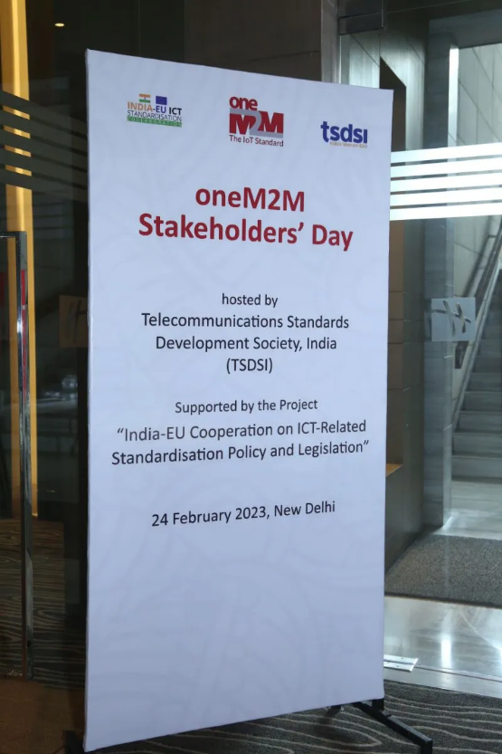
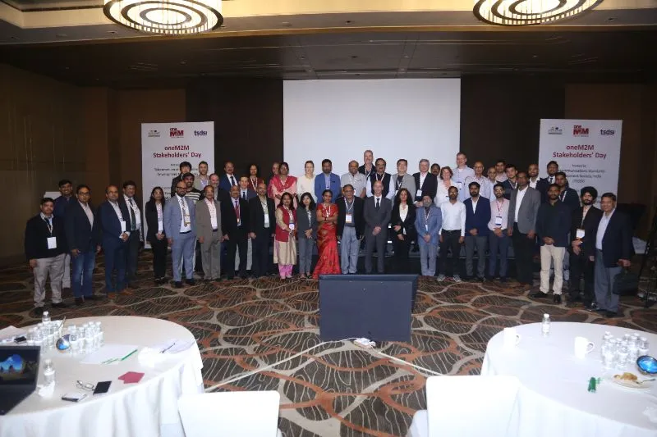
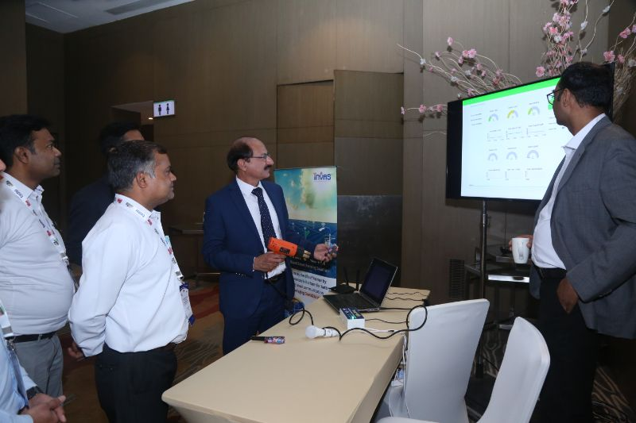
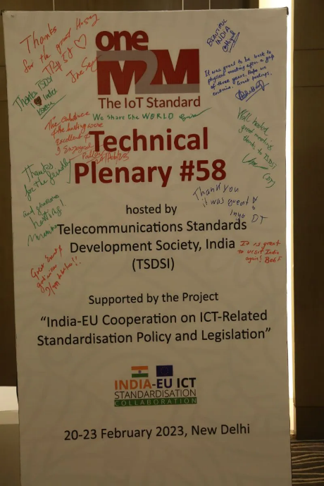
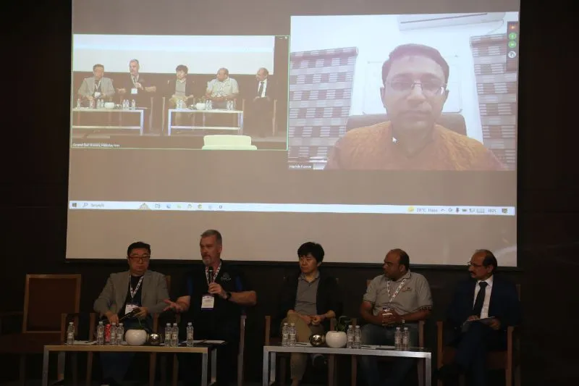
oneM2M Stakeholders Day@ TP58
oneM2M TP 58 and Stakeholders Day hosted by TSDSI from 20th – 23rd Feb and 24th Feb’23 respectively in New Delhi.
In addition to keynotes and panel discussion, event also had demonstrations by domestic IoT/M2M players.
16 participants in person + 77 online

Slide 4
Key Takeaways from the Stakeholders’ Day
TEC’s recommendations on M2M/IoT Security. Released 18 TRs with the outcome intended to be used in policy/ standards.
Significant progress in adoption of oneM2M based platforms in India.
CDACs initiatives in making interoperable ITS solutions
Invitation to CDOT’s team working on PAN-India CAP based Integrated Alert System for Disaster Management for contributing in oneM2M
Efforts by Indian Universities to proliferate oneM2M in academics

Slide 5
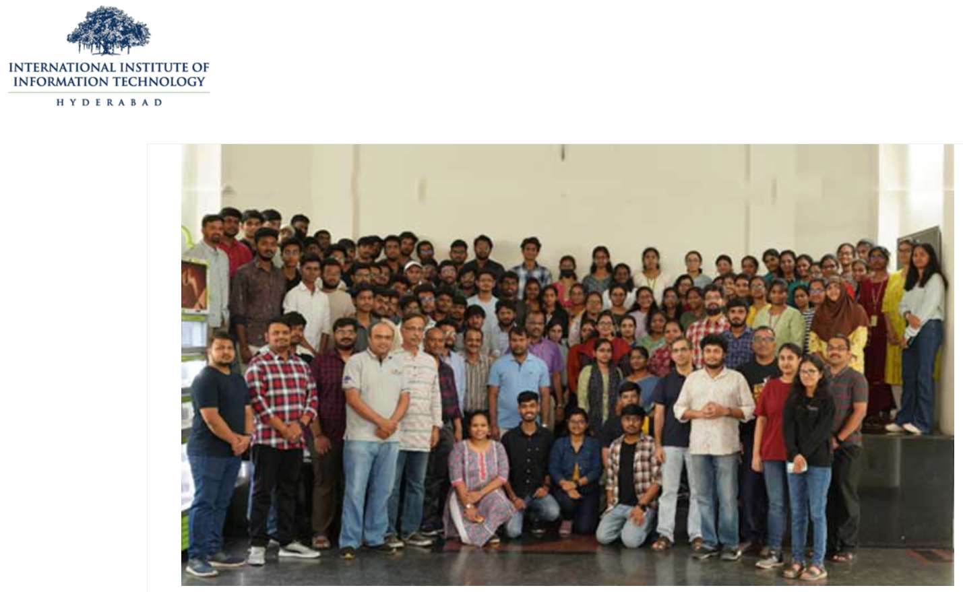
IoT & IoT & oneM2M Workshop for Smart Cities (by IIIT-H)
IIITH organized a Hands-on Workshop on IoT and oneM2M for Smart Cities on 18 and 19 March under its College Research Affiliate Program
Objective of workshop - to train the students and faculty of the affiliated colleges on the topics of IoT, Smart Cities, Plug Load Monitoring, and oneM2M & encouraging them to deploy standard-based solutions in their campuses for energy-efficient smart buildings.
More information

Slide 6
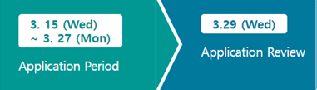
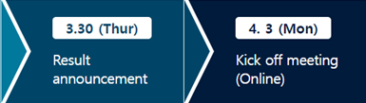
Hackathon
Kicked off with meeting on 3rd April’23 with a meeting (https://www.mobius-contest.co.kr/en/)
Schedule Overview –
oneM2M sponsored LinkedIn campaign conducted by PPR -

Slide 7
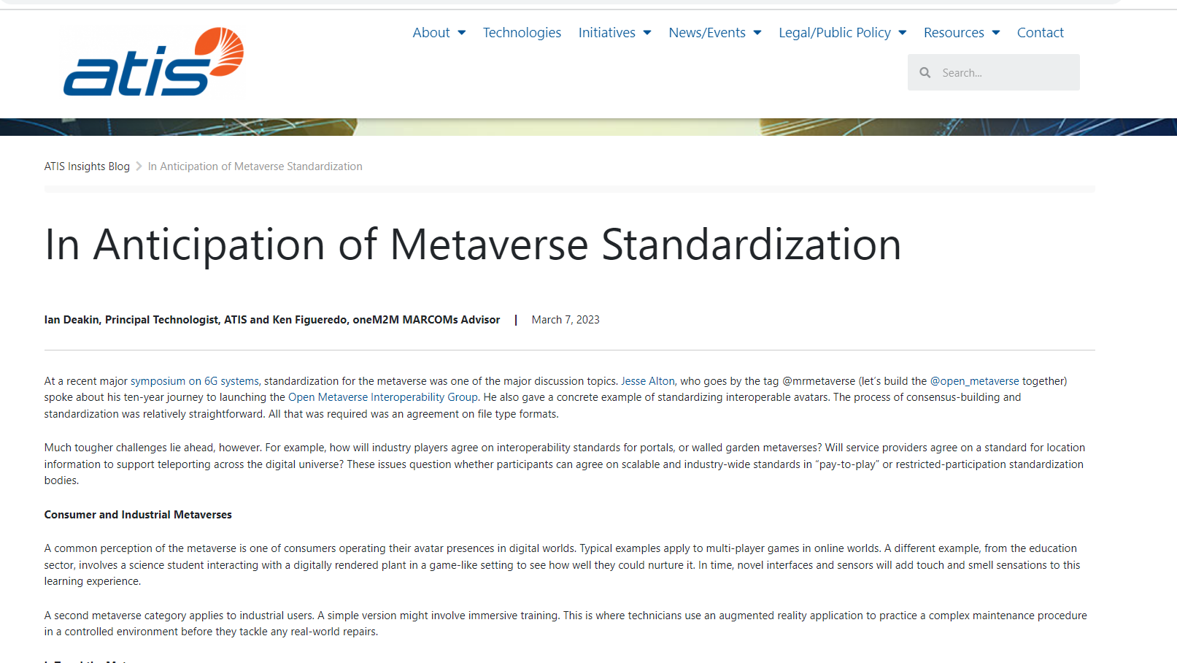
ATIS Blog related to oneM2M

Slide 8
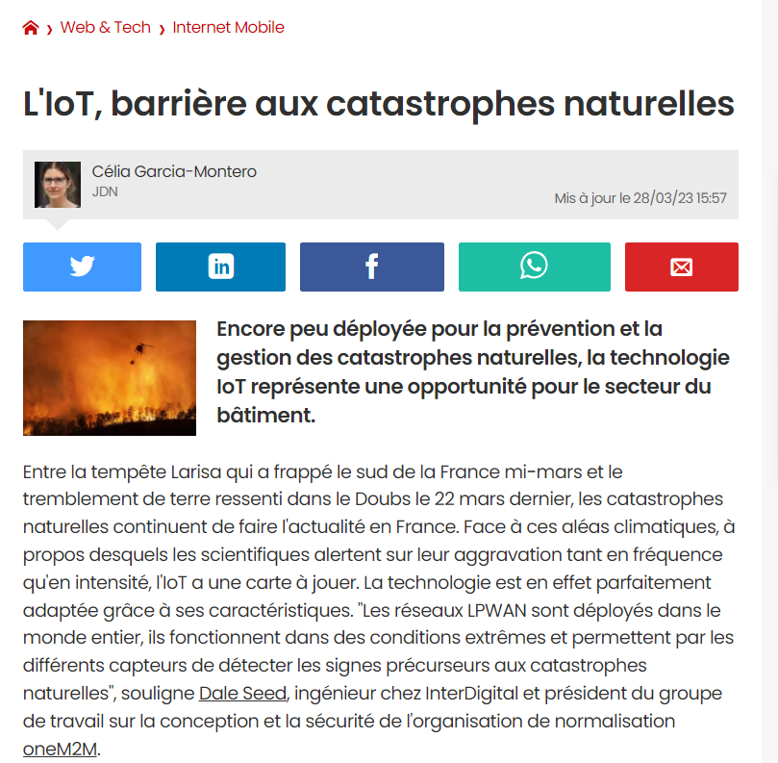
Dale Seed interview with JournalDuNet

Slide 9
Key Highlights - Mar’23
External Publications:
Pipeline Magazine (2023 predictions) (Feb’23)
(Dale Seed) ETSI sustainability Summit + Interview with Journal du Net.it on IoT Sustainability - https://www.journaldunet.com/ebusiness/internet-mobile/1520841-l-iot-barriere-aux-catastrophes-naturelles/
IoT & oneM2M workshop for Smart Cities – organized by IIIT Hyderabad
ATIS blog (Metaverse standardization)
ETSI Enjoy Mar (Sustainability)
Articles: 2023 IoT trends for A&G via PPR;
Engagement: Executive insights – 3 in Feb’23 + 1 in Mar’23
MWC 2023 Engagement - Luis covered oneM2M Sustainability @ GIO Round Table
Visibility:
Total Events organized (0@oneM2M, 2@Partner, 0@Regional):: ETSI Sustainable Event (30th Mar) + TTA Int. oneM2M Hackathon
Speaking Opportunities: Refer oneM2M Promotions Tracker
Social Media: 1452 Twitter followers, 127 posts (+38 in Mar’23); 1331 LinkedIn followers, 20 posts (+ 5 in Mar’23)
Notes:
Potential Articles:
CFP - Special Issue on Metaverse for Connected and Automated Vehicles and
Intelligent Transportation Systems https://www.ieeevtc.org/vtmagazine/specisu--Metaverse-CAVS.php
IEEE VT Magazine (Impact Factor: 13.609). http://www.ieeevtm.org;
- Manuscript Submission deadline: 15th April 2023
- First Round Reviews by: 15 June 2023
- Second Round Submissions by: 1st August 2023
- Final Editorial Decision: 15 September 2023
- Published: December 2023
Potential Speaking Opportunities –
1. oneM2M Stakeholders Day (co-located with TP 58 in Delhi, India)
2. IoT Tech Expo & Edge Computing Expo - North America (17-18 23) – Santa Clara, CA
3. IoT Tech Expo & Edge Computing Expo - Europe (26-27 Sept) – Amsterdam
4. IoT Tech Expo - Global (30th November – 1st December) – London

Slide 10
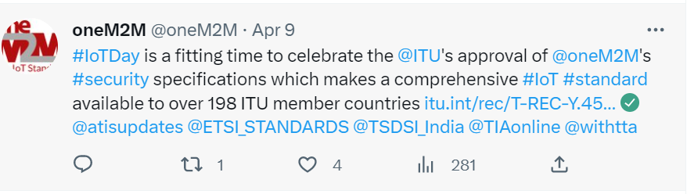
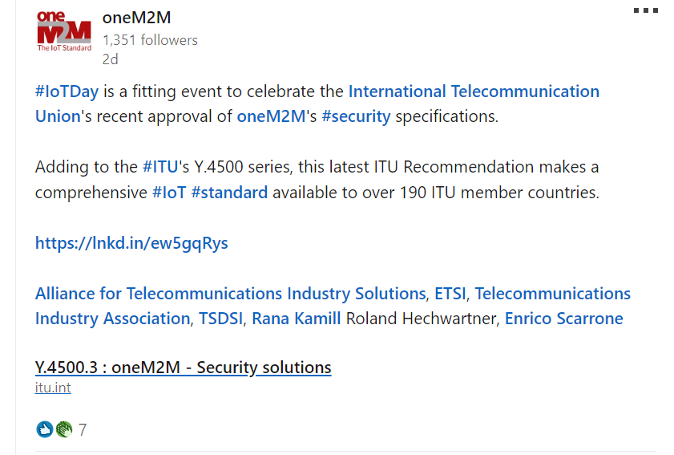
World IoT Day – 9 April 2023
Tweet
LinkedIn Post
Notes:
Potential Articles:
CFP - Special Issue on Metaverse for Connected and Automated Vehicles and
Intelligent Transportation Systems https://www.ieeevtc.org/vtmagazine/specisu--Metaverse-CAVS.php
IEEE VT Magazine (Impact Factor: 13.609). http://www.ieeevtm.org;
- Manuscript Submission deadline: 15th April 2023
- First Round Reviews by: 15 June 2023
- Second Round Submissions by: 1st August 2023
- Final Editorial Decision: 15 September 2023
- Published: December 2023
Potential Speaking Opportunities –
1. oneM2M Stakeholders Day (co-located with TP 58 in Delhi, India)
2. IoT Tech Expo & Edge Computing Expo - North America (17-18 23) – Santa Clara, CA
3. IoT Tech Expo & Edge Computing Expo - Europe (26-27 Sept) – Amsterdam
4. IoT Tech Expo - Global (30th November – 1st December) – London

Slide 11
Opportunities
IoT Tech Expo & Edge Computing Expo - North America || 17-18 May 23 || Santa Clara, CA :: Bob Flynn speaking
ETSI IoT Week
Engagement with Penn State University during TP62 || 14-18 Aug 23 || PSU
IoT Tech Expo & Edge Computing Expo - Europe || 26-27 Sep 23 || Amsterdam
Smart Nation Expo 2023 || 16 -21 Sep 23 || Kuala Lumpur (being explored)
Korea IoT week (11-13 Oct’23)
IMC 2023 (27-29 Oct’23)
TTDD 2023 (Oct-Nov 23)
9th IEEE World Forum on IoT – 12 to 27 Oct’23 // Aveiro, Portugal (Hybrid)
IoT Tech Expo - Global (30th November – 1st December) – London: Rana Kamill

Slide 12
Other CY’23 Activities
oneM2M Tutorials – translate from Korean to English
oneM2M icons library
Microcertifications mechanism
Explore Regional engagements – Malaysia, others?
Capacity Building on oneM2M - In the wake of ITU-T SG20 endorsement?
University outreach :
  2023 International oneM2M hackathon (Mar – May’23 || Application Period - Mar 15 – 27 2023)
  Outreach at TP61 with Penn State university (Aug-Sep?
  developer series? Q2-Q3
oneM2M White paper on MEC (JaeSeung Song)- Q1 ‘CY 23
Retain mindshare in the ecosystem and keep promoting new information around relevant oneM2M TP/SSC milestones through Regular features/media interactions/speaking opportunities - Metaverse, Rel 5 etc.

Slide 13
Reference Slides

Slide 14
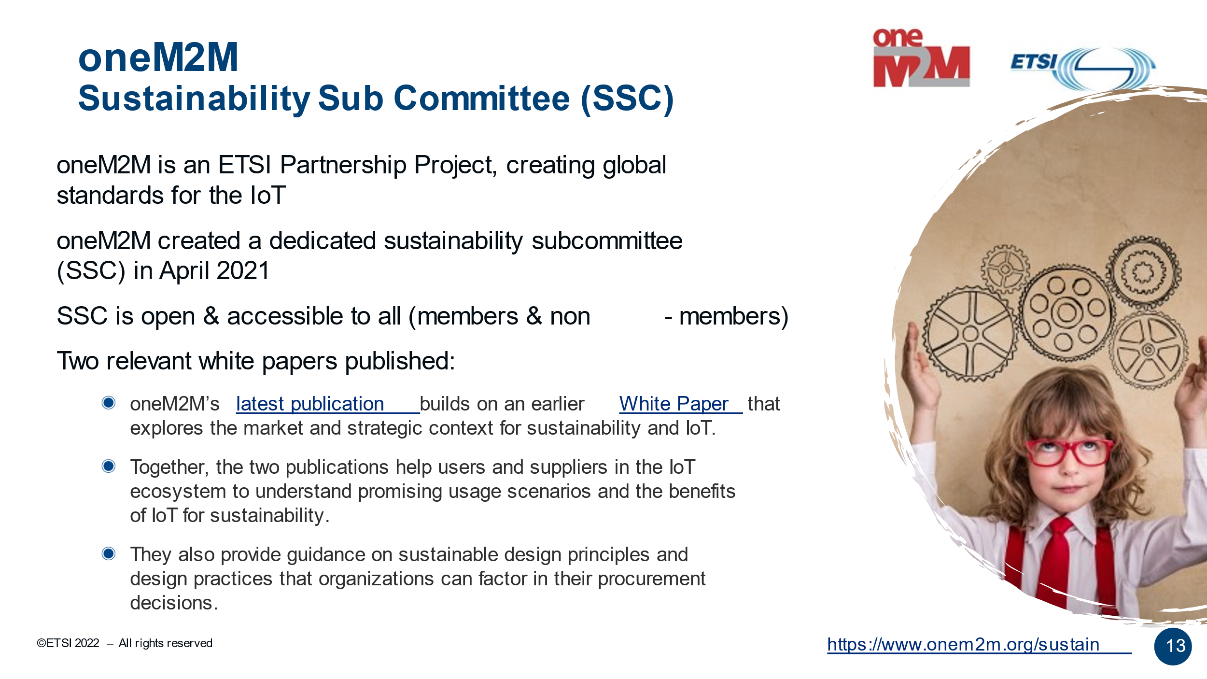

Slide 15
Thought Leadership – Articles CY’23
  Global Journals
  The Fast Mode - Metaverse standards
  Pipeline Magazine (2023 predictions)
  Trade Journals
  Regional
  Partner Communiques
  ETSI Enjoy Jan
Activities Tracker link
Notes:
2023 IoT trends for A&G via PrPR

Slide 16
Engagement – Executive Insights (CY23):
oneM2M in the News – 1206 Subscribers
Press Releases – 2
Media queries to oneM2M_PressMedia@list.onem2m.org being forwarded to Bindoo, Aurindam, Ken, Akash
  Executive Insights
  Indian industry interest in training on CDOT’s oneM2M platform (22 Feb’ 23
  IoT systems and the evolution of solution requirements by nTels – 9th Jan’23
  Standardization in Smart Elevator by Patrick Cox (TRE-E scrl)
  Standardization in Smart Lift Sector by Marco Cogliati (TRE-E scrl)
Activities Tracker link
Notes:
Interview in pipeline –
https://futureiot.tech/

Slide 17
Thought Leadership – Articles CY’22
  Global Journals
  Paper in IEEE Internet of Things Journal
  IEEE paper on CDAC's CoSMiC Platform for Intelligent Transportation System
  Trade Journals
  oneM2M and sustainability - IoT Business News;
  Open Standards article for Interoperability News EU
  ABI Research interview with oneM2M for their Smart Cities research program
  Comments on Industrial IoT submitted to AI Magazine
  Pipeline Magazine - Making IoT Intelligent
  IoTforAll - "efficient IoT messages"
  Regional
  Feature in National Post, Canada)
  Voice & Data, India Smart Cities Edition
  oneM2M in context of smart cities for tele.net, India
  Partner Communiques
  ETSI Enjoy - Addressing Societal Challenges with IoT
  ETSI Enjoy - IoT data for industrial verticals
  ETSI Enjoy: Standards to Support AI/ML Services
  SDO Interviews, 10-year celebration, oneM2M deployments and Market Impact for ETSI Enjoy!
Activities Tracker link
Notes:
2023 IoT trends for A&G via PrPR

Slide 18
Engagement – Executive Insights (CY22):
oneM2M in the News – 1206 Subscribers
Press Releases – 2
Media queries to oneM2M_PressMedia@list.onem2m.org being forwarded to Bindoo, Aurindam, Ken, Akash
  Executive Insights
  Roland on TP#52 – 5th Jan’22
  Roland on TP#53 - 9th Mar’22
  IoT and 6G interview with Onel Alcaraz López (Finland) 16th Mar’22
  Interview about UCL standardization study 7th Apr’22
  SMARTM2M study on IoT data for AI - Michelle W 25th May’22
  Roland on TP#54 – 3rd Jun’22
  Interview with TCS (DigiFleet) – 23rd Jun’22
  Mauro Dragoni – his activities in IoT industry and his project related to SAREF – 27th Jul’22
  Roland on TP#54 – 7th Sep’22
  IUDX-oneM2M pilot – 12th Sep’22
  Roland on TP#56 – 25th Oct’22
  Roland on TP#57 – 14th Dec’22
Activities Tracker link
Notes:
Interview in pipeline –
https://futureiot.tech/

Slide 19
oneM2M in Press
IoT expectations in 2023 | November 2022 | What to Expect with IoT in 2023 - Architecture & Governance
ETSI Enjoy! | October 2022 | The latest ETSI Enjoy! publication devotes three articles to IoT and the impact of oneM2M standardization, ten years after the launch of oneM2M
IoT for all | October 2022 | The IoT for All community recently published an article on the need for efficient message payload techniques to improve the performance of constrained IoT devices and sensors. It presents the benefits of common service functions (CSFs)
IoT devices & cyber threats | August 2022 | This is how enterprises can protect their IoT devices from cyber threats - BizzBuzz
Making IoT Intelligent | July 2022 | Internet of Things (IoT) systems involve combinations of connected devices and sensors.
IoT and Sustainability | April 2022 | IoT technologies provide the building blocks to address sustainability goals
Notes:
International Institute of Information Technology (Hyderabad)
blog post (January 2023) - IITH's Smart City team wins Best Technology award in Korean hackathon ETSI Enjoy! January 2023Research and Innovation in IoT Standardization
ETSI Enjoy! January 2023Research and Innovation in IoT Standardization

Slide 20
oneM2M in News
17 December 2022 | oneM2M Ends 2022 on a High in Korea
18 October 2022 | IOT STANDARDIZATION FOR DIGITAL AND GREEN TRANSFORMATION: SPEAKER PRESENTATIONS FROM ETSI IOT WEEK 2022
17 October 2022 | INVITATION FOR oneM2M 8TH INTEROPERABILITY EVENT
10 October 2022 | oneM2M OUTLINES 8 TECHNIQUES FOR SUSTAINABLE IOT
August 2022 | This is how enterprises can protect their IoT devices from cyber threats – BizzBuzz
July 2022 | Internet of Things (IoT) systems involve combinations of connected devices and sensors.
April 2022 | IoT technologies provide the building blocks to address sustainability goals

Slide 21
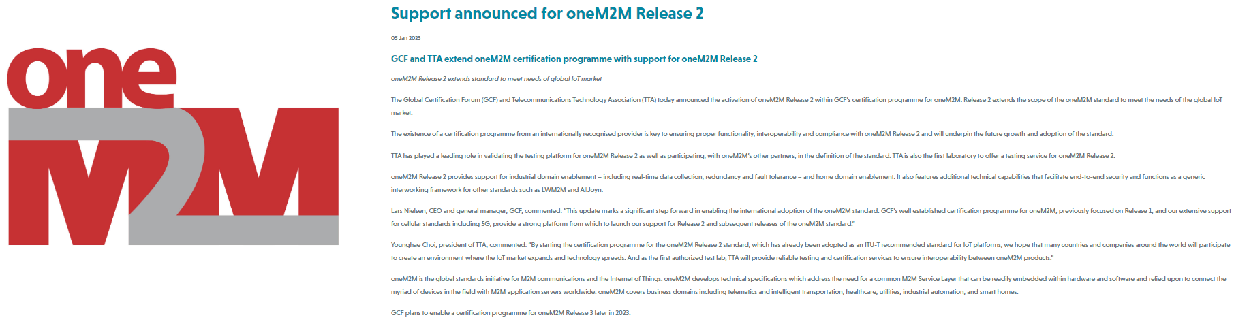
GCF – oneM2M Rel 2 Certification
Global Certification Forum (GCF) and Telecommunications Technology Association (TTA) announced activation of oneM2M Release 2 within GCF’s certification programme for oneM2M
“By starting the certification programme for the oneM2M Release 2 standard, which has already been adopted as an ITU-T recommended standard for IoT platforms, we hope that many countries and companies around the world will participate to create an environment where the IoT market expands and technology spreads. And as the first authorized test lab, TTA will provide reliable testing and certification services to ensure interoperability between oneM2M products.“ - Younghae Choi, president of TTA

Slide 22






Thank You

