Slide 1
Micro-certifications Findings
Jaskirat Singh, TSDSI Marcom Team
8 June 2023
© 2023 oneM2M

Slide 2
Microcertifications Mechanism (Findings)
Microcertifications:
Smaller set of courses/modules designed to provide learners with knowledge, skills, and competencies in the area of study.
More flexible, focussed, more targeted learning.
Helps to fill the gaps and provide upskilling in short duration.
Provide Industry relevant professional growth.
More the No. of learners & certificates issued, more will be the visibility of the organization.
Examples:
Microsoft, IBM, Google etc. offer some free online courses and learners get certificate of completion/digital credentials.
The ITU Academy (for ITU’s capacity development activities) offers a wide range of training courses like ITU A.1 with different delivery modes (online self-paced, online instructor-led, face-to-face, and blended)
IIIT-H has been running a oneM2M MOOC course prepared under the India-EU PP.

Slide 3
Platforms to start online course
Self Hosting
Need to set up everything to host on website- domain name, LMS, place to host the course, email automation etc. This option takes a significant amount of time and technical knowledge. There are many softwares available for that e.g.
a) Teachable:
Teachable - upload text, presentations, videos, audios
b) Thinkific
Free Trial Plan: free 30-day trial of our Start Plan.
Some Features:
Drag and drop course builder/Full video & content hosting
Digital downloads/Certificates are automatically issued after completion of the course.
Market Place platforms
LinkedIn Learning, Udemy, Coursera etc.
For Linkedin Learning, once the form is submitted to become an instructor , they will reach out to us for further process. We can upload course materials that can include a brochure about course, PowerPoint presentations, course handouts (PDFs), videos or graphics etc.
Hosting Custom Course on Udemy Platform- Anyone can create a custom course for their Udemy Business account , however, will need to submit the custom course for review and an admin will need to approve it before it’s published.

Slide 4
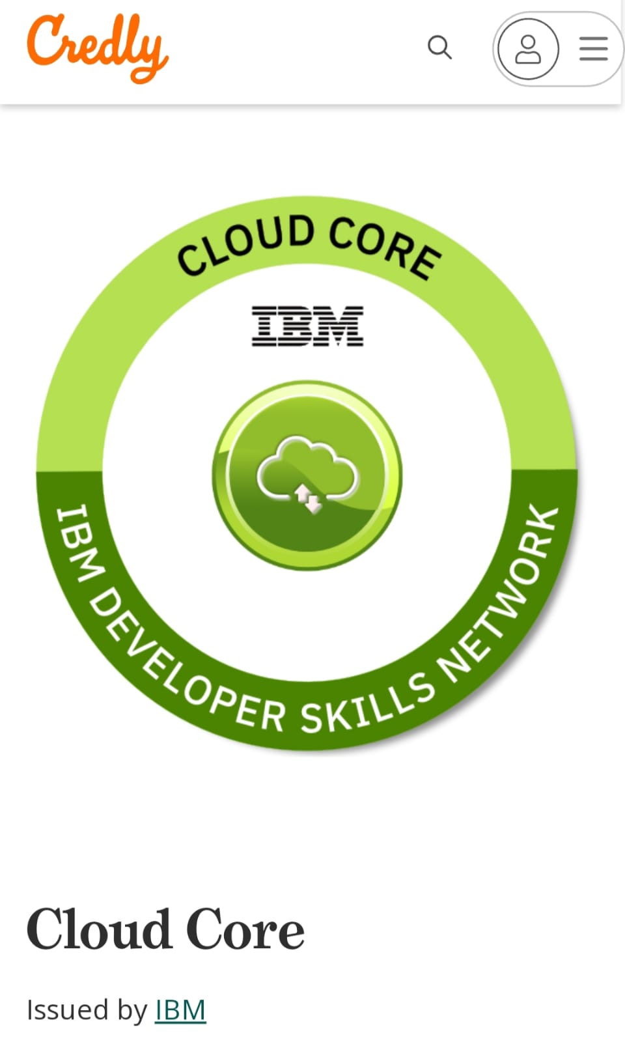
Key considerations
Features for online course:
Type- course to be webinar/text-based/ video-based
Assessment- can be through quizzes/Self-assessment questions/Exercises etc.
Flexibility- can be provided by offering a variety of delivery methods, such as online, in-person, or self-paced .
Mentoring-- it gives online learners the opportunity to benefit from more experienced peers
Issuing Digital Badges
A digital badge contains all the information required to verify the credential: name of the issuing organization, date, holder’s name and proof of acquisition. There are many platforms to issue digital badges .one such example is Credly. These badges are being used by PSU Engineering School (shared by Bob Flynn) https://info.credly.com/solutions/employee-learning-and-development
Different ways to deliver course material:
By Creating articles, videos, and other materials that can be stored online .
Through Powerpoint Slideshows
Recordings of a webinar or training seminar can be added to collection of permanent training material. Having a store of permanent training materials makes self-paced learning easier
By Animated training videos
Pathways to get Micro Certification Accredited: Partnering with University- The Organisation can set the course content & collaborate with universities to deliver the course and issue certificates. Partnering with Professional Organisation- can partner with organisation like Microsoft, IBM, Cisco, Apple, Intel etc. for content creation and issuing certificates.

Slide 5
Thank You
© 2023 oneM2M

