Slide 1
Marcom Report
Bindoo Srivastava, Marcom Chair
8 June 2023
© 2023 oneM2M

Slide 2
Outline
Campaign proposal by PPR – showcasing oneM2M Champions
ETSI-oneM2M joint white paper on MEC: promotion campaign
Discussion on a white paper proposal amplifying message of depth of oneM2M?
Executive Interview with Aetheros’ Ray Bell on their oneM2M based solution
Reactions to the PR issued on oneM2M Security Specs approval @ ITU
oneM2M Webinars under India EU PP
Recent Events/Speak Opps.
IEEE Globecomm IEEE Global Communications Conference 4–8 December 2023 // Kuala Lumpur, Malaysia
Upcoming Events/Opportunities
Webpage giving List of oneM2M Resources
Developer Resources – Updates
Other activities
Review of Bimonthly bulletin – Jun’23 issue.

Slide 3
Key Highlights – May’/Jun 23
External Publications: NIL publications in May’23 (06 TOTAL in CY’23) *ETSI Enjoy! (Ken submitted article in June 2023)
oneM2M Developers Resources – 1 new episode published (total 8 out of 9 now available on Youtube and Wiki)
Engagement: 2 Executive Insights published in May and 1 in June. (11 Total in CY’23)
Visibility:
Total Events organized (nil@oneM2M, 2@Partner, 2@Regional level)
Speaking Opportunities – 2 availed
Social Media (Till May’23): LinkedIn 1365 followers (▲9 in May’23), 32 total posts CY’23; Twitter 1456 followers, 111 total posts CY’23
Communiques & PRs:
PRs – 1 issued; carried by 5 agencies
Media Queries - 2
Refer oneM2M Promotions Tracker
Notes:
External Publications:
ETSI Enjoy! (Ken submitted article in June 2023)
Executive Interviews:
TP#58 and Release 5 Standardization Activities – 22nd Mar’23 by Roland Hechwartner (oneM2M TP Chair)
DT IoT Hub – 4th May’23 – By Andre Dutra (DT)
oneM2M in Utilities by Atheros – 5th Jun’23 Ray Bell
Partner events
TTA – oneM2M International Hackathon
TTA - oneM2M Global seminar - 13 June 2023
Regional level
WTISD celebration (Speaking Opportunity)- 8 June 2023
IoT week Berlin- (19-22 Jun23)
Speaking Opportunities –
Rana Kamill in Telesemana webinar (17 May)
Bob Flynn speaking in IoT Tech Expo & Edge Computing Expo - North America | 18th May ‘23) | Santa Clara, CA
Media Queries - 2
CSO
Security Boulevard
***

Slide 4
Campaign proposal by PPR - oneM2M Champions
Campaign: Champion Series
Showcase the importance of ‘Contributors across oneM2M’ and why each person chooses to play an active role in defining and developing standards to address the need for interoperable and scalable IoT systems.
Objective: Promote membership and increase brand exposure across key target regions.
Post: Carousel style
Need volunteers (at least 3 – 4 )
need headshot and quote giving their reasons of the importance of being an active member of oneM2M.

Slide 5
ETSI-oneM2M joint white paper on MEC: promotion campaign
Queries from Jayne (PPR) on the white paper :
The white paper talks about interworking between oneM2M and IoT. In some places it seems to suggest that is possible today – but it also identifies that further work is needed to build on this, such as a high interworking framework. Are there plans for this new work to be launched within oneM2M to deliver this? If so, what stage is this at? Or are you hoping the whitepaper will generate interest in oneM2M members in starting this work?
Is this the first time that guidance on MEC and oneM2M interworking has been shared? If so, what impact will this have on the IoT landscape as a whole? Could we for example say something like: “The IoT ecosystem will benefit from new 5G capabilities as new guidance on edge computing and IoT interworking is published today.”
Proposed to circulate latest version to larger oneM2M community. (A few TSDSI IMs would like to review)
ETSI regularly publishes White Papers – that are announced/or a ‘collective letter’ sent to members.
Propose a campaign – to generate/rekindle interest in oneM2M via MEC.
Propose oneM2M draft content of the PR announcing launch of the white paper
PR campaign time-plan: Teaser on social media etc. building up to the launch in ETSI IoT week and then issue of the PR. Followed by Interviews with key persons during the launch if feasible.

Slide 6
Executive Interview with Aetheros’ Ray Bell on their oneM2M based solution
…
The Common Service Layer functions like an open, distributed operating system geared to machines and things. That is quite different from an operating system that is designed for smartphones and tablets.
…. Around 2012, we were working through Grid Net on meters and automotive applications. One of our partners was KDDI (Japan). They introduced us to oneM2M. We looked at … common services in our platform, such as digital identity management, dynamic group policy, device, application, and network management, and a durable and reliable publish/subscribe messaging platform. …saw an immediate match with oneM2M’s CSL. …embraced oneM2M …
In the US, for example, Verizon has leveraged AOS and our PolicyNet application (a oneM2M AE) for its smart metering as a service solution (Verizon GridWide).
built massive resource trees …. AOS CSE is deployed at scale meeting our customer’s reporting metrics of over 99% and delivering over 3 billion meter reads daily.
…The orchestration of distributed energy resources requires edge computing, and the management of millions of edge apps at utility scale requires an open-standard Common Service Layer. … AOS is the only proven oneM2M compliant IoT service layer in production in the utility market today. To foster the edge app ecosystem for grid modernization, our AOS SDK and open-source code sample apps, which are freely available on GitHub, enables the IoT app developer to rapidly develop and deploy embedded Edge apps in a matter of days….
https://www.iotm2mcouncil.org/iot-library/news/smart-energy-news/aetheros-to-power-us-smart-meter-deployments/

Slide 7
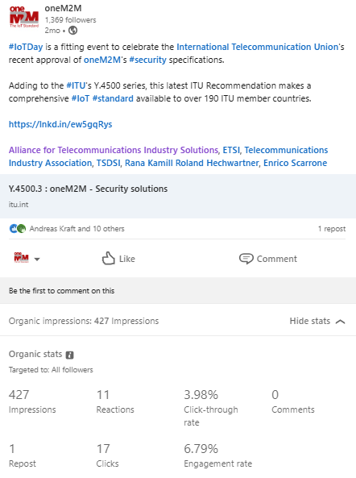
Reactions to the PR issued on oneM2M Security Specs approval @ ITU
Twitter post picked up 101 views, LinkedIn post - over 400 impressions, 10 interactions with followers.
Security Boulevard want an interview: PPR is trying to e-connect Rana with the editor for the interview
Editor CSO magazine was provided information sought by them on the security specs. Possibility of a follow-on interview being explored by PPR

Slide 8
oneM2M Webinars under India EU Cooperation on ICT Related standardization, Policy & Regulation

Slide 9
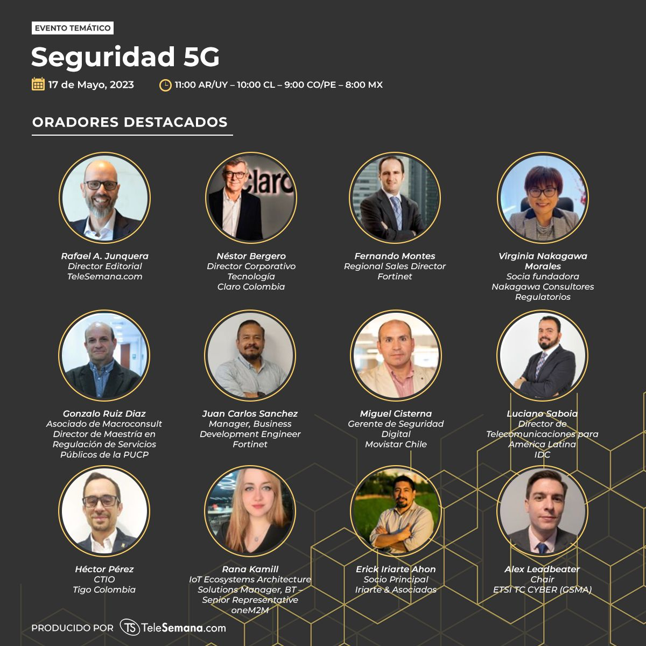
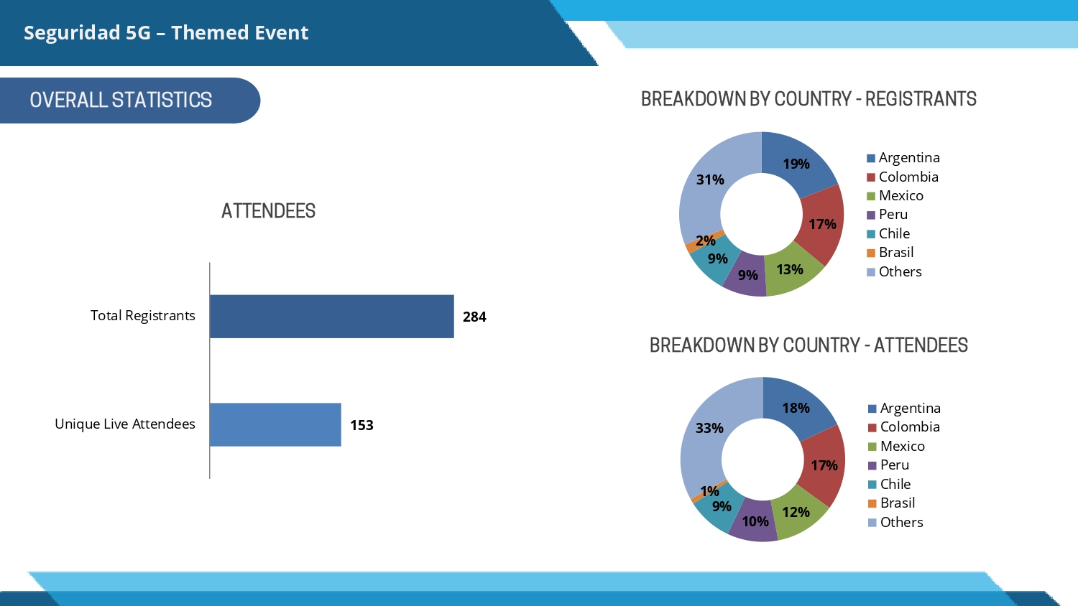
Recent Events/Speak Opps.
Bob Flynn @ Edge Computing Expo North America 17-18 May 2023
Rana Kamill @ TeleSemana May 17, 2023
Aurindam Bhattacharya @ Regional workshop on ‘M2M & IoT security & use cases’ organized by Mumbai LSA, Department of Telecommunications 26 May 2023

Slide 10
IEEE Globecomm IEEE Global Communications Conference | 4–8 Dec’23 | Kuala Lumpur, Malaysias
IEEE GlobeComm Conference in Dec 2023 | Malaysia
An industry program, podium pitches and executive forum that will be run along the conference duration.
For industry presentation, you may view it at: https://globecom2023.ieee-globecom.org/authors/information-industry-presentations
You may submit your proposal via email for industry presentation to Dr Nordin, nordin@ieee.org, our IF&E co-chairs for review and discussion among the OC committee for suitability of the topics etc. Kindly copy us for our reference, should you decide to submit your proposal to IEEE.
For podium pitches, it’s a 5 minutes talk about anything related to communication at the exhibition booths. This can be arranged for MTSFB.
For the executive forum, you can submit the experts' CV to us for nomination, however, this depends on the availability of seats for the speakers.

Slide 11
Upcoming Events/Opportunities
WTISD celebration -8 June 2023- Bindoo Srivastava (Courtesy Dr Hideyuki Iwata San)
The global oneM2M event and hackathon awards ceremony in Seoul 13 Jun’23
ETSI IoT Week || 4-6 July 2023
Engagement with Penn State University during TP62 || 14-18 Aug’23 || PSU
Smart Nation Expo 2023 || 16 -21 Sep’23 || Kuala Lumpur (being explored)
IoT security & Stds based IoT/M2M practical implementations of solutions | 25-26 sep’23 | New Delhi
Korea IoT week (11-13 Oct’23)
IMC 2023 (27-29 Oct’23)
TTDD 2023 || 3-6 Oct’23
IoT Tech Expo - Global (30th November – 1st December) – London: Rana Kamill
Opportunity to contribute an article to Architecture & Governance magazine. We have contributed articles in the past, most recently last year.

Slide 12
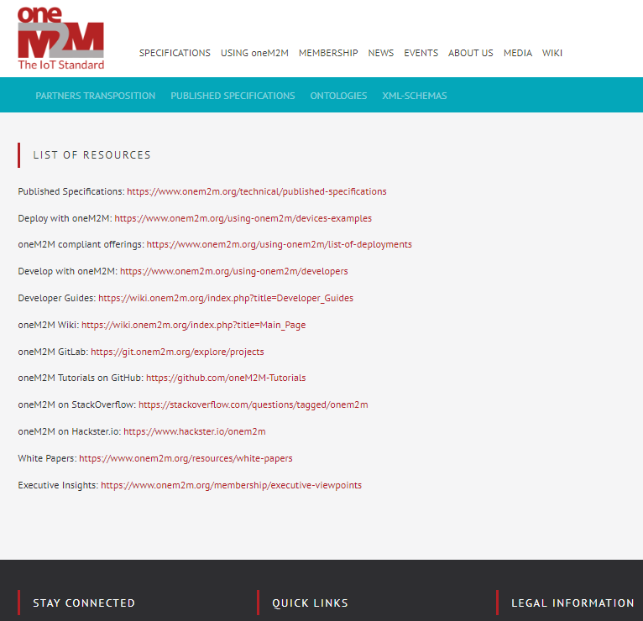
Webpage giving List of oneM2M Resources
Link to the “List of Resources”
https://www.onem2m.org/home/working-documents

Slide 13
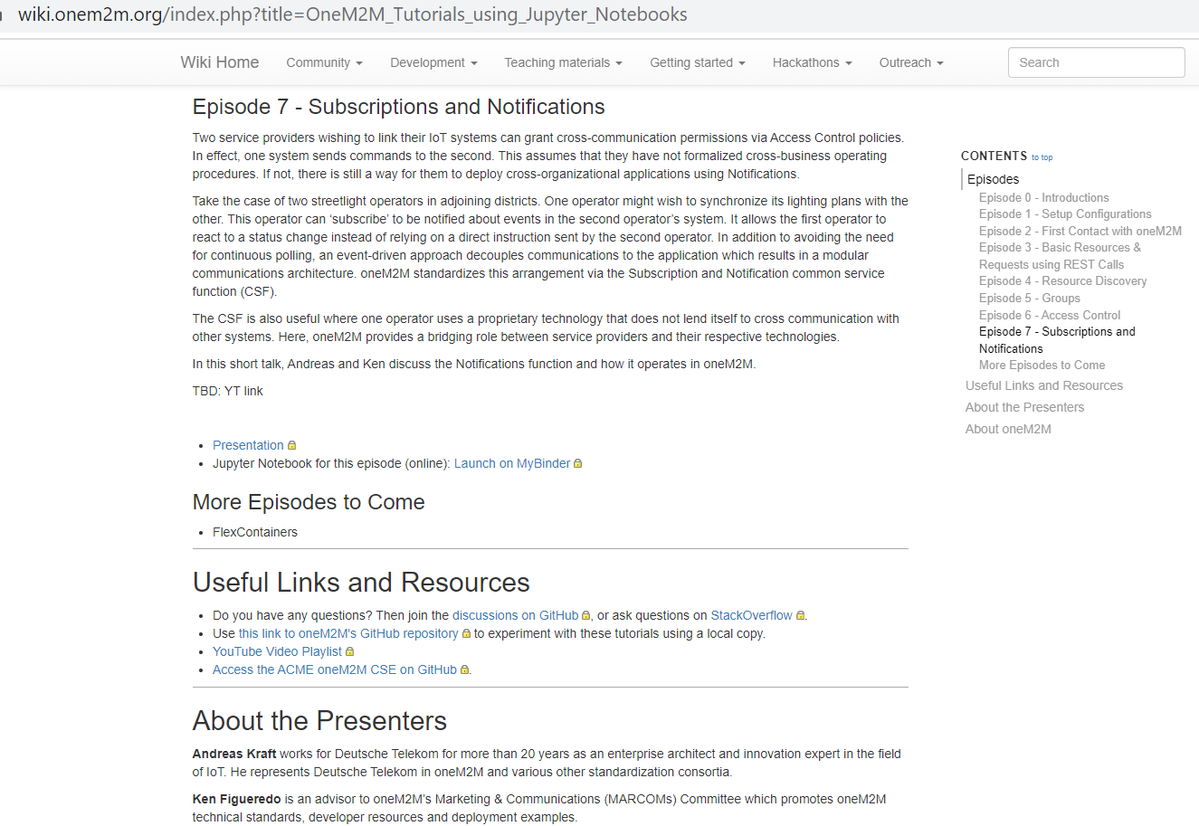
Developer Resources - Updates

Slide 14
Other activities
University outreach :
Hackathons Aug ‘23?
Outreach at TP61 with Penn State university (Aug-Sep?
developer series? Q2-Q3
Retain mindshare in the ecosystem and keep promoting new information around relevant oneM2M TP/SSC milestones through Regular features/media interactions/speaking opportunities, Metaverse, Rel 5 etc.
Notes:
Smart Nation Expo 2023, 16 -21 September 2023 : https://smartnationexpo.org/ - (BEING EXPLORED)

Slide 15
Reference Slides
© 2023 oneM2M

Slide 16
oneM2M in Press: TBU
oneM2M | May 2023 | oneM2M SPECIFICATIONS APPROVED BY MORE THAN 190 ITU MEMBER COUNTRIES AS ITU STANDARD TO SIMPLIFY IOT ADOPTION
EE News Europe | April 2023 | 'Horizontal' IoT Implementations
Journal du Net | March 2023 | L'IoT, barrière aux catastrophes naturelles
International Institute of Information Technology (Hyderabad) | January 2023 | IITH's Smart City team wins Best Technology award in Korean hackathon
ETSI Enjoy! | January 2023 | Research and Innovation in IoT Standardization
The Fast Mode | January 2023 | Standardization is Key for Metaverse Success
Notes:
International Institute of Information Technology (Hyderabad) blog post (January 2023) - IITH's Smart City team wins Best Technology award in Korean hackathon ETSI Enjoy! January 2023Research and Innovation in IoT Standardization
ETSI Enjoy! January 2023Research and Innovation in IoT Standardization

Slide 17
oneM2M in News
16 March 2023 | In Anticipation of Metaverse Standardization
7 February 2023 | Security for oneM2M based smart city network
2 February 2023 | The Journey to Massive IoT Through Interoperable and Open Standards

Slide 18
Engagement – Executive Insights (CY23)
oneM2M in the News – 1210 Subscribers
Press Releases – 1
Media queries to oneM2M_PressMedia@list.onem2m.org being forwarded to Bindoo, Aurindam, Ken, Akash
Executive Insights
IoT systems and the evolution of solution requirements by nTels – 9th Jan’23
Standardization in Smart Elevator by Patrick Cox (TRE-E scrl) – 16th Jan’23
Standardization in Smart Lift Sector by Marco Cogliati (TRE-E scrl) – 1st Feb’23
CDOT’s Common Service Platform – 22nd Feb’23
India’s Standard Based IoT Ecosystem – 23rd Feb’23
TP#58 and Release 5 Standardization Activities – 22nd Mar’23
DT IoT Hub – 4th May’23
TP#59 – 11th May’23
Activities Tracker link
Notes:
Interview in pipeline –
https://futureiot.tech/

Slide 19
Thought Leadership – Articles CY’23
Global Journals
None
Trade Journals
The Fast Mode – Standardization for Metaverse
Pipeline Magazine – IoT Trends for 2023
Regional
None
Partner Communiques
ETSI Enjoy – Research & Innovation in IoT Standardization (Jan’23 edition)
ETSI Enjoy – IoT and Sustainability (Apr’23 edition)
ATIS on Metaverse Standardization (Mar’23)
Activities Tracker link
Notes:
2023 IoT trends for A&G via PrPR

Slide 20
Website – Visits
Website Visits
&
Top 10 countries

Slide 21
Thank You
© 2023 oneM2M

