Slide 1
Marcom Report
Bindoo Srivastava, Marcom Chair
3 August 2023
© 2023 oneM2M

Slide 2
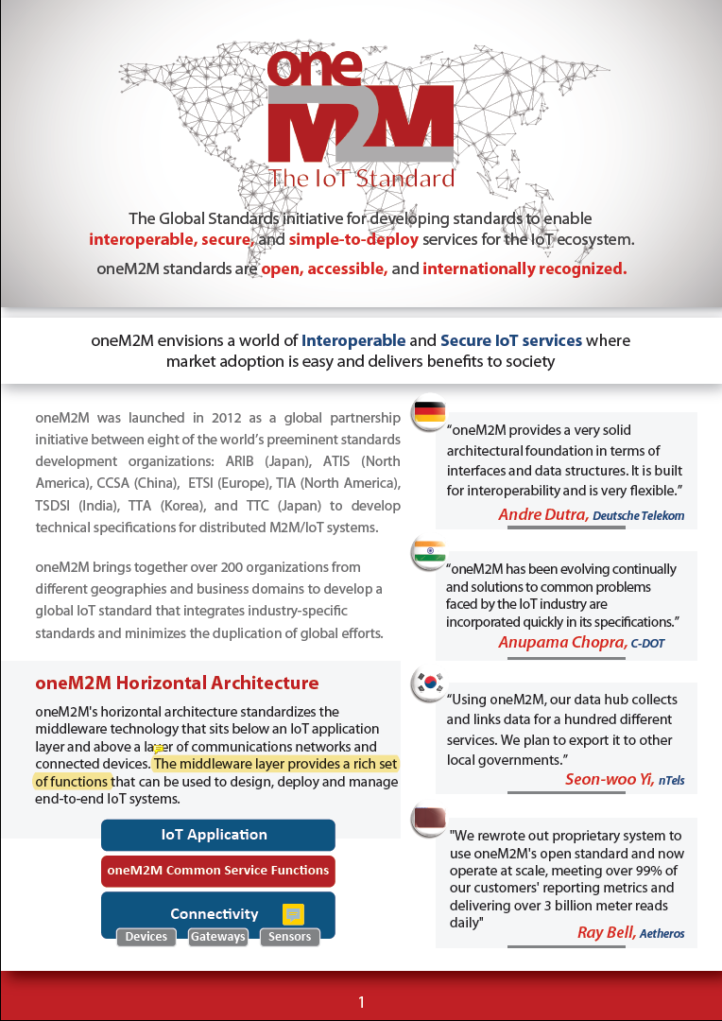
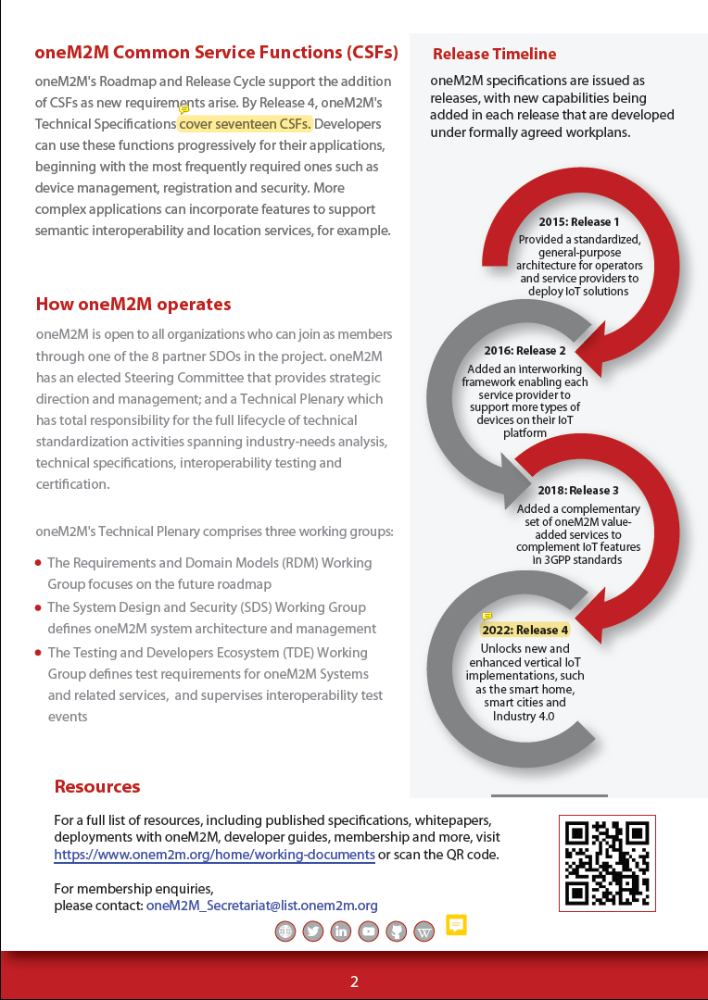
Brochure – Comments to be addressed (1/3)
Comment - provide a word-cloud of the 17 CSFs?
Should we give link to the CSFs picture on oneM2M website? the CSFs can be displayed prominently on the website homepage ?
#Diagram of 17 CSFs needs to be updated on website (dev. section)
(Check next Slide)
Recommend to reword this as - The middleware layer provides a rich set of common service functions (CSFs).
Release 4 highlights needs to be discussed !!
Likewise for other releases

Slide 3
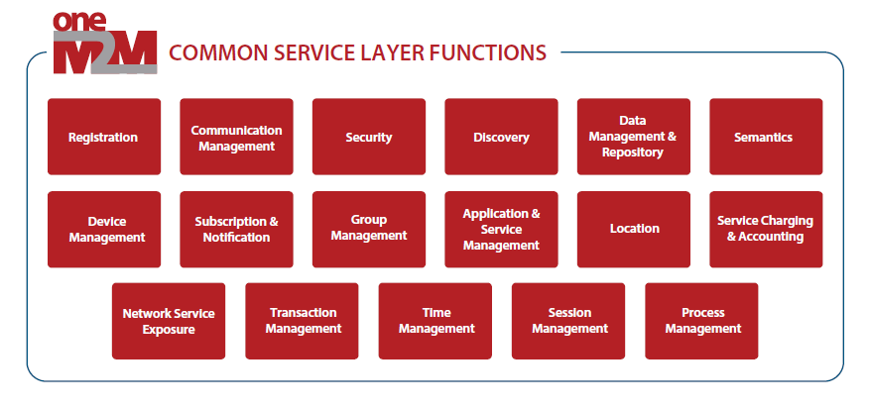
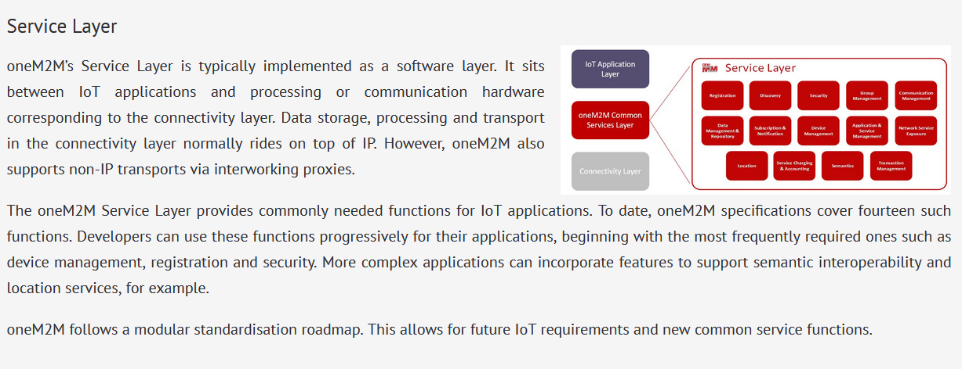
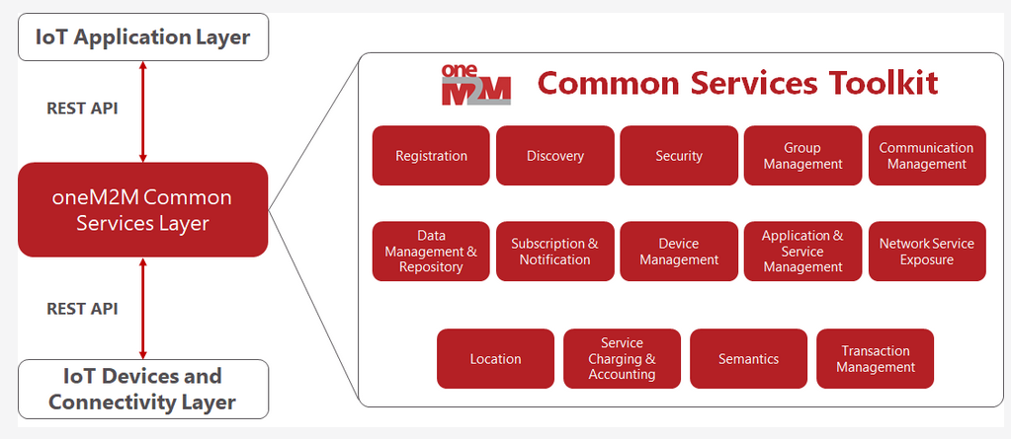
Common Service Functions (2/3)
Diagrams depicting 14 CSFs published on website outdated.
Needs to be replaced with the 17 CSFs diagram.
https://www.onem2m.org/using-onem2m/developers/basics
https://www.onem2m.org/using-onem2m/devices-examples

Slide 4
Brochure Feedback (3/3)
Xavier:
Should the development of a new brochure be the opportunity to think about developing a message about oneM2M showing that oneM2M can connect systems/sources that go beyond pure IoT.
I know that some try to box oneM2M in pure IoT context, which might disserve us in the long run. This can be discussed in Marcom at some point.

Slide 5
Campaign proposal by PPR - oneM2M Champions – Update
Campaign: Champion Series
Showcase the importance of ‘Contributors across oneM2M’ and why each person chooses to play an active role in defining and developing standards to address the need for interoperable and scalable IoT systems.
Objective: Promote membership and increase brand exposure across key target regions.
Post: Carousel style
oneM2M integrates all the necessary IoT components into a unified framework, brings together state-of-the-art technologies, and helps business customers to implement their use cases and innovations independently from a single proprietary technology, openly and sustainable.
- Andreas Kraft (CDOT)
The power of oneM2M lies in providing uniform interfaces, standard data models across several IoT/M2M use cases and collaboration with existing standards such as 3GPP, LWM2M, OCF, OGC, MODBUS and more, thus laying a foundation for interoperable and sustainable IoT/M2M deployments.
- Poornima Shandilya (CDOT)

Slide 6
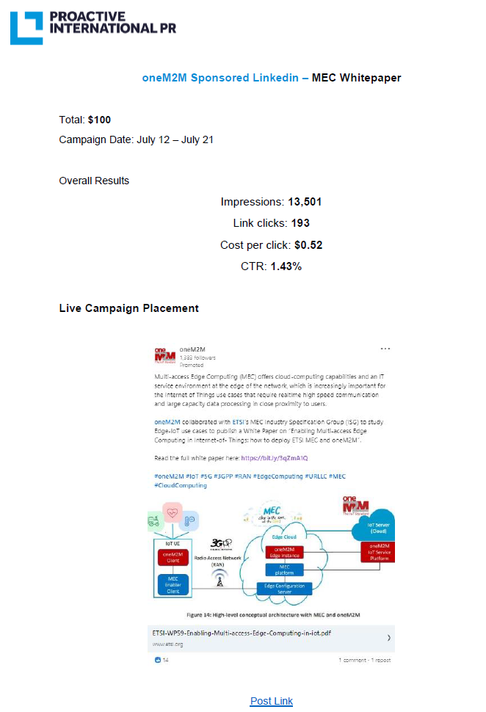
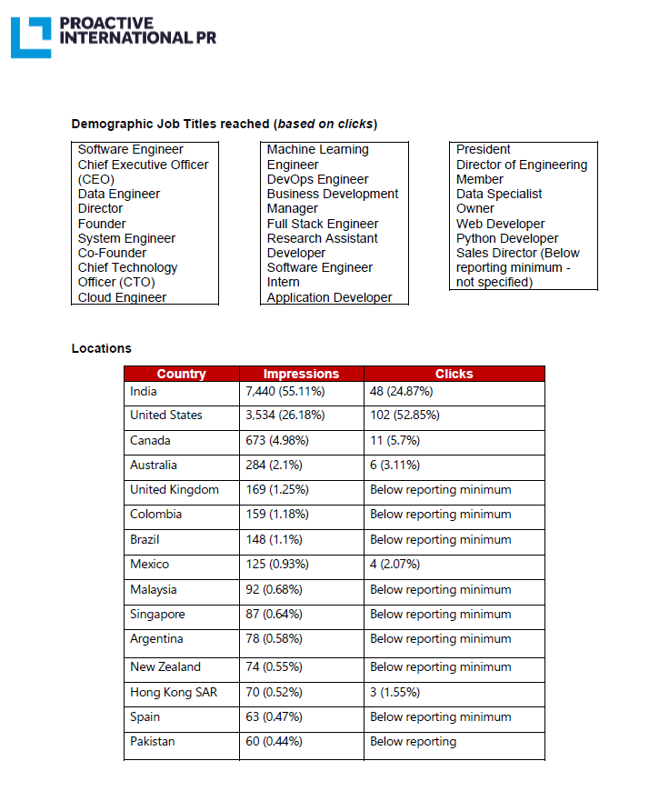
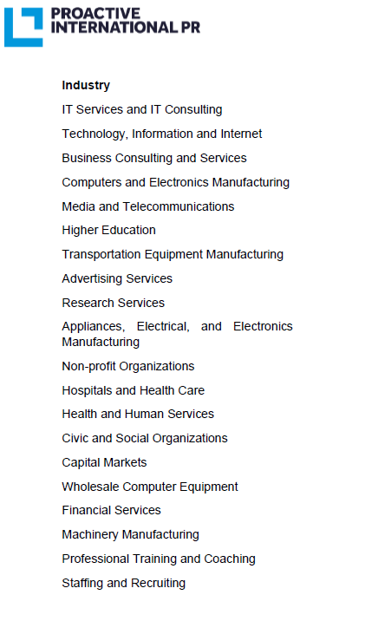
MEC White Paper: Sponsored LinkedIn Plan

Slide 7
Webinars & MOOCs conducted under Indo-EU PP
Webinars on oneM2M conducted under aegis of Indo-EU PP proposed to be made available on oneM2M website.
Office of Indo-EU PP agreed for oneM2M to publish on its website. However, they directed to apply logo indicating that material was supported by EU as well as the following disclaimer –
This publication/material was produced with the financial support of the European Union. Its contents are the sole responsibility of its authors and do not necessarily reflect the views of the European Union or the Gov­ernment of India. The responsibility for the content of this publication rests solely with its authors and publication does not constitute an endorsement by the European Union of the opinions expressed in it.

Slide 8
Reference Slides
© 2023 oneM2M

Slide 9
Key Highlights
External Publications: ETSI Enjoy - Continuity and Technology Strategy in IoT Standardization; Pipeline Magazine How connected Devices will Remake IoT Systems
oneM2M Developers Resources – 8 out of 9 now available on YouTube and Wiki
Engagement: 1 Executive Insights published in July. (11 Total in CY’23)
Visibility:
Total Events organized (nil@oneM2M, 1@Partner, nil@Regional level)
Speaking Opportunities – Nil
Social Media (Till Jun’23): LinkedIn 1371 followers (▲6 in Jun’23), 41 total posts CY’23; Twitter 1451 followers, 194 total posts CY’23
Communiques & PRs:
PRs – 0 issued
Refer oneM2M Promotions Tracker
Notes:
Executive Interviews:
TP 60 by Roland Hechwartner – 5th Jun’23 Ray Bell
Partner events
ETSI IoT Week (Post TP 60) – 4 to 6 Jul’23
Speaking Opportunities –

Slide 10
Events/Opportunities
WTISD celebration -8 June 2023- Bindoo Srivastava (Courtesy Dr Hideyuki Iwata San)
The global oneM2M event and hackathon awards ceremony in Seoul 13 Jun’23
ETSI IoT Week || 4-6 July 2023
Engagement with Penn State University during TP62 || 14-18 Aug’23 || PSU
Smart Nation Expo 2023 || 16 -21 Sep’23 || Kuala Lumpur (being explored)
IoT security & Stds based IoT/M2M practical implementations of solutions | 25-26 sep’23 | New Delhi |CDOT-TSDSI
Korea IoT week (11-13 Oct’23)
IMC 2023 (27-29 Oct’23)
TTDD 2023 || 3-6 Oct’23
IoT Tech Expo - Global (30th November – 1st December) – London: Rana Kamill
Opportunity to contribute an article to Architecture & Governance magazine. We have contributed articles in the past, most recently last year.

Slide 11
oneM2M in Press
Information and Communication Newspaper (Korea Information and Communication Corporation Association) | June 2023 | KETI Completes 'Mobius Developer Competition' and 22 Teams Showcase IoT Application Services
BizWire Express | May 2023 | oneM2M SPECIFICATIONS APPROVED BY MORE THAN 190 ITU MEMBER COUNTRIES AS ITU STANDARD TO SIMPLIFY IOT ADOPTION
EE News Europe | April 2023 | 'Horizontal' IoT Implementations
Journal du Net | March 2023 | L'IoT, barrière aux catastrophes naturelles
International Institute of Information Technology (Hyderabad) | January 2023 | IITH's Smart City team wins Best Technology award in Korean hackathon
ETSI Enjoy! | January 2023 | Research and Innovation in IoT Standardization
The Fast Mode | January 2023 | Standardization is Key for Metaverse Success
Notes:
International Institute of Information Technology (Hyderabad)
blog post (January 2023) - IITH's Smart City team wins Best Technology award in Korean hackathon ETSI Enjoy! January 2023Research and Innovation in IoT Standardization
ETSI Enjoy! January 2023Research and Innovation in IoT Standardization

Slide 12
oneM2M in News
18 July 2023 | Enabling Multi-access Edge Computing in the Internet-of-Things
16 March 2023 | In Anticipation of Metaverse Standardization
7 February 2023 | Security for oneM2M based smart city network
2 February 2023 | The Journey to Massive IoT Through Interoperable and Open Standards

Slide 13
Engagement – Executive Insights (CY23)
oneM2M in the News – 1210 Subscribers
Press Releases – 1
Media queries to oneM2M_PressMedia@list.onem2m.org being forwarded to Bindoo, Aurindam, Ken, Akash
  Executive Insights
  IoT systems and the evolution of solution requirements by nTels – 9th Jan’23
  Standardization in Smart Elevator by Patrick Cox (TRE-E scrl) – 16th Jan’23
  Standardization in Smart Lift Sector by Marco Cogliati (TRE-E scrl) – 1st Feb’23
  CDOT’s Common Service Platform – 22nd Feb’23
  India’s Standard Based IoT Ecosystem – 23rd Feb’23
  TP#58 and Release 5 Standardization Activities – 22nd Mar’23
  DT IoT Hub – 4th May’23
  TP#59 – 11th May’23
  oneM2M in Utilities by Atheros – 5th Jun’23
  IIT Hyderabad – Dr. Sachin Chaudhari 22nd Jun’23
  TP#60 – 17th Jul’23
Activities Tracker link
Notes:
Interview in pipeline –
https://futureiot.tech/

Slide 14
Thought Leadership – Articles CY’23
  Global Journals
  None
  Trade Journals
  The Fast Mode – Standardization for Metaverse
  Pipeline Magazine – IoT Trends for 2023
  Pipeline Magazine How connected Devices will Remake IoT Systems
  Regional
  None
  Partner Communiques
  ETSI Enjoy – Research & Innovation in IoT Standardization (Jan’23 edition)
  ETSI Enjoy – IoT and Sustainability (Apr’23 edition)
  ATIS on Metaverse Standardization (Mar’23 edition)
  ETSI Enjoy - Continuity and Technology Strategy in IoT Standardization (Jul’23 edition)
Activities Tracker link
Notes:
2023 IoT trends for A&G via PrPR

Slide 15






Thank You
© 2023 oneM2M

