Slide 1
Marcom Report
Bindoo Srivastava, Marcom Chair
06 December 2023

Slide 2
Outline – for Opening Plenary
oneM2M Brochure
oneM2M Champions - LinkedIn Campaign
MEC White Paper promotion on
Developer Resources - update
Key Highlights
Potential Speaking Opportunities
CY’23 Activities
Plan for CY’24
Leadership positions open for Vice Chair

Slide 3
oneM2M Brochure
Implication of ATIS withdrawal from the project

Slide 4
oneM2M Champions - Sponsored Campaign
Campaigns 1&2: Impressions: 47,290 Clicks: 409 Cost per Click: $0.73
Key locations reached: India, United States, Canada, Colombia, Mexico, UK, Australia

Slide 5
oneM2M Champions - Sponsored Campaign (upcoming)

Slide 6
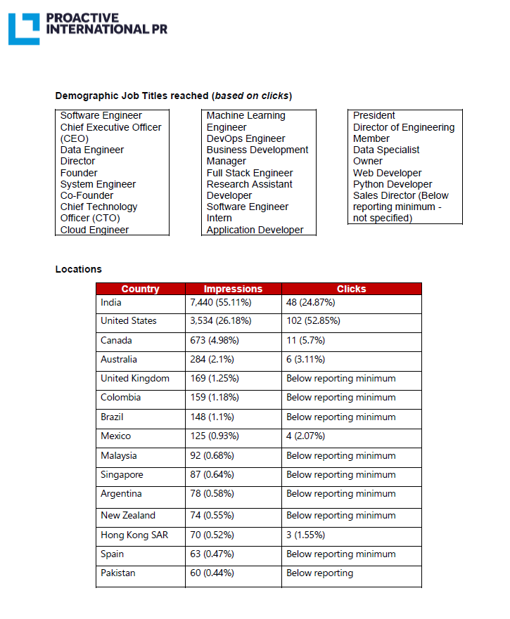
MEC White Paper Sponsored Post 12 -21 July 23

Slide 7
Key Highlights (from MARCOM 123 - Nov 23)
External Publications: 11 publications
oneM2M Developers Resources – 8 videos published on YouTube and Wiki. More in pipeline
Engagement: 14 Executive Insight
Visibility:
Total Events organized (nil@oneM2M, 6@Partner, 1@Regional level)
Speaking Opportunities (availed) – Total 07
Social Media (Till Nov’23): LinkedIn 1420 followers (▲120), 70 total posts CY’23; Twitter 1452 followers (▲5), 325 total posts CY’23
Communiques & PRs:
PRs – 1 issued (in May on oneM2M Security Specs)
Refer oneM2M Promotions Tracker
Notes:
External Publications:
ETSI Enjoy Jan
The Fast Mode - Metaverse standards
Pipeline Magazine (2023 predictions)
ATIS blog (Metaverse standardization)
ETSI Enjoy Mar (Sustainability)
IoT sustainabilty interview for Journal du Net
ETSI MEC oneM2M White Paper
ETSI Enjoy - Continuity and Technology Strategy in IoT Standardization
Pipeline Magazine How connected Devices will Remake IoT Systems
Pipeline Magazine - AI and Analytics for IoT
ETSI Enjoy - APIs for IoT
Executive Interviews:
nTels (Korea)
TRE-E Anthony C (Italy)
TRE-E Marco C (Italy)
Poornima (C-DOT)
India Dept of Telecoms
TP #58
Andre Dutra (Deutsche Telekom IoT Hub)
TP #59
Ray Bell (Aetheros)
Sachin Chaudry - student outreach
TP#60
Rana Kamill ITU-T and IoT security
TP#61 - Roland Hechwartner
CReDo - Jethro Akroyd
Partner events
oneM2M stakeholders' day 24 Feb23 New Delhi, India
ETSI Sustainability event
TTA International oneM2M hackathon Award & Workshop (Mar - May)
TTA - oneM2M Global seminar - 13 June 2023
ETSI IoT Week (Post TP 60)
AIOT Week Korea – 11th to 13th Oct’23
Regional Event –
March - 2nd IoT and oneM2M outreach for academia (IIIT-H) closed door (18-19 March) Prof Sachin Chaudhari
Speaking Opportunities –
ETSI Sustainability event – Dale Seed
Telesemana webinar via PPR (17 May)
IoT Tech Expo & Edge Computing Expo - North America (17-18 May 2023) – Santa Clara, CA - Bob Flynn
M2M & IoT security & use cases organized by Mumbai LSA, Department of Telecommunications 26 May 2023 - By Aurindam Bhattacharya
WTISD celebration (Speaking Opportunity) 8 June 2023- Bindoo Srivastava
Global Conference on "IoT Security and Standards based IoT/M2M Practical Implementations of Solutions" | 25-26 Sep'23| New Delhi | Aurindam Bhattacharya
IoT Tech Expo - Global (30th November – 1st December) – London: Rana

Slide 8
Speaking Opportunities (availed and foregone) and upcoming for CY’24
ETSI Sustainability event || 30 Mar’23 || ETSI, Sophia Antipolis : Dale Seed Spoke
Telesemana webinar on 5G Security || 17 May’23 || Rana spoke on Securing the IoT segment with oneM2M security
IoT Tech Expo & Edge Computing Expo - North America || 17-18 May 23 || Santa Clara, CA :: Bob Flynn spoke
M2M & IoT security & use cases organized by Mumbai LSA, Department of Telecommunications || 26 May 2023 - By Aurindam Bhattacharya
WTISD celebration || 8 June 2023: Bindoo Srivastava
ETSI IoT Week – MEC white paper to be showcased
Engagement with Penn State University during TP62 || 14-18 Aug 23 || PSU
IoT Tech Expo & Edge Computing Expo - Europe || 26-27 Sep 23 || Amsterdam
Global Conference on "IoT Security and Standards based IoT/M2M Practical Implementations of Solutions" || 25-26 Sep’23 || New Delhi by Aurindam Bhattacharya
Korea IoT week (11-13 Oct’23): NTELS and SyncTechno exhibited
IMC 2023 (27-29 Oct’23)
TTDD 2023 (Oct-Nov 23)
9th IEEE World Forum on IoT – 12 to 27 Oct’23 // Aveiro, Portugal (Hybrid)
IoT Tech Expo - Global || 30th November – 1st December || London: Rana Kamill
IEEE Global Communications Conference || 4–8 December 2023 || Kuala Lumpur, Malaysia

Slide 9
Website Unique Visits
Overall increase in visits compared to 2022.
Large surge in May, June noted.
Dip in number noted in Nov

Slide 10
oneM2M Visits across geographies (CY2023)

Slide 11
Page View Comparison CY2023

Slide 12
CY’23 Focus Activities (1 of 2)
Proposed PR on oneM2M Approval by ITU-T
oneM2M Brochure being updated
A white paper or Executive Insight into how oneM2M goes beyond mere pure IoT/M2M and goes all the way up to Metaverse
An Executive Insight Series to celebrate oneM2M Veterans
Micro-certifications mechanism – being explored. Also checking if others like AWS/MS/CISCO et al are using this.
Regional engagements – LATAM, Malaysia, others? ::
Telesemana Webinar || 17 May 23 || Rana Kamill || mobile security, covering how M2M/IoT will be a major disruptor in telecom networks as many new devices may interact with the network.
IEEE Globecom 2023 || KL|| 4-8 Dec 2023

Slide 13
CY’23 Focus Activities (2 of 2)
oneM2M Tutorials – translate from Korean to English
oneM2M icons library
Capacity Building on oneM2M - In the wake of ITU-T SG20 endorsement?
University outreach :
2023 International oneM2M hackathon (Mar – May’23 in progress
Outreach at TP61 with Penn State university (Aug-Sep?
developer series? Q2-Q3 (Developer Series – 7 out of 8 ready)
oneM2M White paper on MEC (JaeSeung Song)- Q1 ‘CY 23 :: ETSI IoT week
Retain mindshare in the ecosystem and keep promoting new information around relevant oneM2M TP/SSC milestones through Regular features/media interactions/speaking opportunities - Metaverse, Rel 5 etc.

Slide 14
Reference Slides

Slide 15
ATIS Blog related to oneM2M

Slide 16
Thought Leadership – Articles CY’23 & upcoming
Global Journals
IEEE Network Magazine - JaeSeung Song (team preparing to submit article)
Trade Journals
The Fast Mode - Metaverse standards
The Fast Mode - Metaverse standards
Pipeline Magazine (2023 predictions)
Pipeline Magazine How connected Devices will Remake IoT SystemsPipeline Magazine - AI and Analytics for IoT
IoT sustainabilty interview for Journal du Net
Regional
Partner Communiques
ETSI Enjoy Jan
ATIS blog (Metaverse standardization)
ETSI Enjoy Mar (Sustainability)
ETSI MEC oneM2M White Paper
ETSI Enjoy - Continuity and Technology Strategy in IoT Standardization
ETSI Enjoy - APIs for IoT
ETSI ENJOY Jan (JaeSeung on AI for IoT)
Activities Tracker link
Notes:
2023 IoT trends for A&G via PrPR

Slide 17
Engagement – Executive Insights (CY23) from MARCOM 123 and upcoming
Executive Insights
IoT systems and the evolution of solution requirements by nTels – 9th Jan’23
Standardization in Smart Elevator by Patrick Cox (TRE-E scrl) – 16th Jan’23
Standardization in Smart Lift Sector by Marco Cogliati (TRE-E scrl) – 1st Feb’23
CDOT’s Common Service Platform – 22nd Feb’23
India’s Standard Based IoT Ecosystem – 23rd Feb’23
TP#58 and Release 5 Standardization Activities – 22nd Mar’23
DT IoT Hub – 4th May’23
TP#59 – 11th May’23
oneM2M in Utilities by Atheros – 5th Jun’23
IIT Hyderabad – Dr. Sachin Chaudhari 22nd Jun’23
TP#60 – 17th Jul’23
ITU-oneM2M Collab (Rana Kamill) – 22nd Aug’23
TP#61 – 21st Sep’23
Climate Resilience Demonstrator – Dr. Jethro Akroyd - 9th Nov’23
TP#62
oneM2M in the News – 1210 Subscribers
Press Releases – 1
Media queries to oneM2M_PressMedia@list.onem2m.org being forwarded to Bindoo, Aurindam, Ken, Akash
Activities Tracker link
Notes:
Interview in pipeline –
https://futureiot.tech/

Slide 18
oneM2M in Press – from MARCOM 123 (oct 23)
Economic Times (India) October 2023 | Oct 2023 | Vodafone India completes testing of over 50 IoT devices and certification based on oneM2M and 3GPP standards at the IoT Lab that it has set up with the Centre for Development of Telematics (C-DOT)
Electronic Times Internet (S. Korea) October 2023 | Oct 2023 | Korea Telecommunications Technology Association (TTA) will introduce achievements related to oneM2M at S. Korea's 2023 AIoT Promotion Week.
Pipeline Publishing September 2023 | Sept 2023 | AI and Analytics for IoT
Pipeline Publishing July 2023 | July 2023 | How Connected Devices will Remake IoT Systems
Information and Communication Newspaper (Korea Information and Communication Corporation Association) | June 2023 | KETI Completes 'Mobius Developer Competition' and 22 Teams Showcase IoT Application Services
BizWire Express | May 2023 | oneM2M SPECIFICATIONS APPROVED BY MORE THAN 190 ITU MEMBER COUNTRIES AS ITU STANDARD TO SIMPLIFY IOT ADOPTION
EE News Europe | April 2023 | 'Horizontal' IoT Implementations
Journal du Net | March 2023 | L'IoT, barrière aux catastrophes naturelles
International Institute of Information Technology (Hyderabad) | January 2023 | IITH's Smart City team wins Best Technology award in Korean hackathon
ETSI Enjoy! | January 2023 | Research and Innovation in IoT Standardization
The Fast Mode | January 2023 | Standardization is Key for Metaverse Success
Notes:
International Institute of Information Technology (Hyderabad) blog post (January 2023) - IITH's Smart City team wins Best Technology award in Korean hackathon ETSI Enjoy! January 2023Research and Innovation in IoT Standardization
ETSI Enjoy! January 2023Research and Innovation in IoT Standardization

Slide 19
oneM2M in News – from MARCOM 123
18 July 2023 | Enabling Multi-access Edge Computing in the Internet-of-Things
16 March 2023 | In Anticipation of Metaverse Standardization
7 February 2023 | Security for oneM2M based smart city network
2 February 2023 | The Journey to Massive IoT Through Interoperable and Open Standards

Slide 20
Thank You

