Slide 1
Marcom Report
Bindoo Srivastava, Marcom Chair
08 February 2024

Slide 2
Outline
CY’23 Report Card
Key Highlights
Plan for CY’24

Slide 3
Key Highlights (CY’23)
External Publications: 11
oneM2M Developers Resources – 8 videos published on YouTube and Wiki. More in pipeline
Engagement: 14 Executive Insights in CY23.
Visibility:
Total Events organized (nil@oneM2M, 6@Partner, 1@Regional level)
Speaking Opportunities (availed) – Total 7
Social Media (CY23):
LinkedIn 1440 followers (▲140), 72 total posts CY’23; Twitter 1451 followers (▲4), 346 total posts CY’23
2 Sponsored LinkedIn promotion campaigns (release of MEC white paper, showcasing oneM2M Champions)
Communiques & PRs:
PRs – 1 issued (in May on oneM2M Security Specs)
oneM2M Brochure-finalized
Refer oneM2M Promotions Tracker
Notes:
External Publications:
ETSI Enjoy Jan
The Fast Mode - Metaverse standards
Pipeline Magazine (2023 predictions)
ATIS blog (Metaverse standardization)
ETSI Enjoy Mar (Sustainability)
IoT sustainabilty interview for Journal du Net
ETSI MEC oneM2M White Paper
ETSI Enjoy - Continuity and Technology Strategy in IoT Standardization
Pipeline Magazine How connected Devices will Remake IoT Systems
Pipeline Magazine - AI and Analytics for IoT
ETSI Enjoy - APIs for IoT
Executive Interviews:
nTels (Korea)
TRE-E Anthony C (Italy)
TRE-E Marco C (Italy)
Poornima (C-DOT)
India Dept of Telecoms
TP #58
Andre Dutra (Deutsche Telekom IoT Hub)
TP #59
Ray Bell (Aetheros)
Sachin Chaudry - student outreach
TP#60
Rana Kamill ITU-T and IoT security
TP#61 - Roland Hechwartner
CReDo - Jethro Akroyd
Partner events
oneM2M stakeholders' day 24 Feb23 New Delhi, India
ETSI Sustainability event
TTA International oneM2M hackathon Award & Workshop (Mar - May)
TTA - oneM2M Global seminar - 13 June 2023
ETSI IoT Week (Post TP 60)
AIOT Week Korea – 11th to 13th Oct’23
Regional Event –
March - 2nd IoT and oneM2M outreach for academia (IIIT-H) closed door (18-19 March) Prof Sachin Chaudhari
Speaking Opportunities –
ETSI Sustainability event – Dale Seed
Telesemana webinar via PPR (17 May)
IoT Tech Expo & Edge Computing Expo - North America (17-18 May 2023) – Santa Clara, CA - Bob Flynn
M2M & IoT security & use cases organized by Mumbai LSA, Department of Telecommunications 26 May 2023 - By Aurindam Bhattacharya
WTISD celebration (Speaking Opportunity) 8 June 2023- Bindoo Srivastava
Global Conference on "IoT Security and Standards based IoT/M2M Practical Implementations of Solutions" | 25-26 Sep'23| New Delhi | Aurindam Bhattacharya
IoT Tech Expo - Global (30th November – 1st December) – London: Rana

Slide 4
Website Unique Visits CY’2023
Surge in May, June 2023:
May be due to Hackathon.
most traffic from USA
Pages visited – what is oneM2M, Dev basics, published specs
Notes:
Surge in May, June noted. (to be corelated with the source of traffic and which pages visited) –
May’23 ->
Countries: US>Ind>S. Korea>France>UK
Pages: Homepage>Published Specs>what is oneM2M>Developers-Basics
Jun’23 ->
Countries: US>Ind>S. Korea>France>Netherlands
Pages: Homepage>what is oneM2M>Developers-Basics>Published Specs
Jul’23 ->
Countries: US>Ind>S. Korea>UK>China
Pages: Homepage>what is oneM2M>Published Specs>Developers-Basics>Membership

Slide 5
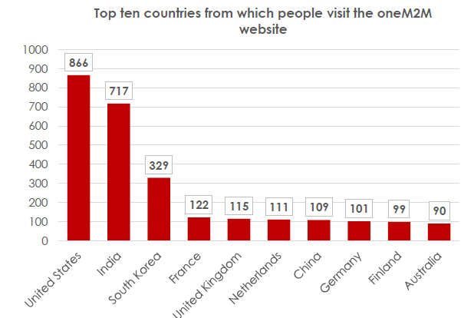
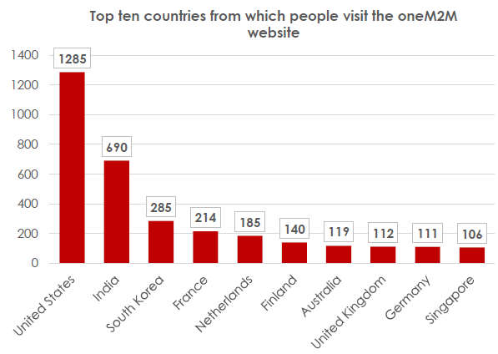
oneM2M Visits across geographies (CY2023)
May’23
Jun’23
Notes:
Surge in May and Jun: check top countries
May’23 ->
Countries: US>Ind>S. Korea>France>UK
Jun’23 ->
Countries: US>Ind>S. Korea>France>Netherlands

Slide 6
Page View Comparison CY2023
May’23
Jun’23
Notes:
Top 10 pages

Slide 7
Calendar Year 2024 – key highlights
External Publications: 1
Engagement: 1 Executive Insight (TP62), 07 in pipeline
Regional Outreach: Malaysia - Developer tutorial proposed in first half of CY’24; TP in Sep; promotional event after the hackathon in Nov. or Dec.
Visibility:
Total Events organized – N/A
Speaking Opportunities (availed) NIL in Jan’24. Opportunities being explored
Social Media (Till Dec’23): LinkedIn 1440 followers (▲140), 72 total posts CY’23; Twitter 1451 followers (▲4), 346 total posts CY’23
Communiques & PRs: Announcement on ATIS exit on website;
(2 PRs and 2 Sponsored posts pending from previous CY carried fwd by PPR team to Q1’24)
MARCOM Consultant onboarded. PPR team engagement to be discussed based on budget and requirements
Refer oneM2M Promotions Tracker

Slide 8
Marcom Strategy for CY 2024
Support Overall Strategy – ACR, promote icons library, New Releases and TRs in new areas
Challenge to be addressed: Existing Membership engagement (total #IM is falling)
Positioning in the ecosystem? It connects systems/sources that go beyond pure IoT as an Interoperability Framework (White Paper?)
Approach: Retain mindshare in the ecosystem on the pillars of maturity, relevance and forward thinking
Proposed Activities
Keep promoting new information around relevant oneM2M milestones
Hosting TP Meetings in diverse new Regions
Capacity Building
Promote the icons library
Support Academia Outreach
Proposed Vehicles:
PR/media interactions
Feature articles
Exec insights/Blogs/Social Media
Events/speaking opportunities
Host meetings in new locations for local engagement

Slide 9
Recommendations from PPR

Slide 10
oneM2M comms strategy
Like all membership organisations it is vital that oneM2M keeps its current and potential future members informed about what is has done, what it is doing and what it will be doing in the future.
The communications strategy could therefore be built upon three pillars.
Pillar 1 - Maturity
Aim – ensure stakeholders understand oneM2M’s rich heritage and the maturity of its technology.
Pillar 2 - Relevance
Aim – ensure stakeholders know that oneM2M is still supporting the global IoT community.
Pillar 3 - Forward Thinking
Aim – ensure stakeholders see that oneM2M is looking beyond today’s needs and already thinking about emerging trends and technologies
Notes:
Case studies

Slide 11
oneM2M comms strategy
The goal of oneM2M’s communications strategy is to deliver relevant content to the following audiences:
Standardization experts
Business decision makers and IoT product managers
Organizations wanting to build oneM2M solutions
Organizations wanting to deploy systems that make use of oneM2M components
Government agencies, policy makers & regulators
Academic institutions (inc. universities)
Notes:
Case studies

Slide 12
oneM2M comms strategy
Delivering the right content to the right audience relies on telling compelling stories using the right channels.
Anniversaries
Exec viewpoints
Releases Events
Publications Spec updates
White papers
Webinars
Speeches and presentations
Content
Features
Interviews
Press releases
Social media
Thought leadership features
Comment opportunities
Channel
Notes:
Case studies

Slide 13
Reference Slides CY 2023 - details

Slide 14
Speaking Opportunities
ETSI Sustainability event || 30 Mar’23 || ETSI, Sophia Antipolis : Dale Seed
Telesemana webinar on 5G Security || 17 May’23 || Rana spoke on Securing the IoT segment with oneM2M security
IoT Tech Expo & Edge Computing Expo - North America || 17-18 May 23 || Santa Clara, CA :: Bob Flynn
M2M & IoT security & use cases organized by Mumbai LSA, Department of Telecommunications || 26 May 2023 - By Aurindam Bhattacharya
WTISD celebration || 8 June 2023: Hideyuki Iwata, Roland Hechwartner, Bindoo Srivastava
ETSI IoT Week
Global Conference on "IoT Security and Standards based IoT/M2M Practical Implementations of Solutions" || 25-26 Sep’23 || New Delhi by Aurindam Bhattacharya
Korea IoT week (11-13 Oct’23): NTELS and SyncTechno exhibited
IoT Tech Expo - Global || 30th November – 1st December || London: Rana Kamill

Slide 15
CY’23 Focus Activities (1 of 2)
Regional engagements – new regions
WTISD event in Peru
LATAM - Telesemana Webinar || 17 May 23 || Rana Kamill || mobile security, covering how M2M/IoT will be a major disruptor in telecom networks as many new devices may interact with the network.
Workshop in Taiwan
Vietnam – product certified ?

Slide 16
Thought Leadership – Articles CY’23 & upcoming
Global Journals
IEEE Network Magazine - JaeSeung Song (team preparing to submit article)
Trade Journals
The Fast Mode - Metaverse standards
The Fast Mode - Metaverse standards
Pipeline Magazine (2023 predictions)
Pipeline Magazine How connected Devices will Remake IoT SystemsPipeline Magazine - AI and Analytics for IoT
IoT sustainabilty interview for Journal du Net
Regional
Partner Communiques
ETSI Enjoy Jan
ATIS blog (Metaverse standardization)
ETSI Enjoy Mar (Sustainability)
ETSI MEC oneM2M White Paper
ETSI Enjoy - Continuity and Technology Strategy in IoT Standardization
ETSI Enjoy - APIs for IoT
ETSI ENJOY Jan (JaeSeung on AI for IoT)
Activities Tracker link
Notes:
2023 IoT trends for A&G via PrPR

Slide 17
Engagement – Executive Insights (CY23) from MARCOM 123 and upcoming
Executive Insights
IoT systems and the evolution of solution requirements by nTels – 9th Jan’23
Standardization in Smart Elevator by Patrick Cox (TRE-E scrl) – 16th Jan’23
Standardization in Smart Lift Sector by Marco Cogliati (TRE-E scrl) – 1st Feb’23
CDOT’s Common Service Platform – 22nd Feb’23
India’s Standard Based IoT Ecosystem – 23rd Feb’23
TP#58 and Release 5 Standardization Activities – 22nd Mar’23
DT IoT Hub – 4th May’23
TP#59 – 11th May’23
oneM2M in Utilities by Atheros – 5th Jun’23
IIT Hyderabad – Dr. Sachin Chaudhari 22nd Jun’23
TP#60 – 17th Jul’23
ITU-oneM2M Collab (Rana Kamill) – 22nd Aug’23
TP#61 – 21st Sep’23
Climate Resilience Demonstrator – Dr. Jethro Akroyd - 9th Nov’23
TP#62
oneM2M in the News – 1210 Subscribers
Press Releases – 1
Media queries to oneM2M_PressMedia@list.onem2m.org being forwarded to Bindoo, Aurindam, Ken, Akash
Activities Tracker link
Notes:
Interview in pipeline –
https://futureiot.tech/

Slide 18
oneM2M in Press – from MARCOM 123 (CY23) – 1/2
Economic Times (India) October 2023 | Oct 2023 | Vodafone India completes testing of over 50 IoT devices and certification based on oneM2M and 3GPP standards at the IoT Lab that it has set up with the Centre for Development of Telematics (C-DOT)
Electronic Times Internet (S. Korea) October 2023 | Oct 2023 | Korea Telecommunications Technology Association (TTA) will introduce achievements related to oneM2M at S. Korea's 2023 AIoT Promotion Week.
Pipeline Publishing September 2023 | Sept 2023 | AI and Analytics for IoT
Pipeline Publishing July 2023 | July 2023 | How Connected Devices will Remake IoT Systems
Information and Communication Newspaper (Korea Information and Communication Corporation Association) | June 2023 | KETI Completes 'Mobius Developer Competition' and 22 Teams Showcase IoT Application Services
BizWire Express | May 2023 | oneM2M SPECIFICATIONS APPROVED BY MORE THAN 190 ITU MEMBER COUNTRIES AS ITU STANDARD TO SIMPLIFY IOT ADOPTION
EE News Europe | April 2023 | 'Horizontal' IoT Implementations
Journal du Net | March 2023 | L'IoT, barrière aux catastrophes naturelles
International Institute of Information Technology (Hyderabad) | January 2023 | IITH's Smart City team wins Best Technology award in Korean hackathon
ETSI Enjoy! | January 2023 | Research and Innovation in IoT Standardization
The Fast Mode | January 2023 | Standardization is Key for Metaverse Success
Notes:
International Institute of Information Technology (Hyderabad) blog post (January 2023) - IITH's Smart City team wins Best Technology award in Korean hackathon ETSI Enjoy! January 2023Research and Innovation in IoT Standardization
ETSI Enjoy! January 2023Research and Innovation in IoT Standardization

Slide 19
oneM2M in Press – from MARCOM 123 (CY23) – 2/2
Economic Times (India) October 2023 | Oct 2023 | Vodafone India completes testing of over 50 IoT devices and certification based on oneM2M and 3GPP standards at the IoT Lab that it has set up with the Centre for Development of Telematics (C-DOT)
Discourse on Development (India) | Jan 2024 | EU Ambassador to India Hon. Hervé Delphin visits IIIT Hyderabad's Smart City Living Lab and Center of Excellence CoE on IoT and oneM2M
The Learning Factory at Penn State University (USA) | Dec 2023 | Cellular-based IoT Device Management following oneM2M Standard project demonstrates the use of cellular data on a cellular receiver transceiver to forward smart architecture calls from local devices not capable of cellular communication Short video demonstration of cellular based IoT device management following oneM2M
Notes:
International Institute of Information Technology (Hyderabad) blog post (January 2023) - IITH's Smart City team wins Best Technology award in Korean hackathon ETSI Enjoy! January 2023Research and Innovation in IoT Standardization
ETSI Enjoy! January 2023Research and Innovation in IoT Standardization

Slide 20
oneM2M in News (CY23)
20 December 2023 | Modelling the Physical World: Interoperability and Standardization Opportunities
20 December 2023 | Smart City Requirements for Scalable Deployment
20 December 2023 | Cellular IoT: Past, Present and Future
19 December 2023 | Japan Industry Day: Overview of oneM2M and Recent Activities
18 July 2023 | Enabling Multi-access Edge Computing in the Internet-of-Things
11 May 2023 | oneM2M specifications approved by more than 190 ITU member countries as ITU Standard to simplify IoT adoption
16 March 2023 | In Anticipation of Metaverse Standardization
7 February 2023 | Security for oneM2M based smart city network
2 February 2023 | The Journey to Massive IoT Through Interoperable and Open Standards

Slide 21
oneM2M in News (CY24)
3 January 2024 | Enhancement to oneM2M Open-Source Resources
3 January 2024 | An elevator Digital Twin System Using oneM2M
3 January 2024 | oneM2M Deployment Experiences in India
3 January 2024 | IoT Security in oneM2M
3 January 2024 | IoT Testing and Certification
3 January 2024 | oneM2M Developer Support
3 January 2024 | Getting Started in oneM2M

Slide 22
Thank You

