Slide 1
Marcom Report
Bindoo Srivastava, Marcom Chair
5 June 2024

Slide 2
Outline – Bindoo
oneM2M Workshop held as part of ASTAP
Details of MARCOM Activities are available at link here

Slide 3
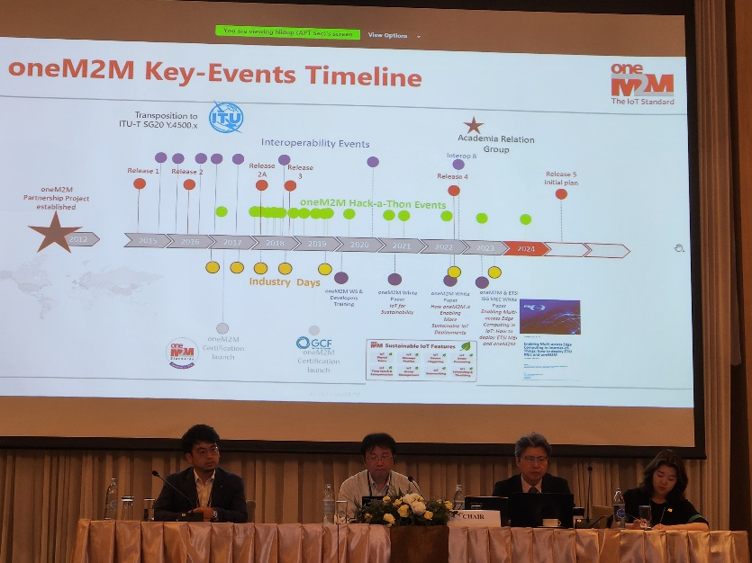
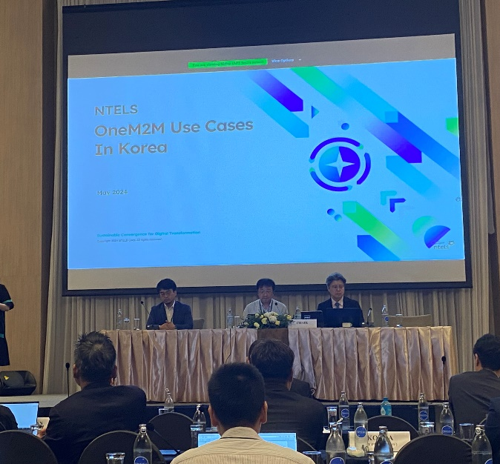
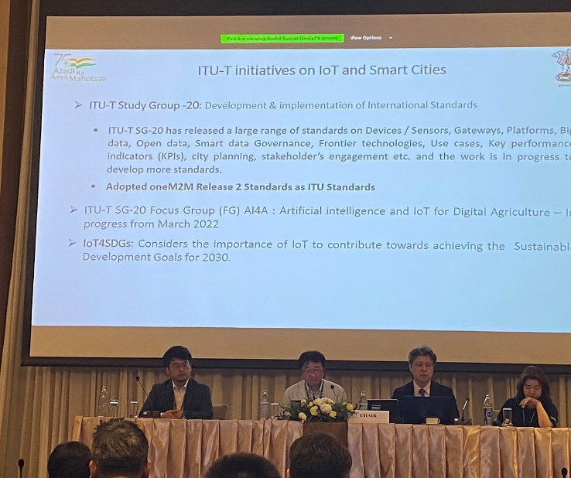
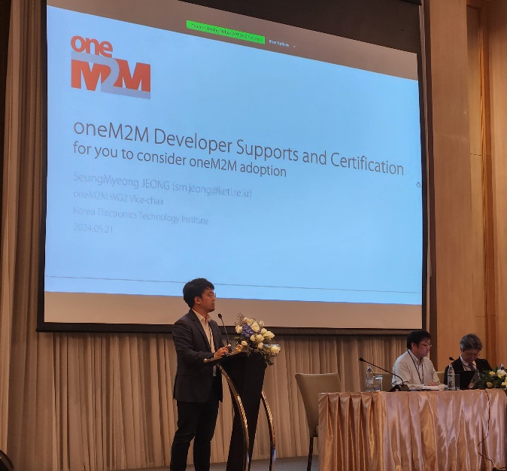
oneM2M Workshop in ASTAP
TTA and KETI organized a oneM2M Workshop in conjunction with the 36th APT Standardization Program Forum (ASTAP-36) on 21st May 2024 in Bangkok, Thailand in hybrid mode.
The workshop featured presentations about oneM2M, its resources and certification process, Indian and Korean use cases.
Presentations made are now posted to oneM2M website (NEWS):
Introducing oneM2M to APT - Roland Hechwartner
oneM2M Developers Support & Certfication - SeungMyeong Jeong
oneM2M Use Cases in Korea by Ms . Yoo Rhee Jin (NTELS)
oneM2M Development and Use Cases in India by Sushil Kumar (Govt of India)

Slide 4
Speaking Opportunities
Bob Flynn is moderating as panel discussion on Environmental IoT: Sustaining the Future through Connected Solutions in Edge Computing Expo in Santa Clara on 6 June 2024.
Co-panelists include Ashwin Chandran (McCord Development) and Srikanth Manthena (Singtel USA)
Speaking opportunity in the Edge Expo in Rai, Amsterdam on 1-2 October is open

Slide 5
Executive Insights published since previous MARCOM meeting
Notification sent to oneM2M News Subscribers from contact@oneM2M.org on 24th May 2024

Slide 6
Key highlights (May’24)
External Publications: 2 in pipeline
Engagement: 8 Executive Insights published (2 in pipeline)
*2 Exec insights promoted through Sponsored LinkedIn posts.
Thought Leadership:
Submission to NIST Consultation (Mar’24)
Article in ETSI Enjoy Jan (Jan’24)
Regional Outreach: oneM2M workshop in ASTAP32, Bangkok, Thailand
Visibility:
Total Events organized – 1@oneM2M (oneM2M workshop in ASTAP32)
Speaking Opportunities – Bob speaking in Tech Edge Expo
Social Media: LinkedIn 1499 followers (▲20 from Apr’24), 31 total posts; Twitter 1444 followers, 134 total posts
Communiques & PRs: - N/A
oneM2M in the News – 1210 Subscribers
Press Releases – 0
Media queries to oneM2M_PressMedia@list.onem2m.org being forwarded to Bindoo, Aurindam, Ken, Akash
Email for sending notifications created contact@oneM2M.org
Refer oneM2M Promotions Tracker
Notes:
External Publication ->
Bob Flynn interview for IoT Show
ETSI Enjoy (DT about cellular-satellite and oneM2M)
Executive Insights ->
Executive Insights
TP 62 – 8th January 2024
Digisaar – 21st February 2024
University of Oulu – 8th March 2024
TP 63 – 14th March 2024
IoT 2.0 (Andreas Kraft) – 16th April 2024
Dr Luigi Liquori (INRIA) – 6th May 2024
TP 64 – 22nd May 2024
Andre Dutra – 23rd May 2024

Slide 7
Media Engagement (CY24)
31 May 2024 | oneM2M Introduction for Asia-Pacific Telecommunity
31 May 2024 | oneM2M Developer Supports and Certification
31 May 2024 | oneM2M Use Cases in Korea
31 May 2024 | oneM2M Development and Application Use Cases in India
3 January 2024 | Getting Started in oneM2M
3 January 2024 | oneM2M Developer Support
3 January 2024 | IoT Testing and Certification
3 January 2024 | IoT Security in oneM2M
3 January 2024 | oneM2M Deployment Experiences in India
3 January 2024 | An elevator Digital Twin System Using oneM2M
3 January 2024 | Enhancement to oneM2M Open Source Resources
oneM2M News
oneM2M in the Press
Discourse on Development (India) | Jan 2024 | EU Ambassador to India Hon. Hervé Delphin visits IIIT Hyderabad's Smart City Living Lab and Center of Excellence CoE on IoT and oneM2M

Slide 8
PR Engagement
PR Agency can be engaged for following task based activities in CY’24
Items | CY’24
Sponsored LinkedIn Campaigns | (2 free of cost CF from CY23) +1 for Rel 4
PR | 1 PR on IEEE IoTWF Engagement
Feature placement | 1 Feature placement on GDLAND/MEC any other topic

Slide 9
Thank You

