Slide 1
Webpages to be updated due to exit of Partners
Bindoo Srivastava, Marcom Chair
5 June 2024

Slide 2
List of webpages to be updated
Partner Transpositions - https://www.onem2m.org/harmonization-m2m/partners
About Us - https://www.onem2m.org/harmonization-m2m
Join oneM2M - https://www.onem2m.org/harmonization-m2m/partners
Partners information - https://www.onem2m.org/harmonization-m2m/partners
Partner application form - https://www.onem2m.org/partner-application-form
IPRs - https://www.onem2m.org/harmonization-m2m/iprs

Slide 3
Partner Transpositions https://www.onem2m.org/harmonization-m2m/partners

Slide 4
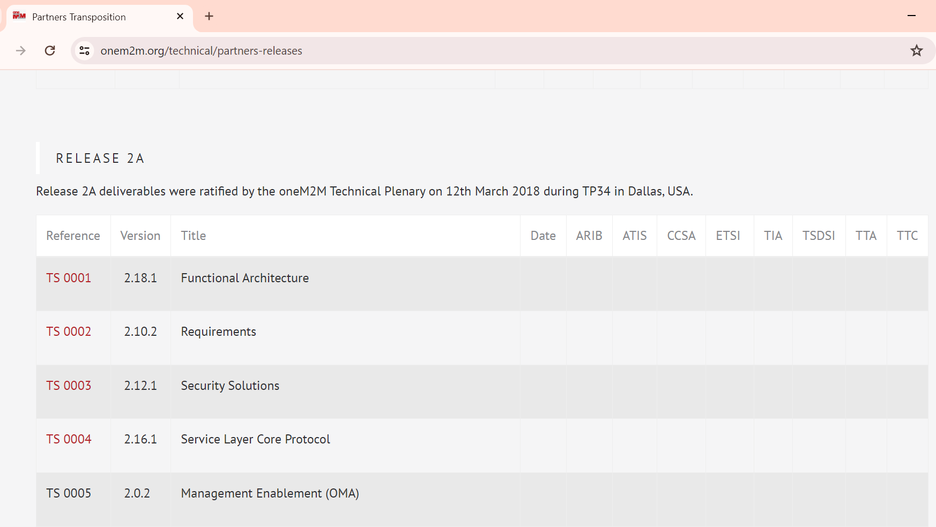
Partner Transpositions https://www.onem2m.org/technical/partners-releases

Slide 5
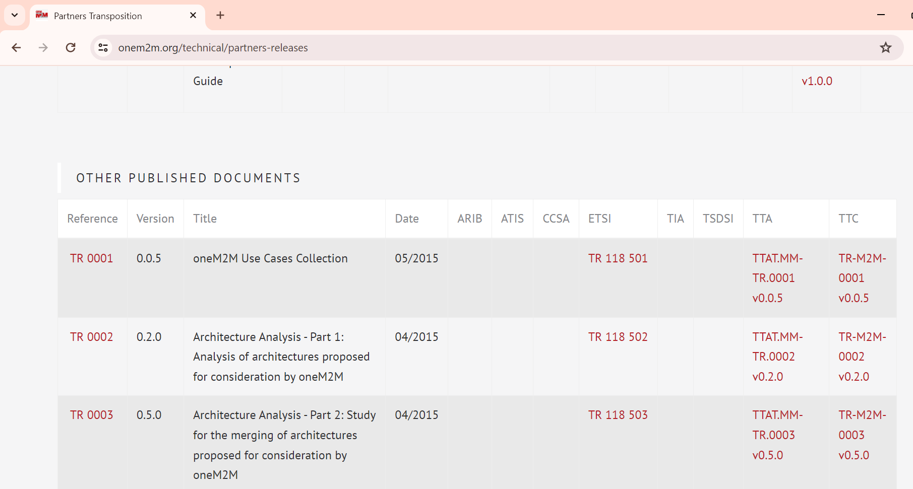
Partner Transpositions https://www.onem2m.org/technical/partners-releases

Slide 6
About Us https://www.onem2m.org/harmonization-m2m

Slide 7
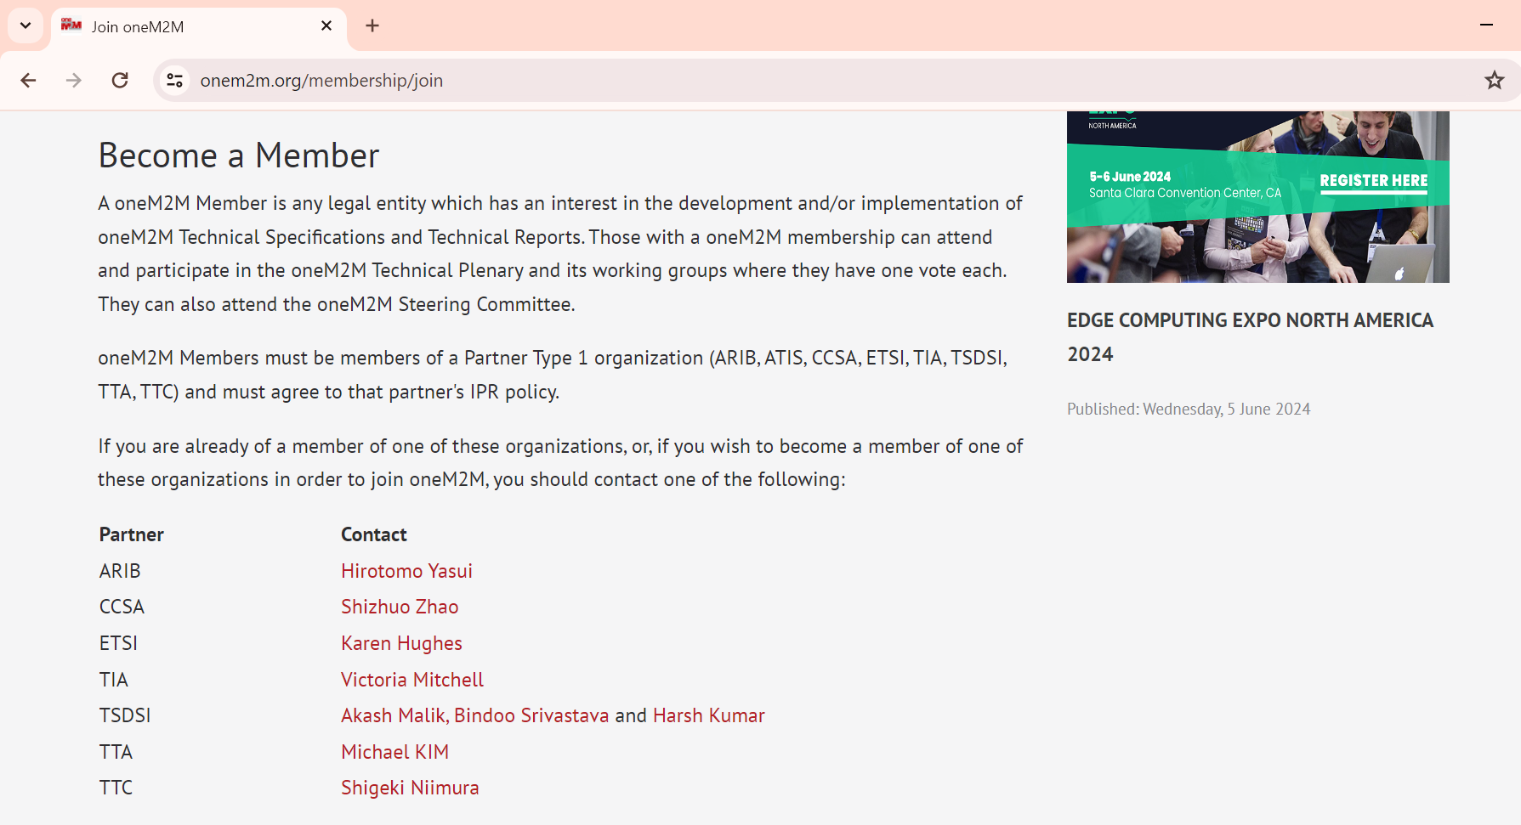
Join oneM2M https://www.onem2m.org/membership/join
Contact information:
Should we simply mention the current SDOs and the contact person details?

Slide 8
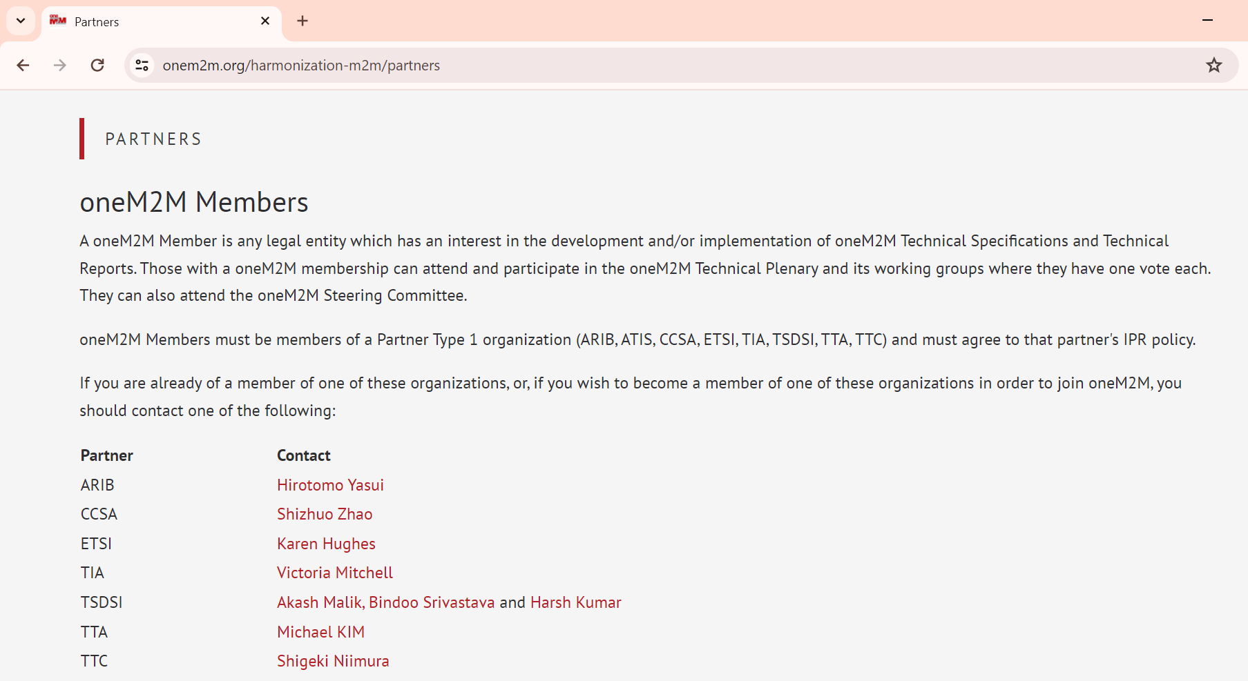
Partner Information https://www.onem2m.org/harmonization-m2m/partners

Slide 9
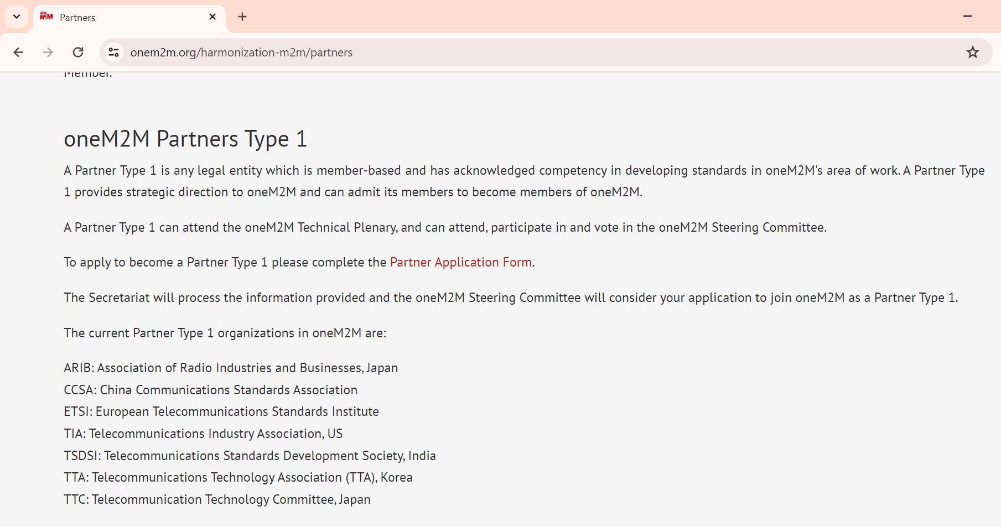
Partner Application https://www.onem2m.org/harmonization-m2m/partnersa

Slide 10
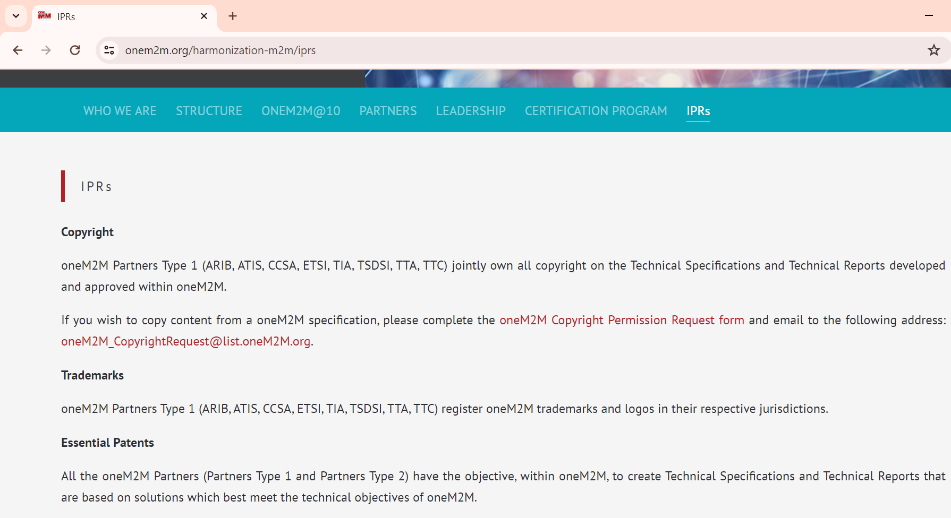
IPRs – Copyright/Trademark https://www.onem2m.org/harmonization-m2m/iprs

Slide 11
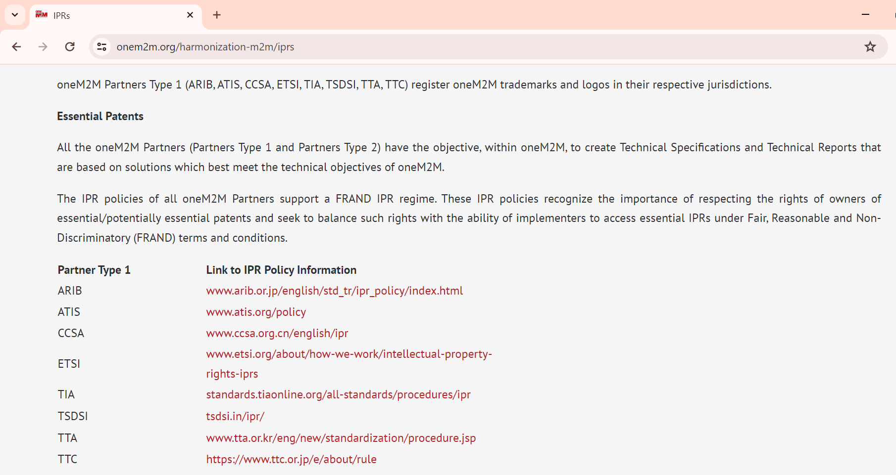
IPRs: Essential Patents https://www.onem2m.org/harmonization-m2m/iprs

Slide 12
oneM2M Partnership Agreement https://bit.ly/4e2t1VS
Refer to Page 12 in oneM2M Partnership Agreement

Slide 13
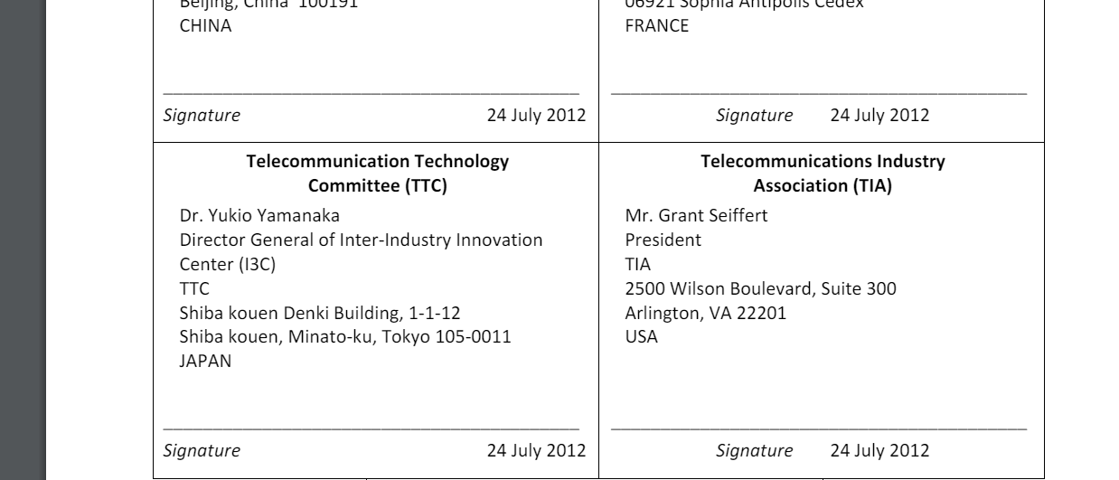
oneM2M Partnership Agreement https://bit.ly/4e2t1VS
Refer to Page 12 in oneM2M Partnership Agreement

Slide 14
Thank You

