Slide 1
Marcom Report
Bindoo Srivastava, Marcom Chair
8 August 2024

Slide 2
Outline
SC guidance on Partner Transposition pages
Items Sent to Legal Sub-Committee for advice
Planning for oneM2M- IEEE IoTWF GDSLAND Industry Forum
Speaking Opportunities
New Executive Insights published
Metrics

Slide 3
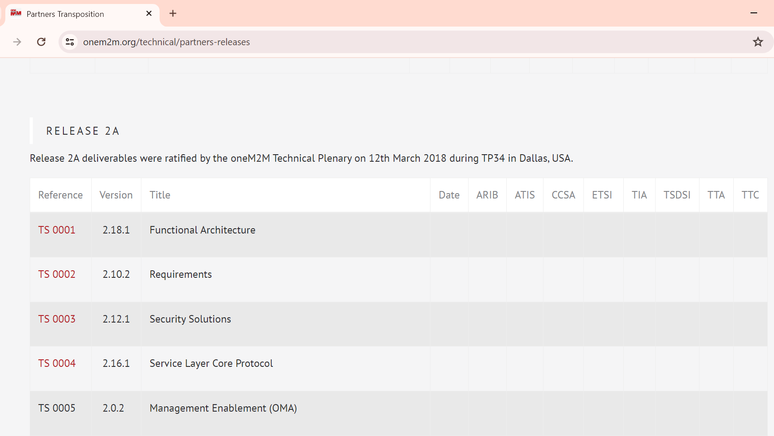
Partner Transpositions – SC guidance wrt Date Field https://www.onem2m.org/technical/partners-releases
Mention date of Release by oneM2M at the top and drop the date column

Slide 4
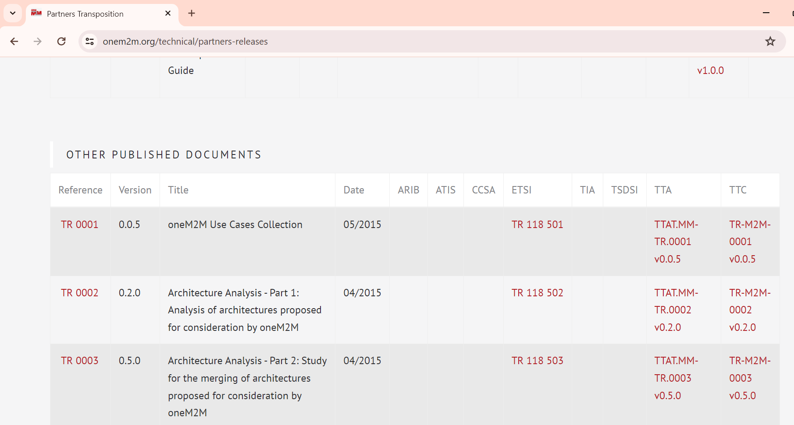
Partner Transpositions – SC guidance wrt partner columns https://www.onem2m.org/technical/partners-releases
Retain columns only for Partners who have transposed the particular Rel and provide links to the same in the fields. Drop the other columns.

Slide 5
Items Sent to Legal Sub-Committee for advice
IPR/Copyright matters
Legal opinion on the IPR/Copyrights webpage
Content of Wiki, artifacts generated by tools such as XMLs to be reviewed/updated because of exiting partners
Partner application form - https://www.onem2m.org/partner-application-form
IPRs - https://www.onem2m.org/harmonization-m2m/iprs
Partners’ Role Acknowledgement:
Should only the documents generated after 1st June onwards only should be modified? Or those generated in the past also to be modified?
How to handle CRs on past baseline documents?
Should the process for generating baseline documents be changed in respect of Partner Roles ?
How should ATIS and other leaving partners be acknowledged for their role in Rel 4 ?

Slide 6
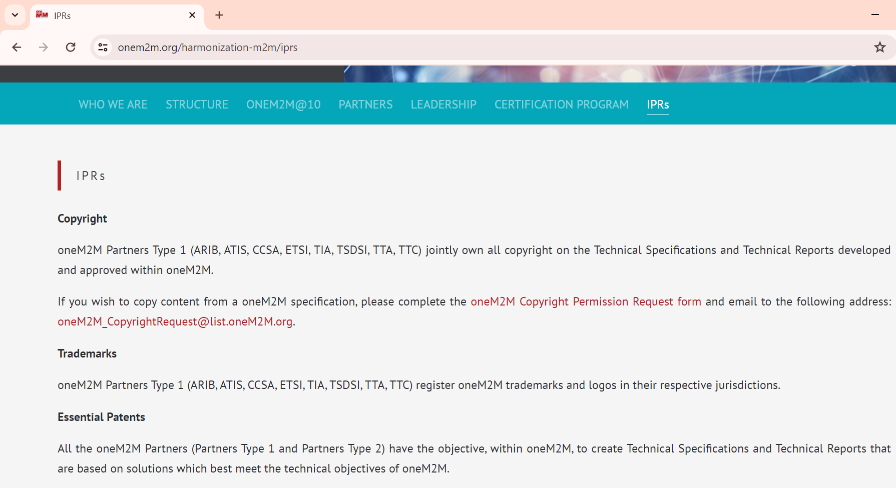
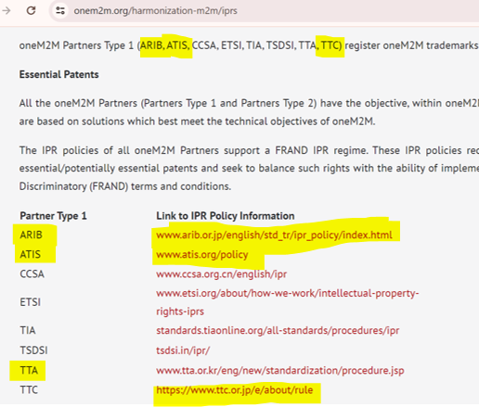
IPRs – Copyright/Trademark https://www.onem2m.org/harmonization-m2m/iprs
To be addressed by LC

Slide 7
oneM2M – IEEE IoT WF GDSLAND Industry Forum
Industry Forum workshop on “Global Data Standards Landscape” along with IEEE as part of the IEEE IoT World Forum, in Ottawa, Canada, tentatively on 12 Nov 2024.
Standards Development Organizations across the world are developing data-related standards to address the rising demand for standardized data formats, management, analysis, and processing. However, there is a lack of active collaboration between these bodies.
The Global Data Standards Landscape Industry Forum aims to gather distinguished speakers from prominent data standards organizations to present their work on data-related standards and to offer insights into the current standardization landscape. This event will serve as a platform to encourage dialogue on gap analysis and to underscore the necessity of collaboration among standards organizations.
Speaker Nominations sought from ARIB, TTC, CCSA, IEEE-SA, ITU, IEC, ISO, ATIS, TIA, and TSDSI for a “Standards” Session

Slide 8
oneM2M – IEEE IoT WF GDSLAND Industry Forum: Proposed announcement content
With unimagined amount of data getting generated by various businesses and vertical sectors as also its B2B & B2C transactions in the era of digital transformation through enablement of the entire ecosystem, the focus on high-quality data and it’s secure handling / transfer is essential both for successful deployment various technologies for personal, critical and business services. Therefore, there is a growing need for standard ICT technologies that can ensure interoperability, quality, and privacy throughout the data lifecycle, from collection to analysis and usage. Efforts are underway in both public and private standardizations to develop standards for managing large-scale IoT data usable for AI machine learning, as well as for distributed standard data processing using edge computing.
For example, the oneM2M international IoT standard is advancing standards for AI/ML IoT data, smart device templates, digital twin, and metaverse standards. Likewise, ITU-T SG-20 is focused on AI and smart city data-related standards, while ETSI TC SmartM2M is working on data semantics standards. Moreover, discussions are unfolding around data semantics at W3C, edge distributed data processing at ETSI ISG MEC, and permission-based distributed ledger standards for managing trusted data at ETSI ISG PDL. These standards are critical across various data and application domains. TSDSI has taken up many activities in the area of edge computing, AI, digital twins, metaverse as also for end-to-end security and privacy.
Currently, these organizations are developing data-related standards, and there is a rising demand in the market for standardized data formats, management, analysis, and processing. However, there is a lack of active collaboration between these standardizing bodies.
Therefore, oneM2M is co-organising an industry forum session on “Global Data Standardization Landscape” with IEEE as part of the IEEE WF-IoT 2024 conference, in Ottawa, tentatively on 12th November 2024. The goal of this industry forum is to gather distinguished speakers from prominent data standards organizations to present their work on data-related standards and to offer insights into the current standardization landscape. This event will serve as a platform to encourage dialogue on gap analysis and to underscore the necessity of collaboration among standards organizations.

Slide 9
Speaking Opportunities
Panel “Innovation: Solutions for Enterprise, Utility, Government. Future Lo band Narrowband/Industrial IOT Network Infrastructure: NTN LoRaWan, 3GPP, Hybrid, Mesh”.
Panel to address the growing market of IOT in its various guises and how Industry / Government / Utilities are turning to these solutions away from traditional satcom / wireless infrastructure. We require two large end user entities from Industry / Government / Utilities to join the panel to give their perspective.
#Commercial Suppliers / Service Providers etc can join but that would be through a Sponsorship
@Strategies in Satellite Ground Segment 2024 (SSGS 2024)
Panel: Future Enterprise /Industrial IoT Network Infrastructure: Solutions for Enterprise, Utility, Government
Day 2 (September 5) 12:15 – 1300
Venue: London

Slide 10
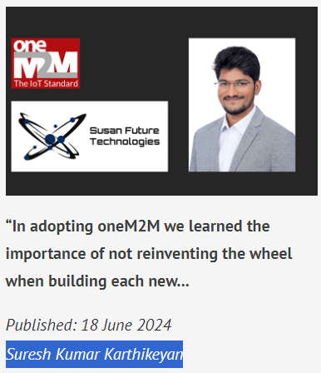
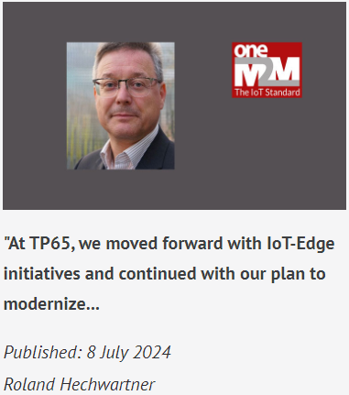
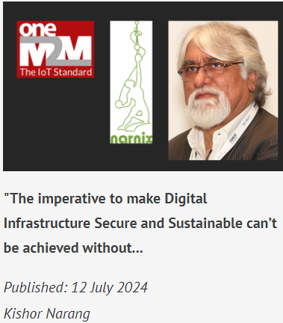
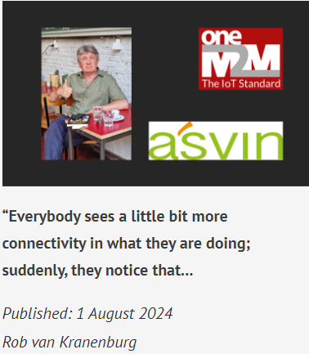
Executive Insights published since previous MARCOM meeting

Slide 11
Metrics (YTD’24)
External Publications: 1 published, 1 in pipeline
Engagement: 12 Executive Insights published (4 post Marcom 128)
Regional Outreach: oneM2M workshop in ASTAP32, Bangkok, Thailand
Visibility:
Total Events organized – 1@oneM2M (oneM2M workshop in ASTAP32)
Speaking Opportunities –
Strategies in Satellite Ground Segment 2024
Bob spoke in the Tech Edge Expo
Social Media: LinkedIn 1538 followers (▲39 from Jun’24), 44 total posts; Twitter 1448 followers, 184 total posts
Communiques & PRs: - N/A
oneM2M in the News – 1210 Subscribers
Press Releases – 0
Media queries to oneM2M_PressMedia@list.onem2m.org being forwarded to Bindoo, Aurindam, Ken, Akash
Email for sending notifications created contact@oneM2M.org
Refer oneM2M Promotions Tracker
Notes:
External Publication ->
JaeSeung SONG introductin to oneM2M (Korean) with TTA
ETSI Enjoy (DT about cellular-satellite and oneM2M) (in Pipeline)
Executive Insights ->
Executive Insights
(post Marcom 128)
Susan Future Technologies (Suresh Kumar)
TP 65
Narnix (Kishore Narang)
Asvin (Rob van Kranenburg)
(Old)
TP 62 – 8th January 2024
Digisaar – 21st February 2024
University of Oulu – 8th March 2024
TP 63 – 14th March 2024
IoT 2.0 (Andreas Kraft) – 16th April 2024
Dr Luigi Liquori (INRIA) – 6th May 2024
TP 64 – 22nd May 2024
Andre Dutra – 23rd May 2024

Slide 12
Media Engagement (CY24)
18 July 2024 | Design for Optimized Public Safety and Earthquake Disaster Mitigation With IoT
20 June 2024 | Telecommunications Technology Association (Korea) Supports oneM2M
31 May 2024 | oneM2M Introduction for Asia-Pacific Telecommunity
31 May 2024 | oneM2M Developer Supports and Certification
31 May 2024 | oneM2M Use Cases in Korea
31 May 2024 | oneM2M Development and Application Use Cases in India
3 January 2024 | Getting Started in oneM2M
3 January 2024 | oneM2M Developer Support
3 January 2024 | IoT Testing and Certification
3 January 2024 | IoT Security in oneM2M
3 January 2024 | oneM2M Deployment Experiences in India
3 January 2024 | An elevator Digital Twin System Using oneM2M
3 January 2024 | Enhancement to oneM2M Open-Source Resources
oneM2M News

Slide 13
oneM2M in Press and PR Engagement
oneM2M in the Press
Discourse on Development (India) | Jan 2024 | EU Ambassador to India Hon. Hervé Delphin visits IIIT Hyderabad's Smart City Living Lab and Center of Excellence CoE on IoT and oneM2M
PR Agency can be engaged for following task based activities in CY’24
Items | CY’24
Sponsored LinkedIn Campaigns | 1 on “Rel 4?”
PR | 1 PR on IEEE IoTWF Engagement
Feature placement | 1 Feature placement on GDLAND/MEC any other topic

Slide 14
Thank You

