Slide 1
Marcom Report
Bindoo Srivastava, Marcom Chair
11 September 2024

Slide 2
Outline
Boiler Plate Template Content
LinkedIn – Engagement
Partners’ transposition of past oneM2M Specifications
oneM2M Workshops @ IEEE IoT WF - Update
Updates
Metrics

Slide 3
Boiler Plate Template - Proposed New Version
oneM2M is the global standards initiative that covers requirements, architecture, API specifications, security solutions and interoperability for Machine-to-Machine and IoT technologies. oneM2M was formed launched in 2012 as a global partnership initiative between and consists of eight of the world’s preeminent standards development organizations: ARIB (Japan), ATIS (U.S.), CCSA (China), ETSI (Europe), TIA (U.S.), TSDSI (India), TTA (Korea), and TTC (Japan), to develop technical specifications for distributed M2M/IoT systems. together with industry fora or consortia (Global Platform) and over 200 member organizations. oneM2M's horizontal architecture standardises a set of common service functions as a middleware between an IoT application layer and the communications networks and connected devices layer, that can be used to design, deploy and manage end-to-end IoT systems to serve applications and services in diverse verticals such as the smart grid, connected car, home automation, public safety, and health. oneM2M specifications provide a framework. oneM2M actively encourages industry associations and forums with specific application requirements to participate in oneM2M, in order to ensure that the solutions developed support their specific needs. For more information, including how to join and participate in oneM2M, see: www.onem2m.org
For more information on oneM2M’s current work, please visit http://www.onem2m.org/.
Based on the latest oneM2M Brochure

Slide 4
Boiler Plate Template - Older version
About oneM2M
oneM2M is the global standards initiative that covers requirements, architecture, API specifications, security solutions and interoperability for Machine-to-Machine and IoT technologies. oneM2M was formed in 2012 and consists of eight of the world’s preeminent standards development organizations: ARIB (Japan), ATIS (U.S.), CCSA (China), ETSI (Europe), TIA (U.S.), TSDSI (India), TTA (Korea), and TTC (Japan), together with industry fora or consortia (Global Platform) and over 200 member organizations. oneM2M specifications provide a framework to support applications and services such as the smart grid, connected car, home automation, public safety, and health. oneM2M actively encourages industry associations and forums with specific application requirements to participate in oneM2M, in order to ensure that the solutions developed support their specific needs. For more information, including how to join and participate in oneM2M, see: www.onem2m.org
For more information on oneM2M’s current work, please visit http://www.onem2m.org/.

Slide 5
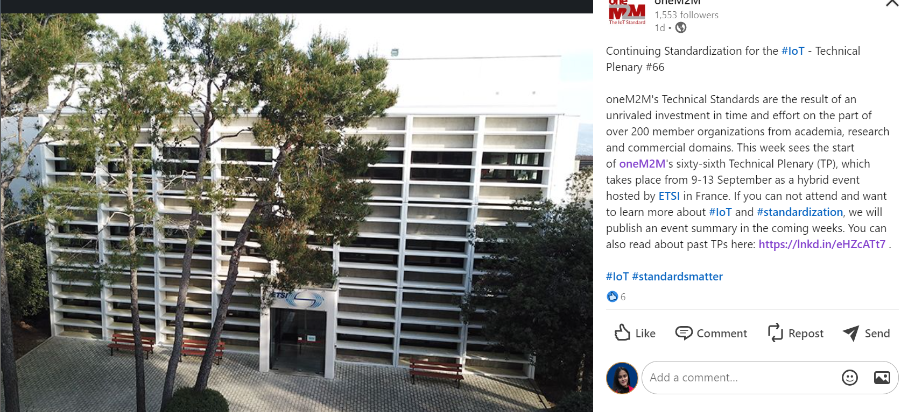
LinkedIn Posts Review https://www.linkedin.com/posts/onem2m_iot-iot-standardization-activity-7238486227593678848-CYOg?utm_source=share&utm_medium=member_desktop
Posted on 9 Sep 2024
Analytics
6 likes
0 comment
0 repost
Posted 1 day ago

Slide 6
LinkedIn Posts Review https://www.linkedin.com/posts/onem2m_connectivity-proprietary-onem2m-activity-7234498132489768962--V6I?utm_source=share&utm_medium=member_desktop
Posted on 3 Sep 2024
Analytics
8 likes
1 comment
1 repost
Posted 1 week ago

Slide 7
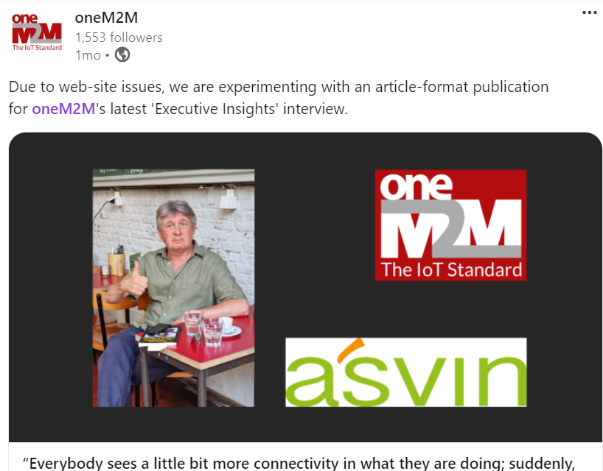
LinkedIn Posts Review https://www.linkedin.com/posts/onem2m_due-to-web-site-issues-we-are-experimenting-activity-7226284225623171072-Jqf2?utm_source=share&utm_medium=member_desktop
Posted on 10 Aug 2024
Analytics
1 likes
2 comments
2 repost
Posted 1 month ago

Slide 8
Upcoming Proposed LinkedIn Posts
Andreas Neubacher’s talk delivered in the SSGS 2024 Conference on 5 Sep 2024
Promoting upcoming talk by Rana Kamill in the IoT Tech Expo Conference 2024 on 2nd October at RAI, Amsterdam
TP 66 Post meeting – Executive Insight
ETSI’s SDG initiative on oneM2M software
Executive Insights with Vi and CDOT (India)
oneM2M workshops in the IEEE IoT WF
LinkedIn followed increased from 1440 (1 Jan24) to 1553 (1 Sep24)
Total 49 posts done

Slide 9
Information from Partners on transposition of previous oneM2M Specs https://www.onem2m.org/technical/partners-releases
Partner | Rel 1 | Rel 2 | Rel 2A | Rel 3
ARIB | n.a. | n.a. | n.a. | n.a.
ATIS | available | available | ?? | ??
CCSA | n.a. | n.a. | ?? | ??
ETSI | available | available | ?? | ??
TIA | available | n.a. | n.a. | n.a.
TSDSI | n.a. | available | ?? | to provide links
TTA | available | available | ?? | ??
TTC | available | available | ?? | ??

Slide 10
Positioning of oneM2M in the Ecosystem
Context:
3 out of 8 partners exiting, # IMs dropping
Interest of community in other initiatives (Matter, CAMARA project etc.)
Should we publish a Position Paper to re-iterate our relevance in the current ecosystem of AI/ Digital Twins/ Edge/ Metaverse/ Data interoperability and so on…

Slide 11
oneM2M global IoT standards and its eco system (GIES 2024) @ IEEE IoT WF (tentatively 11 Nov2024)
Local Ottawa Time | Title | Speaker
09:00~09:15 | Introduction to oneM2M global IoT standard | Roland Hechwartner (oneM2M TP Chair, Deutsche Telekom)
09:15~09:30 | Standardised Data Platform for AI, Metaverse, Blockchain, Edge Computing | JaeSeung Song (oneM2M TP Vice-Chair, Sejong University)
09:30~09:45 | Enabling Edge Computing to oneM2M Standardized IoT Platform | Bob Flynn (EXACTA)
09:45~10:00 | Open and Unified Framework to Interconnect Sensing IoT devices, data and application (oneM2M and OCG) | Ingo Friese (Deutsche Telekom)
Coffee Break
10:15~10:30 | Supporting Metaverse Services via Standardized oneM2M IoT Platform | SeungMyeong Jeong (KETI)
10:30~10:45 | Standardised Testing Framework and Global oneM2M Certification | Miguel Angel Reina Ortega (ETSI)
10:45~11:00 | An overview about the oneM2M Open Source Ecosystem | Andreas Kraft (EXACTA)
11:00~11:15 | Panel Discussion: Next Generation Global IoT Standards | Moderator: Roland Hechwartner

Slide 12
oneM2M GDSLAND Workshop @ IEEE IoT WF (tentatively 12 Nov2024)
Local Ottawa Time | Title | Speaker
09:00~09:15 | oneM2M: Global data standards for IoT, Digital Twin, Semantics, and Metaverse | Roland Hechwartner (oneM2M TP Chair, Deutsche Telekom)
09:15~09:30 | ETSI TC SmartM2M: Standards for Smart Things, Semantics, Ontologies | Enrico Scarrone (Telecom Italia)
09:30~09:45 | ETSI ISG CIM: Context awareness and linked IoT data standards | Franck Le Gall (EGM) – Remote (TBD)
09:45~10:00 | ETSI ISG PDL: Permissioned distributed Ledger Standards for Data Trust | Huawei (PDL delegate)
Coffee Break
10:15~10:30 | ISO: Database Language Standards for Data Storage and Retrieval | Keith Hare (JCC Consulting, Inc.)
10:30~10:45 | TSDSI: Standardised based platform for smart city and agriculture | Hemant Jeevan Magadum (CDAC)
10:45~11:00 | TTA: Data in IoT and Smart City | SeungMyeong Jeong (KETI)
11:00~11:15 | ITU-T SG20: Topic TBD | TBD
11:15~11:30 | Panel Discussion: Gap analysis of data related standards and guides for collaborations | Moderator: JaeSeung Song

Slide 13
Thought Leadership
Article by Andre Dutra (DT) in ETSI Enjoy on Cellular –Satellite and oneM2M

Slide 14
Speaking Opps – SSGS 2024 | 5 Sep 2024
Andreas Neubacher (DT) joined Phil Beecher (WiSun Alliance) and Eric Hewitson (LoRa Alliance) in a panel moderated by Richard Hooper (Satellite Evolution) on
“Innovation: Solutions for Enterprise, Utility, Government. Future Lo band, Narrowband /Industrial IOT Network Infrastructure: NTN LoRaWan, 3GPP, Hybrid, Mesh.
in the “Strategies in Satellite Ground Segment” (SSGS2024) Conference

Slide 15
Metrics (YTD’24)
External Publications: 1 published
Engagement: 12 Executive Insights published (4 post Marcom 128)
Regional Outreach: 0
Visibility:
Total Events organized – 1@oneM2M (oneM2M workshop in ASTAP32)
Speaking Opportunities –
Strategies in Satellite Ground Segment 2024 – Andreas Neubacher spoke as member of oneM2M
Social Media: LinkedIn 1553 followers (▲15 from Aug’24), 49 total posts; Twitter 1445 followers, 210 total posts
Communiques & PRs: - N/A
oneM2M in the News – 1210 Subscribers
Press Releases – 0
Media queries to oneM2M_PressMedia@list.onem2m.org being forwarded to Bindoo, Aurindam, Ken, Akash
Email for sending notifications created contact@oneM2M.org
Refer oneM2M Promotions Tracker
Notes:
External Publication ->
ETSI Enjoy (DT about cellular-satellite and oneM2M)

Slide 16
Media Engagement (CY24)
18 July 2024 | Design for Optimized Public Safety and Earthquake Disaster Mitigation With IoT
20 June 2024 | Telecommunications Technology Association (Korea) Supports oneM2M
31 May 2024 | oneM2M Introduction for Asia-Pacific Telecommunity
31 May 2024 | oneM2M Developer Supports and Certification
31 May 2024 | oneM2M Use Cases in Korea
31 May 2024 | oneM2M Development and Application Use Cases in India
3 January 2024 | Getting Started in oneM2M
3 January 2024 | oneM2M Developer Support
3 January 2024 | IoT Testing and Certification
3 January 2024 | IoT Security in oneM2M
3 January 2024 | oneM2M Deployment Experiences in India
3 January 2024 | An elevator Digital Twin System Using oneM2M
3 January 2024 | Enhancement to oneM2M Open-Source Resources
oneM2M News

Slide 17
oneM2M in Press and PR Engagement
oneM2M in the Press
Discourse on Development (India) | Jan 2024 | EU Ambassador to India Hon. Hervé Delphin visits IIIT Hyderabad's Smart City Living Lab and Center of Excellence CoE on IoT and oneM2M

Slide 18
Thank You

