Slide 1

Supporting Time Series Data
Group Name: WG2
Source: Qi Yu , Mitch Tseng- Huawei Technologies, Co. LTD.
Meeting Date: 2015-07-01
Work Item :WI-0033

Slide 2
Introduction
The definition of Time Series Data in TS-0011:
Time series data is a sequence of data points, typically consisting of successive measurements made over a time interval.
The following two requirements have been agreed and the related WI-0033 Supporting Time Series Data has been agreed at TP#17 as well.
  The oneM2M System shall be able to collect, store time series data.
  The oneM2M System shall be able to detect and report the missing data in time series.

Slide 3
Introduction
Time Series data is widely existing in many verticals .
  Periodical monitoring data from product line in industrial domain
  Report Heartbeat and blood pressure periodically in ehealth
  Report location information of the car in ITS
  The characters of time series data :(v1,t1),(v2,t2),(v3,t3)…….
  Chronologically
  Dynamically
  Infinitely
  Frequently small data in most cases

Slide 4
Issues
Time series data need be updated when there are new data. However, <contenInstance> cannot be modified once created.
The current <content> cannot reflect the time information when the data are collected by the device. Therefore, the following issues should be considered:
  How to search and analyze the data in time series?
  How to detect and report when data lost occurs?

Slide 5
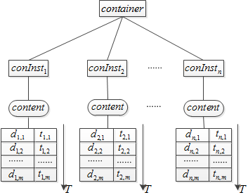
Option 1
Option1 to solve this problem is to extend the existing content attribute in the <contentInstance> resource. In this case, the content attribute needs to store the data and the related time when the data were collected by the device. It will also lead to a need to update content attribute when new data arrive.

Slide 6
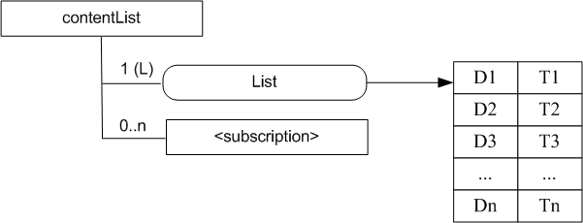
option 2
Option2 to solve this problem is to define a new resource for time series data. The List attribute is used to store data and time when the device generated the data .

Slide 7
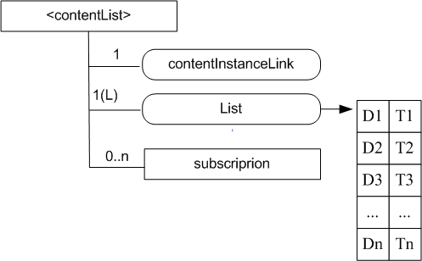
Option 3
Option3 to solve this problem is to define a new resource and let content attribute store the URI linking to this resource.
URI of <contentList >resource

Slide 8
Solution Comparsion
Option1 :
The existing content attribute should be changed to store time series data. This obeys the principle that the contentInstance shall not be modified once it is created defined in Release 1.
Option2 &Option3:
The new resource is defined to support time series data in R2.
We prefer to define a new resource type to store time series data because the following reasons:
it has minimum impact on R1.
it is more flexible to store and detect the time series data.

Slide 9
Thanks

