Slide 1

Supporting Time Series Data
Group Name: WG2
Source: Qi Yu , Mitch Tseng- Huawei Technologies, Co. LTD.
Meeting Date: 2015-07-01
Work Item :WI-0033

Slide 2
Introduction
The definition of Time Series Data in TS-0011:
  Time series data is a sequence of data points, typically consisting of successive measurements made over a time interval.
The following two requirements have been agreed and the related WI-0033 Supporting Time Series Data has been agreed at TP#17 as well.
  The oneM2M System shall be able to collect, store time series data.
  The oneM2M System shall be able to detect and report the missing data in time series.

Slide 3
Introduction
Time Series data is widely existing in many verticals .
  Periodical monitoring data from product line in industrial domain
  Report Heartbeat and blood pressure periodically in ehealth
  Report location information of the car in ITS
  The characters of time series data :(v1,t1),(v2,t2),(v3,t3)…….
  Chronologically
  Dynamically
  Infinitely
  In most cases, small amount of data in each occurrence

Slide 4
Use of Time Series Data
Example: Collecting Location data of taxis in Beijing.
The taxi should report its location information to the platform once every minute. This information includes the GPS data and time when the data was generated. The taxi company can use these data to do the following analysis:
Average miles which the taxi is driven daily or monthly.
Track historical location information of the taxi in a specific month
……
The platform should store the data; however, the use of data depends on the requirements from the application.

Slide 5
Issues
Time series data need to be updated whenever there are new data present. However, <contenInstance> cannot be modified once created.
The current <content> cannot reflect the time information when the data are collected by the device. Whenever a new data is arriving, a new contenInstance ressource needs to be created. It will add to the data redundanby in the attributes e.g. reourceType,ParentID….
Attributes of <contentInstance> | Multiplicity
resourceType | 1
resourceID | 1
resourceName | 1
parentID | 1
labels | 0..1 (L)
expirationTime | 1
creationTime | 1
lastModifiedTime | 1
stateTag | 1
announceTo | 0..1 (L)
announcedAttribute | 0..1 (L)
creator | 0..1
contentInfo | 0..1
contentSize | 1
ontologyRef | 0..1
content | 1

Slide 6
Issues
Location information (GPS) of Beijing’ taxis
  There are nearly 67000 taxis by 2014. Every minute, the taxis generates one GPS data in general. So the total amount of data transactions have reached near 100 Million times level in a day. (67000*24*60 ~ 96.5 Millions)
    There are at 100M level of <contentInstance> resources to be created. That’s to say we should organize and manage these new resources and a huge amount of history data resource.
    There are also at least 4 attributes (resourceType, resourceName, parentID, stateTag) which will be created for one location values in a <contentInstance> resource. So it will make large data redundancy.

Slide 7
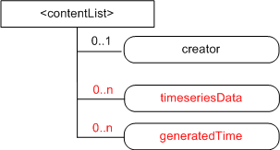
Option 1
Option1 to solve this problem is to define a new resource for time series data. The List attribute is used to store data and time when the device generated the data.

Slide 8
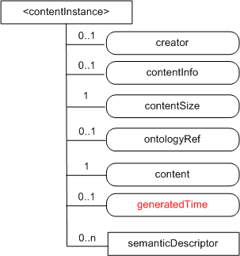
Option 2
A new attribute generatedTime is defined to reflect the time when the device or senor generated the time series data. A new time series data will lead to create a new contentInstance resource.

Slide 9
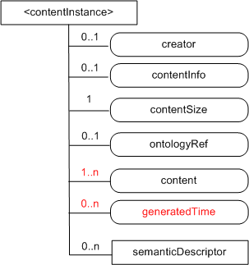
Option 3
A new attribute generatedTime is defined to reflect the time when the device or senor generated the time series data. Multiplicity of content is changed as well to accommodate more time series data. In this case, the content attribute needs to store the data and the related time when the data were collected by the device. It will also lead to a need to update content attribute when new data arrive.

Slide 10
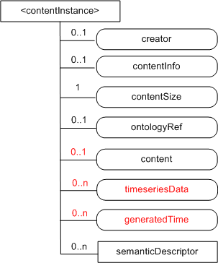
Option 4
Two new attributes are defined to store time series data. In this case, these two attribute needs to store the data and the related time when the data were collected by the device.

Slide 11
Comparison of Solutions
Option | Analysis
Option1 | A new resource is defined and has minimum impact on R1.
Option2 | A new attribute generatedTime is defined. A new time series data will lead to create a new contentInstance resource and may result in redundancy.
Option3 | A new attribute generatedTime is defined to reflect the time when the device or senor generated the time series data. Multiplicity of content is changed as well to accommodate more time series data. This follows the rule that contentInstance cannot be modified once created.
Option4 | Two new attributes are defined to store time series data. This follows the rule that contentInstance cannot be modified once created

Slide 12
Way Forward
Define a new resource or new attributes to support the time series data.

Slide 13
Thanks

