Slide 1
OIC INTERWORKING Resource mapping
Group Name: Architecture WG
Source: Kiran Vedula, Samsung Electronics, kiran.vedula@samsung.com
Jieun Keum, Samsung Electronics, je.keum@samsung.com
Jinhyeock Choi, Samsung Electronics, jinchoe@samsung.com
Sungchan Choi, KETI, sungchan.keti@gmail.com
SeonHyang Kim, DT&C, shkim@dtnc.net
Meeting Date: <2015-10-20>
Agenda Item: <WI 44: oneM2M-OIC interworking >
Notes:
Other suggested titles:
“Benefits of oneM2M Standardization”

Slide 2
Introduction
In this presentation a possible mapping of OIC entities into oneM2M entities is recommended
At first a generic mapping is depicted and further the mapping is extended to specific resources and properties

Slide 3
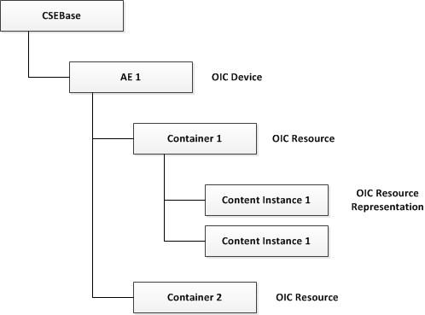
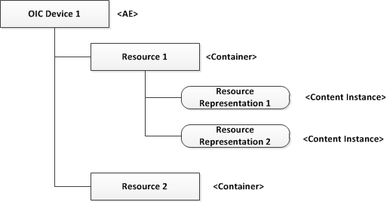
Generic Entity Mapping
The tree represents a structure of any OIC device and how it is mapped into oneM2M entities
Each OIC device can include one or more resources; Each resource can have a representation at any instance of time
Mapping
  OIC Device --- <AE> oneM2M resource
  Any OIC Resource --- <Container> oneM2M resource
  Resource representation --- <content instance> oneM2M resource

Slide 4
Model of Light device in OIC
Resources
Resource URI: /oic/p
oic.wk.p
rt: oic.wk.p
oic.wk.res
if: oic.if.r
n: homePlatform
oic.wk.d + oic.d.light
policy: bm:11
oic.r.switch.binary
pi: at1908
mnmn: Samsung
OIC Device 1
Properties
Physical Device: bulb
An OIC light device is depicted in the figure which supports mandatory common resources ‘oic.wk.res’, ‘oic.wk.d’ and ‘oic.wk.p’
The oic.wk.d is extended by oic.d.light with additional information about the device
OIC light also support oic.r.switch.binary resource which is mandatory for the particular device type
Properties of the oic.wk.p resource type are also depicted

Slide 5
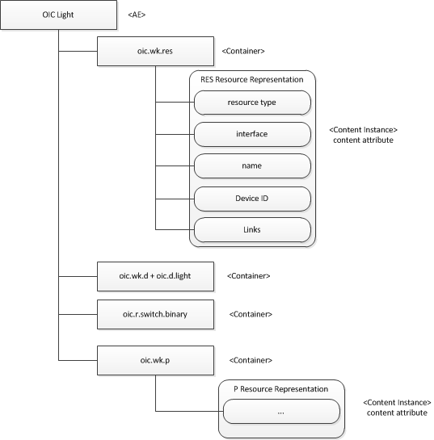
Light Device Resource Mapping
Figure depicting the OIC light device (slide 4) structured using the generic entity mapping (slide 3)

Slide 6
oneM2M AE Resource gets values from oic/d
AE
Resource type: AE
Resource ID
D
Resource URI: /oic/d
Provided by CSE
Resource Name
rt: oic.wk.d
Parent ID
CSE-ID
if: oic.if.r
Expiry Time
n: mybulb
Optional
Creation Time
di: <uuid>
Last Modified Time
App-ID
lsv: <spec ver>
AE-ID
dmv: <data mo ver.>
OIC
oneM2M
Some properties of oic.wk.d resource could be mapped to attributes of <AE> resource. But 2 issues exist:
Issue 1: Some Mandatory AE attributes don’t have corresponding attributes from OIC
Issue 2: Resources in oneM2M are not extensible. So other OIC properties cannot be mapped
Recommendation:
Remaining attributes like creationTime, expiryTime could be filled by MN at the time of <AE> creation
Include complete representation of OIC resource as content inside <contentInstance> resource.

Slide 7
OIC res -> oneM2M Container Mapping
Container
Resource type: Container
RES
Resource URI: /oic/res
Resource ID
Provided by CSE
Resource Name
rt: oic.wk.res
Parent ID
AE-ID
if: oic.if.ll
Expiry Time
n: discRes
Optional
Creation Time
di: <uuid>
Last Modified Time
links: <array of links>
State Tag
OIC
Creator
CurrentNrofInstances
CurrentByteSize
One Container resource is created per each OIC resource discovered. Each value in OIC links point to one resource
Some parameters like name of the resource can be mapped to Resource Name attribute in oneM2M Container resource but size limitations may be there. So it is recommended that creator provides this value
Remaining attributes like creationTime, expiryTime could be filled by MN at the time of <Container> creation
oneM2M

Slide 8
Mapping Options for Properties
Options | PROs | CONs
Option 1: Complete Resource Representation (includes all properties) mapped to Content Instance Resource | All OIC data can be replicated | Some property should be used to differentiate between content instances from different resource types
Option 2: Each Property mapped to Content Instance Resource | Simple mapping | Additional data is created and hence occupies more memory on IPE
Option 3: Properties mapped to Attributes of a oneM2M resource | Less footprint on IPE | Complex mapping New attributes need to be defined in oneM2M (where they are not already present)
Recommendation: To use Option 1

Slide 9
Recommended Mapping Rules
oneM2M <AE> and <Container> Resources related attributes could be filled with OIC properties from OIC resources (esp. oic/d, oic/res and any device specific resources) as much as possible
Complete OIC resource representation could be mapped as a <content instance> resource with the representation data in its ‘content’ attribute
Attributes of oneM2M <AE>, <Container> resources which are mandatory and which could not be filled with OIC properties from OIC resources could be filled either by CSE in some cases or intuitively added by the oneM2M client itself
Most of the OIC Core and Smart Home resources representation could be mapped to <content instance> resource

Slide 10
Recommended Mapping Rules (contd…)
‘Labels’ attribute in <AE> resource
  This could be used to indicate that the device contained is an OIC device for e.g. oic.d.light
‘Labels’ attribute in <Container> resource
  This could be used to indicate the resource type of the OIC resource whose representation is contained for e.g. oic.r.switch.binary
‘contentInfo’ attribute in <contentInstance> resource
  This could be used to indicate the type of content for e.g. JSON, CBOR or XML

