Slide 1

Group multicast
Group Name: ARC
Source: Jiaxin Yin, Huawei Technologies Co., Ltd. yinjiaxin@huawei.com
Meeting Date: 2016-10-17
Agenda Item: TBD
Notes:
改一改Source和date

Slide 2
Background
oneM2M does not support utilizing multicast capability from the underlying network if supported. The underlying network could be 3GPP network or binding protocols like CoAP etc.
The discussion is to kick off the question how to support multicast group by oneM2M?
The contribution is the presentation show for ARC-2016-0455-group_multicast

Slide 3
Multicast Group case1
None of the group member have multicast capability, the same as before: not multicast group
Group create request
Group hosting CSE
Check Multicast capability one by one
Member hosting CSE1
Member hosting CSE2
Member hosting CSE3
Member hosting CSE4
Member hosting CSE5
One Group, no multicast group
Notes:
这页的图和下一页的图看起来没有区别，咱们看出这个是单播的而下一页的是多播的，Check multicast capability one by one这个放在这里有特殊的意义？实线和虚线在这里的含义是什么？

Slide 4
Subgroup management case2
All the group member have the same multicast capability: eg.3GPP MBMS, there is one multicast group.
Group create request
Group hosting CSE
Check Multicast capability one by one
Member hosting CSE1
Member hosting CSE2
Member hosting CSE3
Member hosting CSE4
Member hosting CSE5
One multicast Group: 3GPP MBMS group
Notes:
为什么三个是虚线，两个是实线？

Slide 5
Subgroup management case3
Part of the group member have multicast capability：eg.3GPP MBMS; the others do not.
Group create request
CSE
Check Multicast Capability one by one
Member hosting CSE1
Member hosting CSE2
Member hosting CSE3
Member hosting CSE4
Member hosting CSE5
One multicast group：3GPP MBMS multicast group

Slide 6
Subgroup management case4
Some of the group member have multicast capability：eg. 3GPP MBMS; the others have the IP multicast capability.
Group create request
Group hosting CSE
Check Multicast Capability one by one
Member hosting CSE1
Member hosting CSE2
Member hosting CSE3
Member hosting CSE4
Member hosting CSE5
Multicast group 1：3GPP MBMS multicast
Multicast group 2：IP multicast

Slide 7
Resource structure
Member Hosting CSE registration information are used to support group Hosting CSE to create the multicast group.
<remoteCSE>
externalGroupID
It is an underlying network external globally unique ID which is mapping with a network internal globally unique ID which identifies a set of underlying network identifiers from a given network that are grouped together for one specific group related services.
multicastCapability
Indicates the oneM2M node multicast Capability, pre-defined values are:
MBMS
IP
Notes:
可能需要考虑一下，目前的资源架构，对于MBMS和IP多播是可以支持的，但是如果后续有新的多播技术，这个架构是否还能够适用。我们可能需要一个回答。
multicastCapability应该是圆角框，具体的multicastCapability是什么样的？一个CSE是否有可能同时支持MBMS和IP多播？一个List？

Slide 8
Resource structure
<Group>
Group hosting CSE: the <multicastGroup> resource is for the multicast of the group members. The multicastGroup contains a subset of the group members that belongs to one network and same multicast capability segment.
<multicastGroup>
When the multicastType is 3GPP_MBMS_group, the externalGroupID is a 3GPP network external globally unique ID which is mapping with a network internal globally unique ID which identifies a set of IMSIs (e.g. MTC devices) from a given network that are grouped together for one specific group related services.
externalGroupID
multicastType
multicastAddress
addressType
memberList
List of member resource IDs referred to in the multicast group.
multicastGroupFanOutURI
It is virtual identifier and destination URI used to indicate an access path of the member resource on a member device. When sending multicast message, it’s the universal resource identifier for all the members.

Slide 9
Resource structure
<CSEbase>
Member Hosting CSE: the <localMulticastGroup> resource of member device is to indicate that if the CSE is part of a multicast group.
When the multicastType is 3GPP_MBMS_group, the externalGroupID is a 3GPP network external globally unique ID which is mapping with a network internal globally unique ID which identifies a set of IMSIs (e.g. MTC devices) from a given network that are grouped together for one specific group related services.
<localMulticastGroup>
externalGroupID
parentGroupID
multicastAddress
List of member resource IDs referred to in the multicast group of local device.
memberList
It is virtual identifier and is used to indicate an access path of the member resource on a member device. When receiving the message, the group member host CSE checks whether the multicastGroupFanOutURI is aveable, if not, replace the fanout URI included in the destination URI in the member
resource access request with the member list of access path of
the member resource on the member device
multicastGroupFanOutURI
responseURI
It is used to indicate group multicast message response URI when the multicastType is 3GPP_MBMS_Group.
Notes:
可能需要考虑一下，目前的资源架构，对于MBMS和IP多播是可以支持的，但是如果后续有新的多播技术，这个架构是否还能够适用。我们可能需要一个回答。
multicastCapability应该是圆角框，具体的multicastCapability是什么样的？一个CSE是否有可能同时支持MBMS和IP多播？一个List？

Slide 10
Example of Creating IP_Multicast Group on GroupHosting CSE
Group Hosting CSEbase
ResourceID:/CSE090112
Group
ResourceID:/CSE090112/grp1
multicastGroup
ResourceID:/CSE090112/grp1/mgp1
/d1.example.org/xx1/aa
/d1.example.org/xx2/bb
/d2.example.org/xx1/cc
/d2.example.org/xx2/dd
memberList
multicastGroupFanOutURI
/CSE090112/forIPMulticast1
multicastGroupType
IP_multicast_group
multicastAddress
[FF32:30:3FFE:FFFF:1::1234]
addressType
IPv6
Notes:
memberList里面d1.example.org看起来像是一个SP ID，所以应该是//d1.example.org/xx1/aa
multicastGroupFanOutURI到时候解释的时候可以参考notificationURI，那个URI可能不是一个具体的资源，只是一个服务的入口，另外wellknown拼写有误
Wellknown的时候，需要明确，在这种情况下unstructured resource id也是适用的。另外直接用wellknown可能不好，因为wellknown一般是用于服务发现的，多播的时候最好选另外一个名字，例如multicastPoint

Slide 11
Example of Creating localMulticastGroup on Member Hosting CSEs
ASN-CSEbase1
ResourceID:/d1.example.org
ASN-CSEbase2
ResourceID:/d2.example.org
localMulticastGroup
localMulticastGroup
memberList
/d1.example.org/xx1/aa
/d1.example.org/xx2/bb
memberList
/d2.example.org/xx1/cc
/d2.example.org/xx2/dd
multicastGroupFanOutURI
/CSE090112/ forIPMulticast1
multicastGroupFanOutURI
/CSE090112/ forIPMulticast1
parentGroupID
/CSE090112/grp1
parentGroupID
/CSE090112/grp1
multicastAddress
[FF32:30:3FFE:FFFF:1::1234]
multicastAddress
[FF32:30:3FFE:FFFF:1::1234]
responseURI
/CSE090112
responseURI
/CSE090112

Slide 12
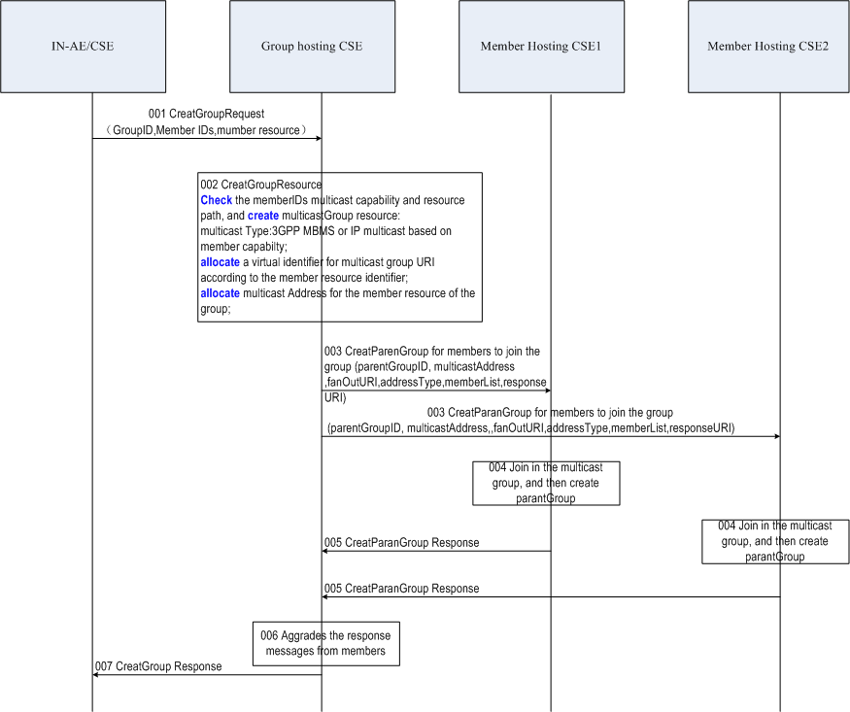
Multicast Group Management Procedures-Creation
Restriction
The current group based multicast can only be used when member hosting CSE and Group Hosting CSE have direct registration relationship.
The current group based multicast can only be applied between CSEs, multicast to ADN is FFS
Notes:
字体调整大一点，Restriction里面的语句描述可以改一改，现在的感觉比较绕。
第6步，如果是配置群组的过程，不需要对成员的响应进行汇聚，因为应用对这个不感兴趣。如果第5步都是成功，第6步成功就行了。如果第5步有一个失败，可能失败的那个要回到单播里去。这部分流程目前还没有体现。

Slide 13
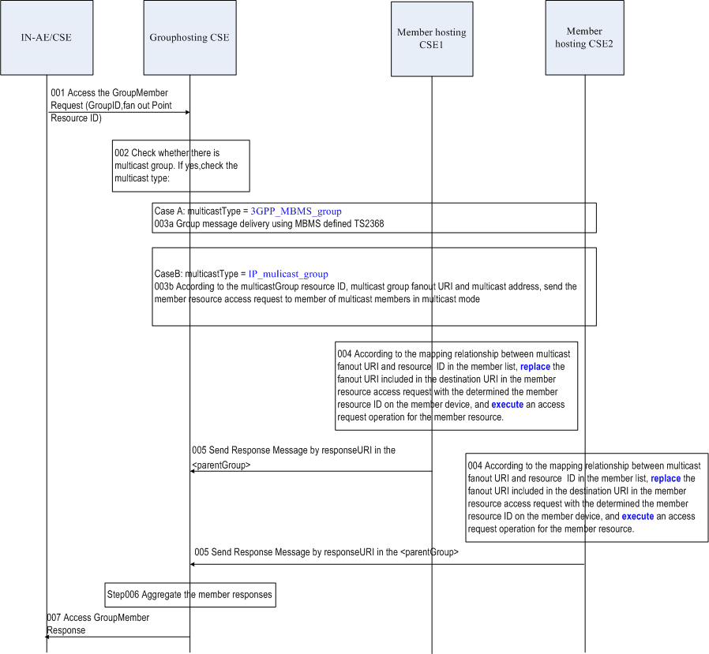
Multicast Group Management Procedures-Fanout
Restriction
The detailed 3GPP MBMS group message delivery procedure is another thread and will be introduced in 3GPP interworking specification.

Slide 14
Questions and comments

