Slide 1

Modbus interworking
Group Name: ARC
Source: Qiuting Li, ZTE, li.qiuting@zte.com.cn,
Weixiang Shao, ZTE, shao.weixiang@zte.com.cn
Meeting Date: 2017-02-015
Agenda Item: TBD

Slide 2
What is Modbus?
An application layer messaging protocol, industry’s serial de facto standard
Its features:
  openly published and royalty-free
  Simple and robust, easy to deploy and maintain
  moves raw bits or words without placing many restrictions on vendors
It is an ideal protocol for RTU(remote terminal unit) applications, and has many varients and versions
Modbus is not industry specific, it is used across a wide range of industries, involving transportation, electricity power system, building, Environmental Monitoring, etc.
Notes:
Be Popular in the Automation process

Slide 3
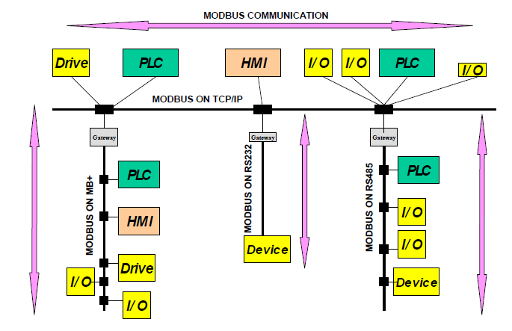
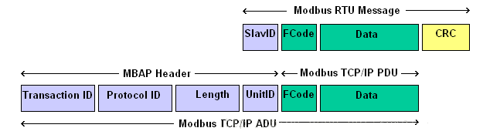
Usage of Modbus
Supervisory control and data acquisition for Remote devices (such as sensor, I/O device), main functions include:
    Date Access , such as Read/Write Coils, Holding Registers, File Record
    Diagnostics, such as Read Exception Status, Device Identification
Client/server (Modbus TCP) or Master/slave (Modbus RTU) communication between devices
Wired/wireless communication within all types of buses or network (e.g. EIA/TIA-485-A, optical fiber, Zigbee, 3G/4G)
Simple message format and defined function codes , and apply to small-data transmission

Slide 4
Why oneM2M need support Modbus devices
Modbus protocol has been Analyzed in TR-0009( Protocol Analysis) and supports generic oneM2M requirement
Be appropriate for some use cases studied in TR-0001(UseCase), specially used in industrial domain
Modbus Devices (such as sensor, controller) in M2M scenarios are frequently used for data collection and remote controlling
it’s a chance to oneM2M system to expand capability for accessing more devices/sensors which support different protocol/technique as a horizontal platform
    non-oneM2M device connect to oneM2M system
    Applications operate Modbus devices by oneM2M mechanism

Slide 5
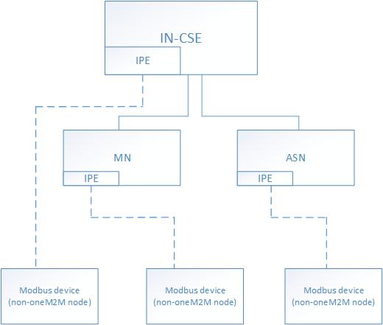
Potential use of Modbus in oneM2M
oneM2M system interworks with Modbus device by IPE that mapping between Modbus and oneM2M
    oneM2M operates (read/write registers) Modbus device
Data model of Modbus device
    Mapping four types of Modbus data model(read/write Discretes Input, Coils, Input Registers, Holding Registers)
    Mapping with <container>/<contentInstance> and other resources
    reuse oneM2M base ontology
Small-date transmission for modbus device
Notes:
Modbus device can’t initiative report data normally. oneM2M can’t get data stored in device, and only get data stored in <container> created in CSE, if IPE can’t report the data, or oneM2M application wants to get the real-time data. Enhancement may be needed.

Slide 6
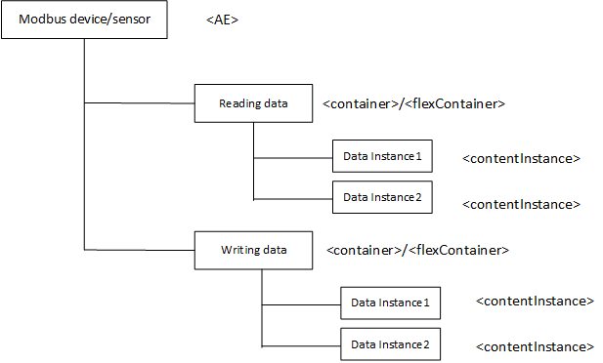
Potential Solution(Option one)
  Mapping by <AE>, <container>, <flexcontainer>, <contentInstance>, <timeSeries> , <timeSeriesInstance> the data of reading/writing registers store in <container> and its child resource
  Exchanging data by CRUD operation to <container>, <flexcontainer>, <contentInstance> , <timeSeries> , <timeSeriesInstance> to trigger action of reading or writing registers and report devices’ data
  Enhancement for mapping resources, such as reading real-time data stored on Modbus device
Reading data
  store data modbus device that IPE report to hostingCSE
Writing data
  store data that oneM2M system write to modbus device
For the real-time data, other container resource may be needed to related to reading operation or new resource may be defined(like virtual resource)

Slide 7
Potential Solution(Option two)
Semantic enablement with oneM2M base ontology
Mapping to InterworkedDevices, Operation and Command, Input / OutputDataPoints(see TS-0030-Generic_Interworking)
  InterworkedDevice(modbus device) registers to CSE by IPE
  Handling of Datapoints by IPE to exchange reading/writing data
  Handling of Operations by IPE to express reading/writing operation
Notes:
Just some classes are used.

Slide 8
work item proposal
 | Document title
New TR | Modbus Interwotking
CRs | CRs to TS-0001 related to Modbus protocol support
Impacted WI
TS-0002 Requirements
TS-0004 Service Layer Core Protocol Specification
TS-0030 Generic Interworking
WI-0056 Evolution of Proximal IoT Interworking

Slide 9
Thanks for your listening!
Q & A

