Slide 1
Edge/Fog Nomenclature Proposal
Group Name: ARC
Source: Catalina Mladin (Convida), Kenichi Yamamoto (KDDI)
Meeting Date: 2018-07-16
Notes:
Other suggested titles:
“Benefits of oneM2M Standardization”

Slide 2
Introduction
This proposal uses as main inputs the terminology and frameworks provided by ETSI MEC and OpenFog, and seeks to:
  Introduce oneM2M terminology that reflects the oneM2M Service Layer focus, while being consistent with the existing work in the Edge/Fog domain.
  Provide a framework for using Edge/Fog technologies in oneM2M with minimal impact on the existing architecture.
The Edge and Fog technologies considered are seen as enablers mapped to functionality within the existing oneM2M entities, which can be realized by functional and deployment options.

Slide 3
Fog Deployment
Hierarchical, scalable collection of nodes, which supports enhanced levels of autonomous functionality at the field nodes.
Autonomous functionality enables fog nodes to continue delivering functionality in the case of external service degradation or failures. The autonomy functions may include discovery, orchestration and management, security, operation and cost savings, which do not rely on a centralized operation entity.
Deployments may include characteristics/capabilities such as:
  Individual fog nodes can scale internally, through the addition of hardware or software.
  Placement of applications allowing system optimizations
  A deployment of fog nodes can be scaled up or down in a demand-driven elastic environment.
  Storage, network connectivity, and analytics services can scale with the fog infrastructure.
Assumed as oneM2M existing design principles (in addition to scalability, hierarchy, autonomy, reliability) and based on the OpenFog pillars :
  Security: including node, network, management and orchestration security.
  Openness: for interoperable systems and ubiquitous ecosystem
  Programmability
  Reliability, Availability and Serviceability
Implemented by deploying “Fog Deployment Enablement” services/ capabilities

Slide 4
Cloudlet (Mobile Edge) Deployment
Scalable collection of nodes using virtualisation technology to provide distributed compute, storage and network resources for cloud/infrastructure services, closer to the end field nodes.
It is proposed to replace the “Edge” concept in oneM2M with “cloudlet”
Based on the ETSI MEC terminology (especially for ME Host, platform, system) and framework.
Using “cloudlet” to clarify/separate from “edge” which may connotate the end devices. Many ETSI MEC informal references use the term “cloudlet”
Implemented by deploying “Cloudlet Deployment Enablement” services/ capabilities
For both “Edge” and “Fog”, the proposal is to understand them as deployments rather than architectural options.

Slide 5
Capabilities (1)
Fog Deployment Enablement (FDE) Service: provides support for functionality targeting the enablement of Fog deployments, such as:
  Remote instantiation of Fog Services, as well as the remote provisioning of information required to instantiate the services.
  Sharing and discovery of Fog Service capability information
  Requests for Fog Services to be provided by specific nodes.
  Fog Service continuity and migration among nodes.
  Orchestration of Fog Services provided by nodes in a deployment in a dynamic fashion to satisfy operational requirements
  Approx. ~ Software view in OpenFog (which includes: App Services + App support + Node mgmgt + Soft Backplane)

Slide 6
Capabilities (2)
Cloudlet (Mobile Edge) Deployment Enablement (CDE) Service: relies upon platform & virtualisation infrastructure to provide support (including compute, storage, and network resources) for the instantiation of cloud applications and services closer to the end devices.
Note:
  For brevity oneM2M can also employ the following terms:
  Fog Node: Node with FDE capabilities
  Cloudlet Node: Node with CDE capabilities

Slide 7
Notes
Cloudlet and Fog capabilities are seen as distinct but not exclusive, some nodes may have both.
For both, there may be different “levels” of capabilities that can be implemented, e.g. not all nodes in a Fog deployment have the same FDE capabilities
Within a deployment similarly capable nodes may have different roles. It is proposed to differentiate some of these roles as needed, e.g.:
Endpoint: A Field Node in a Cloudlet or Fog deployment which does not provide services to any other node. Architecturally, endpoints may be ASNs or ADNs.
Local Fog Node: A Field Node with FDE capabilities which provides services to at least one Endpoint in a Fog deployment. Architecturally, LFNs may be MNs or ASNs.

Slide 8
Example deployment
NOT all deployment options captured.

Slide 9
Way Forward
Include the mapping (figure) proposal as ONE model in TR-0052 (others may be proposed) with the nomenclature being either:
  used specifically for this model for further study
  used as a base for further study within the entire WI (with changes as needed from further study)
  If option b above is chosen:
  Agree on minimizing the use of term “Edge” in favor of “Cloudlet” and “Endpoint” for clarity
  Decide on extent of terminology cleanup in usecases and existing TR-0052 text

Slide 10
OpenFog and ETSI MEC background

Slide 11
ETSI MEC concepts
Mobile edge host
entity containing the ME platform & virtualisation infrastructure which provides compute, storage, and network resources for the ME applications. The virtualisation infrastructure includes a data plane that executes the traffic rules received by the ME platform, and routes the traffic among applications, services, DNS server/proxy, 3GPP network, local networks and external networks.
Mobile edge platform
entity responsible for the following functions:
  enabling ME applications to discover, advertise, consume and offer ME services, including via other platforms;
  receiving traffic rules from the ME platform manager, applications, or services, and instructing the data plane accordingly.
  receiving DNS records from the ME platform manager and configuring a DNS proxy/server accordingly;
  hosting ME services and providing access to persistent storage and time of day information.
Mobile edge application
running as virtual machines (VM) on top of the virtualiation infrastructure provided by the ME host, and can interact with the ME platform to consume and provide ME services. Can interact with the ME platform to perform application lifecycle support (e.g. indicating availability, preparing relocation of user state, etc.)
can have a certain number of rules and requirements associated (e.g. required resources or services, max latency), which are validated by the ME system level management.
Mobile edge services
provided and consumed either by the ME platform or a ME application. When provided by an application, can be registered to the ME platform and ME applications can subscribe to services over the Mp1 reference point. Certain ME services are necessary to fulfil the ETSI requirements . Currently defined: Radio Network Info, Location, Bandwidth Manager

Slide 12
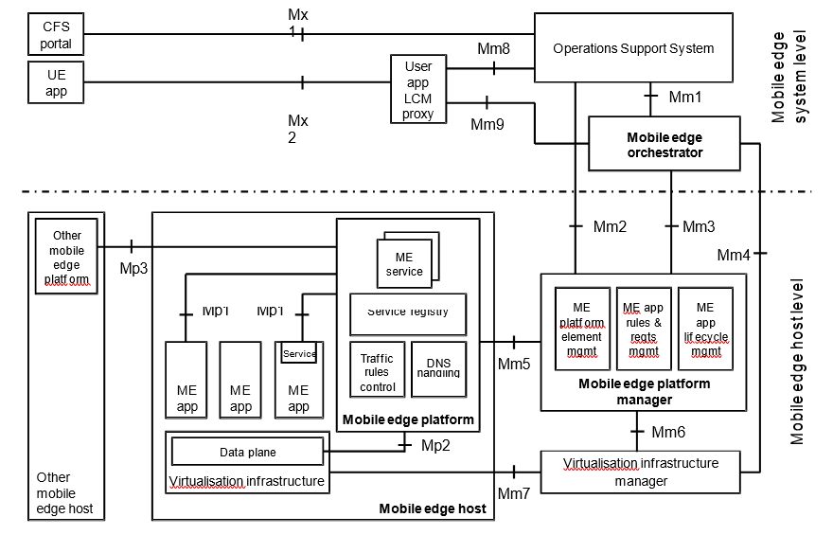
ETSI MEC architecture

Slide 13
ETSI MEC
A mobile edge service is a service provided and consumed either by the mobile edge platform or a mobile edge application. When provided by an application, it can be registered in the list of services to the mobile edge platform over the Mp1 reference point (see clause 7.2.1).
A mobile edge application can subscribe to a service for which it is authorized over the Mp1 reference point.
Currently identified ME services: Radio Network Info, Location, Bandwidth Manager

Slide 14
OpenFog

Slide 15
OpenFog software view

Slide 16
NIST
Fog computing: Fog computing is a horizontal, physical or virtual resource paradigm that resides between smart end-devices and traditional cloud or data centers. This paradigm supports vertically-isolated, latency-sensitive applications by providing ubiquitous, scalable, layered, federated, and distributed computing, storage, and network connectivity.
Edge is the network layer encompassing the smart end- devices and their users, to provide, for example, local computing capability on a sensor, metering or some other devices that are network-accessible. This peripheral layer is also often referred to as IoT network.
In the NIST framework [i.3], the key differences between fog and edge computing can be summarized as follows:.
• Fog works with the cloud, whereas edge is defined by the exclusion of cloud and fog.
• Fog is hierarchical, where edge tends to be limited to a small number of peripheral layers.
• Fog addresses networking, storage, control and data-processing acceleration, in addition to computing.

