Slide 1

Optimize operations on a set of resources
How to optimize workflow?
ARC-2018-0278-DynamicRequest_DynamicGroup_Usecase
Group Name: ARC
Source: Gharout Said, Bonnardel Gregory
Meeting Date: 2018-09-17
Agenda Item: TS-0001 and TS-0004 related

Slide 2
Use case & issue
Use-case: perform the same request on a set of resources (example: perform an UPDATE request that switch on a set of BinarySwitch module FlexContainer)
Current workflow in 3 steps:
perform a discovery request in order to find out BinarySwitch module FlexContainer s matching conditions
based on the discovery result, create a new group
execute UPDATE request on all member of the group through group’s fanOutPoint
Issue : performance issue

Slide 3
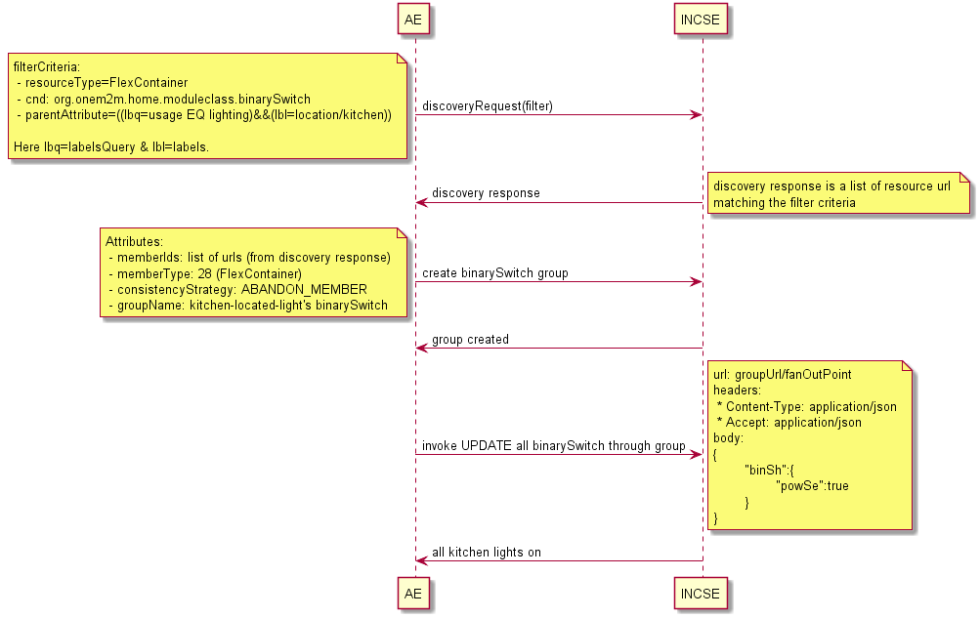
Use case & issue

Slide 4
Possible solutions
Introduce Dynamic Request
Dynamic Request is a single request to be executed on a set of resources
The set of resources is identified by a filter criteria
A single request instead of 3
Introduce Dynamic Group
Group member’s are defined using a filterCriteria
Group membership is evaluated at each request
Reusable group for next call
Workflow in two steps instead of 3

Slide 5
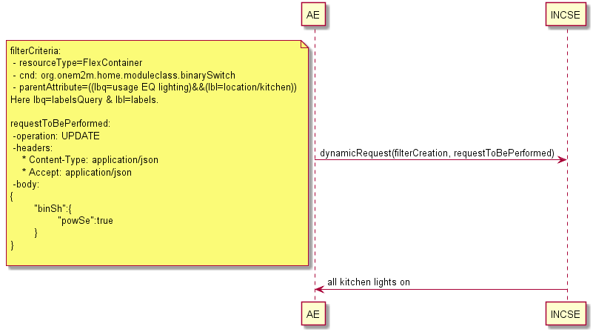
Dynamic Request
    The all in one request
    find out targeted resources using the filter criteria
    create an hidden/temporary Group (to be deleted) based on resource discovered in previous step
    execute operation on each group’s member through the fanOutpoint
    delete group

Slide 6
Dynamic Group
A group where members are defined through a FilterCriteria
Group membership is evaluated at each request
Dynamic Group’s member types must be homogenous
Dynamic Group’s members are evaluated for each incoming request (including request on fanOutPoint)

Slide 7
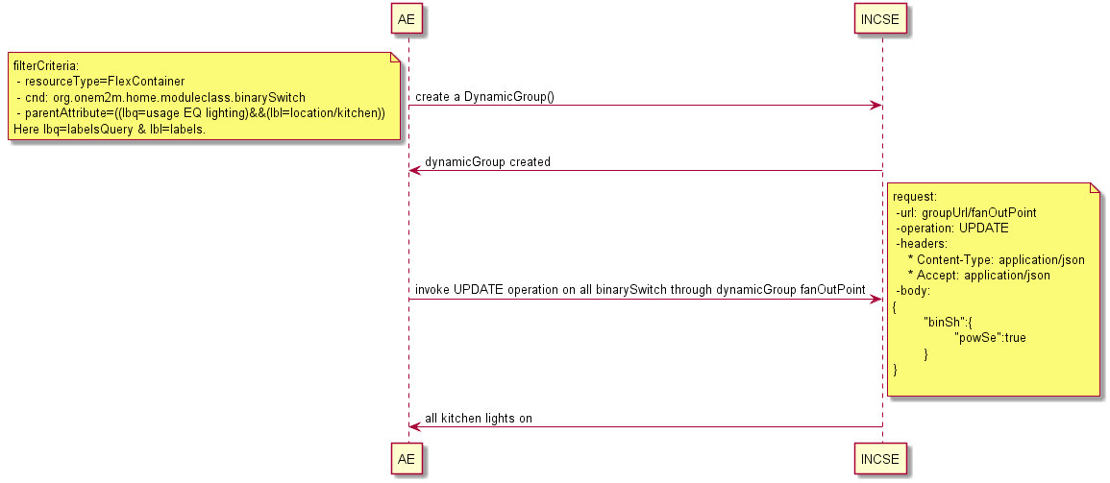
Dynamic Group

