Slide 1

Ontology Architectural Support Options
Group Name: MAS WG
Source: Catalina Mladin, Lijun Dong, InterDigital
Meeting Date: 2015-05-16
Agenda Item: TBD

Slide 2
Overview
TS-0012 oneM2M Base Ontology is under development to define a set of concepts, relationships and properties that are mainly used for defining oneM2M resources
  There are other ontologies defined addressing individual namespaces rated to M2M and agreed requirements to support simultaneous usage of multiple ontologies for the same M2M resource
There are proposals/discussions (MAS-2015-0551R01) under way on modelling approaches when dealing with concepts from different ontologies
  RE-USE (concepts from existing ontologies) where possible and extend the oneM2M Base ontology where needed
  MAPPING ( of similar concepts)

Slide 3
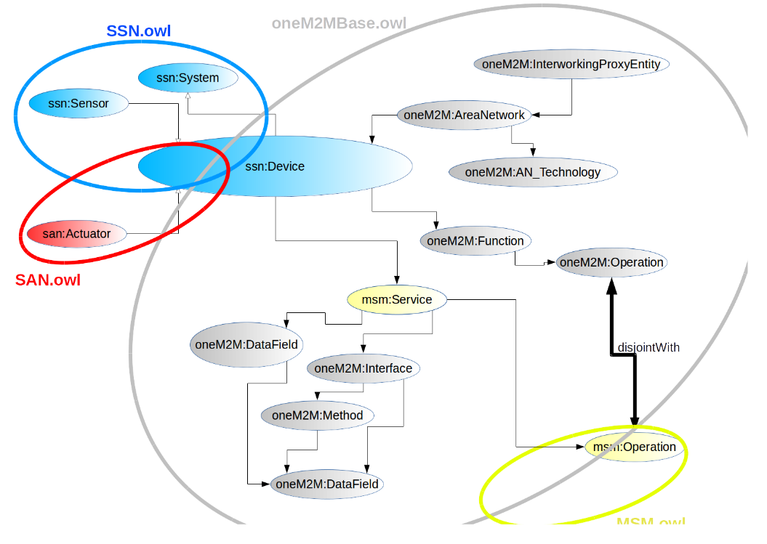
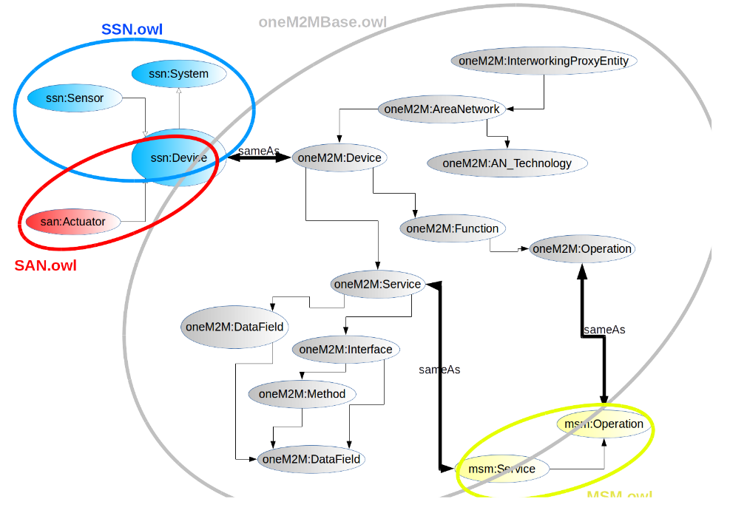
Re-use vs. Mapping
⬅ Re-use
Mapping ➔
by Nicolas Seydoux, LAAS-CNRS, from NEC MAS-2015-0551

Slide 4
Next?
Independent of the answer to the modeling approach to move forward on functionality addressing the existing requirements, we need to determine architectural support needed for Ontology storage and management.
Consider the following e-Health Use Case to highlight the Open Issues to address next

Slide 5



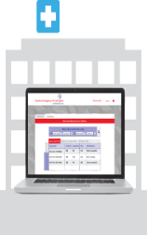

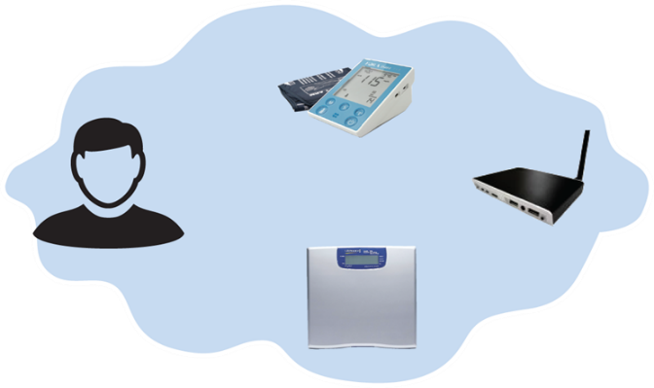
eHealth Use Case
Q1: How to input (E-health) Ontology for oneM2M system use.
Service Provider
(IN-CSE)
3rd Party
(e.g., insurance company)
Q 2. How to create semantic descriptions and annotate resources
Ontology Repository
Smart
Watch
Blood
Pressure Meter
Semantic
Engine
eHealth
Monitoring
System
Home
Gateway
(MN-CSE)
Semantic
Repository
(Triple Store)
Q’ : Enable Semantic Repository (TripleStore)
to store RDF triples?
Q3: How to enable use of the Semantic Repository (TripleStore) for queries
Resource
Repository
Smart Scale

Slide 6
Issues derived from flows in question
We propose for discussion the flows identified in this use-case in order to address the following issues:
How to store multiple ontologies such that they can be discovered and re-used by the M2M system
What the ontology repository resources should look like to enable use for semantic annotation
How to enable semantic queries using the given annotation

Slide 7
Architectural support assumptions
  ontologyRef attribute ( Release 1 agreement)
    For AE, container, contentInstance resources
    URI of the ontology used to represent the information that is managed and understood for that resource
  Semantic descriptor attribute ( several proposals)
    semantic descriptor with relationships and values for the parent resource
    RDF annotation or similar
  Ontology repository (MAS-2015-0528 NEC proposal)
    Supports Management of ontologies
    Supports CRUD, SPARQL query on ontology (as special retrieve)
    <ontology> resource
ontologies
oneM2M base ontology
SSN ontology
Smart home ontology

Slide 8
Q1: Example Definition: Class
Define Concepts such as “Patient”, “Blood Pressure Meter”, etc.
rdfs:Class – declare a resource as a class for other resources
rdf:type – specify that a resource is an instance of a specific RDFS class
rdfs:subClassOf – declare hierarchies of classes

Slide 9
Q1: Example Definition: Property
sValue: systolic value
dValue: diastolic value
rdfs:Property – declare the class of properties
rdfs:domain – mean that when the specified property is used in a triple, the subject of the triple will always be an instance of the class specified by the rdfs:domain property in the ontology.
rdfs:range -- mean that when the specified property is used in a triple, the object of the triple will always be an instance of the class specified by the rdfs:range property in the ontology.

Slide 10
Q2: Creating Semantic Annotations & Triples
Create the real measurement data
Create the semantic descriptions about the measurement data
Create RDF triples and submit/store them in Semantic Repository

Slide 11


Q2: Resource Representation examples
<
healthcare AE
>
:
BPDev
01
<
container
>
:
samples
<
semantics
>
tuple
: /
type
,
“Blood Pressure Sample”
<
Subject under s
01
contentInstance
>
:
s
01
contentInstance
<
<
>
semantic descriptor
semantics
>
Tuple
:
/
measuredFor
,
URI of patient
1
<
contentInstance
/
>;
measuredOn
,
“
2014
-
8
-
21
Resource
Repository
”
content
RDF Triple
:
<
URI of s
01
,
/
measuredOn
,
“
2014
-
8
-
21
”
(
>
70
,
150
)
<
Corresponding RDF triples stored in…
contentInstance
>
:
s
02
<
semantics
>
Tuple
:
/
measuredFor
,
URI of patient N
<
contentInstance
/
>;
measuredOn
,
“
2011
-
4
-
10
”
^^
/
xsd
:
date
Semantic
Repository
(Triple Store)
Example: Resource Representation for Blood Pressure Measurements and its Semantic Descriptor

Slide 12
Q3: Example Query on TripleStore

Slide 13
Q3: SPARQL Query example
Select ?sample ?sValue_var ?dValue_var
Where
{
?sample ex:sValue ?sValue_var.
?sample ex:dValue ?dValue_var.
FILTER ( (?sValue_var >= 120) || (?sValue_var < 90)
|| (?dValue_var >= 80) || (?dValue_var < 60) )
}
Find blood pressure samples that are abnormal

Slide 14
Annex:
Assumed Functional architecture

